Slide 1


Splash Screen

Slide 2
Lesson Menu
Five-Minute Check (over Lesson 4–1)
CCSS
Then/Now
New Vocabulary
Example 1: Write an Equation Given the Slope and a Point
Example 2: Write an Equation Given Two Points
Example 3: Real-World Example: Use Slope-Intercept Form
Example 4: Real-World Example: Predict from Slope-Intercept Form

Slide 3

5-Minute Check 1
Write an equation of the line with the given slope and y-intercept.
slope: 3, y-intercept: –1
A. y = 3x + 1
B. y = 3x – 1
C. y = –x + 3
D. y = x – 3

Slide 4

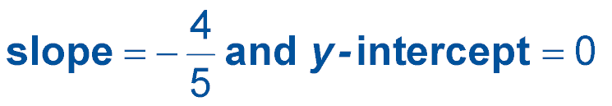
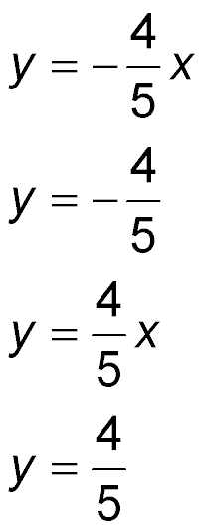
5-Minute Check 2
Write an equation of the line with the given slope
and y-intercept.
A.
B.
C.
D.

Slide 5

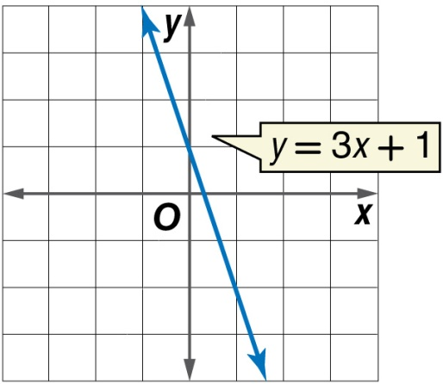
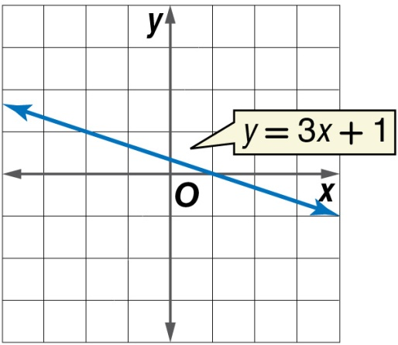
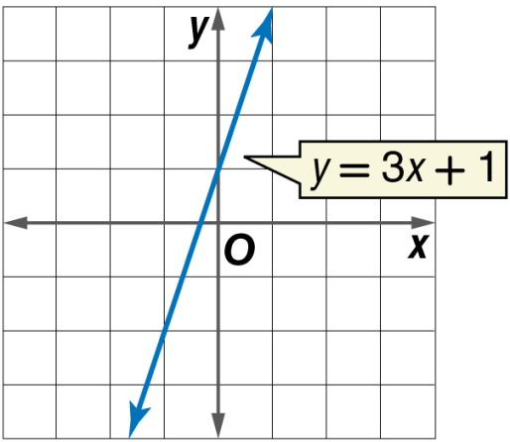
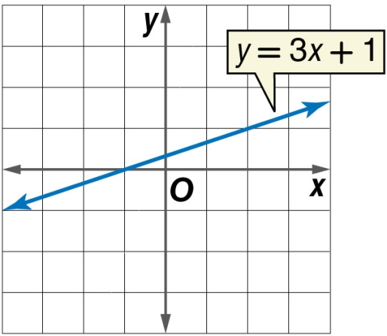
5-Minute Check 3
Which is the graph of the equation y = 3x + 1?
B.
C. D.

Slide 6

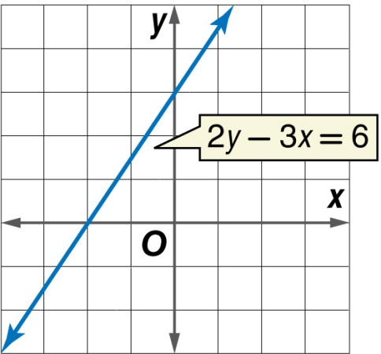
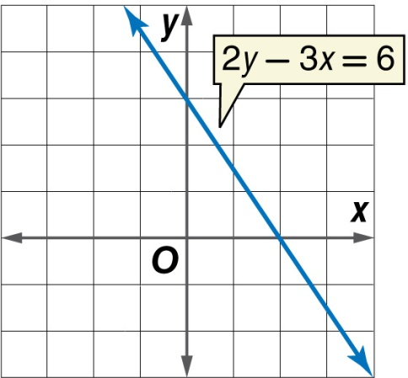
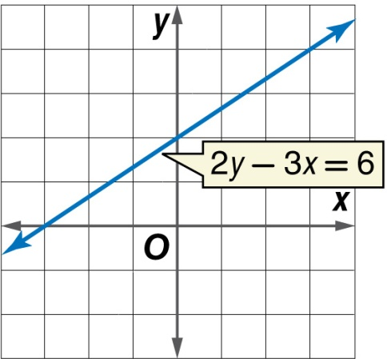
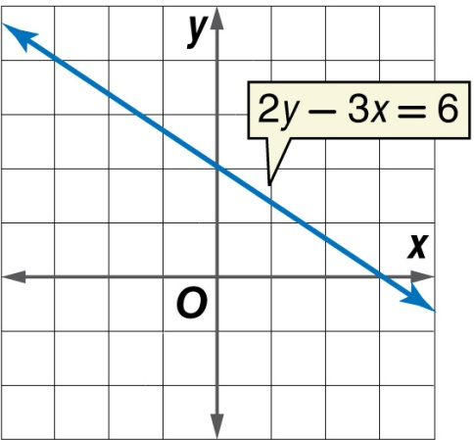
5-Minute Check 4
Which is the graph of the equation 2y – 3x = 6?
B.
D.

Slide 7

5-Minute Check 5
Which of the following equations has a slope of ?
A. 3y = –2x + 9
B. 3y = x – 12
C. –3y = x – 12
4y = –3x + 8

Slide 8

CCSS
Content Standards
F.BF.1 Write a function that describes a relationship between two quantities.
a. Determine an explicit expression, a recursive process, or steps for calculation from a context.
b. Combine standard function types using arithmetic operations.
F.LE.2 Construct linear and exponential functions, including arithmetic and geometric sequences, given a graph, a description of a relationship, or two input-output pairs (include reading these from a table).
Mathematical Practices
3 Construct viable arguments and critique the reasoning of others.
6 Attend to precision.
Common Core State Standards © Copyright 2010. National Governors Association Center for Best Practices and Council of Chief State School Officers. All rights reserved.

Slide 9


Then/Now
You graphed lines given the slope and the
y-intercept.
Write an equation of a line in slope-intercept form given the slope and one point.
Write an equation of a line in slope-intercept form given two points.

Slide 10

Vocabulary
linear extrapolation

Slide 11

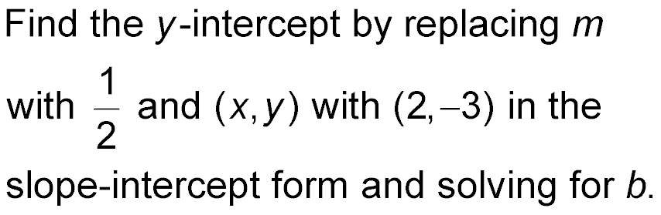
Example 1
Write an Equation Given the Slope and a Point
Write an equation of a line that passes through
(2, –3) with a slope of
Step 1

Slide 12
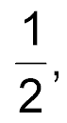
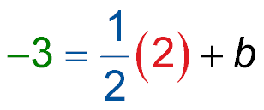
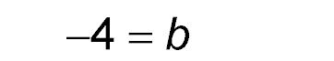
Example 1
Write an Equation Given the Slope and a Point
y = mx + b
Slope-intercept form
Replace m with
y with –3, and x with 2.
–3 = 1 + b
Multiply.
–3 – 1 = 1 + b – 1
Subtract 1 from each side.
Simplify.

Slide 13
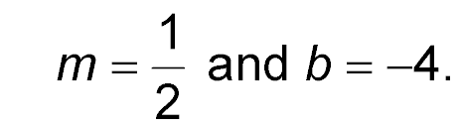
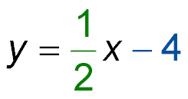
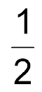
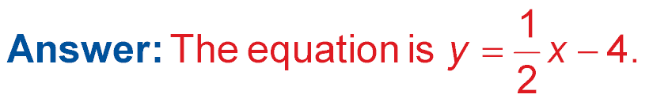
Example 1
Write an Equation Given the Slope and a Point
Step 2 Write the slope-intercept form using
y = mx + b
Slope-intercept form
Replace m with and b with –4.

Slide 14


Example 1
Write an equation of a line that passes through (1, 4)
and has a slope of –3.
A. y = –3x + 4
B. y = –3x + 1
C. y = –3x + 13
D. y = –3x + 7

Slide 15
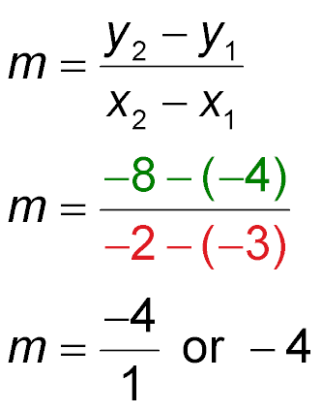
Example 2A
Write an Equation Given Two Points
A. Write the equation of the line that passes through
(–3, –4) and (–2, –8).
Step 1 Find the slope of the line containing the points.
Slope formula
Let (x₁, y₁) = (–3, –4)
and (x₂, y₂) = (–2, –8).
Simplify.

Slide 16
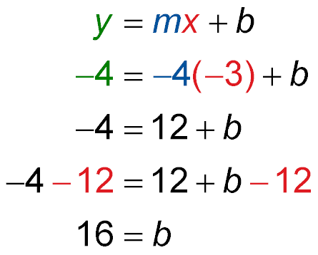
Example 2A
Write an Equation Given Two Points
Step 2 Use the slope and one of the two points to find the y-intercept. In this case, we chose (–3, –4).
Slope-intercept form
Replace m with –4,
x with –3, and y with –4.
Multiply.
Subtract 12 from
each side.
Simplify.

Slide 17
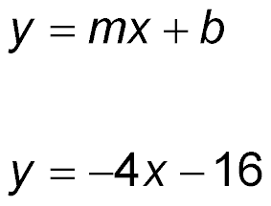
Example 2A
Write an Equation Given Two Points
Step 3 Write the slope-intercept form using
m = –4 and b = –16.
Slope-intercept form
Replace m with –4 and
b with –16.
Answer: The equation of the line is y = –4x – 16.

Slide 18
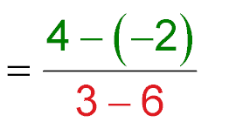
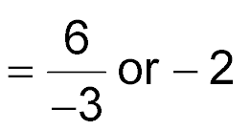
Example 2B
Write an Equation Given Two Points
B. Write the equation of the line that passes through
(6, –2) and (3, 4).
Step 1 Find the slope of the line containing the points.
Slope formula
Let (x₁, y₁) = (6, –2)
and (x₂, y₂) = (3, 4).
Simplify.

Slide 19
Example 2B
Write an Equation Given Two Points
Step 2 Use the slope and either of the two points to find the y-intercept.
Slope-intercept form
4 = –2(3) + b
Replace m with –2,
x with 3, and y with 4.
4 = –6 + b
Simplify.
4 + 6 = –6 + b + 6
Add 6 to both sides.
10 = b
Simplify.

Slide 20
Example 2B
Write an Equation Given Two Points
Step 3 Write the equation in slope-intercept form.
Slope-intercept form
y = –2x + 10
Replace m with –2, and b with 10.
Answer: Therefore, the equation of the line is
y = –2x + 10.

Slide 21
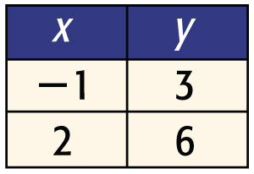
Example 2A
A. The table of ordered pairs shows the coordinates of two points on the graph of a line. Which equation describes the line?
A. y = –x + 4
B. y = x + 4
C. y = x – 4
D. y = –x – 4

Slide 22
Example 2B
B. Write the equation of the line that passes through the points (–2, –1) and (3, 14).
A. y = 3x + 4
B. y = 5x + 3
C. y = 3x – 5
D. y = 3x + 5

Slide 23
Example 3
Use Slope-Intercept Form
ECONOMY During one year, Malik’s cost for self-serve regular gasoline was $3.20 on the first of June and $3.42 on the first of July. Write a linear equation to predict Malik’s cost of gasoline the first of any month during the year, using 1 to represent January.
Understand You know the cost in June is $3.20. You know the cost in July is $3.42.
Plan Let x represent the month. Let y
represent the cost. Write an equation
of the line that passes through
(6, 3.20) and (7, 3.42).

Slide 24
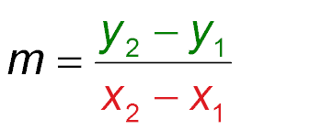
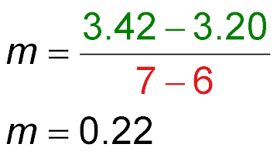
Example 3
Use Slope-Intercept Form
Solve Find the slope.
Slope formula
Let (x₁, y₁) = (6, 3.20)
and (x₂, y₂) = (7, 3.42).
Simplify.

Slide 25
Example 3
Use Slope-Intercept Form
Choose (6, 3.40) and find the y-intercept of the line.
y = mx + b
Slope-intercept form
3.20 = 0.22(6) + b
Replace m with 0.22,
x with 6, and y with 3.20.
1.88 = b
Simplify.
Write the slope-intercept form using m = 0.22 and
b = 1.88.
y = mx + b
Slope-intercept form
y = 0.22x + 1.88
Replace m with 0.22 and b with 1.88.

Slide 26
Example 3
Use Slope-Intercept Form
Answer: Therefore, the equation is y = 0.22x + 1.88.
Check Check your result by substituting the coordinates of the point not chosen,
(7, 3.42), into the equation.
y = 0.22x + 1.88
Original equation
?
3.42 = 0.22(7) + 1.88
Replace y with 3.42 and x with 7.
?
Multiply.
3.42 = 1.54 + 1.88
3.42 = 3.42
Simplify.
✓

Slide 27
Example 3
The cost of a textbook that Mrs. Lambert uses in her class was $57.65 in 2005. She ordered more books in 2008 and the price increased to $68.15. Write a linear equation to estimate the cost of a textbook in any year since 2005. Let x represent years since 2005.
A. y = 3.5x + 57.65
B. y = 3.5x + 68.15
C. y = 57.65x + 68.15
D. y = –3.5x – 10

Slide 28
Example 4
Predict From Slope-Intercept Form
ECONOMY On average, Malik uses 25 gallons of gasoline per month. He budgeted $100 for gasoline in October. Use the prediction equation in Example 3 to determine if Malik will have to add to his budget. Explain.
y = 0.22x + 1.88
Original equation
y = 0.22(10) + 1.88
Replace x with 10.
y = 4.08
Simplify.
If gasoline prices increase at the same rate, a gallon will cost $4.08 in October. 25 gallons at this price is $102, so Malik will have to add at least $2 to his budget.

Slide 29
Example 4
Mrs. Lambert needs to replace an average of 5 textbooks each year. Use the prediction equation
y = 3.5x + 57.65, where x is the years since 2005 and y is the cost of a textbook, to determine the cost of replacing 5 textbooks in 2009.
A. $71.65
B. $358.25
C. $410.75
D. $445.75

Slide 30
End of the Lesson

