Slide 1


Splash Screen

Slide 2
Lesson Menu
Five-Minute Check (over Lesson 4–3)
CCSS
Then/Now
New Vocabulary
Example 1: Parallel Line Through a Given Point
Example 2: Real-World Example: Slopes of Perpendicular Lines
Example 3: Parallel or Perpendicular Lines
Example 4: Parallel Line Through a Given Point
Concept Summary: Parallel and Perpendicular Lines

Slide 3

5-Minute Check 1
What is the point-slope form of an equation for a line that passes through the point (5, –5) with the slope m = 2?
A. y = 2x + 5
B. y = 2x – 5
C. y + 5 = 2(x – 5)
D. y = 2(x – 5)

Slide 4

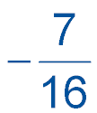
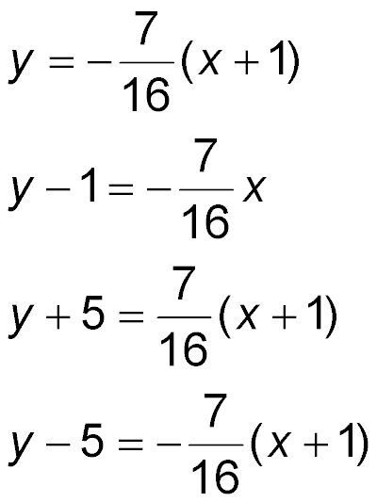
5-Minute Check 2
What is the point-slope form of an equation for a line
that passes through the point (–1, 5) with the slope
m = ?
A.
B.
C.
D.

Slide 5
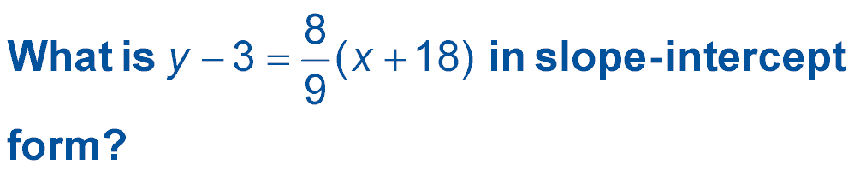

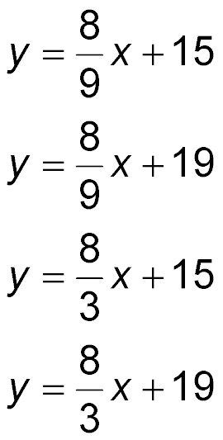
5-Minute Check 3
A.
B.
C.
D.

Slide 6

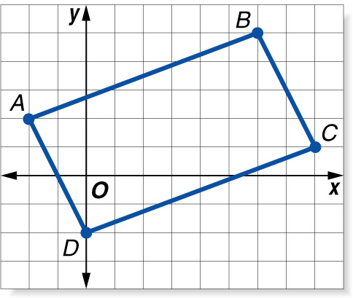
5-Minute Check 4A
A. What is the standard form of the equation of the diagonal AC?
A. x + 10y = 18
B. x + 5y = 9
C. 10x + y = 18
D. x – 10y = 9

Slide 7
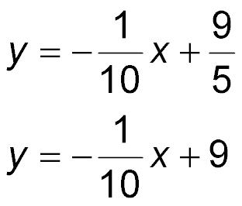
5-Minute Check 4B
B. What is the slope-intercept form of the equation of the diagonal AC?
___
A. 10y = 18 – x
B.
C.
D. y = 18 – x

Slide 8

5-Minute Check 5
Which equation has a graph that passes through the points at (3, 4) and (–1, –4)?
A. y – 3 = 2(x – 4)
B. y + 1 = 2(x + 4)
C. y + 4 = 2(x – 1)
D. y – 4 = 2(x – 3)

Slide 9

CCSS
Content Standards
F.LE.2 Construct linear and exponential functions, including arithmetic and geometric sequences, given a graph, a description of a relationship, or two input-output pairs (include reading these from a table).
S.ID.7 Interpret the slope (rate of change) and the intercept (constant term) of a linear model in the context of the data.
Mathematical Practices
5 Use appropriate tools strategically.
Common Core State Standards © Copyright 2010. National Governors Association Center for Best Practices and Council of Chief State School Officers. All rights reserved.

Slide 10


Then/Now
You wrote equations in point-slope form.
Write an equation of the line that passes through a given point, parallel to a given line.
Write an equation of the line that passes through a given point, perpendicular to a given line.

Slide 11

Vocabulary
parallel lines
perpendicular lines

Slide 12
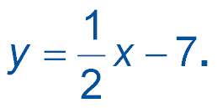
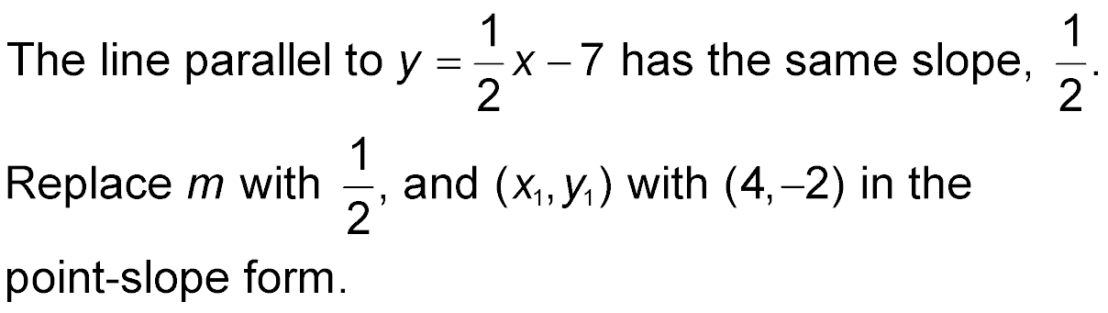
Example 1
Parallel Line Through a Given Point
Write the slope-intercept form of an equation for the line that passes through (4, –2) and is parallel to the graph of

Slide 13
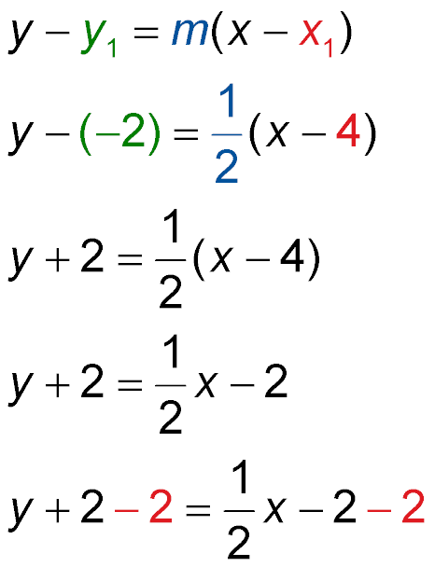
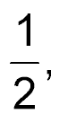
Example 1
Parallel Line Through a Given Point
Point-slope form
Replace m with
y₁ with –2, and x₁ with 4.
Simplify.
Distributive Property
Subtract 2 from each side.

Slide 14
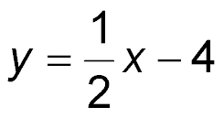
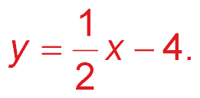
Example 1
Parallel Line Through a Given Point
Write the equation in
slope-intercept form.
Answer: The equation is

Slide 15


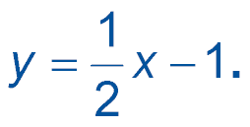
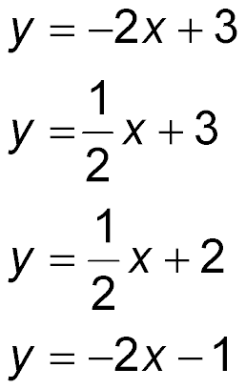
Example 1
Write the slope-intercept form of an equation for the
line that passes through (2, 3) and is parallel to the graph of
A.
B.
C.
D.

Slide 16
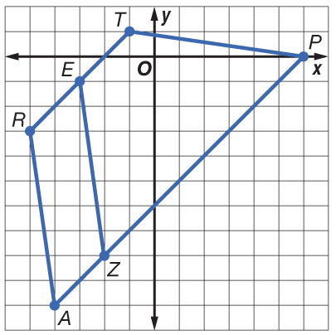
Example 2A
Slopes of Perpendicular Lines
A. GEOMETRY The height of a trapezoid is the length of a segment that is perpendicular to both bases. In trapezoid ARTP, RT and AP are bases. Can EZ be used to measure the height of the trapezoid? Explain.

Slide 17
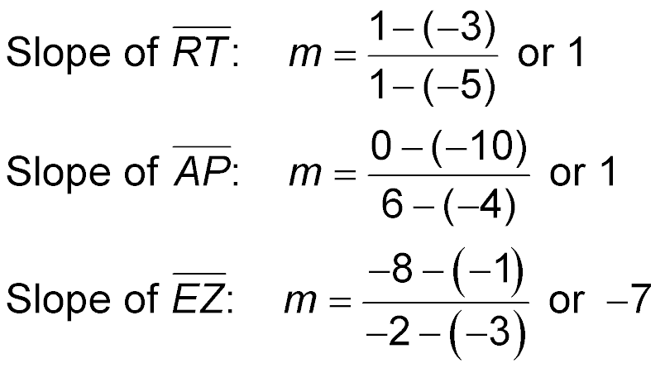
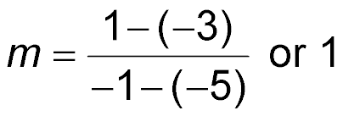
Example 2A
Slopes of Perpendicular Lines
Find the slope of each segment.
Answer: The slope of RT and AP is 1 and the slope of
EZ is –7. Since 1(–7) ≠ –1, EZ is not perpendicular to RT
and AP. So, it cannot be used to measure the height of ARTP.

Slide 18
Example 2B
Slopes of Perpendicular Lines
B. GEOMETRY The height of a trapezoid is the length of a segment that is perpendicular to both bases. In trapezoid ARTP, RT and AP are bases. Are the bases parallel?
Answer: Yes, both RT and AP have a slope of 1.

Slide 19
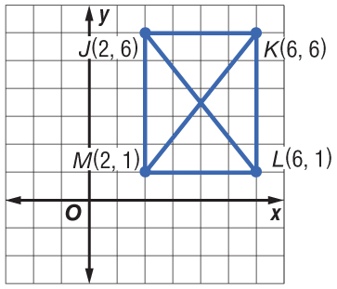
Example 2
The graph shows the diagonals of a rectangle. Determine whether JL is perpendicular to KM.
A. JL is not perpendicular to KM.
B. JL is perpendicular to KM.
C. cannot be determined

Slide 20
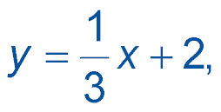
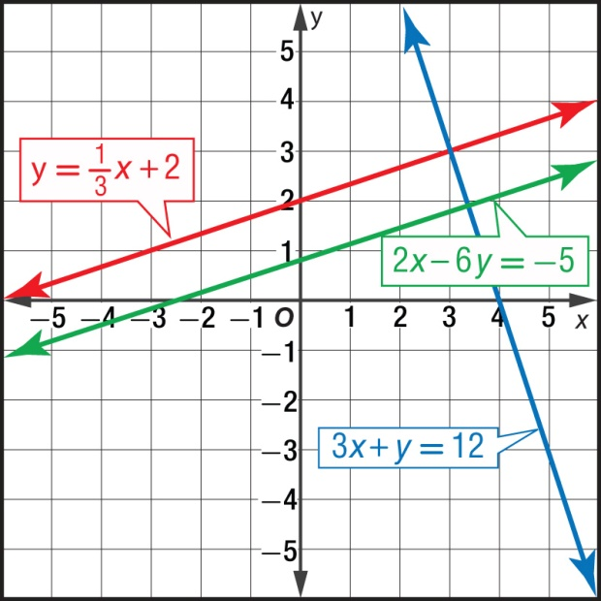
Example 3
Parallel or Perpendicular Lines
Determine whether the graphs of 3x + y = 12,
and 2x – 6y = –5 are parallel or perpendicular. Explain.
Graph each line on a coordinate plane.

Slide 21
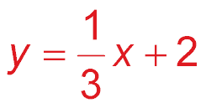
Example 3
Parallel or Perpendicular Lines
Answer: From the graph, you can see that is parallel to
2x – 6y = –5. They are parallel because they have equal slopes.
3x + y = 12 is perpendicular to them both because the product of their slopes, and –3, is –1.

Slide 22
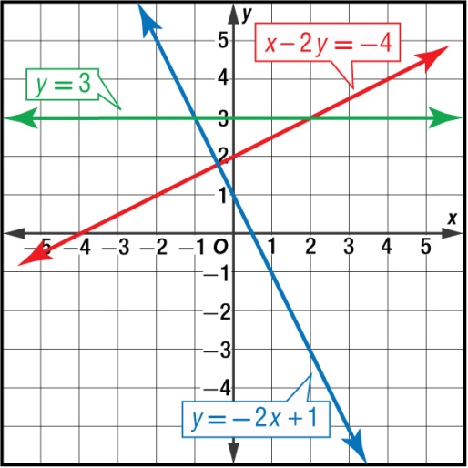
Example 3
Determine whether the graphs of y = –2x + 1,
x – 2y = –4, and y = 3 are parallel or perpendicular.
A. y = –2x + 1 and x – 2y = –4 are perpendicular. None of the lines are parallel.
B. y = –2x + 1 and y = 3 are perpendicular. None of the lines are parallel.
C. y = –2x + 1 and x – 2y = –4 are parallel. None of the lines are perpendicular.
D. None of the lines are parallel or perpendicular.

Slide 23
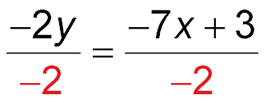
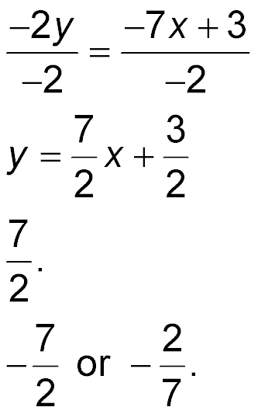
Example 4
Parallel Line Through a Given Point
Write an equation in slope-intercept form for the line that passes through (4, –1) and is perpendicular to the graph of 7x – 2y = 3.
Step 1 Find the slope of the given line by solving the
equation for y.
7x – 2y = 3 Original equation
7x – 7x – 2y = –7x + 3 Subtract 7x from each side.
–2y = –7x + 3 Simplify.
Divide each side by –2.
Simplify.

Slide 24
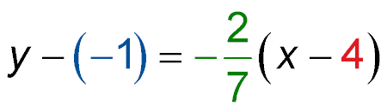
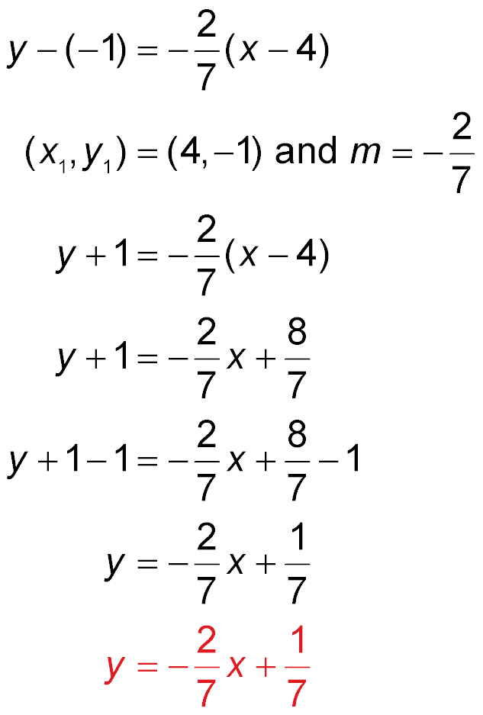
Example 4
Parallel Line Through a Given Point
The slope is
Step 2 The slope of the perpendicular line is the opposite reciprocal of Find the equation of the perpendicular line.
y – y₁ = m(x – x₁) Point-slope form
Simplify.

Slide 25
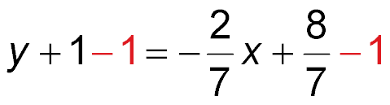
Example 4
Parallel Line Through a Given Point
Distributive Property
Subtract 1 from each
side.
Simplify.
Answer:

Slide 26
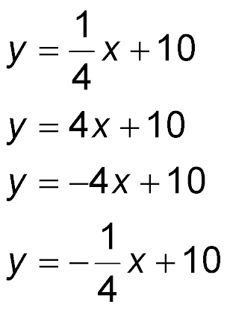
Example 4
Write an equation in slope-intercept form for the line that passes through (–3, –2) and is perpendicular to the graph of x + 4y = 12.
A.
B.
C.
D.

Slide 27
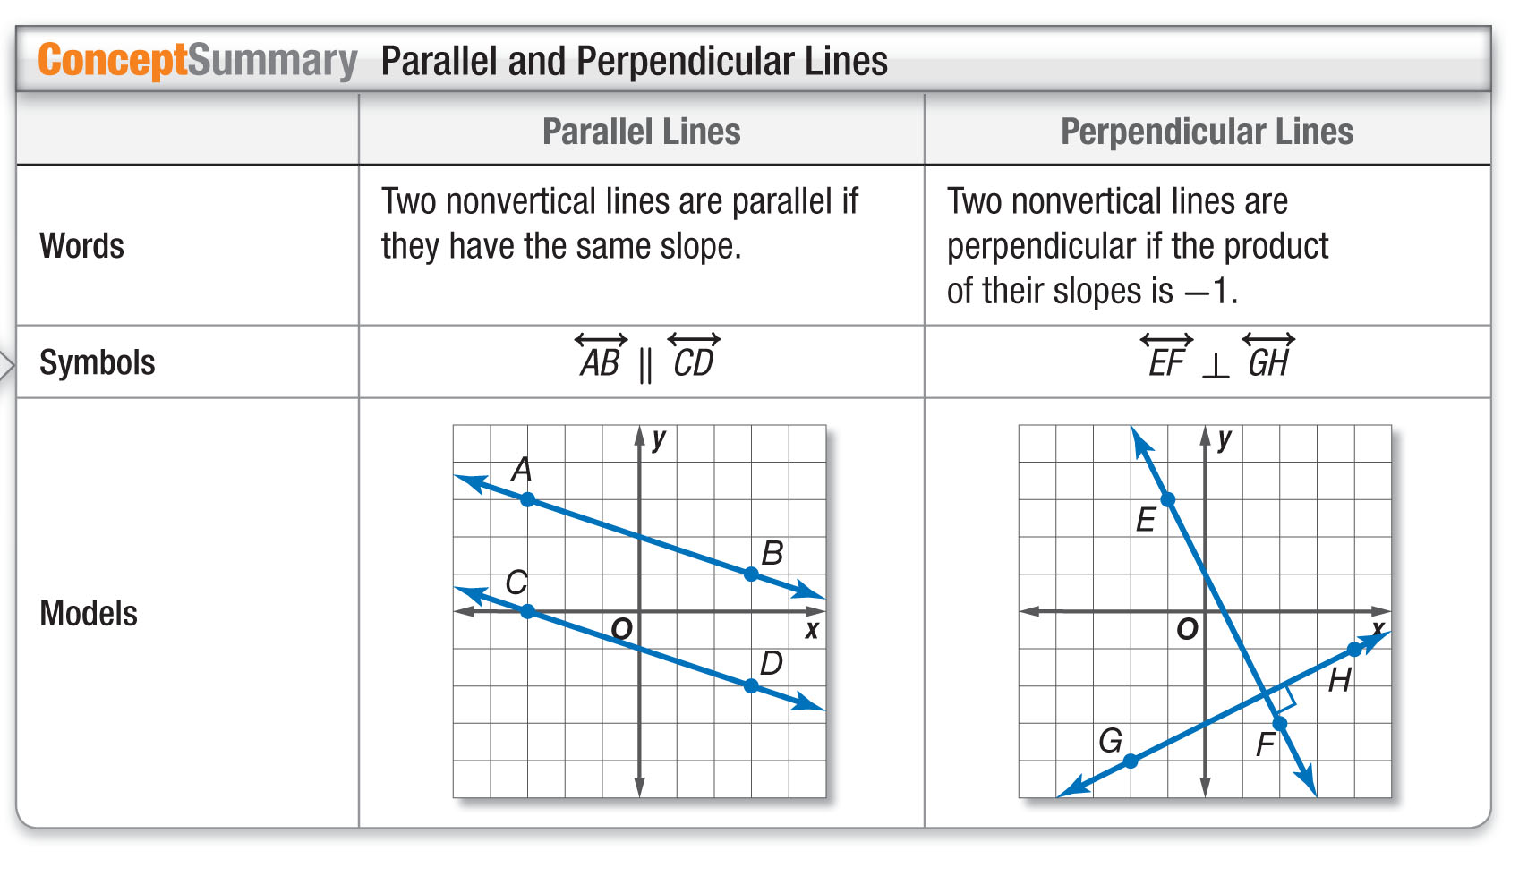
Concept

Slide 28
End of the Lesson

