Slide 1


Splash Screen

Slide 2
Lesson Menu
Five-Minute Check (over Lesson 4–4)
CCSS
Then/Now
New Vocabulary
Concept Summary: Scatter Plot
Example 1: Real-World Example: Evaluate a Correlation
Key Concept: Using a Linear Function to Model Data
Example 2: Real-World Example: Write a Line of Fit
Example 3: Real-World Example: Use Interpolation
or Extrapolation

Slide 3

5-Minute Check 1
Which equation represents the line that passes through the point (–1, 1) and is parallel to the graph of y = x – 3?
A. y = x + 3
B. y = x + 2
C. y = 3x – 3
D. y = x – 1

Slide 4

5-Minute Check 2
Which equation represents the line that passes through the point (2, 3) and is parallel to the graph of y = 2x + 1?
A. y = 4x + 4
B. y = 4x + 2
C. y = 2x + 2
D. y = 2x – 1

Slide 5

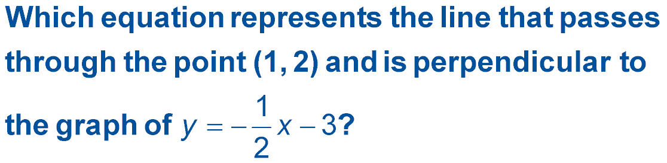
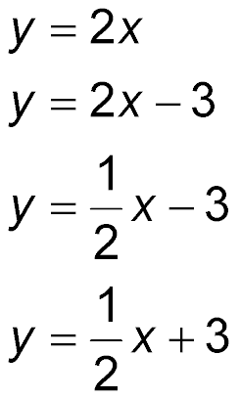
5-Minute Check 3
A.
B.
C.
D.

Slide 6

5-Minute Check 4
Which equation represents the line that passes through the point (–4, 1) and is perpendicular to the graph of y = –x + 1?
A. y = –4x + 2
B. y = –x + 5
C. y = x + 5
D. y = x + 1

Slide 7

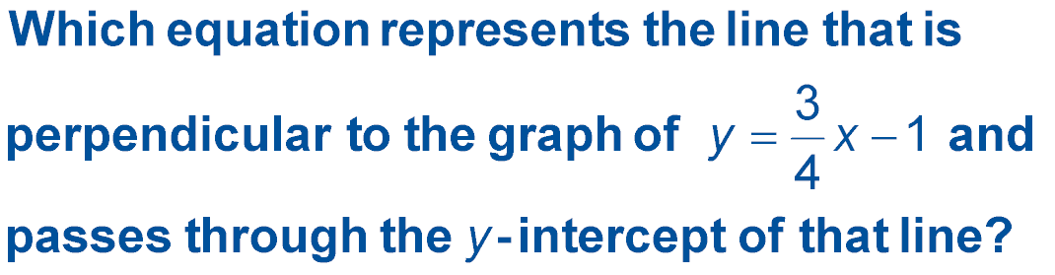
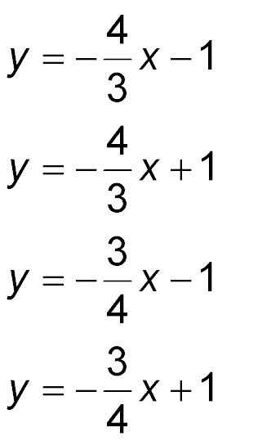
5-Minute Check 5
A.
B.
C.
D.

Slide 8

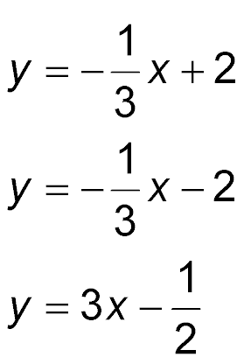
5-Minute Check 6
Which equation describes a line that contains (0, 2) and is perpendicular to the graph of y = 3x + 1?
A. y = –3x – 2
B.
C.
D.

Slide 9

CCSS
Content Standards
S.ID.6a Fit a function to the data; use functions fitted to data to solve problems in the context of the data. Use given functions or choose a function suggested by the context. Emphasize linear, quadratic, and exponential models.
S.ID.6c Fit a linear function for a scatter plot that suggests a linear association.
Mathematical Practices
1 Make sense of problems and persevere in solving them.
4 Model with mathematics.
Common Core State Standards © Copyright 2010. National Governors Association Center for Best Practices and Council of Chief State School Officers. All rights reserved.

Slide 10


Then/Now
You wrote linear equations given a point and the slope.
Investigate relationships between quantities by using points on scatter plots.
Use lines of fit to make and evaluate predictions.

Slide 11

Vocabulary
bivariate data
scatter plot
line of fit
linear interpolation

Slide 12
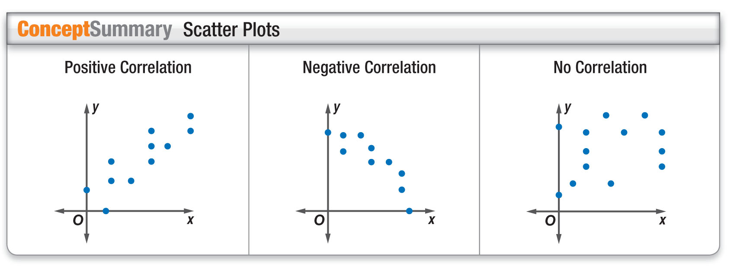
Concept

Slide 13
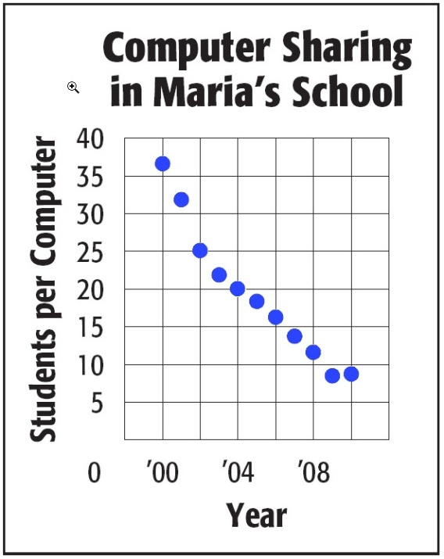
Example 1
Evaluate a Correlation
TECHNOLOGY The graph shows the average number of students per computer in Maria’s school. Determine whether the graph shows a positive correlation, a negative correlation, or no correlation. If there is a positive or negative correlation, describe its meaning in the situation.
Sample Answer: The graph shows a negative correlation. Each year, more computers are in Maria’s school, making the students-per-computer rate smaller.

Slide 14


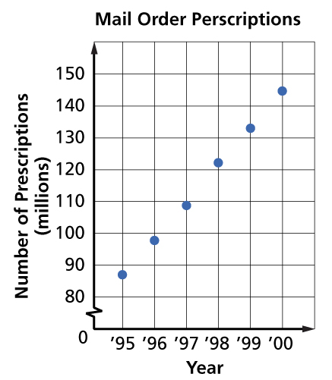
Example 1
The graph shows the number of mail-order prescriptions. Determine whether the graph shows a positive correlation, a negative correlation, or no correlation. If there is a positive or negative correlation, describe it.
A. Positive correlation; with each year, the number of mail-order prescriptions has increased.
B. Negative correlation; with each year, the number of mail-order prescriptions has decreased.
C. no correlation
D. cannot be determined

Slide 15
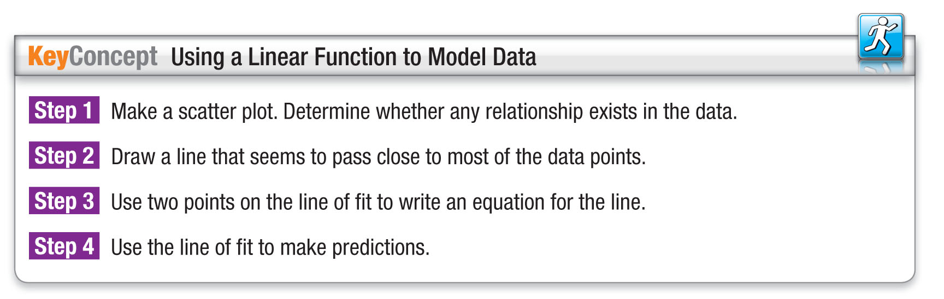
Concept

Slide 16
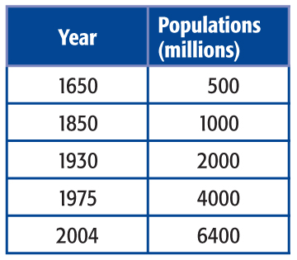
Example 2
Write a Line of Fit
POPULATION The table shows the world population growing at a rapid rate. Identify the independent and dependent variables. Make a scatter plot and determine what relationship, if any, exists in the data.

Slide 17
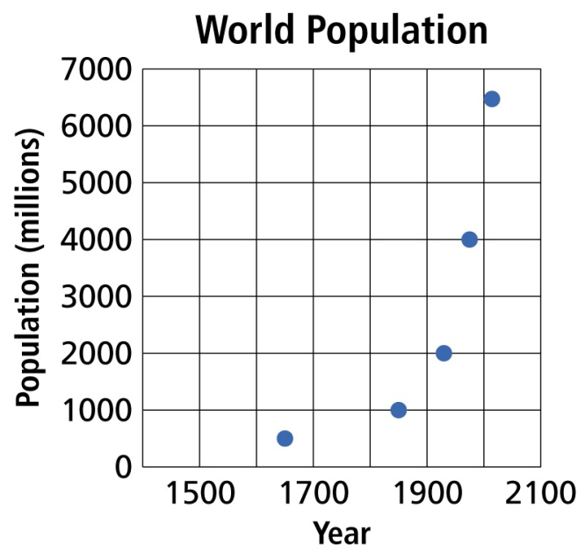
Example 2
Write a Line of Fit
Step 1 Make a scatter plot.
The independent variable is the year, and the dependent variable is the population (in millions).
As the years increase, the population increases. There is a positive correlation between the two variables.

Slide 18
Example 2
Write a Line of Fit
Step 2 Draw a line of fit.
No one line will pass through all of the data points. Draw a line that passes close to the points. A line of fit is shown.

Slide 19
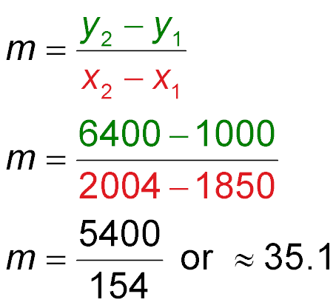
Example 2
Write a Line of Fit
Step 3 Write the slope-intercept form of an equation for the line of fit.
The line of fit shown passes through the points
(1850, 1000) and (2004, 6400).
Find the slope.
Slope formula
Let (x₁, y₁) = (1850, 1000) and (x₂, y₂) = (2004, 6400).
Simplify.

Slide 20
Example 2
Write a Line of Fit
Use m = and either the point-slope form or the
slope-intercept form to write the equation of the line of fit.
y – y₁ = m(x – x₁)
y – 1000 = (x – 1850)
y – 1000 ≈ 35.1x – 64,870
y ≈ 35.1x – 63,870
Answer: The equation of the line is y = 35.1x – 63,870.

Slide 21
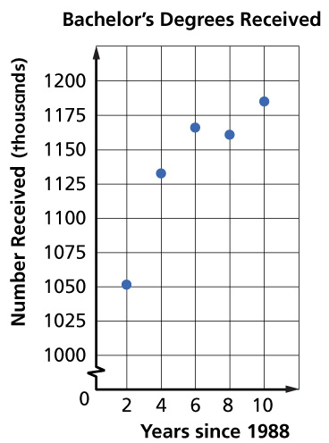
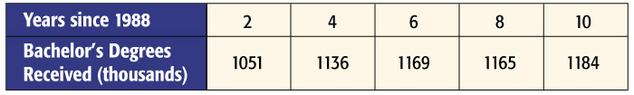
Example 2a
The table shows the number of bachelor’s degrees received since 1988. Draw a scatter plot and determine what relationship exists, if any, in the data.
A. There is a positive correlation between the two variables.
B. There is a negative correlation between the two variables.
C. There is no correlation between the two variables.
D. cannot be determined

Slide 22
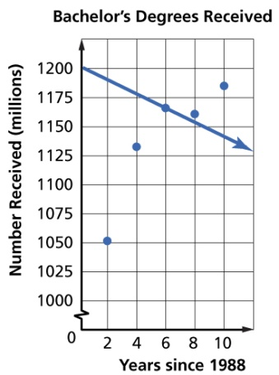
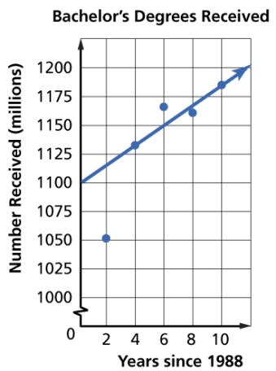

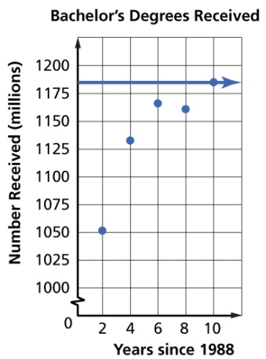
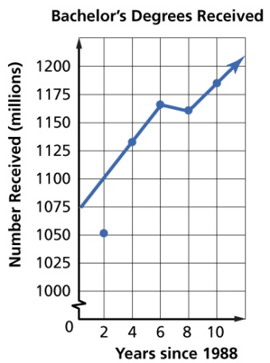
Example 2b
Draw a line of best fit for the scatter plot.
A. B.
C. D.

Slide 23
Example 2c
Write the slope-intercept form of an equation for the line of fit.
A. y = 8x + 1137
B. y = –8x + 1104
C. y = 6x + 47
D. y = 8x + 1104

Slide 24
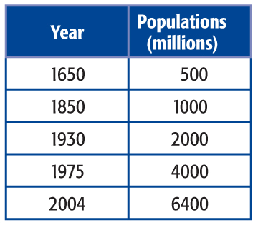
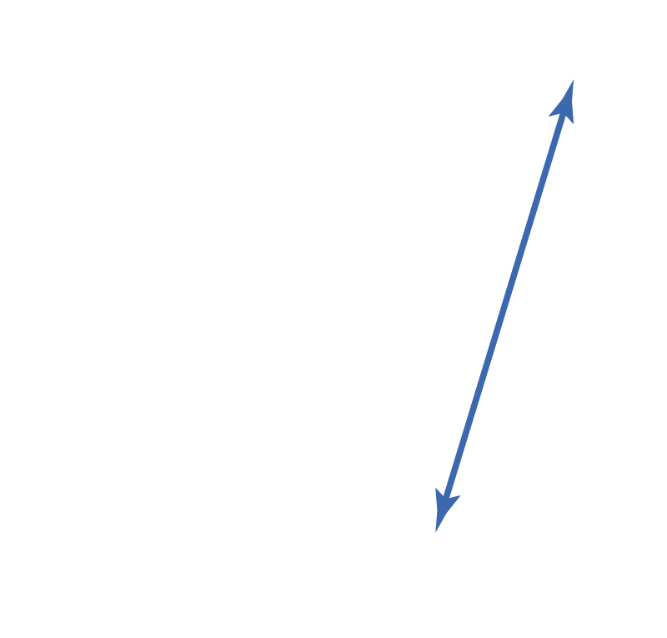
Example 3
Use Interpolation or Extrapolation
The table and graph show the world population growing at a rapid rate. Use the equation
y = 35.1x – 63,870 to predict the world’s population in 2025.

Slide 25
Example 3
Use Interpolation or Extrapolation
Evaluate the function for x = 2025.
y = 35.1x – 63,870
Equation of best-fit line
y = 35.1(2025) – 63,870
x = 2025
y = 71,077.5 – 63,870
Multiply.
y = 7207.5
Subtract.
Answer: In 2025, the population will be about 7207.5 million.

Slide 26

Example 3
The table and graph show the number of bachelor’s degrees received since 1988.

Slide 27
Example 3
Use the equation y = 8x + 1104, where x is the years since 1988 and y is the number of bachelor’s degrees (in thousands), to predict the number of bachelor’s degrees that will be received in 2015.
A. 1,320,000
B. 1,112,000
C. 1,224,000
D. 1,304,000

Slide 28
End of the Lesson

