Slide 1


Splash Screen

Slide 2
Lesson Menu
Five-Minute Check (over Lesson 4–5)
CCSS
Then/Now
New Vocabulary
Example 1: Real-World Example: Write an Equation
for a Best Fit Line
Example 2: Real-World Example: Use Interpolation
and Extrapolation
Example 3: Use a Median-Fit Line

Slide 3

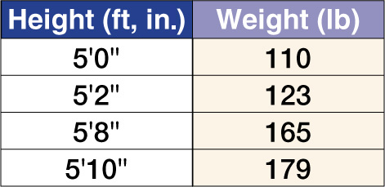
5-Minute Check 1
The table shows the average weight for given heights. Does the data have a positive or negative correlation?
A. positive
B. negative
C. no correlation

Slide 4

5-Minute Check 2
The table shows the average weight for given heights. Approximately how much would you expect a person who is 5’6” tall to weigh?
A. 140 lbs
B. 152 lbs
C. 160 lbs
D. 170 lbs

Slide 5
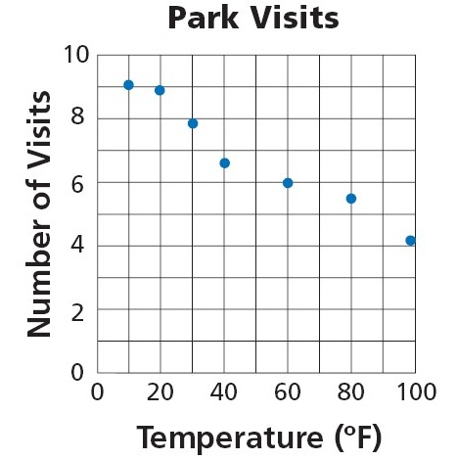

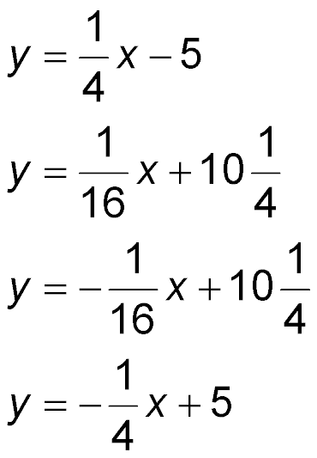
5-Minute Check 3
Refer to the scatter plot of Jessica’s visits to the park. Use the points (20, 9) and (100, 4) to write the slope-intercept form of an equation for a line of fit.
A.
B.
C.
D.

Slide 6

5-Minute Check 4
Refer to the scatter plot of Jessica’s visits to the park. Predict the number of times Jessica will go to the park when the temperature is 50 degrees.
A. 9
B. 7
C. 5
D. 4

Slide 7

5-Minute Check 5
What is an equation of the line of fit that passes through the points at (2, –1) and (–1, –7)?
A. y = x – 3
B. y = 2x – 5
C. y = x – 6
D. y = 3x – 7

Slide 8

CCSS
Content Standards
S.ID.6 Represent data on two quantitative variables on a scatter plot, and describe how the variables are related.
a. Fit a function to the data; use functions fitted to data to solve problems in the context of the data. Use given functions or choose a function suggested by the context. Emphasize linear, quadratic, and exponential models.
b. Informally assess the fit of a function by plotting and analyzing residuals.
c. Fit a linear function for a scatter plot that suggests a linear association.
S.ID.8 Compute (using technology) and interpret the correlation coefficient of a linear fit.
Mathematical Practices
5 Use appropriate tools strategically.
Common Core State Standards © Copyright 2010. National Governors Association Center for Best Practices and Council of Chief State School Officers. All rights reserved.

Slide 9


Then/Now
You used lines of fit and scatter plots to evaluate trends and make predictions.
Write equations of best-fit lines using linear regression.
Write equations of median-fit lines.

Slide 10

Vocabulary
best-fit line
linear regression
correlation coefficient
median-fit line

Slide 11
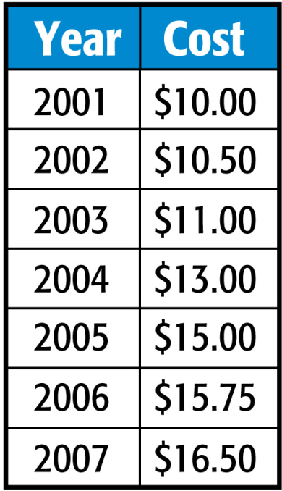
Example 1
Write an Equation for a Best-Fit Line
EARNINGS The table shows Ariana’s hourly earnings for the years
2001–2007. Use a graphing calculator to write an equation for the best-fit line for the data. Name the correlation coefficient. Round to the nearest
ten-thousandth.
Step 1 Enter the data by pressing
STAT and selecting the Edit
option. Let the year 2000 be represented by 0. Enter the years since 2000 into List 1 (L1). These will represent the x-values. Enter the cost into List 2 (L2). These will represent the y-values.

Slide 12
Example 1
Write an Equation for a Best-Fit Line
Step 2 Perform the regression by pressing STAT and selecting the CALC option. Scroll down to LinReg (ax + b) and press ENTER twice.
Step 3 Write the equation of the regression line by rounding the a and b values on the screen. The form we chose for the regression was ax + b, so the equation is y = 1.21x + 8.25. The correlation coefficient is about 0.9801, which means that the equation models the data very well.
Answer: The equation for the best-fit line is
y = 1.21x + 8.25. The correlation coefficient is 0.9801.

Slide 13


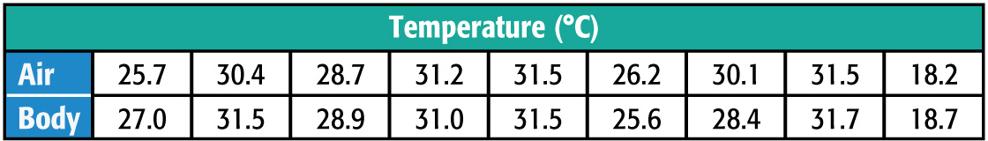
Example 1
BIOLOGY The table shows the average body temperature in degrees Celsius of nine insects at a given temperature. Use a graphing calculator to write the equation for the best-fit line for that data. Name the correlation coefficient.
A. y = 0.85x + 1.28; 0.8182
B. y = 0.95x + 1.53; 0.9783
C. y = 1.53x + 0.95; 0.9873
D. y = 1.95x + 0.53; 0.8783

Slide 14
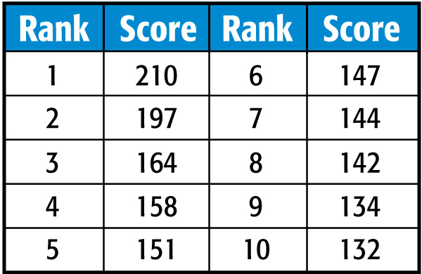
Example 2
Use Interpolation and Extrapolation
BOWLING The table shows the points earned by the top ten bowlers in a tournament. How many points did the 15th-ranked bowler earn?
Use a graphing calculator to write an equation of the best-fit line for the data. Then extrapolate to find the missing value.
Step 1 Enter the data from the table in the lists. Let the rank be the x-values and the score be the y-values. Then graph the scatter plot.

Slide 15
Example 2
Use Interpolation and Extrapolation
Step 2 Perform the linear regression using the data in the lists. Find the equation of the best-fit line. The equation of the best-fit line is
y = –7.87x + 201.2.
Step 3 Graph the best-fit line. Then use the TRACE feature and the arrow keys until you find a point where x = 15. When x = 15, y ≈ 83.
Answer: The 15th-ranked player earned about 83 points.

Slide 16
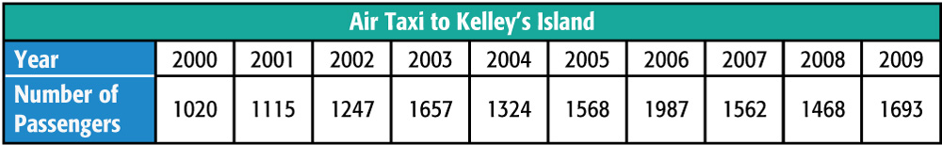
Example 2
TRAVEL An air taxi keeps track of how many passengers it carries to various islands. The table shows the number of passengers who have traveled to Kelley’s Island in previous years. How many passengers should the airline expect to go to Kelley’s Island in 2115?
A. 1186 passengers
B. 1702 passengers
C. 1890 passengers
D. 2186 passengers

Slide 17
Example 3
Use a Median-Fit Line
Find and graph the equation of a median-fit line for the data on the bowling tournament in the table. Then predict the score of the 20th-ranked bowler.
Step 1 Graph the data from the table.
Step 2 To find the median-fit equation, press the
STAT key and select the CALC option. Scroll
down to Med-Med option and press ENTER .
The value of a is the slope, and the value of b is the y-intercept.

Slide 18
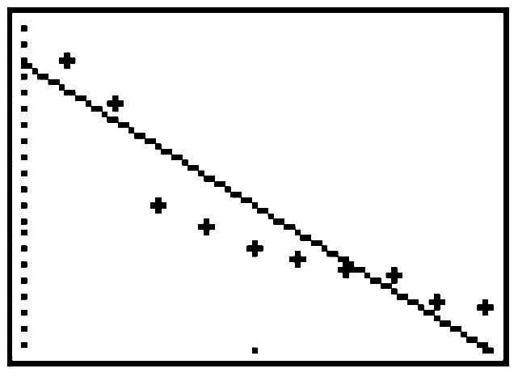
Example 3
Use a Median-Fit Line
The equation for the median-fit line is y = –9x + 209.5.
Step 3 Copy the equation to
the Y= list and graph.
Use the trace option
until you reach x = 20.
[0, 22] scl: 1 by [0, 225] scl: 5
Answer: The score of the 20th-ranked player is about 30.

Slide 19
Example 3
Use the data from the table and a median-fit line to estimate the number of passengers the airline will have in 2015.
A. 1100 passengers
B. 1700 passengers
C. 1900 passengers
D. 2100 passengers

Slide 20
End of the Lesson

