Slide 1


Splash Screen

Slide 2
Lesson Menu
Five-Minute Check (over Lesson 4–6)
CCSS
Then/Now
New Vocabulary
Key Concept: Inverse Relations
Example 1: Inverse Relations
Example 2: Graph Inverse Relations
Key Concept: Finding Inverse Functions
Example 3: Find Inverse Linear Functions
Example 4: Real-World Example: Use an Inverse Function

Slide 3

5-Minute Check 1
Which equation of a regression line best represents the table? Let x be the number of years since 2001.
A. y = 4.3x + 15.2
B. y = 5.7x + 16.1
C. y = 2x + 13
D. y = x + 3

Slide 4

5-Minute Check 2
Which equation of a regression line best represents the table?
A. y = 25x + 13.2
B. y = 0.08x + 14.3
C. y = 0.16x + 14.61
D. y = 0.25x + 12

Slide 5

5-Minute Check 3
Which equation of a regression line best represents the table?
A. y = 200.2x – 30
B. y = 190x – 20
C. y = 97x + 7
D. y = 54x – 18

Slide 6

5-Minute Check 4
A line of best fit for a set of data has slope 6.5 and passes through the point at (–8, 40). What is the regression equation?
A. y = x + 70
B. y = 4x + 40
C. y = 5.5x + 92
D. y = 6.5x + 92

Slide 7

CCSS
Content Standards
A.CED.2 Create equations in two or more variables to represent relationships between quantities; graph equations on coordinate axes with labels and scales.
F.BF.4a Solve an equation of the form f (x ) = c for a simple function f that has an inverse and write an expression for the inverse.
Mathematical Practices
6 Attend to precision.
Common Core State Standards © Copyright 2010. National Governors Association Center for Best Practices and Council of Chief State School Officers. All rights reserved.

Slide 8


Then/Now
You represented relations as tables, graphs, and mappings.
Find the inverse of a relation.
Find the inverse of a linear function.

Slide 9

Vocabulary
inverse relation
inverse function

Slide 10
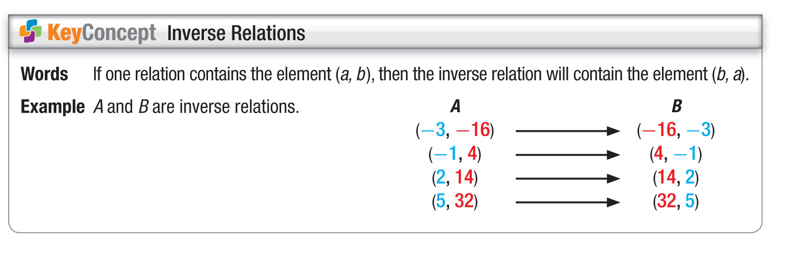
Concept

Slide 11
Example 1
Inverse Relations
A. Find the inverse of each relation.
{(−3, 26), (2, 11), (6, −1), (−1, 20)}
To find the inverse, exchange the coordinates of the ordered pairs.
(–3, 26) → (26, –3)
(6, –1) → (–1, 6)
(2, 11) → (11, 2)
(−1, 20) → (20, −1)
Answer: The inverse is {(26, –3), (11, 2), (–1, 6),
(20, –1)}.

Slide 12
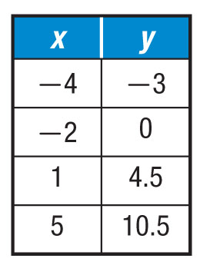
Example 1
Inverse Relations
B. Find the inverse of each relation .
Write the coordinates as ordered pairs. Then exchange the coordinates of each pair.
(−4, −3) → (−3, −4)
(–2, 0) → (0, –2)
(1, 4.5) → (4.5, 1)
(5, 10.5) → (10.5, 5)
Answer: The inverse is {(3, 4), (4.5, 1), (0, –2),
(10.5, 5)}.

Slide 13


Example 1
Find the inverse of {(4, 8), (–6, 6), (3, 3), (0, –8)}.
A. {(4, 8), (–6, 6), (3, 3), (0, –8)}
B. {(8, 4), (6, –6), (3, 3), (–8, 0)}
C. {(0, –8), (3, 3), (–6, 6), (4, 8)}
D. {(–4, –8), (6, –6), (–3, –3), (0, 8)}

Slide 14
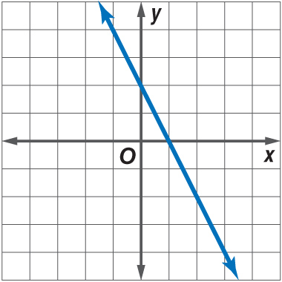
Example 2
Graph Inverse Relations
A. Graph the inverse of each relation.

Slide 15
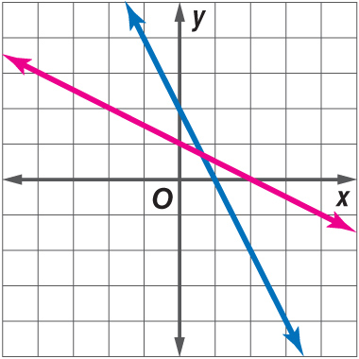
Example 2
Graph Inverse Relations
Answer: The graph of the relation passes through the points at (–2, 6), (2, 0), and (6, 6). To find points through which the graph of the inverse passes, exchange the coordinates of the ordered pairs. The graph of the inverse passes through the points at (6, –2), (0, 2), and (6, 6). Graph these points and then draw the line that passes through them.

Slide 16
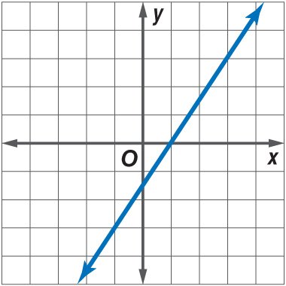
Example 2
Graph Inverse Relations
B. Graph the inverse of each relation.

Slide 17
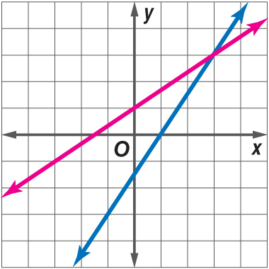
Example 2
Graph Inverse Relations
Answer: The graph of the relation passes through the points at (–2,– 6), (0, 4), (2, 0), (4, –4), and
(6, –8). To find points through which the graph of the inverse passes, exchange the coordinates of the ordered pairs. The graph of the inverse passes through the points at (6, 2), (4, 0), (0, 2), (–4, 4), and (–8, 6). Graph these points and then draw the line that passes through them.

Slide 18
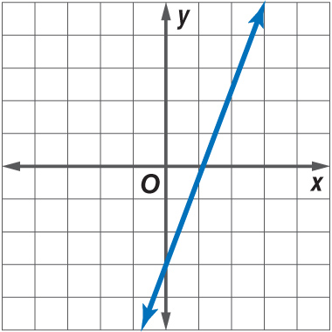
Example 2
Graph the inverse of the relation.

Slide 19
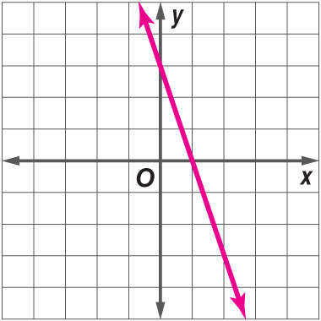
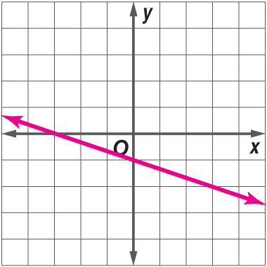
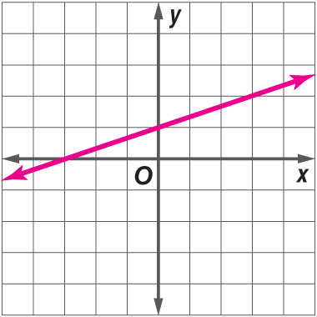
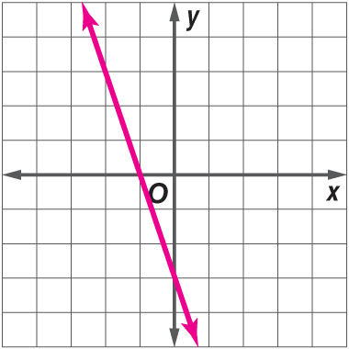
Example 2
A. B.
C. D.

Slide 20
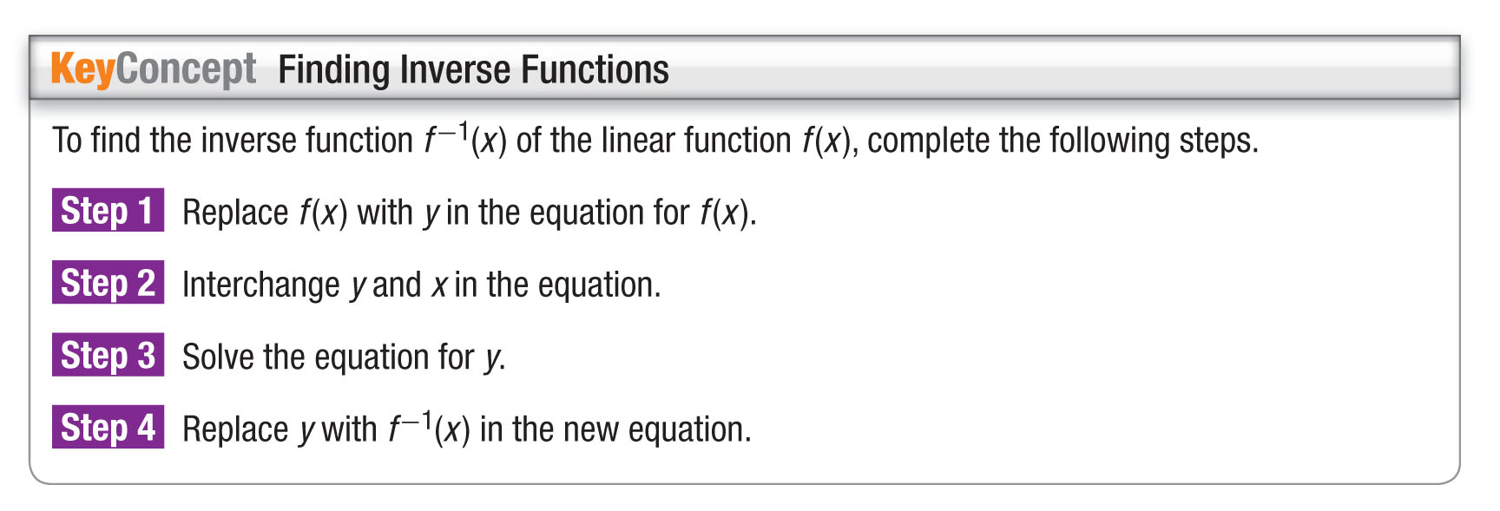
Concept

Slide 21
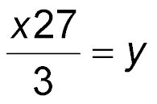
Example 3
Find Inverse Linear Functions
A. Find the inverse of the function f (x) = –3x + 27.
Step 1
f(x) = –3x + 27 Original equation
y = –3x + 27 Replace f(x) with y.
Step 2
x = –3y + 27 Interchange y and x.
Step 3
x – 27 = –3y Subtract 27 from each side.
Divide each side by –3.

Slide 22
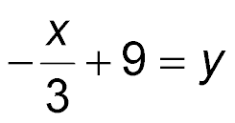
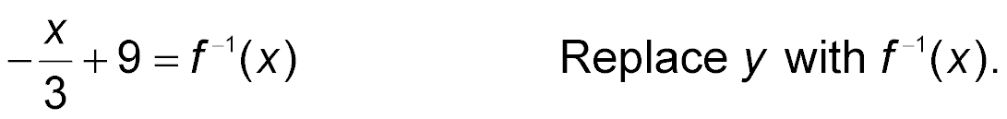
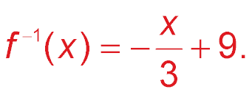
Example 3
Find Inverse Linear Functions
Simplify.
Step 4
Answer: The inverse of f(x) = –3x + 27 is

Slide 23
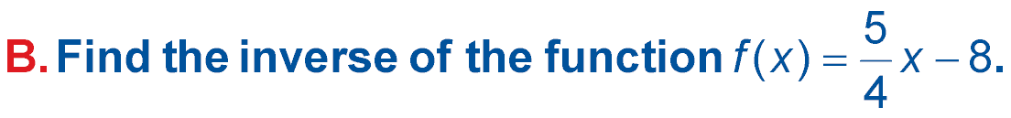
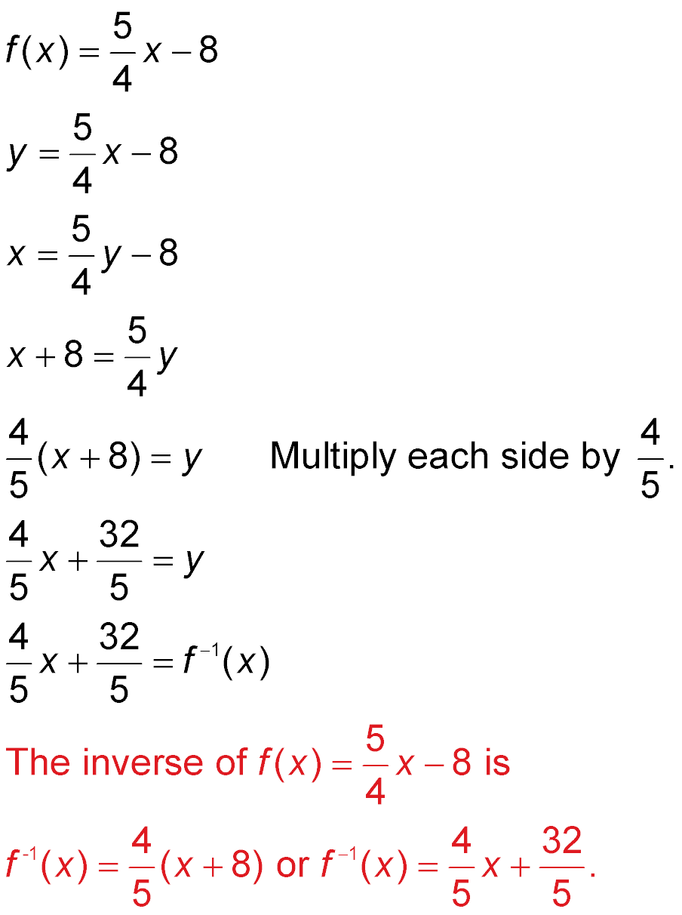
Example 3
Find Inverse Linear Functions
Step 1
Original equation
Replace f(x) with y.
Step 2
Interchange y and x.
Step 3
Add 8 to each side.

Slide 24
Example 3
Find Inverse Linear Functions
Simplify.
Step 4
Answer:

Slide 25
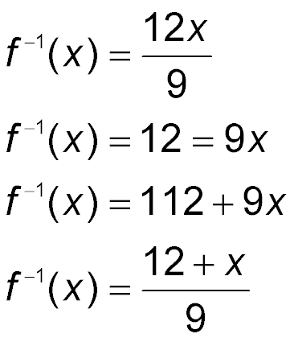
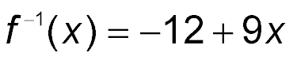
Example 3
Find the inverse of f(x) = 12 – 9x.
A.
B.
C.
D.

Slide 26
Example 4
Use an Inverse Function
SALES Carter sells paper supplies and makes a base salary of $2200 each month. He also earns 5% commission on his total sales. His total earnings
f(x) for a month in which he compiled x dollars in total sales is f(x) = 2200 + 0.05x.
A. Find the inverse function.
Step 1
f(x) = 2200 + 0.05x Original equation
y = 2200 + 0.05x Replace f(x) with y.
Step 2
x = 2200 + 0.05y Interchange y and x.

Slide 27
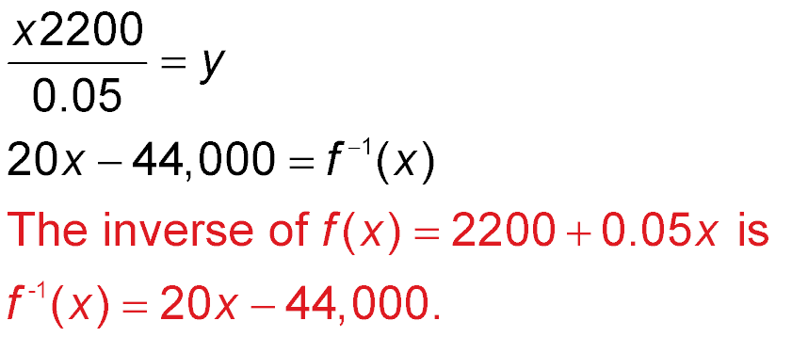
Example 4
Use an Inverse Function
Step 3
x – 2200 = 0.05y Subtract 2200 from each side.
Divide each side by 0.05.
Step 4
Answer:

Slide 28
Example 4
Use an Inverse Function
SALES Carter sells paper supplies and makes a base salary of $2200 each month. He also earns 5% commission on his total sales. His total earnings
f(x) for a month in which he compiled x dollars in total sales is f(x) = 2200 + 0.05x.
B. What do x and f ^{–1}(x)represent in the context of the inverse function?
Answer: x represents Carter’s total earnings for the month and f ^{–1}(x) represents the total monthly sales by Carter for the company.

Slide 29
Example 4
Use an Inverse Function
SALES Carter sells paper supplies and makes a base salary of $2200 each month. He also earns 5% commission on his total sales. His total earnings
f(x) for a month in which he compiled x dollars in total sales is f(x) = 2200 + 0.05x.
C. Find Carter’s total sales for last month if his earnings for that month were $3450.
Carter earned $3450 for the month. To find Carter’s total sales for that month, find f ^{–1}(3450).

Slide 30
Example 4
Use an Inverse Function
f ^{–1}(x) = 20x – 44,000 Original equation
f ^{–1}(3450) = 20(3450) – 44,000 total earnings = $3450
f ^{–1}(3450) = 69,000 – 44,000 Multiply.
f ^{–1}(3450) = 25,000 Subtract.
Answer: Carter had $25,000 in total sales for the month.

Slide 31
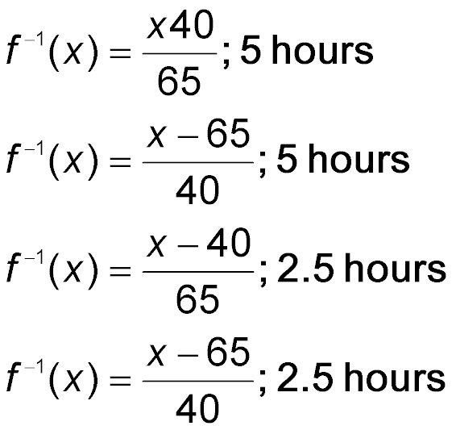
Example 4
REPAIRS Nikki’s car is getting repairs. The mechanic is charging her $40 to look at the car and $65 for each half-hour to fix the car. Her total cost f(x) for the repairs is f(x) = 40 + 65x. Find the inverse function and how long it took the mechanic to fix the car if Nikki was charged a total of $365.
A.
B.
C.
D.

Slide 32
End of the Lesson

