Slide 1


Splash Screen

Slide 2
Lesson Menu
Five-Minute Check (over Chapter 4)
CCSS
Then/Now
New Vocabulary
Key Concept: Addition Property of Inequalities
Example 1: Solve by Adding
Key Concept: Subtraction Property of Inequalities
Example 2: Standardized Test Example
Example 3: Variables on Each Side
Concept Summary: Phrases for Inequalities
Example 4: Real-World Example: Use an Inequality to Solve a Problem

Slide 3

5-Minute Check 1
Which equation represents the line that has slope 3 and y-intercept –5?
A. y = 3x + 5
B. y = 3x – 5
C. y = 5x + 3
D. y = –5x + 3

Slide 4

5-Minute Check 2
Choose the correct equation of the line that passes through (3, 5) and (–2, 5).
A. y = 5x + 1
B. y = 5x – 1
C. y = 5x
D. y = 5

Slide 5

5-Minute Check 3
Which equation represents the line that has a slope of and passes through (–3, 7)?
1
__
2
1
17
__
__
A. y = x +
B. y = x –
C. y = x –
D. y = x +
2
2
1
17
__
__
2
2
17
1
__
__
2
2
17
1
__
__
2
2

Slide 6

5-Minute Check 4
Choose the correct equation of the line that
passes through (6, –1) and is perpendicular to the
graph of y = x – 1.
3
__
4
4
__
A. y = x + 6
B. y = x – 6
C. y = – x + 7
D. y = – x + 1
3
3
__
4
4
__
3
3
__
4

Slide 7
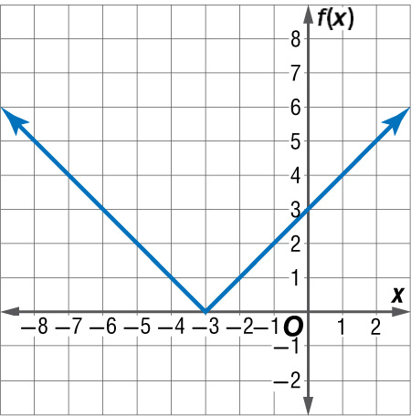

5-Minute Check 5
Which special function is represented by the graph?
A. f(x) = |x + 3|
B. f(x) = |x – 3|
C. f(x) = |3x|
D. f(x) = |x|

Slide 8

CCSS
Content Standards
A.CED.1 Create equations and inequalities in one variable and use them to solve problems.
A.REI.3 Solve linear equations and inequalities in one variable, including equations with coefficients represented by letters.
Mathematical Practices
2 Reason abstractly and quantitatively.
4 Model with mathematics.
Common Core State Standards © Copyright 2010. National Governors Association Center for Best Practices and Council of Chief State School Officers. All rights reserved.

Slide 9


Then/Now
You solved equations by using addition and subtraction.
Solve linear inequalities by using addition.
Solve linear inequalities by using subtraction.

Slide 10

Vocabulary
set-builder notation

Slide 11
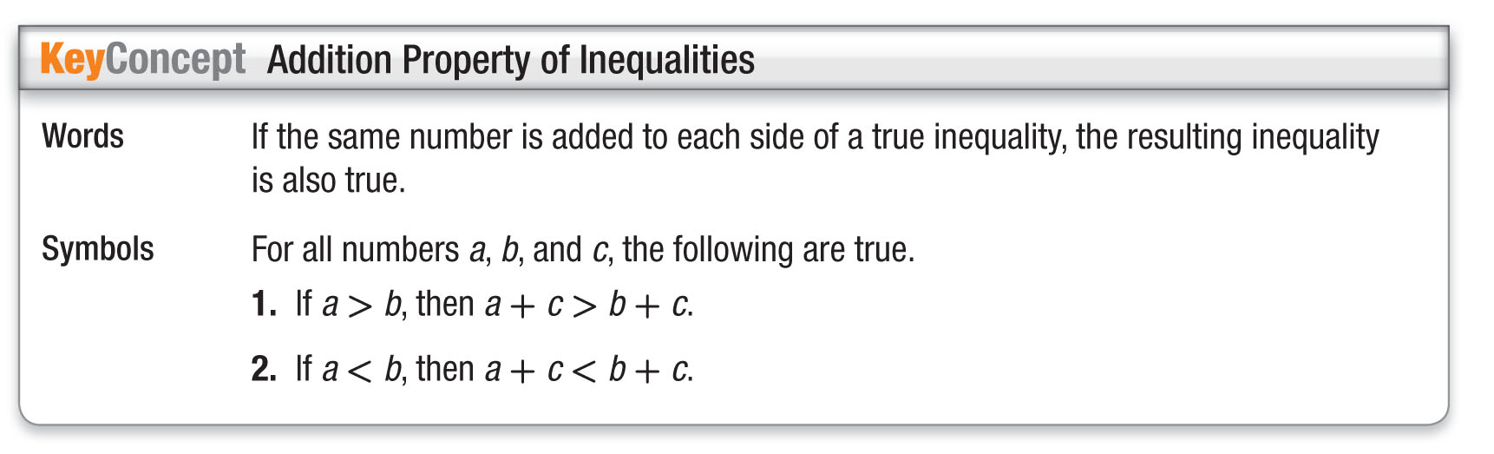
Concept

Slide 12
Example 1
Solve by Adding
Solve c – 12 > 65. Check your solution.
c – 12 > 65 Original inequality
c – 12 + 12 > 65 + 12 Add 12 to each side.
c > 77 Simplify.
Check To check, substitute 77, a number less than 77, and a number greater than 77.
Answer: The solution is the set {all numbers greater than 77}.

Slide 13


Example 1
Solve k – 4 < 10.
A. k > 14
B. k < 14
C. k < 6
D. k > 6

Slide 14
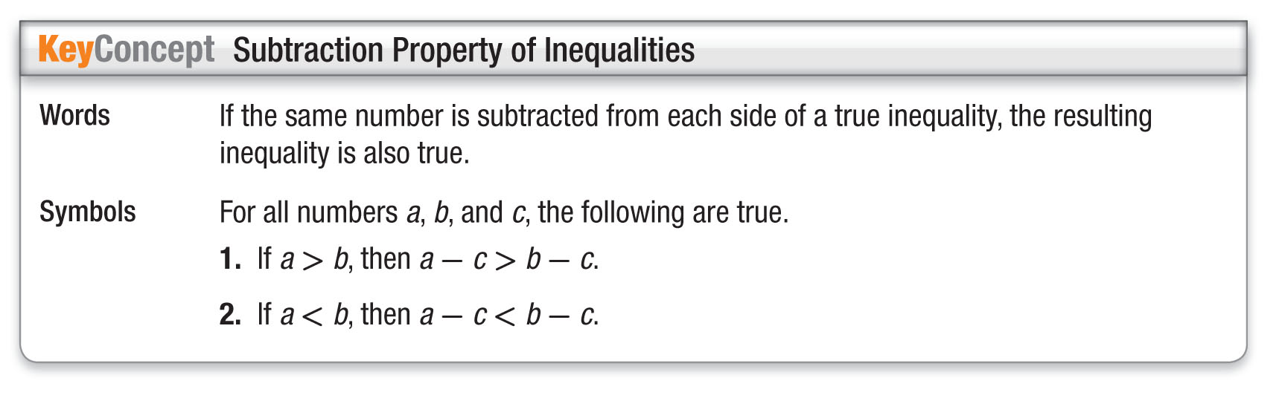
Concept

Slide 15
Example 2
Solve the inequality x + 23 < 14.
A {x|x < –9}
B {x|x < 37}
C {x|x > –9}
D {x|x > 39}
Read the Test Item
You need to find the solution to the inequality.

Slide 16
Example 2
Solve the Test Item
Step 1 Solve the inequality.
x + 23 < 14 Original inequality
x + 23 – 23 < 14 – 23 Subtract 23 from each side.
x < –9 Simplify.
Step 2 Write in set-builder notation.
{x|x < –9}
Answer: The answer is A.

Slide 17
Example 2
Solve the inequality m – 4 ≥ –8.
A. {m|m ≥ 4}
B. {m|m ≤ –12}
C. {m|m ≥ –4}
D. {m|m ≥ –8}

Slide 18

Example 3
Variables on Each Side
Solve 12n – 4 ≤ 13n. Graph the solution.
12n – 4 ≤ 13n Original inequality
12n – 4 – 12n ≤ 13n – 12n Subtract 12n from
each side.
–4 ≤ n Simplify.
Answer: Since –4 ≤ n is the same as n ≥ –4, the solution set is {n | n ≥ –4}.

Slide 19


Example 3
Solve 3p – 6 ≥ 4p. Graph the solution.
A. {p | p ≤ –6}
B. {p | p ≤ –6}
C. {p | p ≥ –6}
D. {p | p ≥ –6}

Slide 20
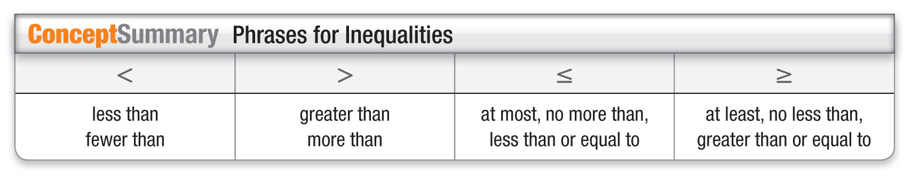
Concept

Slide 21
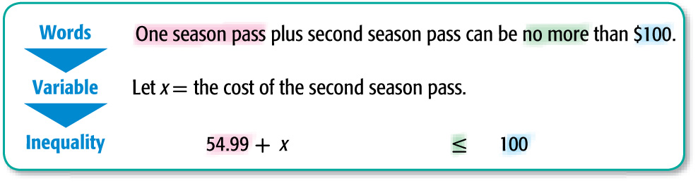
Example 4
Use an Inequality to Solve a Problem
ENTERTAINMENT Panya wants to buy season passes to two theme parks. If one season pass costs $54.99 and Panya has $100 to spend on both passes, the second season pass must cost no more than what amount?

Slide 22
Example 4
Use an Inequality to Solve a Problem
  54.99 + x ≤ 100 Original inequality
  54.99 + x – 54.99 ≤ 100 – 54.99 Subtract 54.99 from each side.
  x ≤ 45.01 Simplify.
Answer: The second season pass must cost no more than $45.01.

Slide 23
Example 4
BREAKFAST Jeremiah is taking two of his friends out for pancakes. If he spends $17.55 on their meals and has $26 to spend in total, Jeremiah’s pancakes must cost no more than what amount?
A. $8.15
B. $8.45
C. $9.30
D. $7.85

Slide 24
End of the Lesson

