Slide 1


Splash Screen

Slide 2
Lesson Menu
Five-Minute Check (over Lesson 5–1)
CCSS
Then/Now
New Vocabulary
Key Concept: Multiplication Property of Inequalities
Example 1: Real-World Example: Write and Solve an Inequality
Example 2: Solve by Multiplying
Key Concept: Division Property of Inequalities
Example 3: Divide to Solve an Inequality

Slide 3





5-Minute Check 1
Solve y – 3 > 5. Then graph the solution on a number line.
A. {y | y > 2}
B. {y | y > –2}
C. {y | y < 8}
D. {y | y > 8}

Slide 4





5-Minute Check 2
Solve t + 9 ≤ 6. Then graph the solution on a number line.
A. {t | t ≤ –3}
B. {t | t ≥ –3}
C. {t | t ≤ 3}
D. {t | t ≥ 3}

Slide 5

5-Minute Check 3
Solve 4n > 3n + 9. Then graph the solution on a number line.
A. {n | n > 9}
B. {n | n < 9}
C. {n | n ≥ 9}
D. {n | n ≤ 9}

Slide 6

5-Minute Check 4
Write and solve an inequality for the problem.
The sum of a number and 7 is at least –5.
A. n + 7 ≤ –5; {n | n ≤ –12}
B. n + 7 ≤ –5; {n | n ≤ 2}
C. n + 7 ≥ –5; {n | n ≥ –12}
D. n + 7 ≥ –5; {n | n ≥ 2}

Slide 7

5-Minute Check 5
Write and solve an inequality for the problem.
Twenty is less than the sum of twice a number
and 8.
A. 20 < 2n + 8; {n | n > 6}
B. 20 < 2n + 8; {n | n > 14}
C. 20 < 2n + 8; {n | n < 6}
D. 20 < 2n + 8; {n | n < 14}

Slide 8

5-Minute Check 6
Solve –7 < m – (–16).
A. m > –23
B. m > 23
C. m < –9
D. m < 9

Slide 9

CCSS
Content Standards
A.CED.1 Create equations and inequalities in one variable and use them to solve problems.
A.REI.3 Solve linear equations and inequalities in one variable, including equations with coefficients represented by letters.
Mathematical Practices
1 Make sense of problems and persevere in solving them.
6 Attend to precision.
Common Core State Standards © Copyright 2010. National Governors Association Center for Best Practices and Council of Chief State School Officers. All rights reserved.

Slide 10


Then/Now
You solved equations by using multiplication and division.
Solve linear inequalities by using multiplication.
Solve linear inequalities by using division.

Slide 11
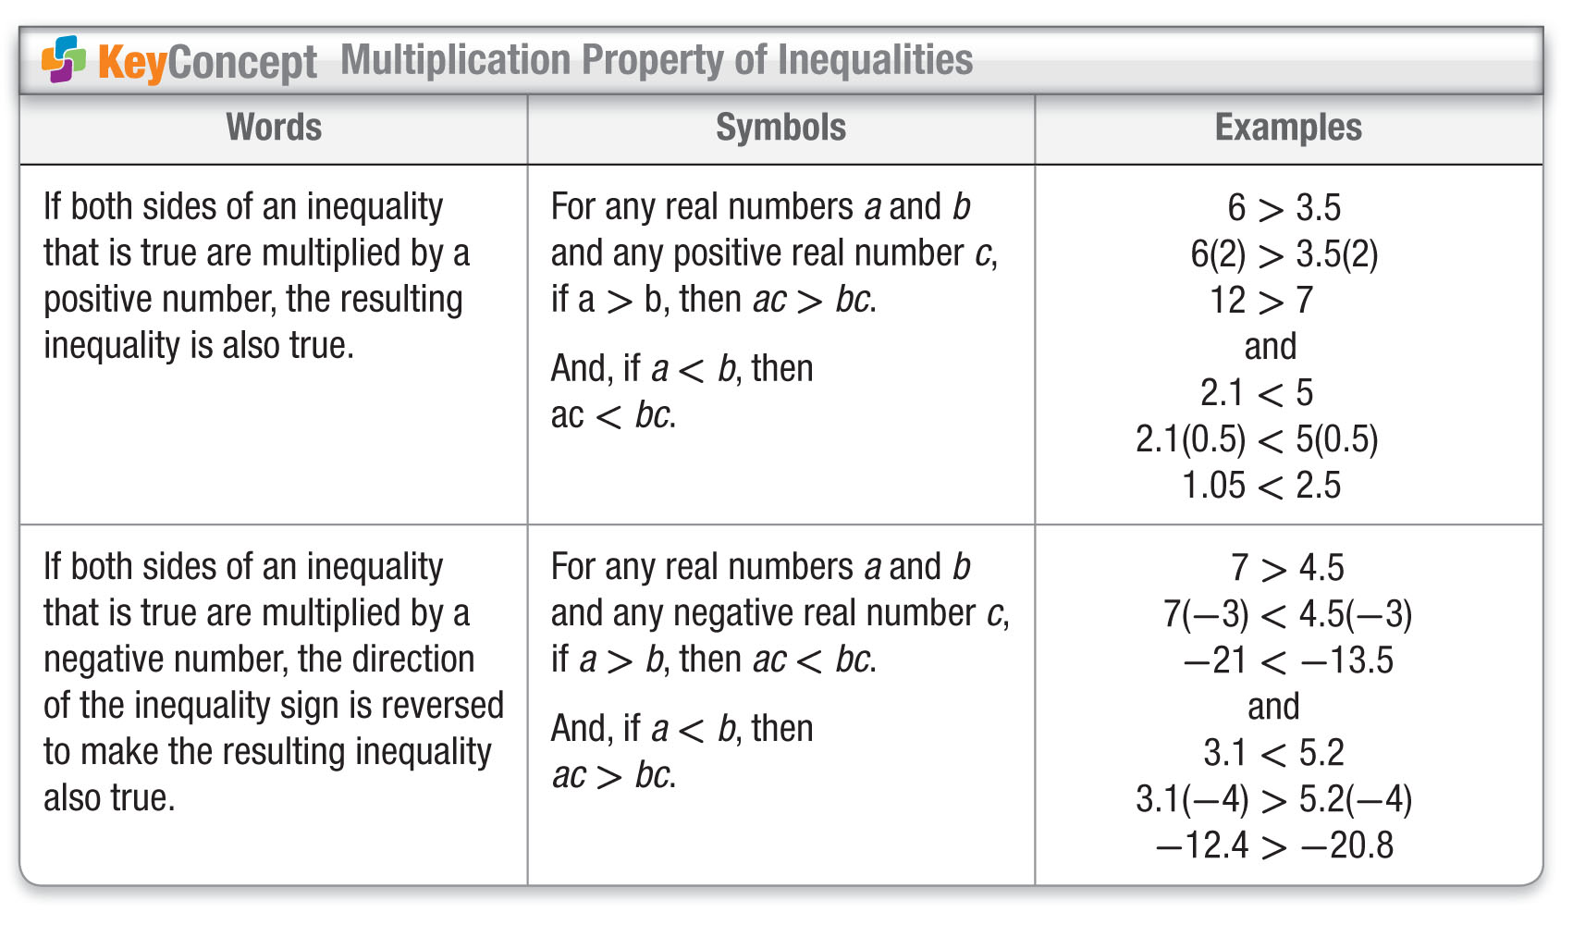
Concept

Slide 12

Example 1
Write and Solve and Inequality
HIKING Mateo is walking at a rate of mile per hour. He knows that it is at least 9 miles to Onyx Lake. How long will it take Mateo to get there? Write and solve an inequality to find the length of time.
Understand You know the rate that Mateo is walking and the approximate distance to the lake.
Plan The formula for distance is d = rt. Write an inequality that represents this situation.

Slide 13
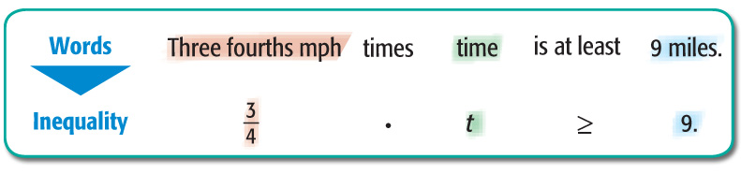
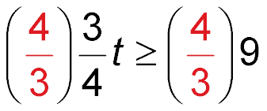

Example 1
Write and Solve and Inequality
Solve
t ≥ 9 Original inequality
Multiply each side by .
t ≥ 12 Simplify.

Slide 14
Example 1
Write and Solve and Inequality
Answer: It will take Mateo at least 12 hours.
Check To check this answer, substitute a
number greater than 12 into the
original inequality. If n = 16, then
(16) or 12 ≥ 9, so the solution checks.

Slide 15



Example 1
SCHOOL At Midpark High School, of the junior class attended the dance. There were at least 200 juniors at the dance. How many students are in the junior class?
A. j ≤ 300
B. j ≥ 300
C. j ≥ 200
D. j ≤ 200

Slide 16
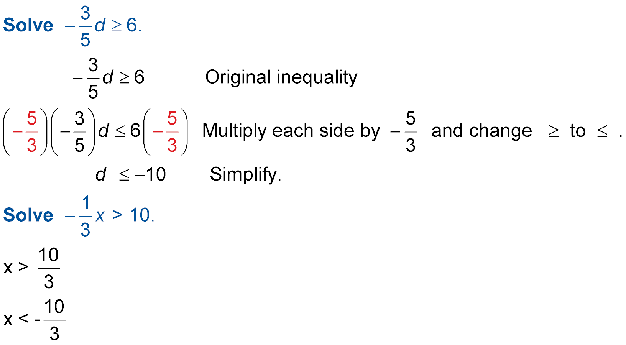
Example 2
Solve by Multiplying
change ≥ to ≤.
Answer: The solution set is {d | d ≤ –10}.

Slide 17
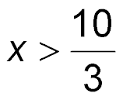
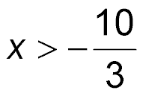
Example 2
A.
B.
C. x < –30
D. x > –30

Slide 18
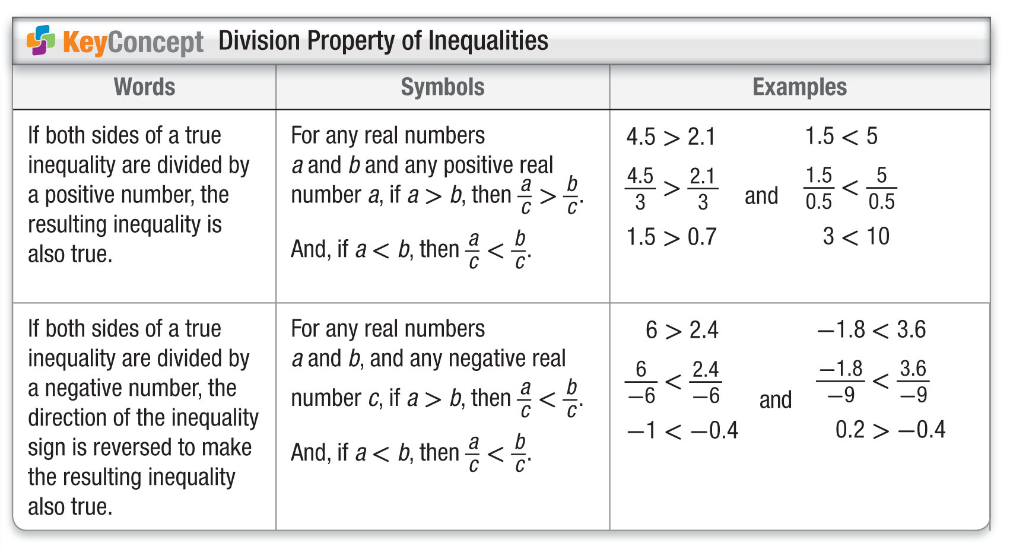
Concept

Slide 19
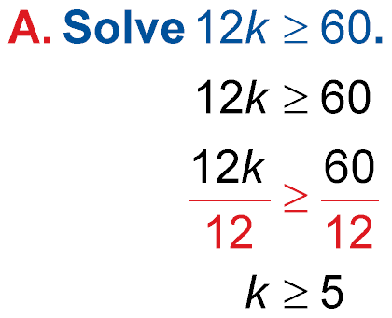
Example 3
Divide to Solve an Inequality
Original inequality
Divide each side by 12 and do
not change the direction of the inequality sign.
Simplify.
Answer: The solution set is {k | k ≥ 5}.

Slide 20
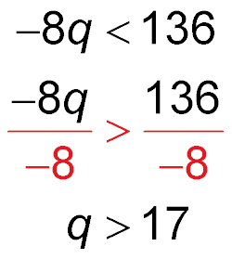
Example 3
Divide to Solve an Inequality
B. Solve –8q < 136.
Original inequality
Divide each side by –8 and change < to >.
Simplify.
Answer: The solution set is {q | q > –17}.

Slide 21
Example 3
A. Solve 15p < 60.
A. {p | p < 4}
B. {p | p < 45}
C. {p | p < 75}
D. {p | p > 4}

Slide 22
Example 3
B. Solve –4z > 64.
A. {z | z < 16}
B. {z | z < –16}
C. {z | z > –16}
D. {z | z > 16}

Slide 23
End of the Lesson

