Slide 1


Splash Screen

Slide 2
Lesson Menu
Five-Minute Check (over Lesson 5–2)
CCSS
Then/Now
Example 1: Real-World Example: Solve a Multi-Step Inequality
Example 2: Inequality Involving a Negative Coefficient
Example 3: Write and Solve an Inequality
Example 4: Distributive Property
Example 5: Empty Set and All Reals

Slide 3

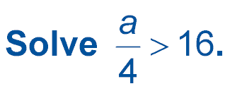
5-Minute Check 1
A. {a | a > 64}
B. {a | a < 64}
C. {a | a > 4}
D. {a | a < 4}

Slide 4

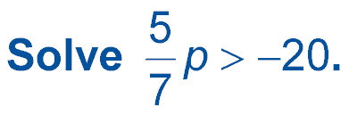
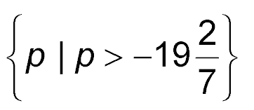
5-Minute Check 2
A. {p | p > 28 }
B. {p | p < 28 }
C.
D. {p | p > –28 }

Slide 5

5-Minute Check 3
Solve –9v ≥ –108.
A. {v | v ≥ 99}
B. {v | v ≤ 12}
C. {v | v ≥ 12}
D. {v | v ≥ –12}

Slide 6
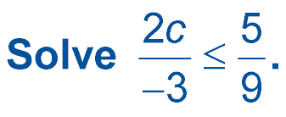

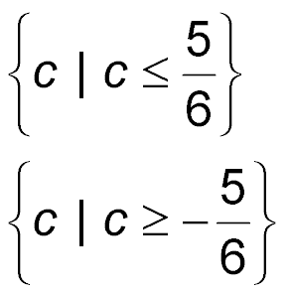
5-Minute Check 4
A. {c | c ≤ –5}
B. {c | c ≤ –2}
C.
D.

Slide 7

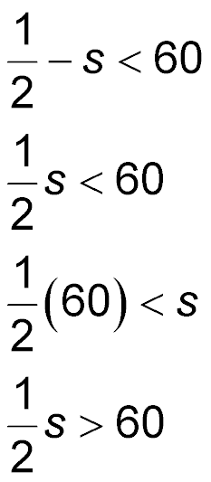
5-Minute Check 5
Which inequality represents one half of Dan’s savings is less than $60.00?
A.
B.
C.
D.

Slide 8

5-Minute Check 6
Marta wants to purchase charms for her necklace. Each charm costs $1.59. She wants to spend no more than $20 for the charms. Which inequality represents this situation? How many charms can Marta purchase?
A. 1.59 – c > 20; 22
B. c + 1.59 < 20; 18
C. 1.59c ≥ 20; 12
D. 1.59c ≤ 20; 12

Slide 9

CCSS
Content Standards
A.CED.1 Create equations and inequalities in one variable and use them to solve problems.
A.REI.3 Solve linear equations and inequalities in one variable, including equations with coefficients represented by letters.
Mathematical Practices
7 Look for and make use of structure.
Common Core State Standards © Copyright 2010. National Governors Association Center for Best Practices and Council of Chief State School Officers. All rights reserved.

Slide 10


Then/Now
You solved multi-step equations.
Solve linear inequalities involving more than one operation.
Solve linear inequalities involving the Distributive Property.

Slide 11
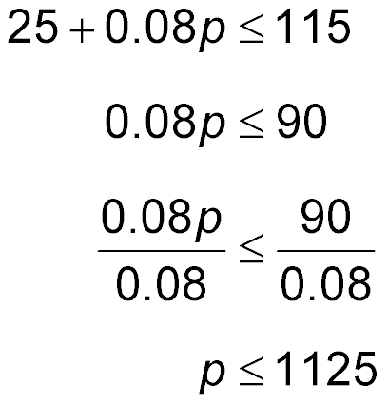
Example 1
Solve a Multi-Step Inequality
FAXES Adriana has a budget of $115 for faxes.
The fax service she uses charges $25 to activate
an account and $0.08 per page to send faxes. How many pages can Adriana fax and stay within her budget? Use the inequality 25 + 0.08p ≤ 115.
Original inequality
Subtract 25 from each side.
Divide each side by 0.08.
Simplify.
Answer: Adriana can send at most 1125 faxes.

Slide 12


Example 1
Rob has a budget of $425 for senior pictures. The cost for a basic package and sitting fee is $200. He wants to buy extra wallet-size pictures for his friends that cost $4.50 each. How many wallet-size pictures can he order and stay within his budget? Use the inequality 200 + 4.5p ≤ 425.
A. 50 pictures
B. 55 pictures
C. 60 pictures
D. 70 pictures

Slide 13
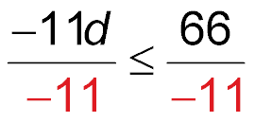
Example 2
Inequality Involving a Negative Coefficient
Solve 13 – 11d ≥ 79.
13 – 11d ≥ 79 Original inequality
13 – 11d – 13 ≥ 79 – 13 Subtract 13 from each side.
–11d ≥ 66 Simplify.
Divide each side by –11 and change ≥ to ≤.
d ≤ –6 Simplify.
Answer: The solution set is {d | d ≤ –6} .

Slide 14
Example 2
Solve –8y + 3 > –5.
A. {y | y < –1}
B. {y | y > 1}
C. {y | y > –1}
D. {y | y < 1}

Slide 15
Example 3
Write and Solve an Inequality
Define a variable, write an inequality, and solve the problem below.
Four times a number plus twelve is less than the number minus three.
Four times a number
a number minus three.
plus
twelve
is less than
4n
+
12
<
n – 3

Slide 16
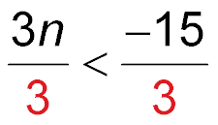
Example 3
Write and Solve an Inequality
4n + 12 < n – 3 Original inequality
4n + 12 – n < n – 3 – n Subtract n from each side.
3n + 12 < –3 Simplify.
3n + 12 – 12 < –3 – 12 Subtract 12 from each side.
3n < –15 Simplify.
Divide each side by 3.
n < –5 Simplify.
Answer: The solution set is {n | n < –5} .

Slide 17
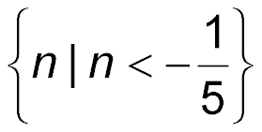
Example 3
Write an inequality for the sentence below. Then solve the inequality.
6 times a number is greater than 4 times the number
minus 2.
A. 6n > 4n – 2; {n | n > –1}
B. 6n < 4n – 2; {n | n < –1}
C. 6n > 4n + 2; {n | n > 1}
D. 6n > 2 – 4n;

Slide 18
Example 4
Distributive Property
Solve 6c + 3(2 – c) ≥ –2c + 1.
6c + 3(2 – c) ≥ –2c + 1 Original inequality
6c + 6 – 3c ≥ –2c + 1 Distributive Property
3c + 6 ≥ –2c + 1 Combine like terms.
3c + 6 + 2c ≥ –2c + 1 + 2c Add 2c to each side.
5c + 6 ≥ 1 Simplify.
5c + 6 – 6 ≥ 1 – 6 Subtract 6 from each side.
5c ≥ –5 Simplify.
c ≥ –1 Divide each side by 5.
Answer: The solution set is {c | c ≥ –1}.

Slide 19
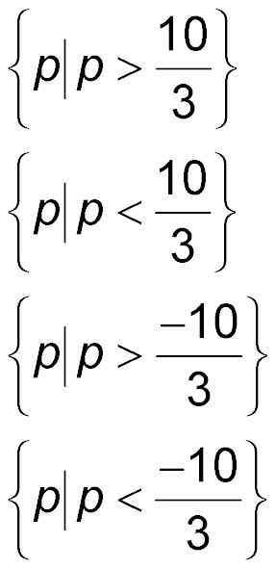
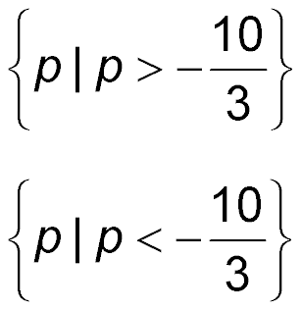
Example 4
Solve 3p – 2(p – 4) < p – (2 – 3p).
p | p
A.
B.
C.
D.
p | p

Slide 20
Example 5
Empty Set and All Reals
A. Solve –7(s + 4) + 11s ≥ 8s – 2(2s + 1).
–7(s + 4) + 11s ≥ 8s – 2(2s + 1) Original inequality
–7s – 28 + 11s ≥ 8s – 4s – 2 Distributive Property
4s – 28 ≥ 4s – 2 Combine like terms.
4s – 28 – 4s ≥ 4s – 2 – 4s Subtract 4s from each
side.
– 28 ≥ – 2 Simplify.
Answer: Since the inequality results in a false statement, the solution set is the empty set, Ø.

Slide 21
Example 5
Empty Set and All Reals
B. Solve 2(4r + 3) ≤ 22 + 8(r – 2).
2(4r + 3) ≤ 22 + 8(r – 2) Original inequality
8r + 6 ≤ 22 + 8r – 16 Distributive Property
8r + 6 ≤ 6 + 8r Simplify.
8r + 6 – 8r ≤ 6 + 8r – 8r Subtract 8r from each side.
6 ≤ 6 Simplify.
Answer: All values of r make the inequality true.
All real numbers are the solution.
{r | r is a real number.}

Slide 22

Example 5
A. Solve 8a + 5 ≤ 6a + 3(a + 4) – (a + 7).
A. {a | a ≤ 3}
B. {a | a ≤ 0}
C. {a | a is a real number.}
D.

Slide 23
Example 5
B. Solve 4r – 2(3 + r) < 7r – (8 + 5r).
A. {r | r > 0}
B. {r | r < –1}
C. {r | r is a real number.}
D.

Slide 24
End of the Lesson

