Slide 1


Splash Screen

Slide 2
Lesson Menu
Five-Minute Check (over Lesson 5–3)
CCSS
Then/Now
New Vocabulary
Example 1: Solve and Graph an Intersection
Example 2: Real-World Example: Write and Graph a Compound Inequality
Example 3: Solve and Graph a Union

Slide 3

5-Minute Check 1
Solve 3x – 15 < 45.
A. {x | x < 30}
B. {x | x < 20}
C. {x | x < 15}
D. {x | x < 10}

Slide 4

5-Minute Check 2
Solve 2p – 22 ≥ 4p + 14.
A. {p | p ≥ 18}
B. {p | p ≥ –18}
C. {p | p ≤ 18}
D. {p | p ≤ –18}

Slide 5

5-Minute Check 3
x
__
Solve –3 – < 13.
4
A. x < 64
B. x < 4
C. x > –64
D. x > –4

Slide 6

5-Minute Check 4
Choose the correct inequality for two times the difference of a number and five is greater than seven.
A. 2(n – 5 ) > 7
B. 2(n – 5 ) < 7
C. 2 < (n – 5 )7
D. 2n < 7 – 5

Slide 7

5-Minute Check 5
Solve 8(6 – k) + 2k ≥ –15 – (–3k).
A. k ≤ –5
B. k ≥ 5
C. k ≥ 7
D. k ≤ 7

Slide 8

CCSS
Content Standards
A.CED.1 Create equations and inequalities in one variable and use them to solve problems.
A.REI.3 Solve linear equations and inequalities in one variable, including equations with coefficients represented by letters.
Mathematical Practices
1 Make sense of problems and persevere in solving them.
8 Look for and express regularity in repeated reasoning.
Common Core State Standards © Copyright 2010. National Governors Association Center for Best Practices and Council of Chief State School Officers. All rights reserved.

Slide 9


Then/Now
You solved absolute value equations with two cases.
Solve compound inequalities containing the word and, and graph their solution set.
Solve compound inequalities containing the word or, and graph their solution set.

Slide 10

Vocabulary
compound inequality
intersection
union

Slide 11
Example 1
Solve and Graph an Intersection
Solve 7 < z + 2 ≤ 11. Graph the solution set.
First express 7 < z + 2 ≤ 11 using and. Then solve each inequality.
7 < z + 2 and z + 2 ≤ 11 Write the inequalities.
7 – 2 < z + 2 – 2 z – 2 + 2 ≤ 11 – 2 Subtract 2 from each side.
5 < z z ≤ 9 Simplify.
The solution set is {z | 5 < z ≤ 9}.

Slide 12
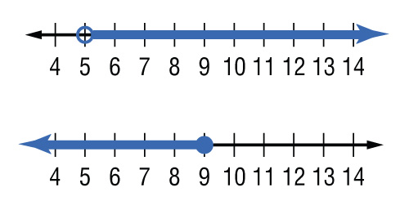
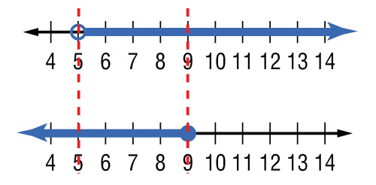

Example 1
Solve and Graph an Intersection
Graph 5 < z or z > 5.
Graph z ≤ 9.
Find the intersection.
Answer:

Slide 13






Example 1
Solve –3 < x – 2 < 5. Then graph the solution set.
A. {x | –1 < x < 7}
B. {x | –5 < x < 3}
C. {x | x < 7}
D. {x | –1 < x < 3}

Slide 14
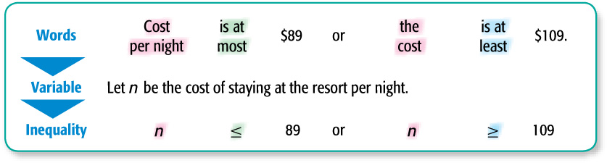
Example 2
Write and Graph a Compound Inequality
TRAVEL A ski resort has several types of hotel rooms and several types of cabins. The hotel rooms cost at most $89 per night and the cabins cost at least $109 per night. Write and graph a compound inequality that describes the amount that a guest would pay per night at the resort.

Slide 15
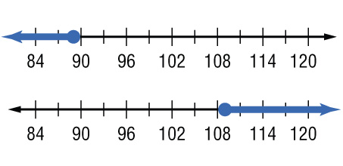
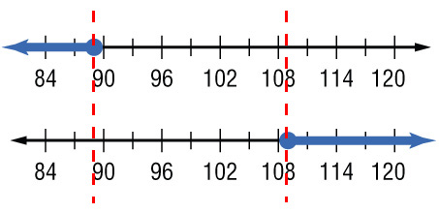

Example 2
Write and Graph a Compound Inequality
Now graph the solution set.
Graph n ≤ 89.
Graph n ≥ 109.
Find the union.
Answer: {n | n ≤ 89 or n ≥ 109}

Slide 16




Example 2
TICKET SALES A professional hockey arena has seats available in the Lower Bowl level that cost at most $65 per seat. The arena also has seats available at the Club Level and above that cost at least $80 per seat. Write and graph a compound inequality that describes the amount a spectator would pay for a seat at the hockey game.
A. c ≤ 65 or c ≥ 80
B. c ≥ 65 or c ≤ 80
C. c ≥ 65 or c ≥ 80
D. c ≤ 65 or c ≤ 80

Slide 17
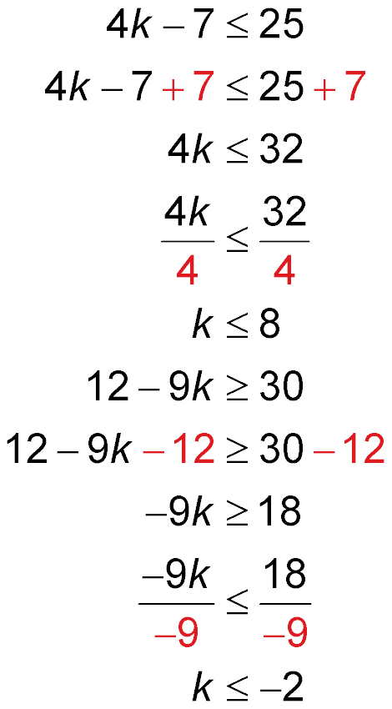
Example 3
Solve and Graph a Union
Solve 4k – 7 ≤ 25 or 12 – 9k ≥ 30. Graph the solution set.
or

Slide 18
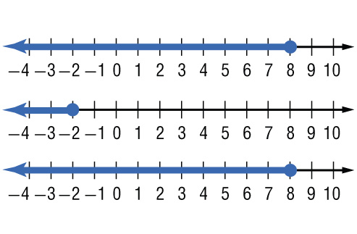
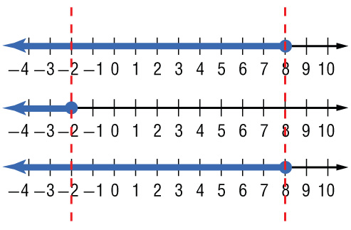
Example 3
Solve and Graph a Union
Graph k ≤ 8.
Graph k ≤ –2.
Find the
union.
Answer: Notice that the graph of k ≤ 8 contains every point in the graph of k ≤ –2. So, the union is the graph of k ≤ 8. The solution set is {k | k ≤ 8}.

Slide 19




Example 3
Solve –2x + 5 < 15 or 5x + 15 > 20. Then graph the solution set.
A. {x | x > 1}
B. {x | x < –5}
C. {x | x > –5}
D. {x | x < 1}

Slide 20
End of the Lesson

