Slide 1


Splash Screen

Slide 2
Lesson Menu
Five-Minute Check (over Lesson 5–4)
CCSS
Then/Now
Example 1: Solve Absolute Value Inequalities (<)
Example 2: Real-World Example: Apply Absolute Value Inequalities
Example 3: Solve Absolute Value Inequalities (>)

Slide 3





5-Minute Check 1
What graph is the solution set of the compound inequality b > 3 or b < 0?
A.
B.
C.
D.

Slide 4

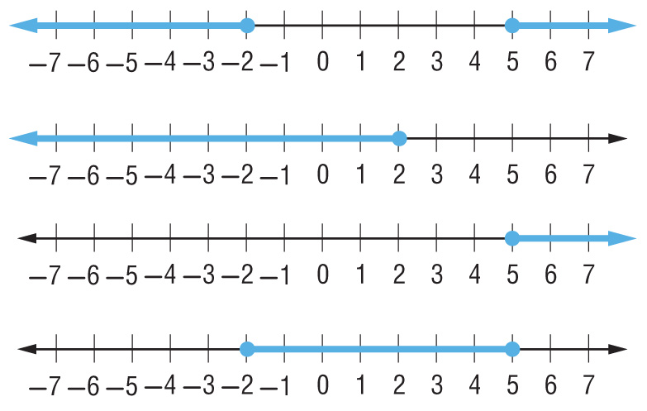
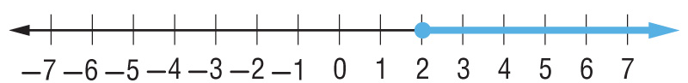
5-Minute Check 2
Solve the compound inequality
3x ≤ –6 or 2x – 6 ≥ 4. Graph the
solution set.
A. {x | x ≤ –2 or x ≥ 5};
B. {x | x ≤ 2 or x ≤ –5};
C. {x | x ≥ 2 or x ≥ 5};
D. {x | x ≥ –2 or x ≤ 5};

Slide 5

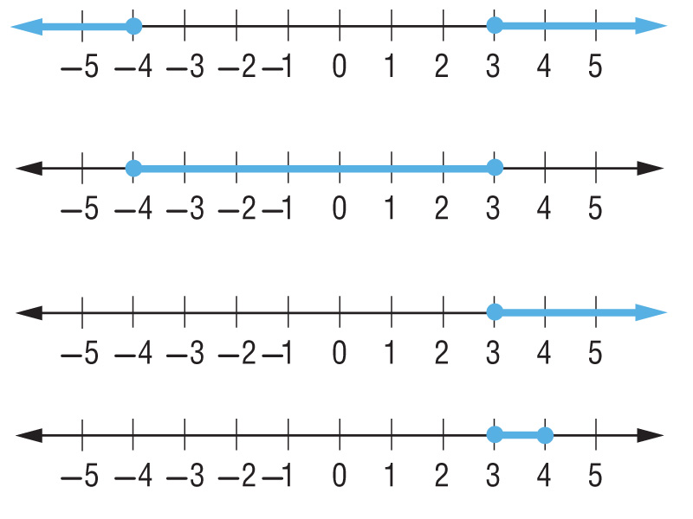
5-Minute Check 3
Solve the compound inequality
–5 ≤ x – 1 ≤ 2.
A. {x | x ≤ –4 or x ≥ 3};
B. {x | –4 ≤ x ≤ 3};
C. {x | x ≥ 3};
D. {x | x ≤ 4 or x ≥ 3};

Slide 6

5-Minute Check 4
Choose the compound inequality represented by the graph.
A. x < 2 or x ≥ 5
B. x > 2 or x ≤ 5
C. x ≤ 2
D. x ≥ 5

Slide 7


5-Minute Check 5
Which compound inequality does this solution represent?
A. 8 – 5x ≥ –12 or 4x + 6 ≤ 30
B. –5 > 3x + 7 or 2x + 4 ≤ 16
C. –5 ≤ 3x + 7 < 25
D. 26 ≤ 8x – 6 < 42

Slide 8

CCSS
Content Standards
A.CED.1 Create equations and inequalities in one variable and use them to solve problems.
A.REI.3 Solve linear equations and inequalities in one variable, including equations with coefficients represented by letters.
Mathematical Practices
3 Construct viable arguments and critique the reasoning of others.
7 Look for and make use of structure.
Common Core State Standards © Copyright 2010. National Governors Association Center for Best Practices and Council of Chief State School Officers. All rights reserved.

Slide 9


Then/Now
You solved equations involving absolute value.
Solve and graph absolute value inequalities (<).
Solve and graph absolute value inequalities (>).

Slide 10

Example 1
Solve Absolute Value Inequalities (<)
A. Solve |s – 3| ≤ 12. Then graph the solution set.
Write |s – 3| ≤ 12 as s – 3 ≤ 12 and s – 3 ≥ –12.
Case 1
Case 2
s – 3 ≤ 12 Original inequality
s – 3 ≥ –12
s – 3 + 3 ≤ 12 + 3 Add 3 to
each side.
s – 3 + 3 ≥ –12 + 3
s ≤ 15 Simplify.
s ≥ –9
Answer: The solution set is {s | –9 ≤ s ≤ 15}.

Slide 11
Example 1
Solve Absolute Value Inequalities (<)
B. Solve |x + 6| < –8.
Since |x + 6| cannot be negative, |x + 6| cannot be less than –8. So, the solution is the empty set Ø.
Answer: Ø

Slide 12






Example 1
A. Solve |p + 4| < 6. Then graph the solution set.
A. {p | p < 2}
B. {p | p > –10}
C. {p | –10 < p < 2}
D. {p | –2 < p < 10}

Slide 13

Example 1
B. Solve |p – 5| < –2.
A. {p | p ≤ –2}
B. {p | p < –2}
C. {p | p < 3}
D.

Slide 14
Example 2
Apply Absolute Value Inequalities
RAINFALL The average annual rainfall in California for the last 100 years is 23 inches. However, the annual rainfall can differ by 10 inches from the 100 year average. What is the range of annual rainfall for California?
The difference between the actual rainfall and the average is less than or equal to 10. Let x be the actual rainfall in California. Then |x – 23| ≤ 10.

Slide 15
Example 2
Apply Absolute Value Inequalities
Case 1
x – 23 ≤ 10
x – 23 + 23 ≤ 10 + 23
x ≤ 33
Case 2
–(x – 23) ≤ 10
x – 23 ≥ –10
x – 23 + 23 ≥ –10 + 23
x ≥ 13
Answer: The range of rainfall in California is
{x |13 ≤ x ≤ 33}.

Slide 16
Example 2
A thermostat inside Macy’s house keeps the temperature within 3 degrees of the set temperature point. If the thermostat is set at 72 degrees Fahrenheit, what is the range of temperatures
in the house?
A. {x | 70 ≤ x ≤ 74}
B. {x | 68 ≤ x ≤ 72}
C. {x | 68 ≤ x ≤ 74}
D. {x | 69 ≤ x ≤ 75}

Slide 17
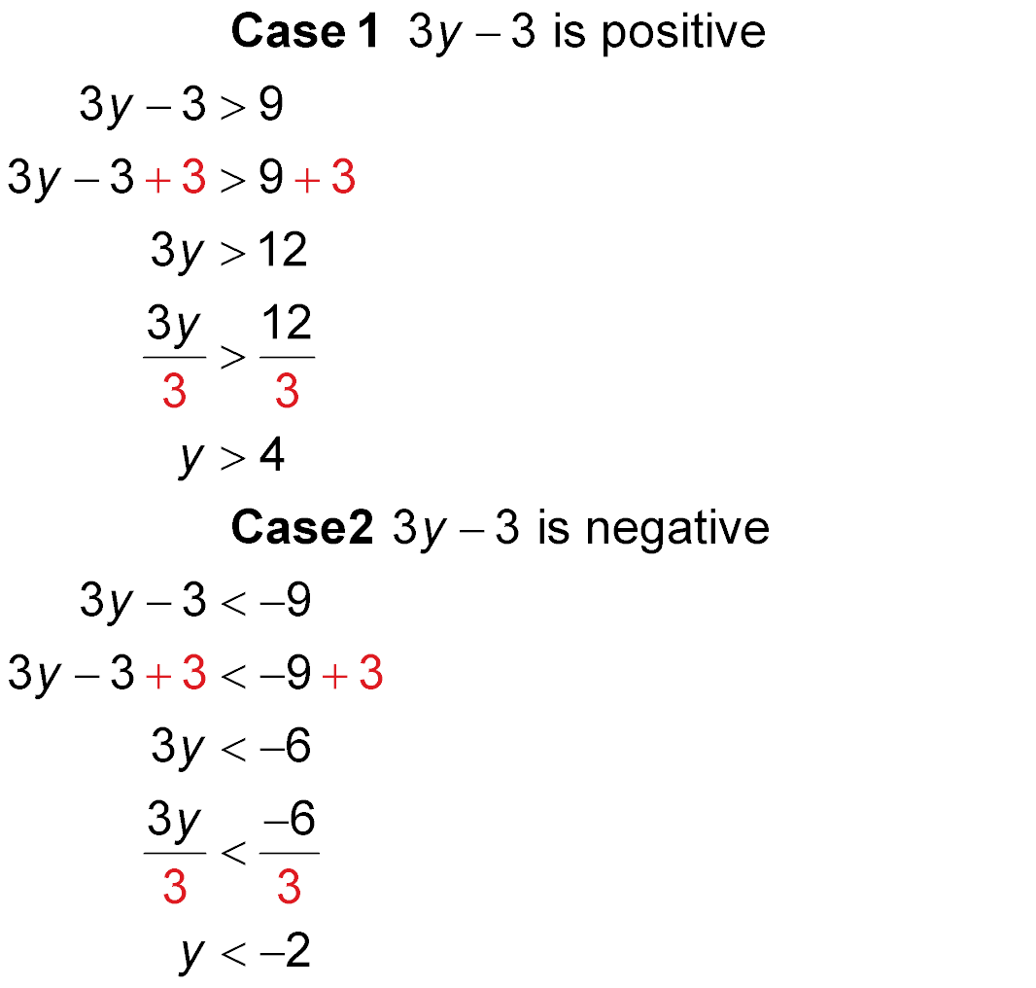
Example 3
Solve Absolute Value Inequalities (>)
A. Solve |3y – 3| > 9. Then graph the solution set.
Case 1 3y – 3 is positive.
Case 2 3y – 3 is negative.
Original inequality
Add 3 to each side.
Simplify.
Divide each side by 3.
Simplify.

Slide 18

Example 3
Solve Absolute Value Inequalities (>)
Answer: The solution set is {y | y < –2 or y > 4}.

Slide 19

Example 3
Solve Absolute Value Inequalities (>)
B. Solve |2x + 7| ≥ –11.
Answer: Since |2x + 7| is always greater than or equal to 0, the solution set is {x | x is a real number.}.

Slide 20




Example 3
A. Solve |2m – 2| > 6. Then graph the solution set.
A. {m | m > –2 or m < 4}.
B. {m | m > –2 or m > 4}.
C. {m | –2 < m < 4}.
D. {m | m < –2 or m > 4}.

Slide 21
Example 3
B. Solve |5x – 1| ≥ –2.
A. {x | x ≥ 0}
B. {x | x ≥ –5}
C. {x | x is a real number.}
D.

Slide 22
End of the Lesson

