Slide 1


Splash Screen

Slide 2
Lesson Menu
Five-Minute Check (over Lesson 5–5)
CCSS
Then/Now
New Vocabulary
Key Concept: Graphing Linear Inequalities
Example 1: Graph an Inequality (< or >)
Example 2: Graph an Inequality ( ≤ or ≥)
Example 3: Solve Inequalities from Graphs
Example 4: Write and Solve an Inequality

Slide 3

5-Minute Check 1
Express the statement using an inequality involving absolute value. Do not solve. The hitter’s batting average stayed within 0.150 of 0.260 during the month of July.
A. 0.150 ≤ a ≤ 0.260
B. |a – 0.150| < 0.260
C. |a + 0.260| ≤ 0.150
D. |a – 0.260| ≤ 0.150

Slide 4





5-Minute Check 2
Solve the inequality |a – 1| < 4. Then graph the solution set.
A. {a | –3 < a < 5};
B. {a | a < –3 or a > 5};
C. {a | a > –3};
D. {a | a < 5};

Slide 5





5-Minute Check 3
Solve the inequality |x + 5| > 2. Then graph the solution set.
A. {x | x > –3};
B. {x | –7 < x < –3};
C. {x | x < –7 or x > –3};
D. {x | x < –3};

Slide 6

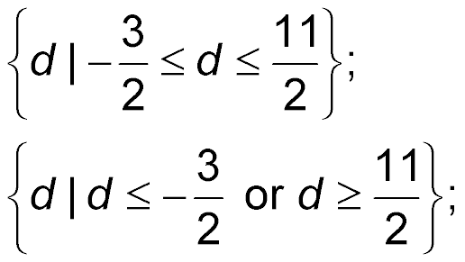
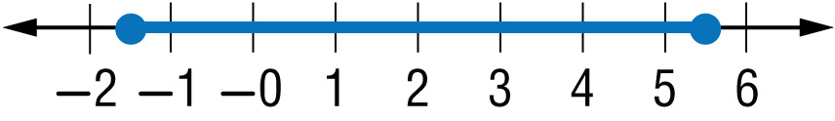



5-Minute Check 4
Solve the inequality |2d – 7| ≤ –4. Then graph the solution set.
A.
B.
C. all real numbers;
D. Ø;

Slide 7

5-Minute Check 5
A poll showed that 62% of the voters are in favor
of a proposed law. The margin of error was 2.5%. What is the range of the percent of voters p who are in favor of the law?
A. 62% ≤ p
B. 59.5% < p < 64.5%
C. 59.5% ≤ p ≤ 64.5%
D. 59% < p < 65%

Slide 8

5-Minute Check 6
Solve |z + 5| ≤ 12.
A. –17 ≤ z ≤ 7
B. z ≤ –17 or z ≥ 7
C. z ≤ 7
D. z ≥ –17

Slide 9

CCSS
Content Standards
A.CED.3 Represent constraints by equations or inequalities, and by systems of equations and/or inequalities, and interpret solutions as viable or nonviable options in a modeling context.
A.REI.12 Graph the solutions to a linear inequality in two variables as a half-plane (excluding the boundary in the case of a strict inequality), and graph the solution set to a system of linear inequalities in two variables as the intersection of the corresponding half-planes.
Mathematical Practices
5 Use appropriate tools strategically.
Common Core State Standards © Copyright 2010. National Governors Association Center for Best Practices and Council of Chief State School Officers. All rights reserved.

Slide 10


Then/Now
You graphed linear equations.
Graph linear inequalities on the coordinate plane.
Solve inequalities by graphing.

Slide 11

Vocabulary
boundary
half-plane
closed half-plane
open half-plane

Slide 12
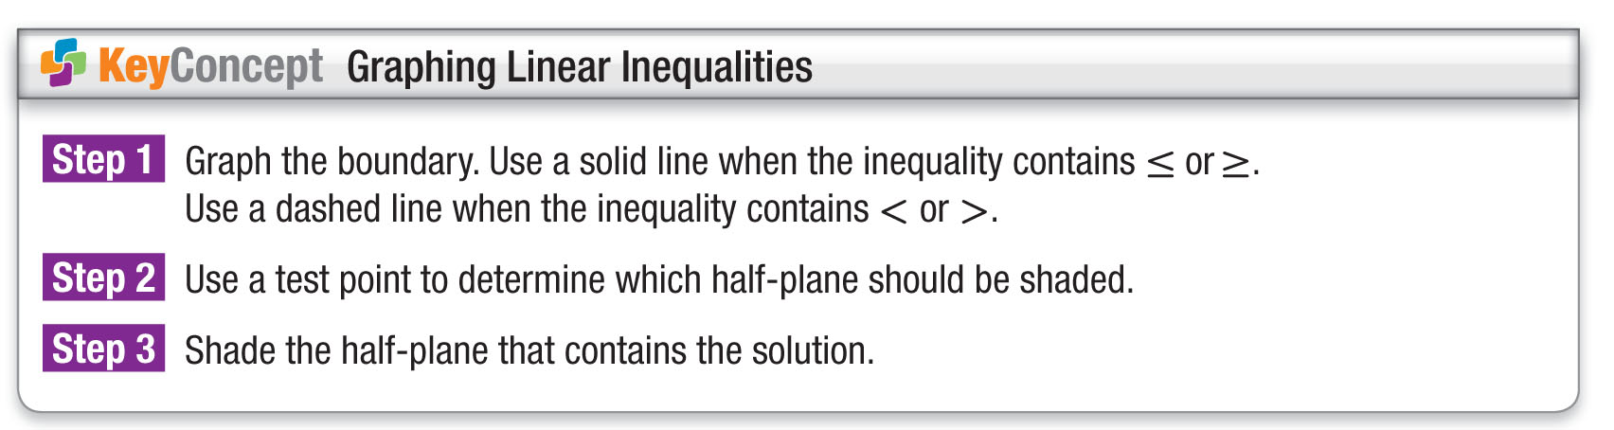
Concept

Slide 13
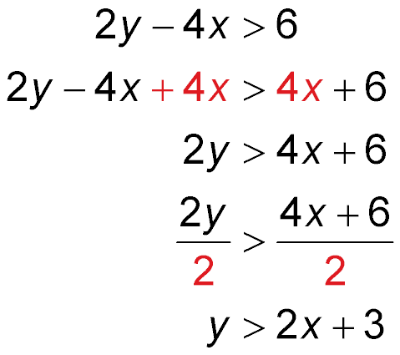
Example 1
Graph an Inequality (< or >)
Graph 2y – 4x > 6.
Step 1 Solve for y in terms of x.
Original inequality
Add 4x to each side.
Simplify.
Divide each side by 2.
Simplify.

Slide 14
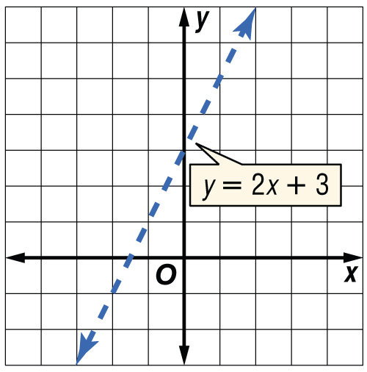
Example 1
Graph an Inequality (< or >)
Step 2 Graph y = 2x + 3.
Since y > 2x + 3 does not include
values when y = 2x + 3, the
boundary is not included in the
solution set. The boundary
should be drawn as a dashed line.
Step 3 Select a point in one of
the half-planes and test it.
Let’s use (0, 0).
y > 2x + 3 Original inequality
0 > 2(0) + 3 x = 0, y = 0
0 > 3 false

Slide 15
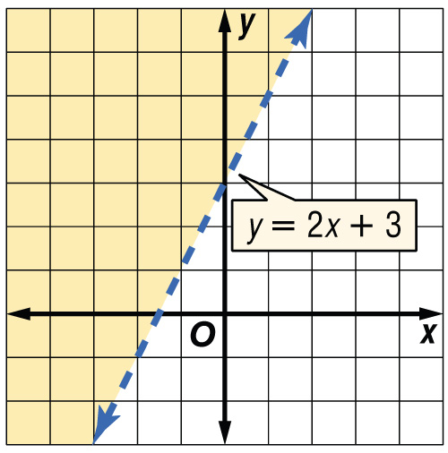
Example 1
Graph an Inequality (< or >)
Since the statement is false, the half-plane containing the origin is not part of the solution. Shade the other half-plane.
Answer:
Check Test a point in the
other half-plane, for example,
(–3, 1).
y > 2x + 3 Original inequality
1 > 2(–3) + 3 x = –3, y = 1
1 > –3
✓
Since the statement is true, the half-plane containing (–3, 1) should be shaded. The graph of the solution is correct.

Slide 16


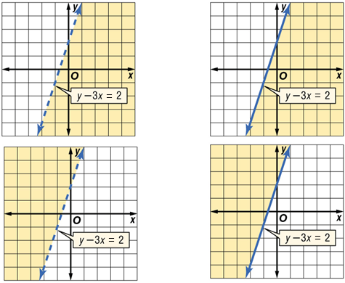
Example 1
Graph y – 3x < 2.
A. B.
C. D.

Slide 17
Example 2
Graph an Inequality (≤ or ≥)
Graph x + 4y ≥ 2.
Step 1 Solve for y in terms of x.
x + 4y ≥ 2 Original inequality
4y ≥ –x + 2 Subtract x from both sides
and simplify.
1
1
__
__
y ≥ – x + Divide each side by 4.
4
2

Slide 18
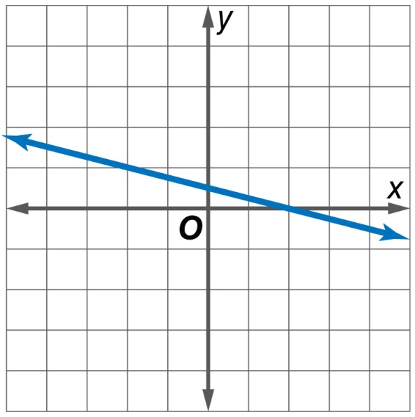
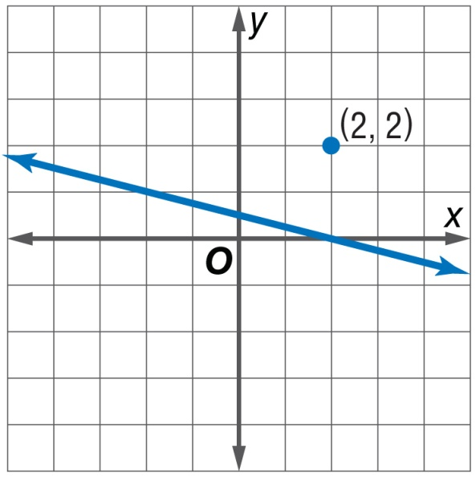
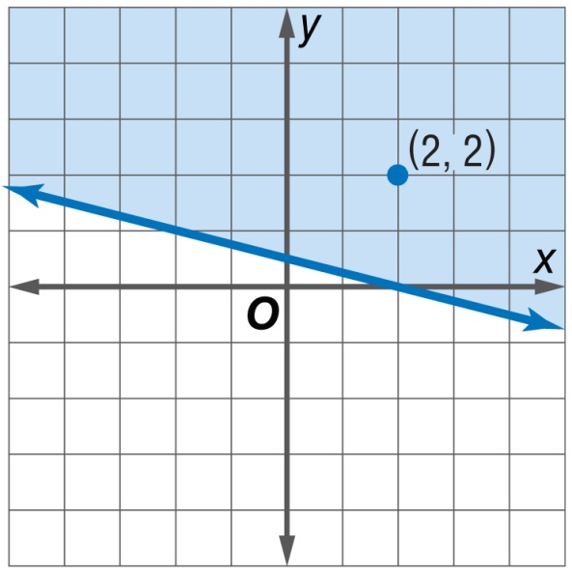
Example 2
Graph an Inequality (≤ or ≥)
Graph y ≥ – x + . Because the inequality symbol is ≥, graph the boundary with a solid line.
1
1
__
__
4
2
Step 2 Select a test point. Let’s use (2, 2). Substitute the values into the original inequality.
x + 4y ≥ 2 Original
inequality
2 + 4(2) ≥ 2 x = 2 and y = 2
10 ≥ 2 Simplify.
Answer:
Step 3 Since the statement is true, shade the same half-plane.

Slide 19
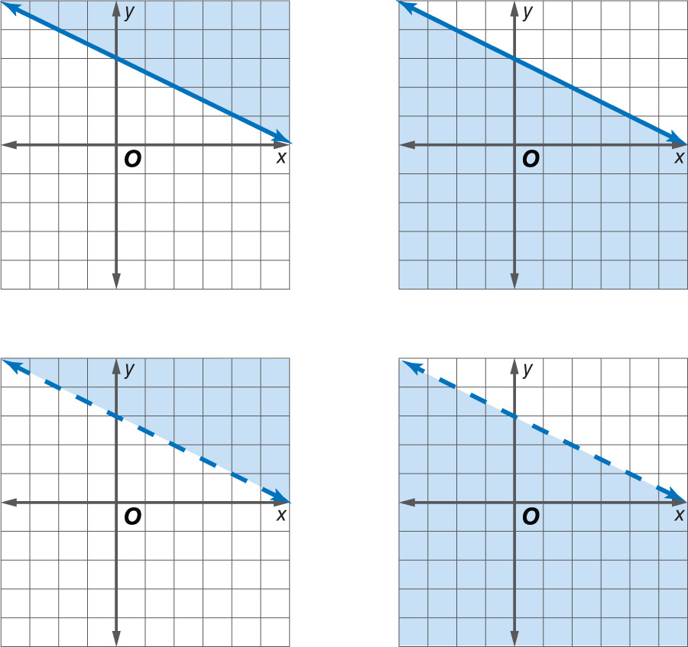
Example 2
Graph x + 2y ≥ 6.
A. B.
C. D.

Slide 20
Example 3
Solve Inequalities from Graphs
Use a graph to solve 2x + 3 ≤ 7.
Step 1 First graph the boundary, which is the related function. Replace the inequality sign with an equals sign, and solve for x.
2x + 3 ≤ 7 Original inequality
2x + 3 = 7 Change ≤ to =.
x = 2 Subtract 3 from each side
and simplify.

Slide 21
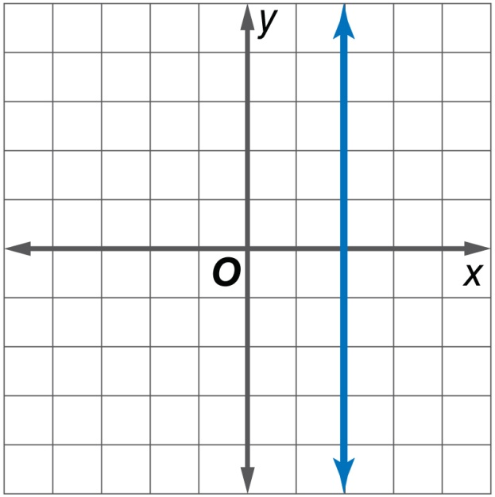
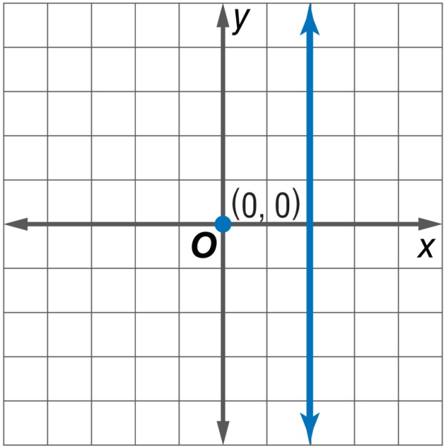
Example 3
Solve Inequalities from Graphs
Graph x = 2 with a solid line.
Step 2 Choose (0, 0) as a test point. These values in the original inequality give us 3 ≤ 7.

Slide 22
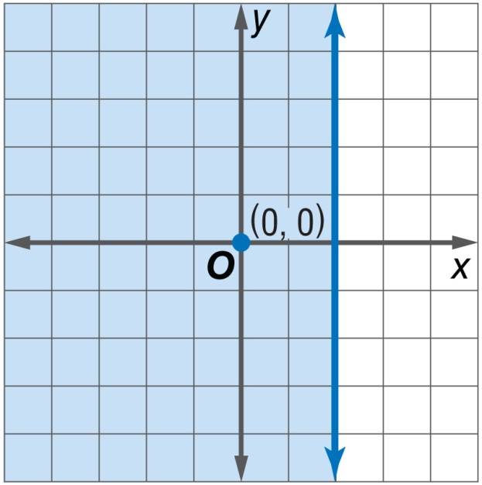
Example 3
Solve Inequalities from Graphs
Step 3 Since this statement is true, shade the half-plane containing the point (0, 0).

Slide 23
Example 3
Solve Inequalities from Graphs
Notice the x-intercept of the graph is at 2. Since the half-plane to the left of the x-intercept is shaded, the solution is x ≤ 2.
Answer:

Slide 24
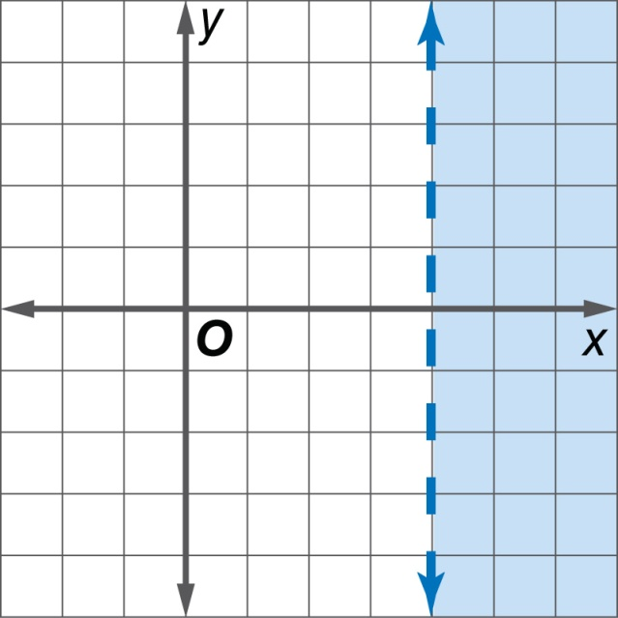
Example 3
Use a graph to solve 5x – 3 > 17.
A. x > 20
B. x > 3
C. x < –4
D. x > 4

Slide 25
Example 4
Write and Solve an Inequality
JOURNALISM Ranjan writes and edits short articles for a local newspaper. It takes him about an hour to write an article and about a half-hour to edit an article. If Ranjan works up to 8 hours a day, how many articles can he write and edit in one day?
Understand You know how long it takes him to write and edit an article and how long he works each day.

Slide 26

Example 4
Write and Solve an Inequality
Plan Let x equal the number of articles Ranjan can write. Let y equal the number of articles that Ranjan can edit. Write an open sentence representing the situation.
Number of articles he
can write
number of articles he can edit
is up to
plus
hour
times
8 hours.
x
+
●
y
≤
8

Slide 27
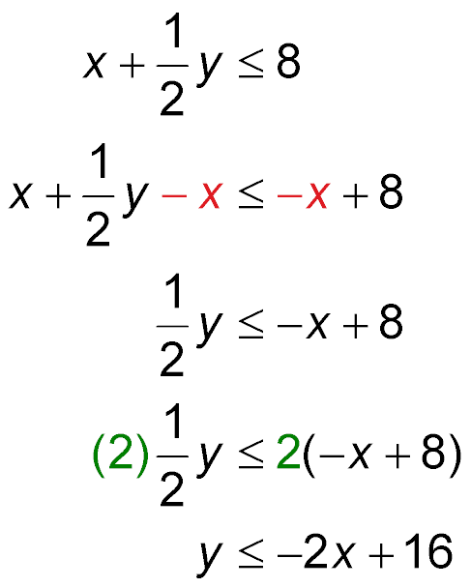
Example 4
Write and Solve an Inequality
Solve Solve for y in terms of x.
Original inequality
Subtract x from each side.
Simplify.
Multiply each side by 2.
Simplify.

Slide 28
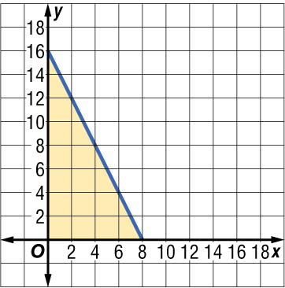
Example 4
Write and Solve an Inequality
Since the open sentence includes the equation, graph y = –2x +16 as a solid line. Test a point in one of the half-planes, for example, (0, 0). Shade the half-plane containing (0, 0) since 0 ≤ –2(0) + 16 is true.
Answer:

Slide 29
Example 4
Write and Solve an Inequality
Check Examine the situation.
• Ranjan cannot work a negative number of hours. Therefore, the domain and range contain only nonnegative numbers.
• Ranjan only wants to count articles that are completely written or completely edited. Thus, only points in the half-plane whose x- and y-coordinates are whole numbers are possible solutions.
• One solution is (2, 3). This represents
2 written articles and 3 edited articles.

Slide 30
Example 4
FOOD You offer to go to the local deli and pick up sandwiches for lunch. You have $30 to spend. Chicken sandwiches cost $3.00 each and tuna sandwiches are $1.50 each. How many sandwiches can you purchase for $30?
A. 11 chicken sandwiches,
1 tuna sandwich
B. 12 chicken sandwiches,
3 tuna sandwiches
C. 3 chicken sandwiches,
15 tuna sandwiches
D. 5 chicken sandwiches,
9 tuna sandwiches

Slide 31
End of the Lesson

