Slide 1


Splash Screen

Slide 2
Lesson Menu
Five-Minute Check (over Chapter 5)
CCSS
Then/Now
New Vocabulary
Concept Summary: Possible Solutions
Example 1: Number of Solutions
Example 2: Solve by Graphing
Example 3: Real-World Example: Write and Solve a System of Equations

Slide 3

5-Minute Check 1
Solve the inequality –7x < –9x + 14.
A. {x | x < 2}
B. {x | x > 2}
C. {x | x < 7}
D. {x | x > 9}

Slide 4
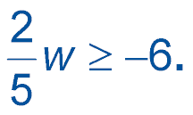

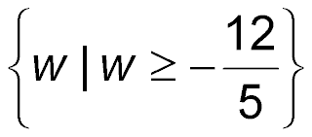
5-Minute Check 2
Solve the inequality
A. {w | w ≥ –15}
B. {w | w ≥ –30}
C.
D. {w | ≤ 15}

Slide 5

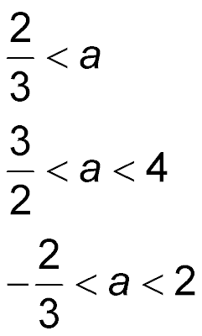
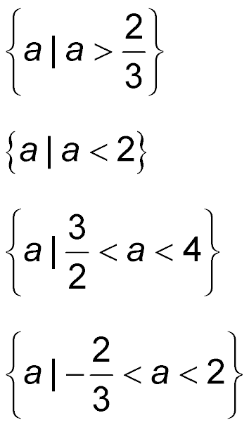
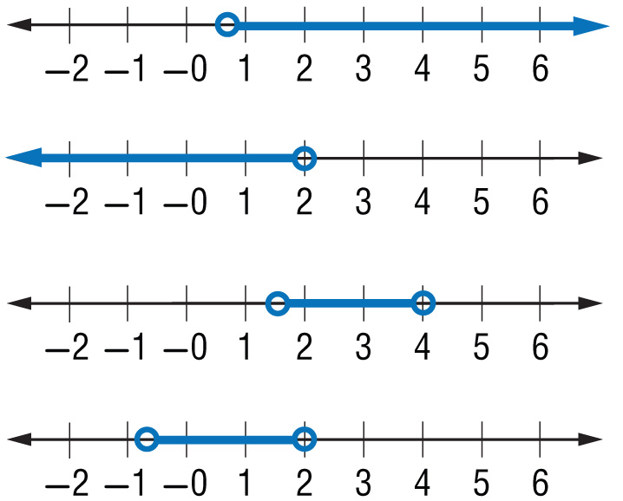
5-Minute Check 3
Solve │3a – 2│< 4. Then graph
the solution set.
A.
B.
C.
D.

Slide 6

5-Minute Check 4
Write an inequality, and then solve the following.
Ten less than five times a number is greater than ten.
A. 5n > 10; n > 2
B. 5n – 10 > 10; n > 4
C. 5n – 10 < 10; n < 4
D. 5n < 10; n < 2

Slide 7

5-Minute Check 5
Lori had a quarter and some nickels in her pocket, but she had less than $0.80. What is the greatest number of nickels she could have had?
A. 12 nickels
B. 11 nickels
C. 10 nickels
D. 9 nickels

Slide 8

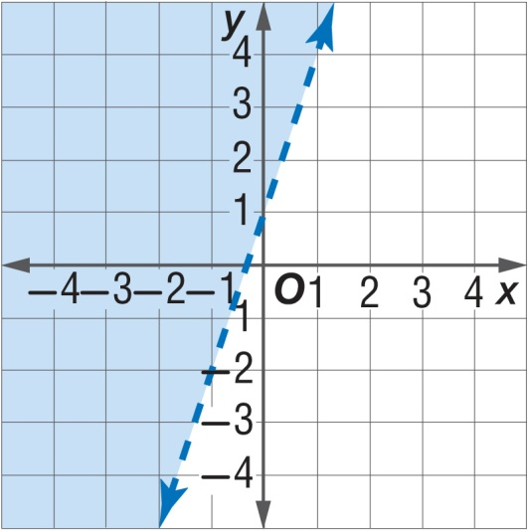
5-Minute Check 6
Which inequality does this graph represent?
A. 3x – y < 1
B. –3x + y > 1
C. 2x – y > 3
D. –2x + y < 1

Slide 9

CCSS
Content Standards
A.CED.3 Represent constraints by equations or inequalities, and by systems of equations and/or inequalities, and interpret solutions as viable or nonviable options in a modeling context.
A.REI.6 Solve systems of linear equations exactly and approximately (e.g., with graphs), focusing on pairs of linear equations in two variables.
Mathematical Practices
3 Construct viable arguments and critique the reasoning of others.
8 Look for and express regularity in repeated reasoning.
Common Core State Standards © Copyright 2010. National Governors Association Center for Best Practices and Council of Chief State School Officers. All rights reserved.

Slide 10


Then/Now
You graphed linear equations.
Determine the number of solutions a system of linear equations has.
Solve systems of linear equations by graphing.

Slide 11

Vocabulary
system of equations
consistent
independent
dependent
inconsistent

Slide 12
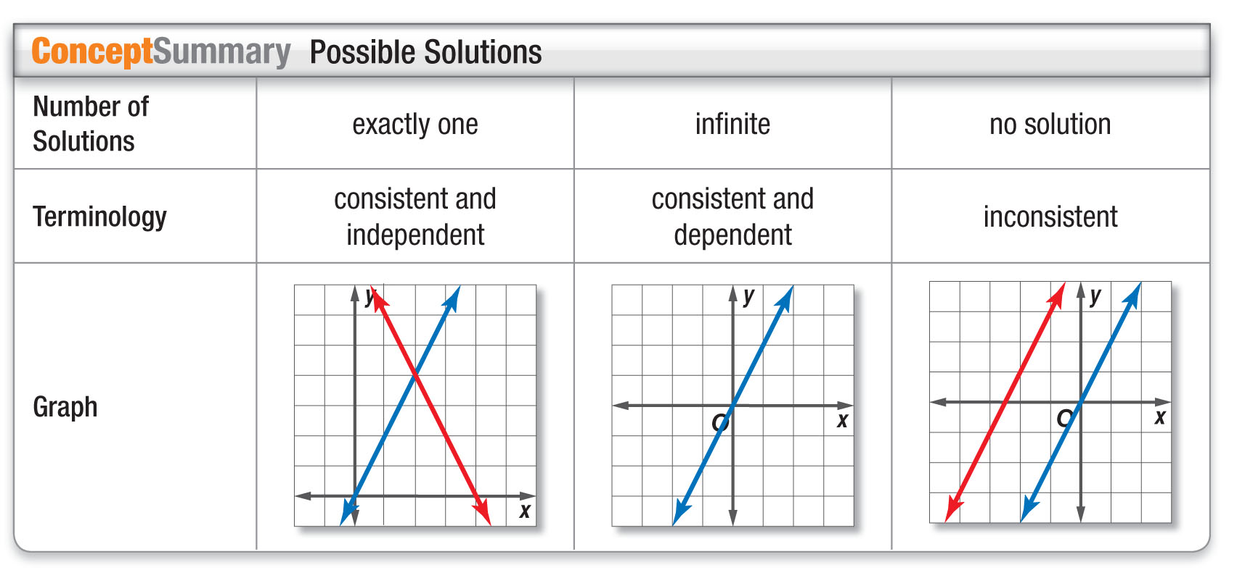
Concept

Slide 13
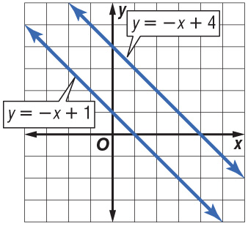
Example 1A
Number of Solutions
A. Use the graph to determine whether the system is consistent or inconsistent and if it is independent or dependent.
y = –x + 1
y = –x + 4
Answer: The graphs are parallel, so there is no solution. The system is inconsistent.

Slide 14
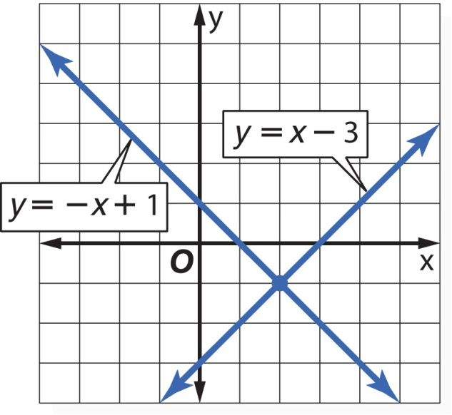
Example 1B
Number of Solutions
B. Use the graph to determine whether the system is consistent or inconsistent and if it is independent or dependent.
y = x – 3
y = –x + 1
Answer: The graphs intersect at one point, so there is exactly one solution. The system is consistent and independent.

Slide 15


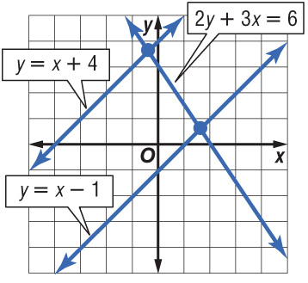
Example 1A
A. Use the graph to determine whether the system is consistent or inconsistent and if it is independent or dependent.
2y + 3x = 6
y = x – 1
A. consistent and independent
B. inconsistent
C. consistent and dependent
D. cannot be determined

Slide 16
Example 1B
B. Use the graph to determine whether the system is consistent or inconsistent and if it is independent or dependent.
y = x + 4
y = x – 1
A. consistent and independent
B. inconsistent
C. consistent and dependent
D. cannot be determined

Slide 17
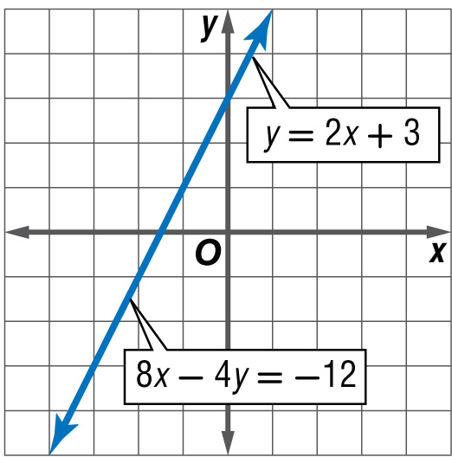
Example 2A
Solve by Graphing
A. Graph the system of equations. Then determine whether the system has no solution, one solution, or infinitely many solutions. If
the system has one solution, name it.
y = 2x + 3
8x – 4y = –12
Answer: The graphs coincide. There are infinitely many solutions of this system of equations.

Slide 18
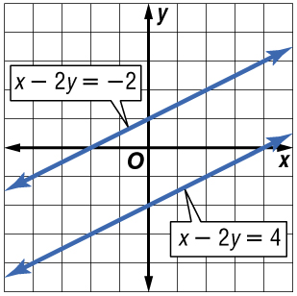
Example 2B
Solve by Graphing
B. Graph the system of equations. Then determine whether the system has no solution, one solution, or infinitely many solutions. If
the system has one solution, name it.
x – 2y = 4
x – 2y = –2
Answer: The graphs are parallel lines. Since they do not intersect, there are no solutions of this system of equations.

Slide 19
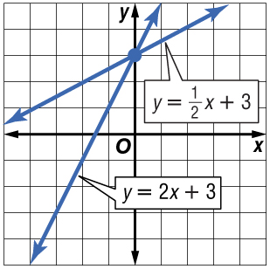
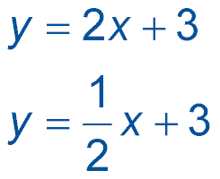
Example 2A
A. Graph the system of equations. Then determine whether the system has no solution, one solution, or infinitely many solutions. If the system has one solution, name it.
A. one; (0, 3)
B. no solution
C. infinitely many
D. one; (3, 3)

Slide 20
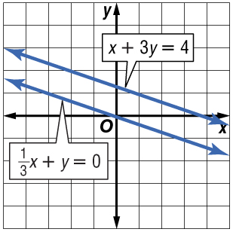
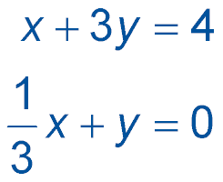
Example 2B
B. Graph the system of equations. Then determine whether the system has no solution, one solution, or infinitely many solutions. If the system has one solution, name it.
A. one; (0, 0)
B. no solution
C. infinitely many
D. one; (1, 3)

Slide 21
Example 3
Write and Solve a System of Equations
BICYCLING Naresh rode 20 miles last week and plans to ride 35 miles per week. Diego rode 50 miles last week and plans to ride 25 miles per week. Predict the week in which Naresh and Diego will have ridden the same number of miles.

Slide 22
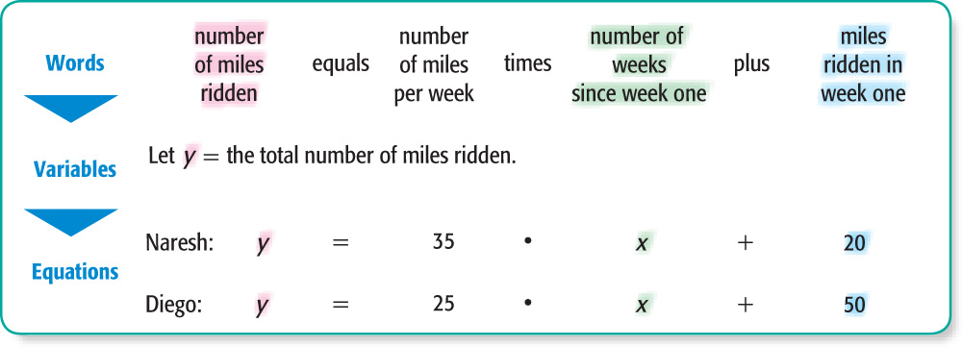
Example 3
Write and Solve a System of Equations

Slide 23
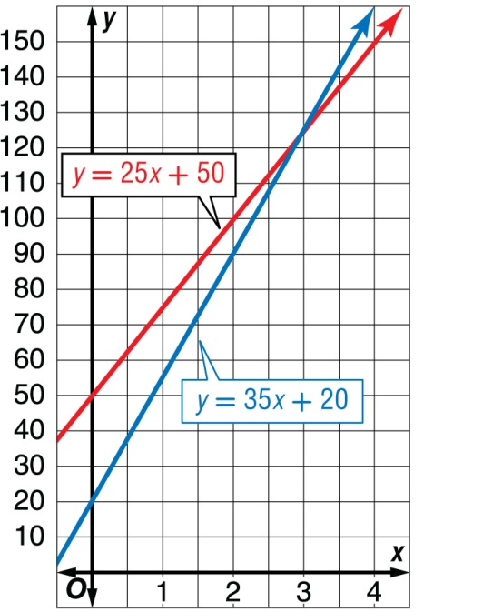
Example 3
Write and Solve a System of Equations
Graph the equations y = 35x + 20 and y = 25x + 50.
The graphs appear to intersect at the point with the coordinates (3, 125). Check this estimate by replacing
x with 3 and y with 125 in each equation.

Slide 24
Example 3
Write and Solve a System of Equations
Check y = 35x + 20 y = 25x + 50
125 = 35(3) + 20 125 = 25(3) + 50
✓
✓
125 = 125 125 = 125
Answer: The solution means that in week 3, Naresh and Diego will have ridden the same number of miles, 125.

Slide 25
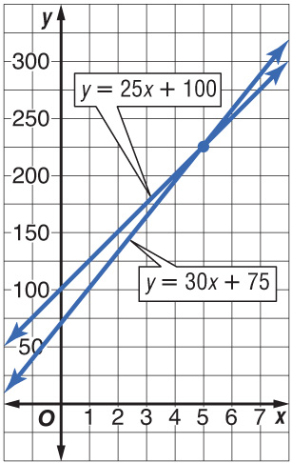
Example 3
Alex and Amber are both saving money for a summer vacation. Alex has already saved $100 and plans to save $25 per week until the trip. Amber has $75 and plans to save $30 per week. In how many weeks will Alex and Amber have the same amount of money?
A. 225 weeks
B. 7 weeks
C. 5 weeks
D. 20 weeks

Slide 26
End of the Lesson

