Slide 1


Splash Screen

Slide 2
Lesson Menu
Five-Minute Check (over Lesson 6–1)
CCSS
Then/Now
New Vocabulary
Key Concept: Solving by Substitution
Example 1: Solve a System by Substitution
Example 2: Solve and then Substitute
Example 3: No Solution or Infinitely Many Solutions
Example 4: Real-World Example: Write and Solve a System of Equations

Slide 3

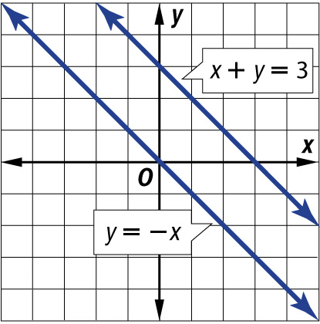
5-Minute Check 1
Graph the system of equations. Then determine whether the system has no solution, one solution, or infinitely many solutions. If the system has one solution, name it.
x + y = 3
y = –x
A. one; (1, –1)
B. one; (2, 2)
C. infinitely many solutions
D. no solution

Slide 4

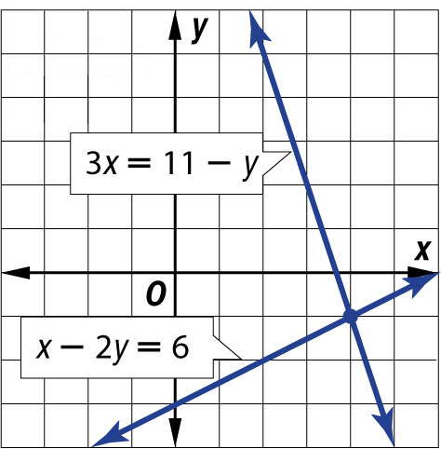
5-Minute Check 2
Graph the system of equations. Then determine whether the system has no solution, one solution, or infinitely many solutions. If the system has one solution, name it.
3x = 11 – y
x – 2y = 6
A. one; (4, –1)
B. one; (2, 2)
C. infinitely many solutions
D. no solution

Slide 5

5-Minute Check 3
Today Tom has $100 in his savings account, and plans to put $25 in the account every week. Maria has nothing in her account, but plans to put $50 in her account every week. In how many weeks will they have the same amount in their accounts? How much will each person have saved at that time?
A. 6 weeks; $300
B. 5 weeks; $250
C. 4 weeks; $200
D. 3 weeks; $150

Slide 6

5-Minute Check 4
What is the solution to the system of equations
y = 2x + 1 and y = –x – 2?
A. (0, –1)
B. (0, 1)
C. (–1, –1)
D. (1, 0)

Slide 7

CCSS
Content Standards
A.CED.3 Represent constraints by equations or inequalities, and by systems of equations and/or inequalities, and interpret solutions as viable or nonviable options in a modeling context.
A.REI.6 Solve systems of linear equations exactly and approximately (e.g., with graphs), focusing on pairs of linear equations in two variables.
Mathematical Practices
2 Reason abstractly and quantitatively.
Common Core State Standards © Copyright 2010. National Governors Association Center for Best Practices and Council of Chief State School Officers. All rights reserved.

Slide 8


Then/Now
You solved systems of equations by graphing.
Solve systems of equations by using substitution.
Solve real-world problems involving systems of equations by using substitution.

Slide 9

Vocabulary
substitution

Slide 10
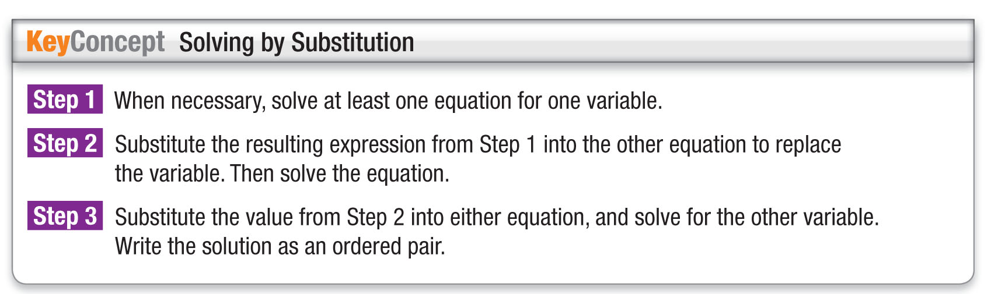
Concept

Slide 11
Example 1
Solve a System by Substitution
Use substitution to solve the system of equations.
y = –4x + 12
2x + y = 2
Substitute –4x + 12 for y in the second equation.
2x + y = 2 Second equation
2x + (–4x + 12) = 2 y = –4x + 12
2x – 4x + 12 = 2 Simplify.
–2x + 12 = 2 Combine like terms.
–2x = –10 Subtract 12 from each side.
x = 5 Divide each side by –2.

Slide 12
Example 1
Solve a System by Substitution
Substitute 5 for x in either equation to find y.
y = –4x + 12 First equation
y = –4(5) + 12 Substitute 5 for x.
y = –8 Simplify.
Answer: The solution is (5, –8).

Slide 13


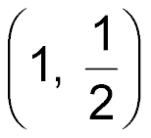
Example 1
Use substitution to solve the system of equations.
y = 2x
3x + 4y = 11
A.
B. (1, 2)
C. (2, 1)
D. (0, 0)

Slide 14
Example 2
Solve and then Substitute
Use substitution to solve the system of equations.
x – 2y = –3
3x + 5y = 24
Step 1 Solve the first equation for x since the
coefficient is 1.
x – 2y = –3 First equation
x – 2y + 2y = –3 + 2y Add 2y to each side.
x = –3 + 2y Simplify.

Slide 15
Example 2
Solve and then Substitute
Step 2 Substitute –3 + 2y for x in the second
equation to find the value of y.
3x + 5y = 24 Second equation
3(–3 + 2y) + 5y = 24 Substitute –3 + 2y for x.
–9 + 6y + 5y = 24 Distributive Property
–9 + 11y = 24 Combine like terms.
–9 + 11y + 9 = 24 + 9 Add 9 to each side.
11y = 33 Simplify.
y = 3 Divide each side by 11.

Slide 16
Example 2
Solve and then Substitute
Step 3 Find the value of x.
x – 2y = –3 First equation
x – 2(3) = –3 Substitute 3 for y.
x – 6 = –3 Simplify.
x = 3 Add 6 to each side.
Answer: The solution is (3, 3).

Slide 17
Example 2
Use substitution to solve the system of equations.
3x – y = –12
–4x + 2y = 20
A. (–2, 6)
B. (–3, 3)
C. (2, 14)
D. (–1, 8)

Slide 18
Example 3
No Solution or Infinitely Many Solutions
Use substitution to solve the system of equations.
2x + 2y = 8
x + y = –2
Solve the second equation for y.
x + y = –2 Second equation
x + y – x = –2 – x Subtract x from each side.
y = –2 – x Simplify.
Substitute –2 – x for y in the first equation.
2x + 2y = 8 First equation
2x + 2(–2 – x) = 8 y = –2 – x

Slide 19
Example 3
No Solution or Infinitely Many Solutions
2x – 4 – 2x = 8 Distributive Property
–4 = 8 Simplify.
The statement –4 = 8 is false. This means there are no solutions of the system of equations.
Answer: no solution

Slide 20
Example 3
Use substitution to solve the system of equations.
3x – 2y = 3
–6x + 4y = –6
A. one; (0, 0)
B. no solution
C. infinitely many solutions
D. cannot be determined

Slide 21
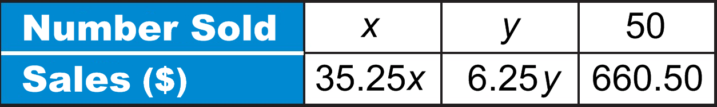
Example 4
Write and Solve a System of Equations
NATURE CENTER A nature center charges
$35.25 for a yearly membership and $6.25 for a single admission. Last week it sold a combined total of 50 yearly memberships and single admissions for $660.50. How many memberships and how many single admissions were sold?
Let x = the number of yearly memberships, and let
y = the number of single admissions.
So, the two equations are x + y = 50 and
35.25x + 6.25y = 660.50.

Slide 22
Example 4
Write and Solve a System of Equations
Step 1 Solve the first equation for x.
x + y = 50 First equation
x + y – y = 50 – y Subtract y from each side.
x = 50 – y Simplify.
Step 2 Substitute 50 – y for x in the second equation.
35.25x + 6.25y = 660.50 Second equation
35.25(50 – y) + 6.25y = 660.50 Substitute 50 – y for x.

Slide 23
Example 4
Write and Solve a System of Equations
1762.50 – 35.25y + 6.25y = 660.50 Distributive Property
1762.50 – 29y = 660.50 Combine like terms.
–29y = –1102 Subtract 1762.50 from each side.
y = 38 Divide each side by –29.

Slide 24
Example 4
Write and Solve a System of Equations
Step 3 Substitute 38 for y in either equation to find x.
x + y = 50 First equation
x + 38 = 50 Substitute 38 for y.
x = 12 Subtract 38 from each side.
Answer: The nature center sold 12 yearly memberships and 38 single admissions.

Slide 25
Example 4
CHEMISTRY Mikhail needs 10 milliliters of 25% HCl (hydrochloric acid) solution for a chemistry experiment. There is a bottle of 10% HCl solution and a bottle of 40% HCl solution in the lab. How much of each solution should he use to obtain the required amount of 25% HCl solution?
A. 0 mL of 10% solution, 10 mL of 40% solution
B. 6 mL of 10% solution, 4 mL of 40% solution
C. 5 mL of 10% solution, 5 mL of 40% solution
D. 3 mL of 10% solution, 7 mL of 40% solution

Slide 26
End of the Lesson

