Slide 1


Splash Screen

Slide 2
Lesson Menu
Five-Minute Check (over Lesson 6–2)
CCSS
Then/Now
New Vocabulary
Key Concept: Solving by Elimination
Example 1: Elimination Using Addition
Example 2: Write and Solve a System of Equations
Example 3: Elimination Using Subtraction
Example 4: Real-World Example: Write and Solve a System of Equations

Slide 3

5-Minute Check 1
Use substitution to solve the system of equations.
x = –2y
x + y = 4
A. (8, –4)
B. (2, –2)
C. infinitely many solutions
D. no solution

Slide 4

5-Minute Check 2
Use substitution to solve the system of equations.
0.3t = –0.4r + 0.1
4r + 3t = 8
A. (–1, 2)
B. (2, 4)
C. infinitely many solutions
D. no solution

Slide 5

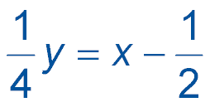
5-Minute Check 3
Use substitution to solve the system of equations.
4x – y = 2
A. (1, 2)
B. (2, 6)
C. infinitely many solutions
D. no solution

Slide 6

5-Minute Check 4
The sum of two numbers is 31. The greater number is 5 more than the lesser number. What are the two numbers?
A. 10, 15
B. 13, 18
C. 14, 19
D. 16, 21

Slide 7

5-Minute Check 5
Angles A and B are complementary, and the measure of ∠A is 14° less than the measure of ∠B. Find the measures of angles A and B.
A. A = 83°, B = 97°
B. A = 81°, B = 96°
C. A = 38°, B = 52°
D. A = 35°, B = 50°

Slide 8

5-Minute Check 6
Adult tickets to a play cost $5 and student tickets cost $4. On Saturday, the adults that paid accounted for seven more than twice the number of students that paid. The income from ticket sales was $455. How many students paid?
A. 130
B. 90
C. 80
D. 30

Slide 9

CCSS
Content Standards
A.CED.2 Create equations in two or more variables to represent relationships between quantities; graph equations on coordinate axes with labels and scales.
A.REI.6 Solve systems of linear equations exactly and approximately (e.g., with graphs), focusing on pairs of linear equations in two variables.
Mathematical Practices
7 Look for and make use of structure.
Common Core State Standards © Copyright 2010. National Governors Association Center for Best Practices and Council of Chief State School Officers. All rights reserved.

Slide 10


Then/Now
You solved systems of equations by using substitution.
Solve systems of equations by using elimination with addition.
Solve systems of equations by using elimination with subtraction.

Slide 11

Vocabulary
elimination

Slide 12
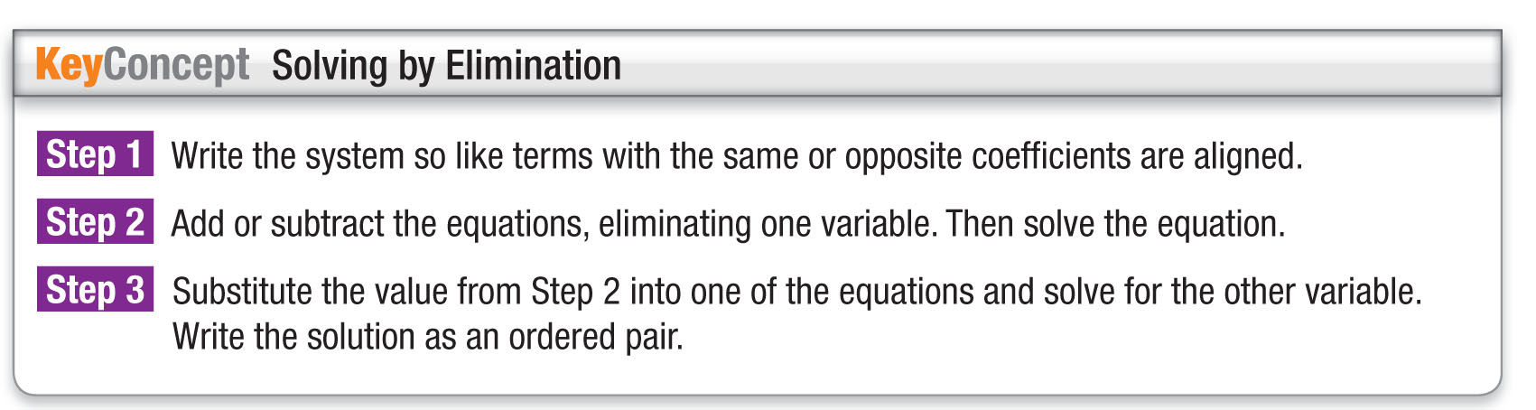
Concept

Slide 13
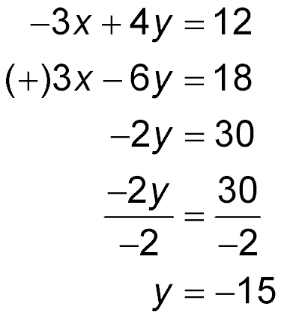
Example 1
Elimination Using Addition
Use elimination to solve the system of equations.
–3x + 4y = 12
3x – 6y = 18
Since the coefficients of the x-terms, –3 and 3, are additive inverses, you can eliminate the x-terms by adding the equations.
Write the equations in column form and add.
The x variable is eliminated.
Divide each side by –2.
y = –15 Simplify.

Slide 14
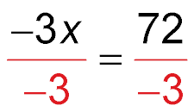
Example 1
Elimination Using Addition
Now substitute –15 for y in either equation to find the value of x.
–3x + 4y = 12 First equation
–3x + 4(–15) = 12 Replace y with –15.
–3x – 60 = 12 Simplify.
–3x – 60 + 60 = 12 + 60 Add 60 to each side.
–3x = 72 Simplify.
Divide each side by –3.
x = –24 Simplify.
Answer: The solution is (–24, –15).

Slide 15


Example 1
Use elimination to solve the system of equations.
3x – 5y = 1
2x + 5y = 9
A. (1, 2)
B. (2, 1)
C. (0, 0)
D. (2, 2)

Slide 16
Example 2
Write and Solve a System of Equations
Four times one number minus three times another number is 12. Two times the first number added to three times the second number is 6. Find the numbers.
Let x represent the first number and y represent the second number.
Four times
one number
three times
another number
minus
is
12.
4x
–
3y
=
12
Two times
the first number
three times
the second number
added to
is
6.
2x
+
3y
=
6

Slide 17
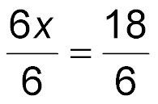
Example 2
Write and Solve a System of Equations
Use elimination to solve the system.
4x – 3y = 12
(+) 2x + 3y = 6
Write the equations in column form and add.
6x = 18 The y variable is eliminated.
Divide each side by 6.
x = 3 Simplify.
Now substitute 3 for x in either equation to find the
value of y.

Slide 18
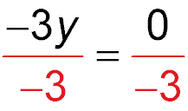
Example 2
Write and Solve a System of Equations
4x – 3y = 12 First equation
4(3) – 3y = 12 Replace x with 3.
12 – 3y = 12 Simplify.
12 – 3y – 12 = 12 – 12 Subtract 12 from each side.
–3y = 0 Simplify.
Divide each side by –3.
y = 0 Simplify.
Answer: The numbers are 3 and 0.

Slide 19
Example 2
Four times one number added to another number is
–10. Three times the first number minus the second number is –11. Find the numbers.
A. –3, 2
B. –5, –5
C. –5, –6
D. 1, 1

Slide 20
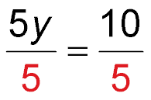
Example 3
Elimination Using Subtraction
Use elimination to solve the system of equations.
4x + 2y = 28
4x – 3y = 18
Since the coefficients of the x-terms are the same, you can eliminate the x-terms by subtracting the equations.
4x + 2y = 28
(–) 4x – 3y = 18
Write the equations in column form and subtract.
5y = 10 The x variable is eliminated.
Divide each side by 5.
y = 2 Simplify.

Slide 21
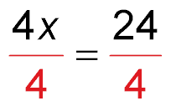
Example 3
Elimination Using Subtraction
Now substitute 2 for y in either equation to find the value of x.
4x – 3y = 18 Second equation
4x – 3(2) = 18 y = 2
4x – 6 = 18 Simplify.
4x – 6 + 6 = 18 + 6 Add 6 to each side.
4x = 24 Simplify.
Divide each side by 4.
x = 6 Simplify.
Answer: The solution is (6, 2).

Slide 22
Example 3
Use elimination to solve the system of equations.
9x – 2y = 30
x – 2y = 14
A. (2, 2)
B. (–6, –6)
C. (–6, 2)
D. (2, –6)

Slide 23
Example 4
Write and Solve a System of Equations
RENTALS A hardware store earned $956.50 from renting ladders and power tools last week. The store charged 36 days for ladders and 85 days for power tools. This week the store charged 36 days for ladders, 70 days for power tools, and earned $829. How much does the store charge per day for ladders and for power tools?
Understand You know the number of days the
ladders and power tools were rented
and the total cost for each.

Slide 24
Example 4
Write and Solve a System of Equations
Plan Let x = the cost per day for ladders
rented and y = the cost per day for
power tools rented.
Ladders Power Tools Earnings
36x + 85y = 956.50
36x + 70y = 829
Solve Subtract the equations to eliminate one
of the variables. Then solve for the
other variable.

Slide 25
Example 4
Write and Solve a System of Equations
36x + 85y = 956.50
(–) 36x + 70y = 829
Write the equations vertically.
15y = 127.5 Subtract.
y = 8.5 Divide each side by 15.
Now substitute 8.5 for y in either equation.

Slide 26
Example 4
Write and Solve a System of Equations
36x + 85y = 956.50 First equation
36x + 85(8.5) = 956.50 Substitute 8.5 for y.
36x + 722.5 = 956.50 Simplify.
36x = 234 Subtract 722.5 from
each side.
x = 6.5 Divide each side by 36.
Answer: The store charges $6.50 per day for ladders and $8.50 per day for power tools.
Check Substitute both values into the other equation to see if the equation holds true. If x = 6.5 and y = 8.5, then 36(6.5) + 70(8.5) = 829.

Slide 27
Example 4
FUNDRAISING For a school fundraiser, Marcus and Anisa participated in a walk-a-thon. In the morning, Marcus walked 11 miles and Anisa walked 13. Together they raised $523.50. After lunch, Marcus walked 14 miles and Anisa walked 13. In the afternoon they raised $586.50. How much did each raise per mile of the walk-a-thon?
A. Marcus: $22.00, Anisa: $21.65
B. Marcus: $21.00, Anisa: $22.50
C. Marcus: $24.00, Anisa: $20.00
D. Marcus: $20.75, Anisa: $22.75

Slide 28
End of the Lesson

