Slide 1


Splash Screen

Slide 2
Lesson Menu
Five-Minute Check (over Lesson 6–3)
CCSS
Then/Now
Key Concept: Solving by Elimination
Example 1: Multiply One Equation to Eliminate a Variable
Example 2: Multiply Both Equations to Eliminate a Variable
Example 3: Real-World Example: Solve a System of Equations

Slide 3

5-Minute Check 1
Use elimination to solve the system of equations.
5x + y = 9
3x – y = 7
A. (2, –1)
B. (–2, 1)
C. (4, –3)
D. (5, –2)

Slide 4

5-Minute Check 2
Use elimination to solve the system of equations.
2x + 4y = –8
2x + y = 1
A. (3, –2)
B. (2, –3)
C. (1, 3)
D. (–1, 2)

Slide 5

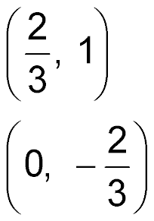
5-Minute Check 3
Use elimination to solve the system of equations.
x – 3y = 2
6x + 3y = –2
A.
B. (0, 1)
C.
D. (–1, 3)

Slide 6

5-Minute Check 4
Find two numbers that have a sum of 151 and a difference of 7.
A. 67, 84
B. 69, 82
C. 71, 80
D. 72, 79

Slide 7

5-Minute Check 5
The student council sold pennants and pom-poms. The pom-poms cost $0.75 more than the pennants. Two pennants and two pom-poms cost $6.50. What are the prices for the pennants and the pom-poms?
pennants = $1.50
pom poms = $2.25
B. pennants = $1.25
pom poms = $2.00
C. pennants = $1.10
pom poms = $2.10
D. pennants = $1.00
pom poms = $1.50

Slide 8

5-Minute Check 6
Solve the system of equations below by using the elimination method.
x – 3y = 15
4x + 3y = 15
A. (6, –3)
B. (9, –2)
C. (3, 1)
D. (–3, 6)

Slide 9

CCSS
Content Standards
A.REI.5 Prove that, given a system of two equations in two variables, replacing one equation by the sum of that equation and a multiple of the other produces a system with the same solutions.
A.REI.6 Solve systems of linear equations exactly and approximately (e.g., with graphs), focusing on pairs of linear equations in two variables.
Mathematical Practices
1 Make sense of problems and persevere in solving them.
Common Core State Standards © Copyright 2010. National Governors Association Center for Best Practices and Council of Chief State School Officers. All rights reserved.

Slide 10


Then/Now
You used elimination with addition and subtraction to solve systems of equations.
Solve systems of equations by using elimination with multiplication.
Solve real-world problems involving systems of equations.

Slide 11
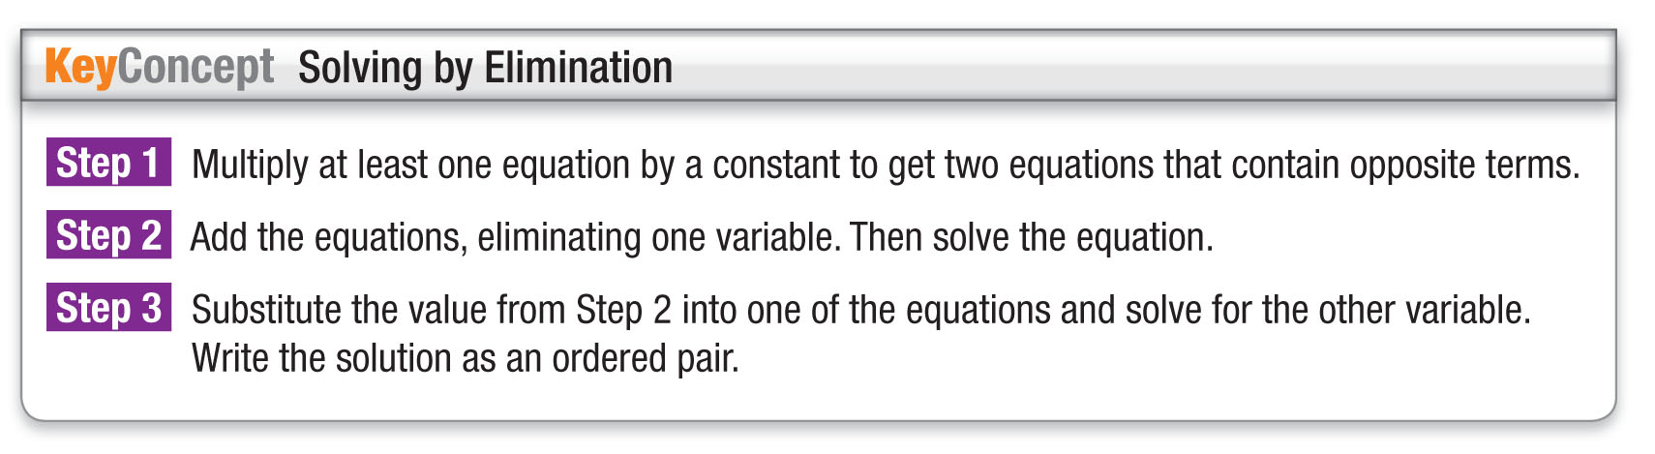
Concept

Slide 12
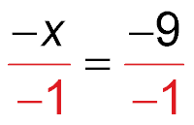
Example 1
Multiply One Equation to Eliminate a Variable
Use elimination to solve the system of equations.
2x + y = 23
3x + 2y = 37
Multiply the first equation by –2 so the coefficients of the
y terms are additive inverses. Then add the equations.
2x + y = 23
3x + 2y = 37
–4x – 2y = –46 Multiply by –2.
(+) 3x + 2y = 37
–x = –9 Add the equations.
Divide each side
by –1.
x = 9 Simplify.

Slide 13
Example 1
Multiply One Equation to Eliminate a Variable
Now substitute 9 for x in either equation to find the
value of y.
2x + y = 23 First equation
2(9) + y = 23 x = 9
18 + y = 23 Simplify.
18 + y – 18 = 23 – 18 Subtract 18 from each side.
y = 5 Simplify.
Answer: The solution is (9, 5).

Slide 14


Example 1
Use elimination to solve the system of equations.
x + 7y = 12
3x – 5y = 10
A. (1, 5)
B. (5, 1)
C. (5, 5)
D. (1, 1)

Slide 15
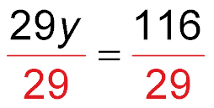
Example 2
Multiply Both Equations to Eliminate a Variable
Use elimination to solve the system of equations.
4x + 3y = 8
3x – 5y = –23
Method 1 Eliminate x.
4x + 3y = 8
3x – 5y = –23
12x + 9y = 24 Multiply by 3.
(+)–12x + 20y = 92 Multiply by –4.
29y = 116 Add the equations.
Divide each side
by 29.
y = 4 Simplify.

Slide 16
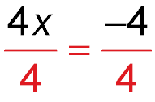
Example 2
Multiply Both Equations to Eliminate a Variable
Now substitute 4 for y in either equation to find x.
4x + 3y = 8 First equation
4x + 3(4) = 8 y = 4
4x + 12 = 8 Simplify.
4x + 12 – 12 = 8 – 12 Subtract 12 from each side.
4x = –4 Simplify.
Divide each side by 4.
x = –1 Simplify.
Answer: The solution is (–1, 4).

Slide 17
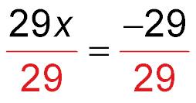
Example 2
Multiply Both Equations to Eliminate a Variable
Method 2 Eliminate y.
4x + 3y = 8
3x – 5y = –23
20x + 15y = 40 Multiply by 5.
(+) 9x – 15y = –69 Multiply by 3.
29x = –29 Add the equations.
Divide each side
by 29.
x = –1 Simplify.
Now substitute –1 for x in either equation.

Slide 18
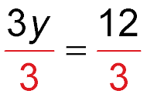
Example 2
Multiply Both Equations to Eliminate a Variable
4x + 3y = 8 First equation
4(–1) + 3y = 8 x = –1
–4 + 3y = 8 Simplify.
–4 + 3y + 4 = 8 + 4 Add 4 to each side.
3y = 12 Simplify.
Divide each side by 3.
y = 4 Simplify.
Answer: The solution is (–1, 4), which matches the result obtained with Method 1.

Slide 19
Example 2
Use elimination to solve the system of equations.
3x + 2y = 10
2x + 5y = 3
A. (–4, 1)
B. (–1, 4)
C. (4, –1)
D. (–4, –1)

Slide 20
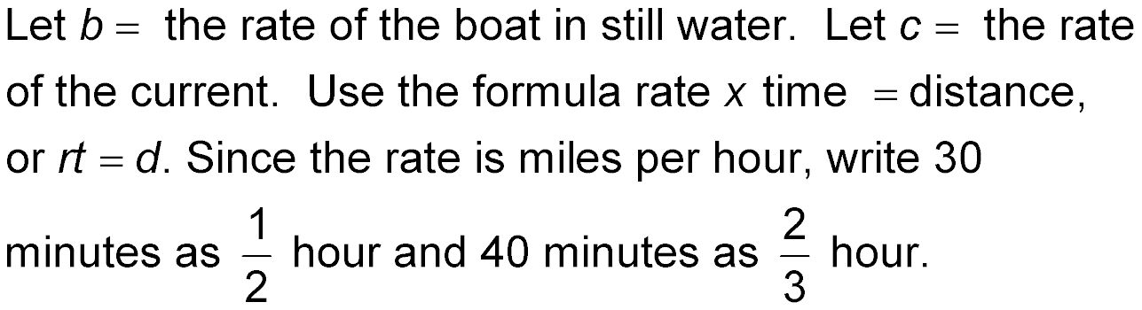

Example 3
Solve a System of Equations
TRANSPORTATION A fishing boat travels
10 miles downstream in 30 minutes. The return trip takes the boat 40 minutes. Find the rate in miles per hour of the boat in still water.

Slide 21

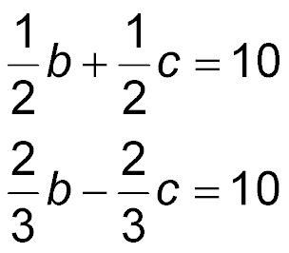
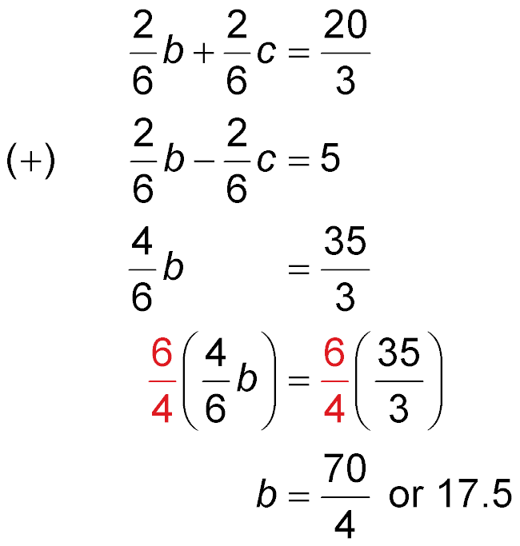
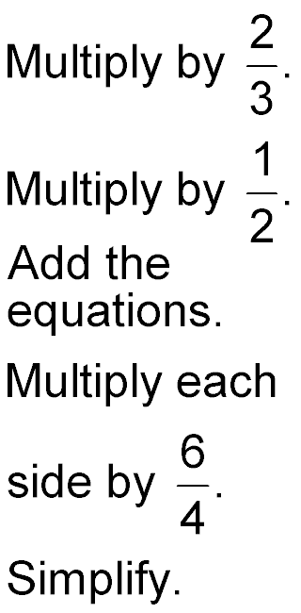
Example 3
Solve a System of Equations
Use elimination with multiplication to solve this system. Since the problem asks for b, eliminate c.

Slide 22
Example 3
Solve a System of Equations
Answer: The rate of the boat in still water is 17.5 mph.

Slide 23
Example 3
TRANSPORTATION A helicopter travels 360 miles with the wind in 3 hours. The return trip against the wind takes the helicopter 4 hours. Find the rate of the helicopter in still air.
A. 103 mph
B. 105 mph
C. 100 mph
D. 17.5 mph

Slide 24
End of the Lesson

