Slide 1


Splash Screen

Slide 2
Lesson Menu
Five-Minute Check (over Lesson 6–4)
CCSS
Then/Now
Concept Summary: Solving Systems of Equations
Example 1: Choose the Best Method
Example 2: Real-World Example: Apply Systems of Linear Equations

Slide 3

5-Minute Check 1
Use elimination to solve the system of equations.
2a + b = 19
3a – 2b = –3
A. (9, 5)
B. (6, 5)
C. (5, 9)
D. no solution

Slide 4

5-Minute Check 2
Use elimination to solve the system of equations.
4x + 7y = 30
2x – 5y = –36
A. (–3, 6)
B. (–3, 2)
C. (6, 4)
D. no solution

Slide 5

5-Minute Check 3
Use elimination to solve the system of equations.
2x + y = 3
–x + 3y = –12
A. (2, –2)
B. (3, –3)
C. (9, 2)
D. no solution

Slide 6

5-Minute Check 4
Use elimination to solve the system of equations.
8x + 12y = 1
2x + 3y = 6
A. (3, 1)
B. (3, 2)
C. (3, 4)
D. no solution

Slide 7

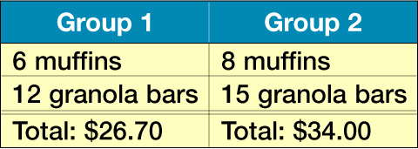
5-Minute Check 5
Two hiking groups made the purchases shown in the chart. What is the cost of each item?
muffin, $1.60;
granola bar, $1.25
B. muffin, $1.25;
granola bar, $1.60
C. muffin, $1.30;
granola bar, $1.50
D. muffin, $1.50;
granola bar, $1.30

Slide 8

5-Minute Check 6
Find the solution to the system of equations.
–2x + y = 5
–6x + 4y = 18
A. (2, 8)
B. (–2, 1)
C. (3, –1)
D. (–1, 3)

Slide 9

CCSS
Content Standards
A.REI.6 Solve systems of linear equations exactly and approximately (e.g., with graphs), focusing on pairs of linear equations in two variables.
Mathematical Practices
2 Reason abstractly and quantitatively.
4 Model with mathematics.
Common Core State Standards © Copyright 2010. National Governors Association Center for Best Practices and Council of Chief State School Officers. All rights reserved.

Slide 10


Then/Now
You solved systems of equations by using substitution and elimination.
Determine the best method for solving systems of equations.
Apply systems of equations.

Slide 11
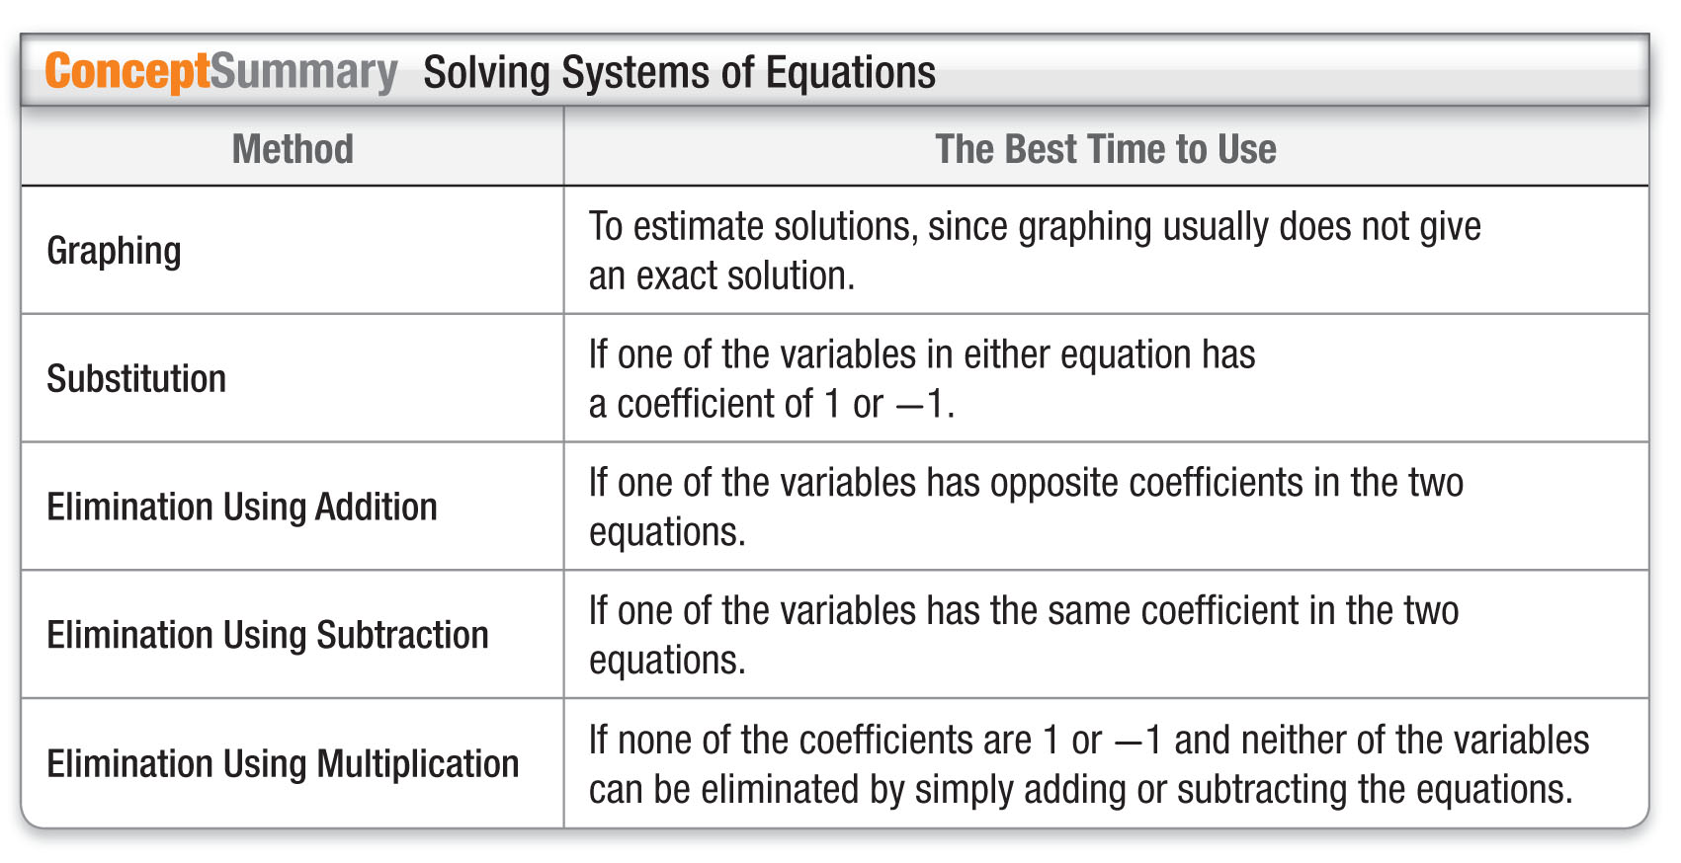
Concept

Slide 12
Example 1
Choose the Best Method
Determine the best method to solve the system of equations. Then solve the system.
2x + 3y = 23
4x + 2y = 34
Understand
To determine the best method to solve the system of equations, look closely at the coefficients of each term.
Plan
Since neither the coefficients of x nor the coefficients of
y are 1 or –1, you should not use the substitution method.
Since the coefficients are not the same for either
x or y, you will need to use elimination with multiplication.

Slide 13
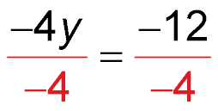
Example 1
Choose the Best Method
Solve
Multiply the first equation by –2 so the coefficients of the x-terms are additive inverses. Then add the equations.
2x + 3y = 23
4x + 2y = 34
–4x – 6y = –46 Multiply by –2.
(+) 4x + 2y = 34
–4y = –12 Add the equations.
Divide each side
by –4.
y = 3 Simplify.

Slide 14
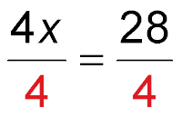
Example 1
Choose the Best Method
Now substitute 3 for y in either equation to find the value of x.
4x + 2y = 34 Second equation
4x + 2(3) = 34 y = 3
4x + 6 = 34 Simplify.
4x + 6 – 6 = 34 – 6 Subtract 6 from each side.
4x = 28 Simplify.
Divide each side by 4.
x = 7 Simplify.
Answer: The solution is (7, 3).

Slide 15
Example 1
Choose the Best Method
Check
Substitute (7, 3) for (x, y) in the first equation.
2x + 3y = 23 First equation
2(7) + 3(3) = 23 Substitute (7, 3) for (x, y).
23 = 23 ✓ Simplify.
?

Slide 16


Example 1
POOL PARTY At the school pool party, Mr. Lewis bought 1 adult ticket and 2 child tickets for $10.
Mrs. Vroom bought 2 adult tickets and 3 child tickets for $17. The following system can be used to represent this situation, where x is the number of adult tickets and y is the number of child tickets. Determine the best method to solve the system of equations. Then solve the system.
x + 2y = 10
2x + 3y = 17
A. substitution; (4, 3)
B. substitution; (4, 4)
C. elimination; (3, 3)
D. elimination; (–4, –3)

Slide 17
Example 2
Apply Systems of Linear Equations
CAR RENTAL Ace Car Rental rents a car for $45 and $0.25 per mile. Star Car Rental rents a car for $35 and $0.30 per mile. How many miles would a driver need to drive before the cost of renting a car at Ace Car Rental and renting a car at Star Car Rental were the same?
Let x = number of miles and y = cost of renting a car.
y = 45 + 0.25x
y = 35 + 0.30x

Slide 18
Example 2
Apply Systems of Linear Equations
Subtract the equations to eliminate the y variable.
y = 45 + 0.25x
(–) y = 35 + 0.30x Write the equations
vertically and subtract.
0 = 10 – 0.05x
–10 = –0.05x Subtract 10 from each side.
200 = x Divide each side by –0.05.

Slide 19
Example 2
Apply Systems of Linear Equations
Substitute 200 for x in one of the equations.
y = 45 + 0.25x First equation
y = 45 + 0.25(200) Substitute 200 for x.
y = 45 + 50 Simplify.
y = 95 Add 45 and 50.
Answer: The solution is (200, 95). This means that when the car has been driven 200 miles, the cost of renting a car will be the same ($95) at both rental companies.

Slide 20
Example 2
VIDEO GAMES The cost to rent a video game from Action Video is $2 plus $0.50 per day. The cost to rent a video game at TeeVee Rentals is $1 plus $0.75 per day. After how many days will the cost of renting a video game at Action Video be the same as the cost of renting a video game at TeeVee Rentals?
A. 8 days
B. 4 days
C. 2 days
D. 1 day

Slide 21
End of the Lesson

