Slide 1


Splash Screen

Slide 2
Lesson Menu
Five-Minute Check (over Lesson 6–5)
CCSS
Then/Now
New Vocabulary
Example 1: Solve by Graphing
Example 2: No Solution
Example 3: Real-World Example: Whole-Number Solutions

Slide 3

5-Minute Check 1
Solve the system of equations.
y = 2x – 7
y = –3x + 3
A. (–1, 0)
B. (0, 7)
C. (1, –5)
D. (2, –3)

Slide 4

5-Minute Check 2
Solve the system of equations.
3y – 2x = 12
2y + x = 8
A. (4, 4)
B. (2, 4)
C. (0, 4)
D. (–1, 2)

Slide 5

5-Minute Check 3
Solve the system of equations.
5x – 2y = 18
x + 2y = –6
A. (2, –4)
B. (2, –3)
C. (1, 3)
D. (0, 9)

Slide 6

5-Minute Check 4
Solve the system of equations.
4x – 2y = 6
6x + 4y = 16
A. (–1, –3)
B. (0, 4)
C. (1, 2)
D. (2, 1)

Slide 7

5-Minute Check 5
In a basketball game, Isha made a total of 23
2-point and 3-point baskets. She scored a total of 54 points. Find the number of 2-point and 3-point baskets Isha made.
15 2-point baskets,
8 3-point baskets
B. 8 2-point baskets,
3 3-point baskets
C. 16 2-point baskets,
7 3-point baskets
D. 14 2-point baskets,
9 3-point baskets

Slide 8

5-Minute Check 6
T-shirts sell for $9 each and sweatshirts sell for $16 each. During a sale, a store collects $1062 for selling a combined total of 90 T-shirts and sweatshirts. How many sweatshirts were sold?
A. 28 sweatshirts
B. 41 sweatshirts
C. 36 sweatshirts
D. 38 sweatshirts

Slide 9

CCSS
Content Standards
A.REI.12 Graph the solutions to a linear inequality in two variables as a half-plane (excluding the boundary in the case of a strict inequality), and graph the solution set to a system of linear inequalities in two variables as the intersection of the corresponding half-planes.
Mathematical Practices
1 Make sense of problems and persevere in solving them.
6 Attend to precision.

Slide 10


Then/Now
You graphed and solved linear inequalities.
Graph systems of linear inequalities.
Solve systems of linear inequalities by graphing.

Slide 11

Vocabulary
system of inequalities

Slide 12
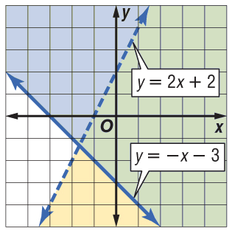
Example 1
Solve by Graphing
Solve the system of inequalities
by graphing.
y < 2x + 2
y ≥ – x – 3
Answer: The solution includes the ordered pairs in the intersection of the graphs of y < 2x + 2 and y ≥ – x – 3. The region is shaded in green. The graphs y = 2x + 2 and y = – x – 3 are boundaries of this region. The graph y = 2x + 2 is dashed and is not included in the solution. The graph of y = – x – 3 is solid and is included in the graph of the solution.

Slide 13


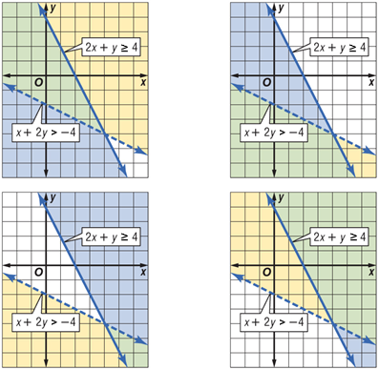
Example 1
Solve the system of inequalities by graphing
2x + y ≥ 4 and x + 2y > –4.
A. B.
C. D.

Slide 14
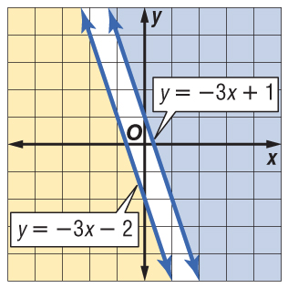
Example 2
No Solution
Solve the system of inequalities by graphing.
y ≥ –3x + 1
y ≤ –3x – 2
Answer: The graphs of y = –3x + 1 and y = –3x – 2 are parallel lines. Because the two regions have no points in common, the system of inequalities has no solution.

Slide 15
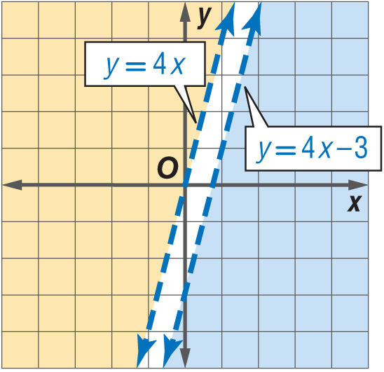

Example 2
Solve the system of inequalities by graphing.
y > 4x
y < 4x – 3
A. y > 4x
B. all real numbers
C.
D. y < 4x

Slide 16
Example 3
Whole-Number Solutions
A. SERVICE A college service organization requires that its members maintain at least a
3.0 grade point average, and volunteer at least
10 hours a week. Define the variables and write a system of inequalities to represent this situation. Then graph the system.
Let g = grade point average. So, g ≥ 3.0.
Let v = the number of volunteer hours. So, v ≥ 10.

Slide 17
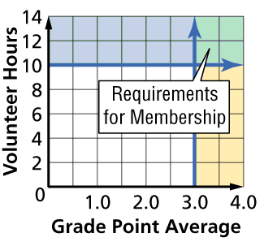
Example 3
Whole-Number Solutions
Answer: The system of inequalities is g ≥ 3.0 and
v ≥ 10.

Slide 18
Example 3
Whole-Number Solutions
B. SERVICE A college service organization requires that its members maintain at least a
3.0 grade point average, and volunteer at least 10 hours a week. Name one possible solution.
Answer: One possible solution is (3.5, 12). A grade point average of 3.5 and 12 hours of volunteering meet the requirements of the college service organization.

Slide 19
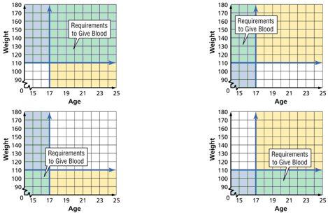
Example 3
A. The senior class is sponsoring a blood drive. Anyone who wishes to give blood must be at least 17 years old and weigh at least 110 pounds. Graph these requirements.
A. B.
C. D.

Slide 20
Example 3
B. The senior class is sponsoring a blood drive. Anyone who wished to give blood must be at least 17 years old and weigh at least 110 pounds. Choose one possible solution.
A. (16, 115)
B. (17, 105)
C. (17, 125)
D. (18, 108)

Slide 21
End of the Lesson

