Slide 1


Splash Screen

Slide 2
Lesson Menu
Five-Minute Check (over Chapter 6)
CCSS
Then/Now
New Vocabulary
Example 1: Identify Monomials
Key Concept: Product of Powers
Example 2: Product of Powers
Key Concept: Power of a Power
Example 3: Power of a Power
Key Concept: Power of a Product
Example 4: Power of a Product
Key Concept: Simplify Expressions
Example 5: Simplify Expressions

Slide 3

5-Minute Check 1
Use substitution or elimination to solve the system of equations.
r – t = –5
r + t = 25
A. (12, 13)
B. (10, 15)
C. (8, 4)
D. (6, 7)

Slide 4

5-Minute Check 2
Use substitution or elimination to solve the system of equations.
2x + y = 7
y = 0.5x + 2
A. (4, 2)
B. (3, 2)
C. (2, 2)
D. (2, 3)

Slide 5

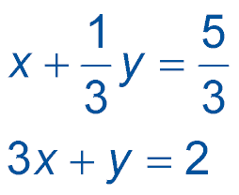
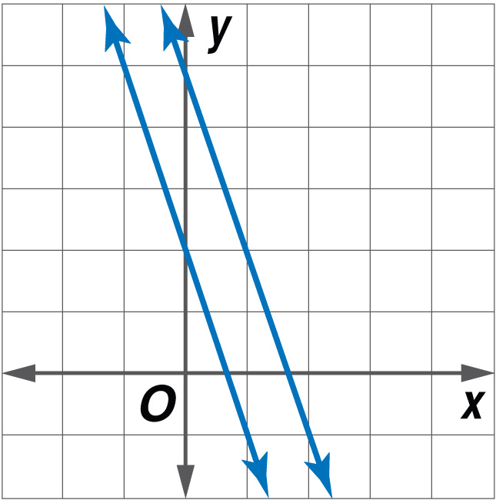
5-Minute Check 3
Graph the system of equations. How many solutions does the system of equations have?
A. no solution
B. one solution
C. infinitely many solutions

Slide 6

5-Minute Check 4
The tens digit of a two-digit number is 5 more than twice the ones digit. The sum of the digits is 8. What is the number?
A. 53
B. 62
C. 71
D. 80

Slide 7

5-Minute Check 5
What is the solution of the system of equations?
y = x + 3
y = –2x
A. (1, –2)
B. (–1, 2)
C. (2, –1)
D. (–2, 1)

Slide 8

CCSS
Content Standards
A.SSE.2 Use the structure of an expression to identify ways to rewrite it.
F.IF.8b Use the properties of exponents to interpret expressions for exponential functions.
Mathematical Practices
8 Look for and express regularity in repeated reasoning.
Common Core State Standards © Copyright 2010. National Governors Association Center for Best Practices and Council of Chief State School Officers. All rights reserved.

Slide 9


Then/Now
You performed operations on expressions with exponents.
Multiply monomials.
Simplify expressions involving monomials.

Slide 10

Vocabulary
monomial
constant

Slide 11
Example 1
Identify Monomials
Determine whether each expression is a monomial. Explain your reasoning.
A. 17 – c
B. 8f ²g
Answer: No; the expression involves subtraction, so it has more than one term.
Answer: Yes; the expression is the product of a number and two variables.
C.
3
__
Answer: Yes; the expression is a constant.
4
5
__
Answer: No; the expression involves
division by a variable.
D.
t

Slide 12



Example 1
Which expression is a monomial?
A. x⁵
B. 3p – 1
C.
D.

Slide 13
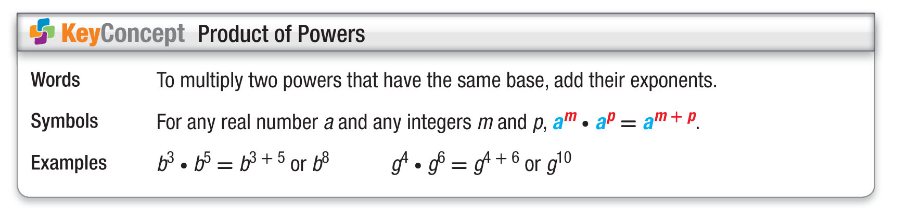
Concept

Slide 14
Example 2
Product of Powers
A. Simplify (r ⁴)(–12r ⁷).
(r ⁴)(–12r ⁷) = [1 ● (–12)](r ⁴)(r ⁷) Group the coefficients and the variables.
= [1 ● (–12)](r ⁴⁺⁷) Product of Powers
= –12r¹¹ Simplify.
Answer: –12r¹¹

Slide 15
Example 2
Product of Powers
B. Simplify (6cd ⁵)(5c⁵d²).
(6cd ⁵)(5c⁵d²) = (6 ● 5)(c ● c⁵)(d ⁵ ● d²) Group the coefficients and the variables.
= (6 ● 5)(c¹⁺⁵)(d ⁵⁺²) Product of Powers
= 30c⁶d ⁷ Simplify.
Answer: 30c⁶d ⁷

Slide 16
Example 2
A. Simplify (5x²)(4x³).
A. 9x⁵
B. 20x⁵
C. 20x⁶
D. 9x⁶

Slide 17
Example 2
B. Simplify 3xy²(–2x²y³).
A. 6xy⁵
B. –6x²y⁶
C. 1x³y⁵
D. –6x³y⁵

Slide 18
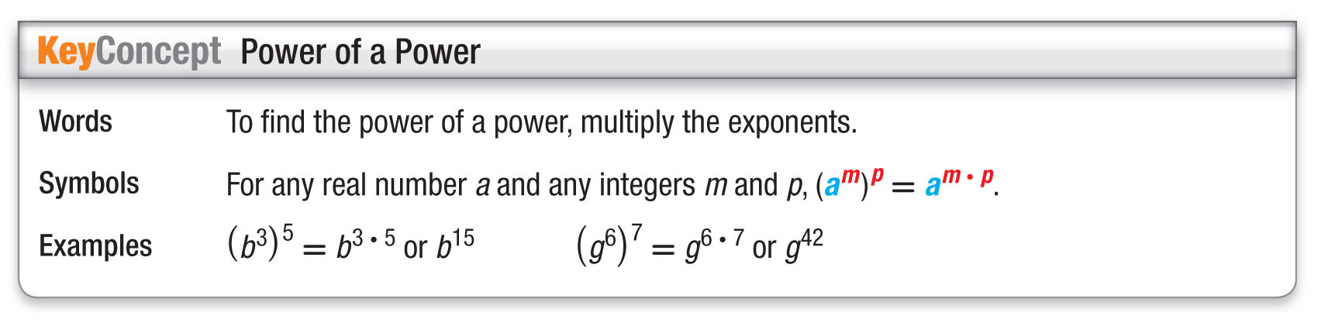
Concept

Slide 19
Example 3
Power of a Power
Simplify [(2³)³]².
[(2³)³]² = (2^{3●3})² Power of a Power
= (2⁹)² Simplify.
= 2^{9●2} Power of a Power
= 2¹⁸ or 262,144 Simplify.
Answer: 2¹⁸ or 262,144

Slide 20
Example 3
Simplify [(4²)²]³.
A. 4⁷
B. 4⁸
C. 4¹²
D. 4¹⁰

Slide 21
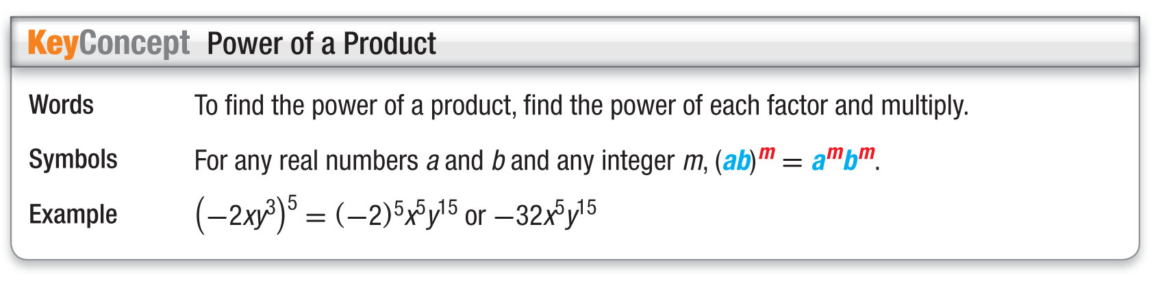
Concept

Slide 22
Example 4
Power of a Product
GEOMETRY Find the volume of a cube with side length 5xyz.
Volume = s³ Formula for volume of a cube
= (5xyz)³ Replace s with 5xyz.
= 5³x³y³z³ Power of a Product
= 125x³y³z³ Simplify.
Answer: 125x³y³z³

Slide 23
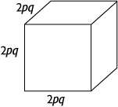
Example 4
Express the surface area of the cube as a monomial.
A. 8p³q³
B. 24p²q²
C. 6p²q²
D. 8p²q²

Slide 24
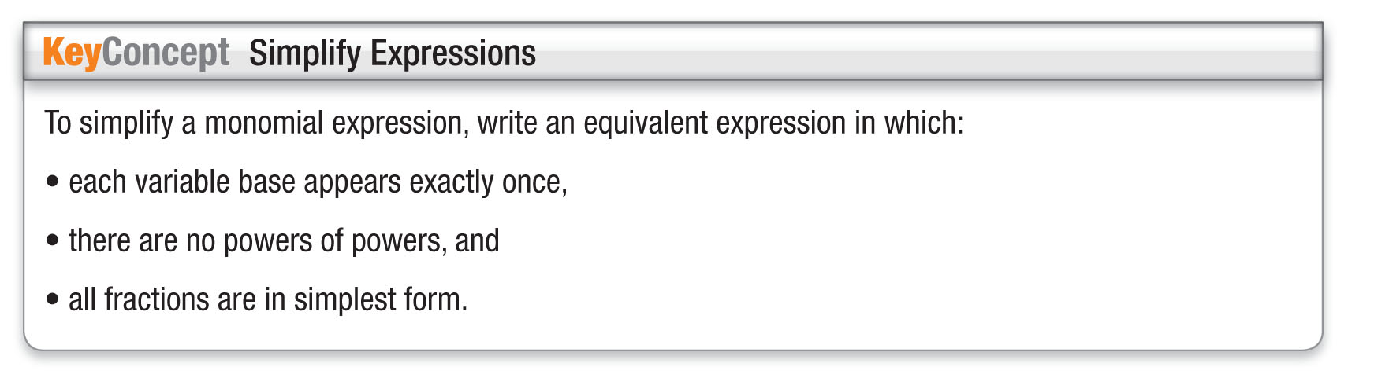
Concept

Slide 25
Example 5
Simplify Expressions
Simplify [(8g³h⁴)²]²(2gh⁵)⁴.
[(8g³h⁴)²]²(2gh⁵)⁴
= (8g³h⁴)⁴(2gh⁵)⁴ Power of a Power
= (8)⁴(g³)⁴(h⁴)⁴ (2)⁴g⁴(h⁵)⁴ Power of a Product
= 4096g¹²h¹⁶(16)g⁴h²⁰ Power of a Power
= 4096(16)g¹² ● g⁴ ● h¹⁶ ● h²⁰ Commutative Property
= 65,536g¹⁶h³⁶ Product of Powers
Answer: 65,536g¹⁶h³⁶

Slide 26
Example 5
Simplify [(2c²d³)²]³(3c⁵d²)³.
A. 1728c²⁷d²⁴
B. 6c⁷d⁵
C. 24c¹³d¹⁰
D. 5c⁷d²¹

Slide 27
End of the Lesson

