Slide 1


Splash Screen

Slide 2
Lesson Menu
Five-Minute Check (over Lesson 7–1)
CCSS
Then/Now
New Vocabulary
Key Concept: Quotient of Powers
Example 1: Quotient Powers
Key Concept: Power of a Quotient
Example 2: Power of a Quotient
Key Concept: Zero Exponent Property
Example 3: Zero Exponent
Key Concept: Negative Exponent Property
Example 4: Negative Exponents
Example 5: Real-World Example: Apply Properties of Exponents

Slide 3

5-Minute Check 1
Determine whether –5x² is a monomial. Explain your reasoning.
A. Yes, the expression is a product of a number and variables.
B. No, it has a variable.

Slide 4

5-Minute Check 2
Determine whether x³ – y³ is a monomial. Explain your reasoning.
A. Yes, the exponents are the same power.
B. No, the expression is the difference between two powers of variables.

Slide 5

5-Minute Check 3
Simplify (3ab⁴)(–a⁴b²).
A. 3a⁵b⁶
B. –3a⁵b⁶
C. 3a³b²
D. 9a³b⁶

Slide 6

5-Minute Check 4
Simplify (2x⁵y⁴)².
A. 2x⁷y⁶
B. 2x¹⁰y⁸
C. 4x¹⁰y⁸
D. 4x⁷y⁶

Slide 7

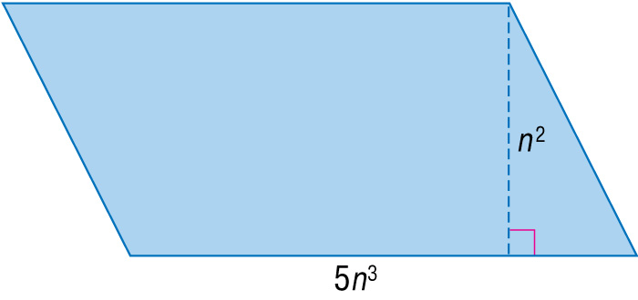
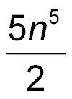
5-Minute Check 5
Find the area of the parallelogram.
A.
B. 10n⁵
C. 5n⁶
D. 5n⁵
units²
units²
units²
units²

Slide 8

5-Minute Check 6
What is the product (–3x²y³z²)(–17x³z⁴)?
A. 20x⁵y³z⁶
B. 20x⁶y³z⁸
C. 51x⁵y³z⁶
D. 51x⁶y³z⁸

Slide 9

CCSS
Content Standards
A.SSE.2 Use the structure of an expression to identify ways to rewrite it.
F.IF.8b Use the properties of exponents to interpret expressions for exponential functions.
Mathematical Practices
2 Reason abstractly and quantitatively.
Common Core State Standards © Copyright 2010. National Governors Association Center for Best Practices and Council of Chief State School Officers. All rights reserved.

Slide 10


Then/Now
You multiplied monomials.
Find the quotient of two monomials.
Simplify expressions containing negative and zero exponents.

Slide 11

Vocabulary
zero exponent
negative exponent
order of magnitude

Slide 12
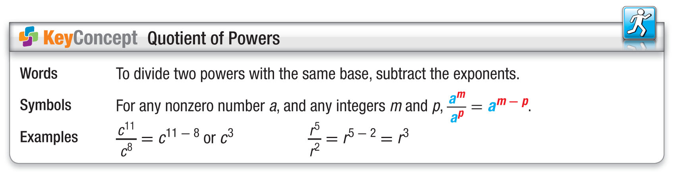
Concept

Slide 13

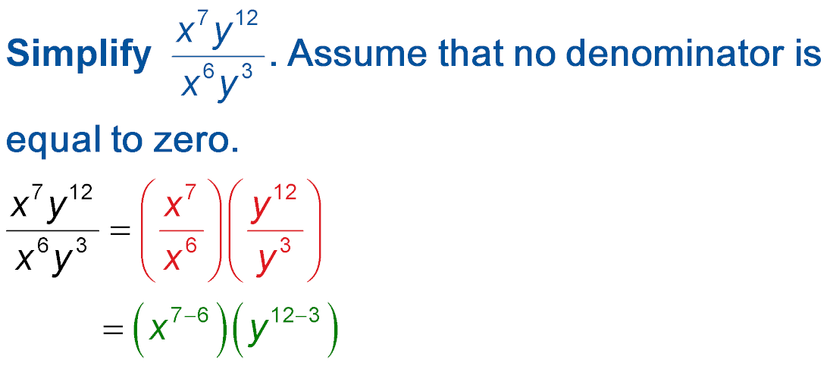
Example 1
Quotient of Powers
Group powers that have the same base.
Quotient of Powers
= xy⁹ Simplify.
Answer: xy⁹

Slide 14


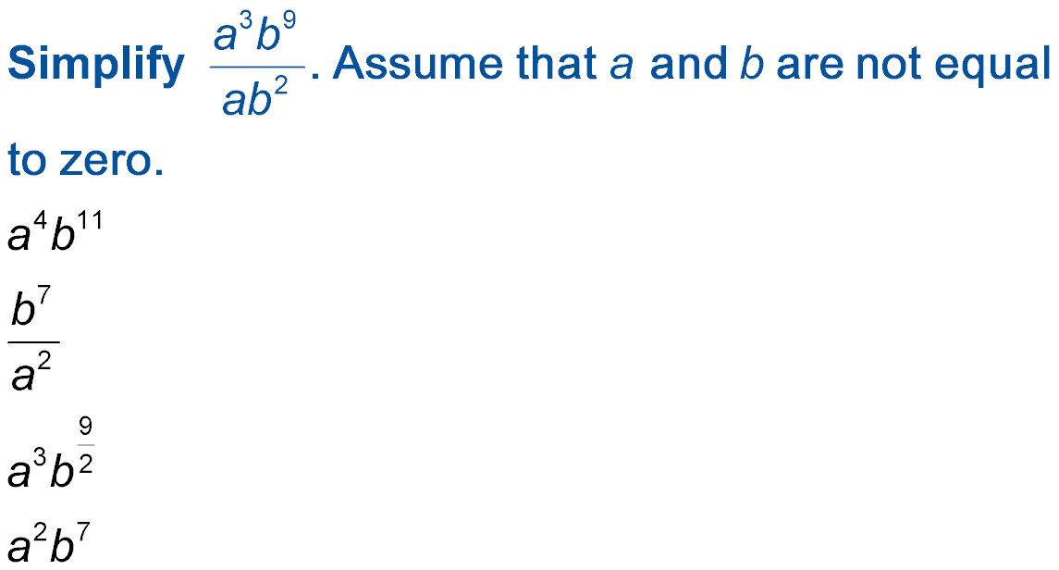
Example 1
A.
B.
C.
D.

Slide 15
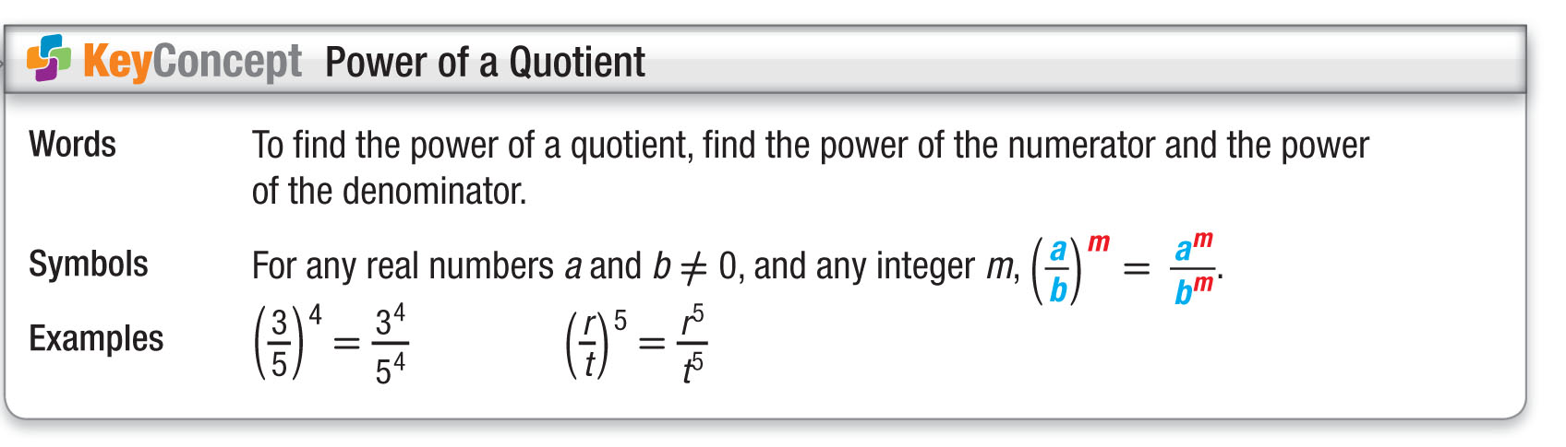
Concept

Slide 16
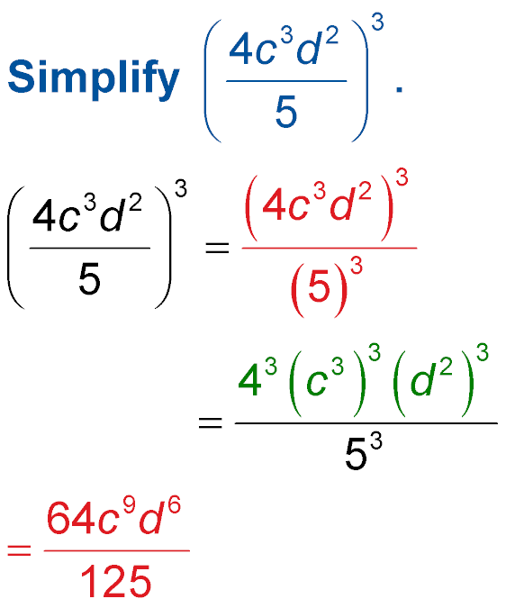
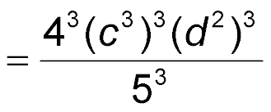
Example 2
Power of a Quotient
Power of a Quotient
Power of a Product
Power of a Power
Answer:

Slide 17
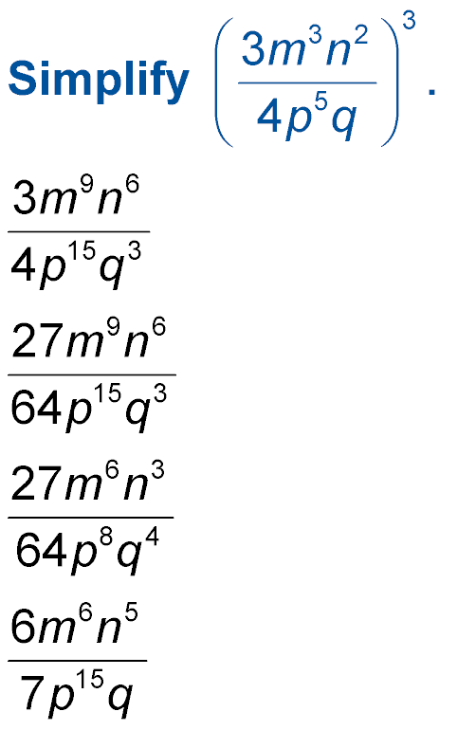
Example 2
Simplify Assume that p and q are not
equal to zero.
A. AnsA
B. AnsB
C. AnsC
D. AnsD

Slide 18
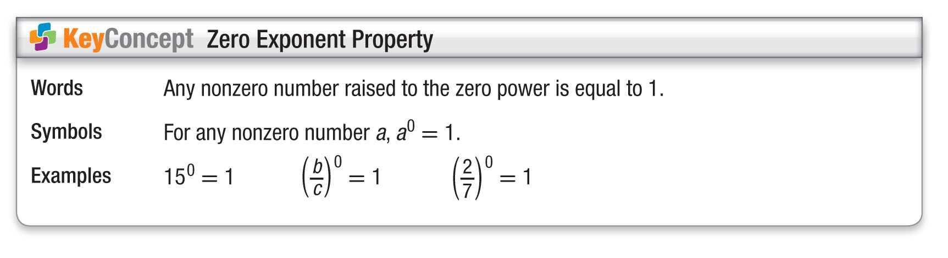
Concept

Slide 19
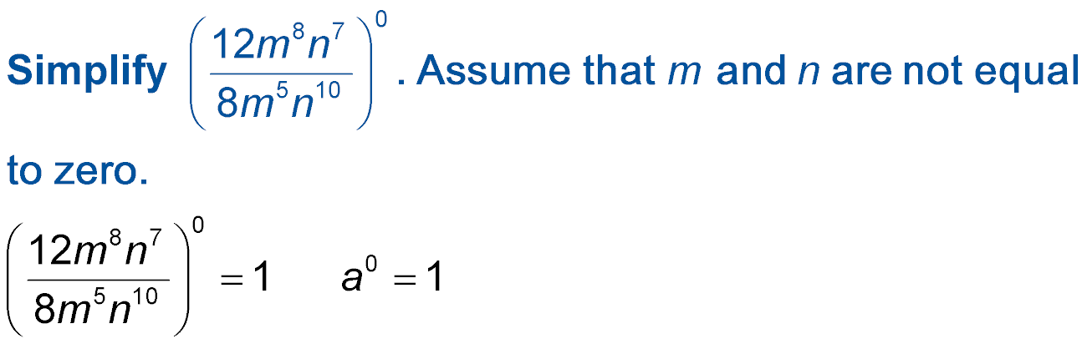
Example 3
Zero Exponent
A.
Answer: 1

Slide 20
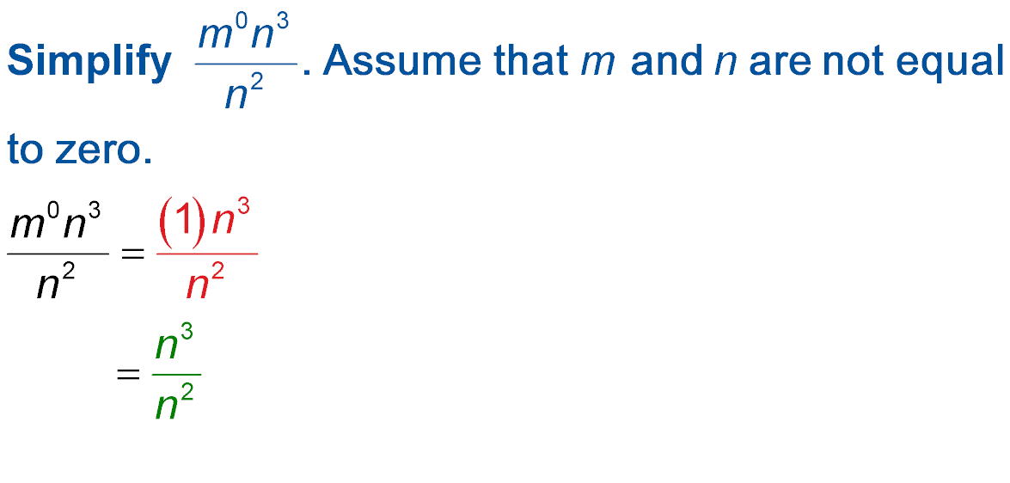
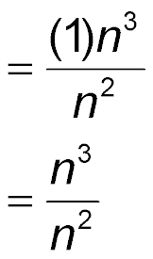
Example 3
Zero Exponent
B.
a⁰ = 1
Simplify.
= n Quotient of Powers
Answer: n

Slide 21
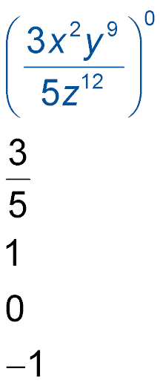
Example 3
A. Simplify . Assume that z is not equal to zero.
A.
B. 1
C. 0
D. –1

Slide 22
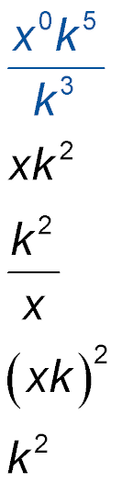
Example 3
B. Simplify . Assume that x and k are not equal to zero.
A.
B.
C.
D.

Slide 23
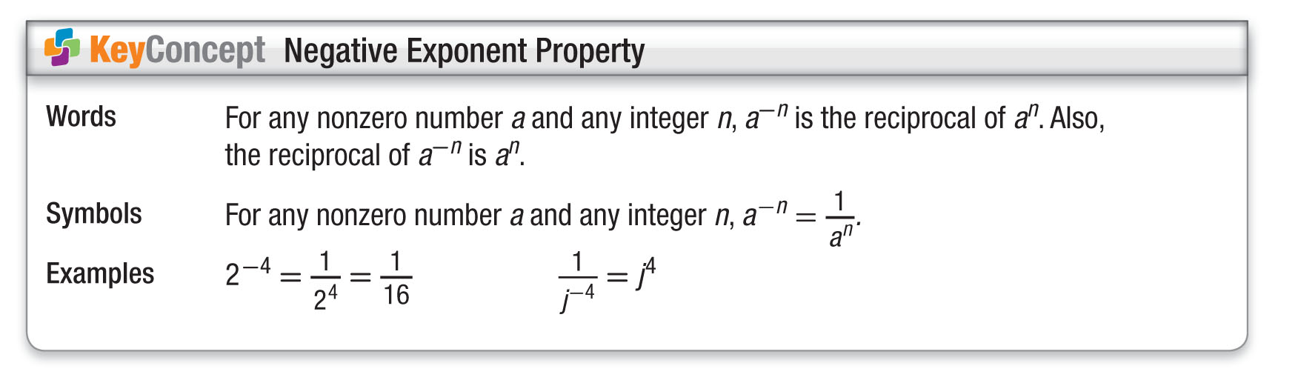
Concept

Slide 24
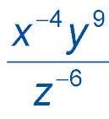
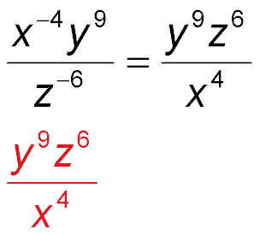
Example 4
Negative Exponents
A. Simplify . Assume that no denominator is equal to zero.
Negative Exponent Property
Answer:

Slide 25
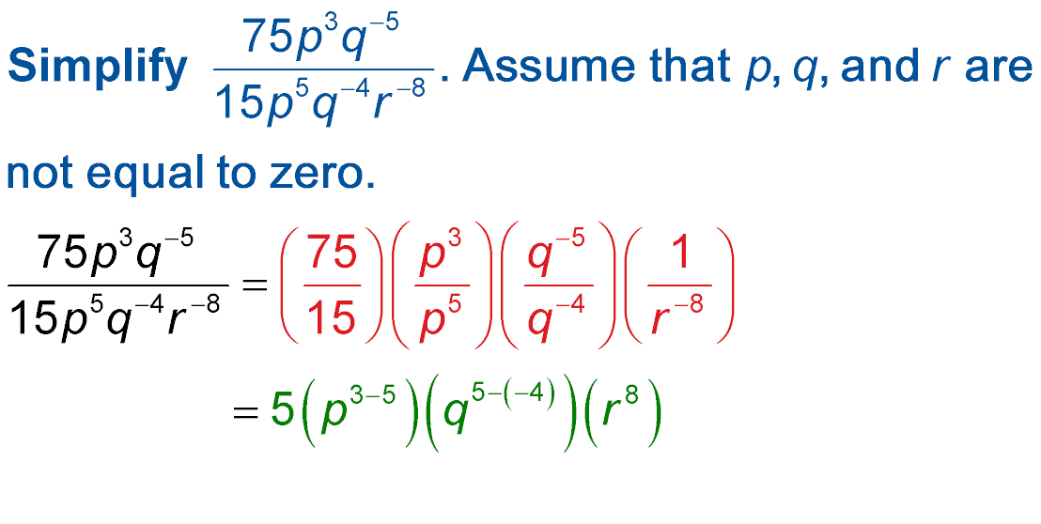
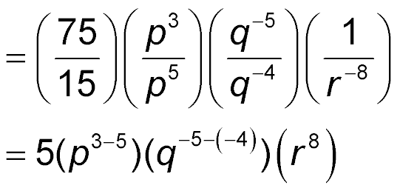
Example 4
Negative Exponents
B. Simplify . Assume that p, q and r are not equal to zero.
Group powers with the same base.
Quotient of Powers and Negative Exponent Property

Slide 26
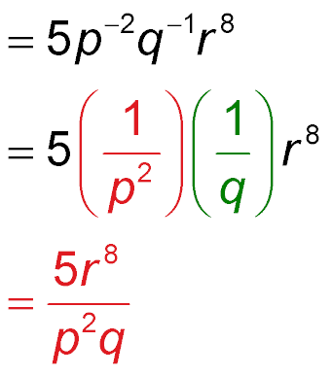
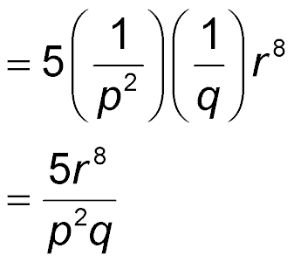
Example 4
Negative Exponents
Simplify.
Negative Exponent Property
Multiply.
Answer:

Slide 27
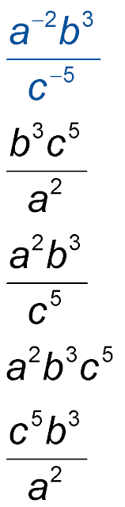
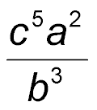
Example 4
A. Simplify . Assume that no denominator is equal to zero.
A.
B.
C.
D.

Slide 28
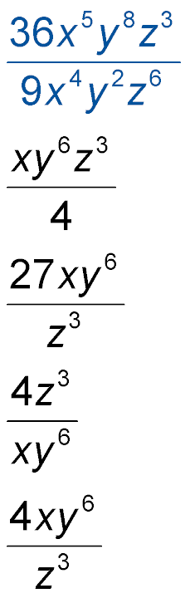
Example 4
B. Simplify . Assume that no denominator is equal to zero.
A. AnsA
B. AnsB
C. AnsC
D. AnsD

Slide 29
Example 5
Apply Properties of Exponents
SAVINGS Darin has $123,456 in his savings account. Tabo has $156 in his savings account. Determine the order of magnitude of Darin’s account and Tabo’s account. How many orders of magnitude as great is Darin’s account as Tabo’s account?
Understand We need to find the order of magnitude of the amounts of money in each account. Then find the ratio of Darin’s account to Tabo’s account.
Plan Round each dollar amount to the nearest power of ten. Then find the ratio.

Slide 30

Example 5
Apply Properties of Exponents
Solve The amount in Darin’s account is close to $100,000. So, the order is 10⁵. The amount in Tabo’s account is close to 100, so the order of magnitude is 10².
The ratio of Darin’s account to Tabo’s account is or 10³.
Answer: So, Darin has about 1000 times as much as Tabo, or Darin has 3 orders of magnitude as much in his account as Tabo.

Slide 31
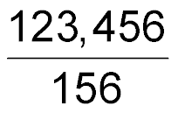
Example 5
Apply Properties of Exponents
Check The ratio of Darin’s account to Tabo’s account is ≈ 792. The power of ten closest to 792 is 1000, which has an order of magnitude of 10³.

Slide 32
Example 5
A circle has a radius of 210 centimeters. How many orders of magnitude as great is the area of the circle as the circumference of the circle?
A. 10¹
B. 10²
C. 10³
D. 10⁴

Slide 33
End of the Lesson

