Slide 1


Splash Screen

Slide 2
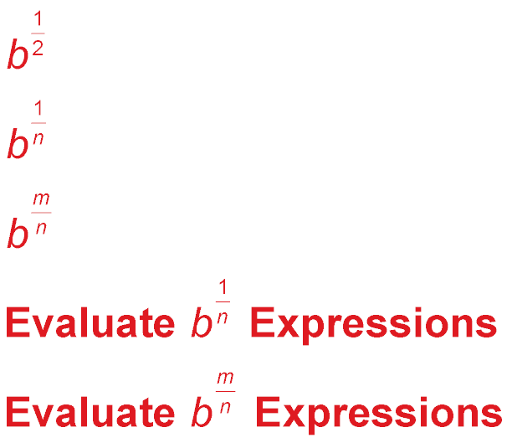
Lesson Menu
Five-Minute Check (over Lesson 7–2)
CCSS
Then/Now
New Vocabulary
Key Concept: b
Example 1: Radical and Exponential Forms
Key Concept: nth Root
Example 2: nth roots
Key Concept: b
Example 3: Evaluate b Expressions
Key Concept: b
Example 4: Evaluate b Expressions
Key Concept: Power Property of Equality
Example 5: Solve Exponential Equations
Example 6: Real-World Example: Solve Exponential Equations

Slide 3
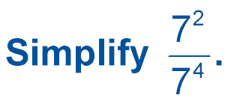

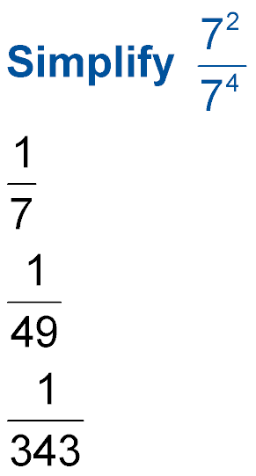
5-Minute Check 1
A. 49
B.
C.
D.

Slide 4
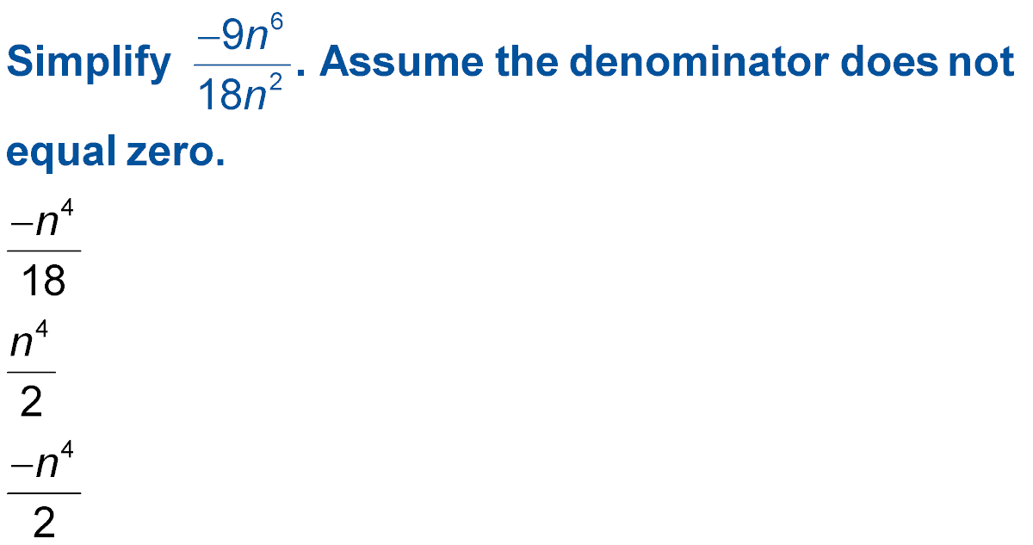

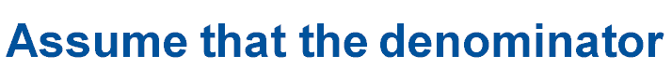
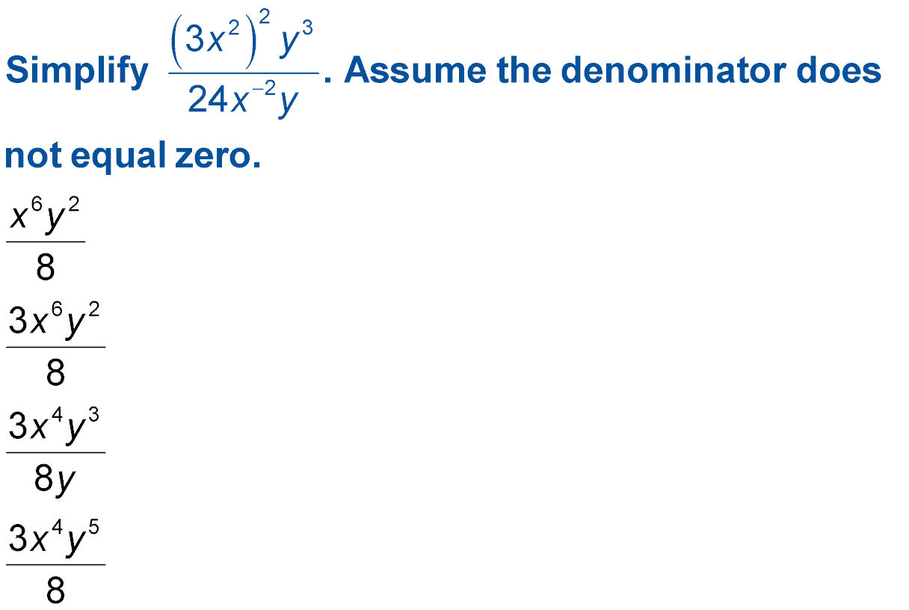
5-Minute Check 2
A.
B. 2n⁴
C.
D.

Slide 5


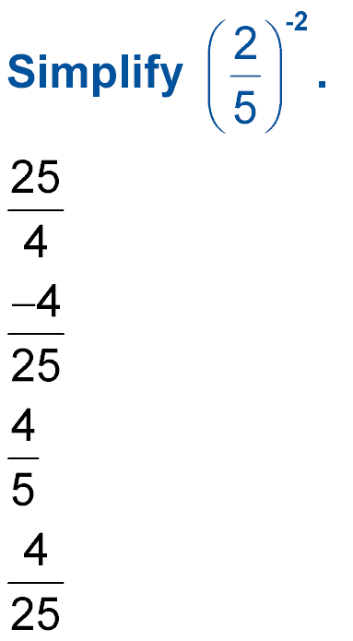
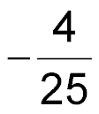
5-Minute Check 3
A.
B.
C.
D.

Slide 6


5-Minute Check 4
A.
B.
C.
D.

Slide 7
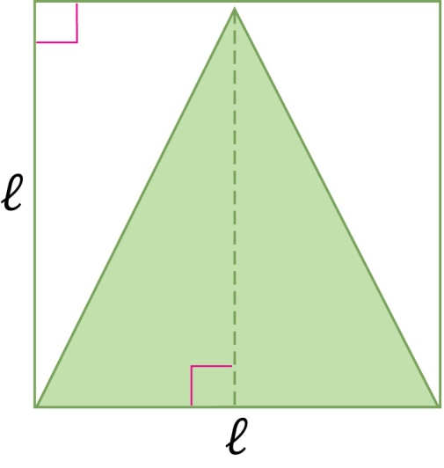

5-Minute Check 5
What is the ratio of the area of the square to the area of the triangle?
A. 2 to 1
B. 1 to 1
C. 4 to 1
D. 3 to 1

Slide 8
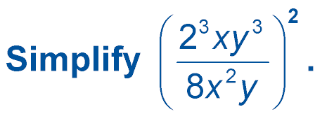

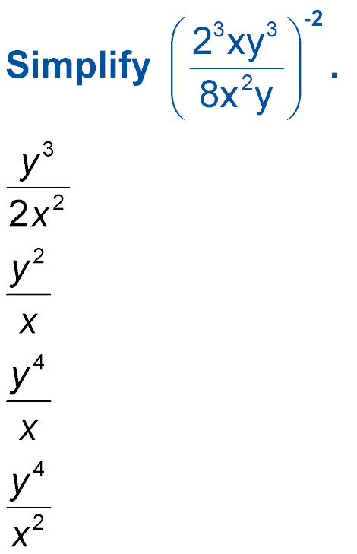
5-Minute Check 6
A. B.
C. D.

Slide 9

CCSS
Content Standards
N.RN.1 Explain how the definition of the meaning of rational exponents follows from extending the properties of integer exponents to those values, allowing for a notation for radicals in terms of rational exponents.
N.RN.2 Rewrite expressions involving radicals and rational exponents using the properties of exponents.
Mathematical Practices
5 Use appropriate tools strategically.
Common Core State Standards © Copyright 2010. National Governors Association Center for Best Practices and Council of Chief State School Officers. All rights reserved.

Slide 10


Then/Now
You used the laws of exponents to find products and quotients of monomials.
Evaluate and rewrite expressions involving rational exponents.
Solve equations involving expressions with rational exponents.

Slide 11

Vocabulary
rational exponent
cube root
nth root
exponential equation

Slide 12
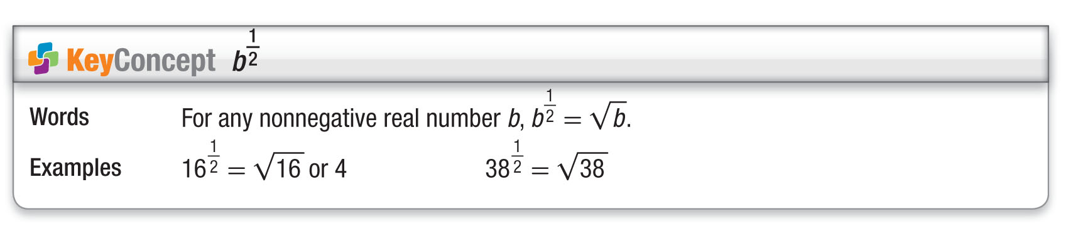
Concept

Slide 13
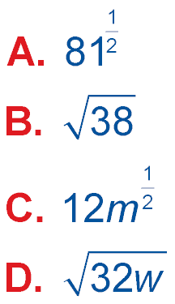
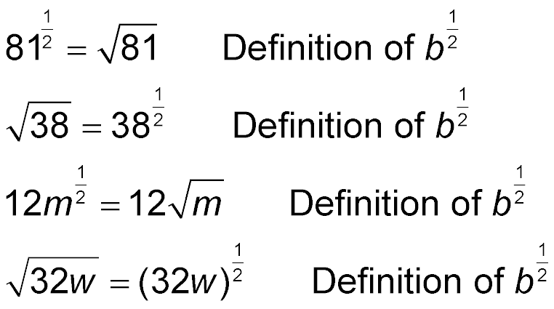
Example 1A
Radical and Exponential Forms
Write each expression in radical form, or write each radical in exponential form.
= 9 Simplify.
Answer: 9

Slide 14
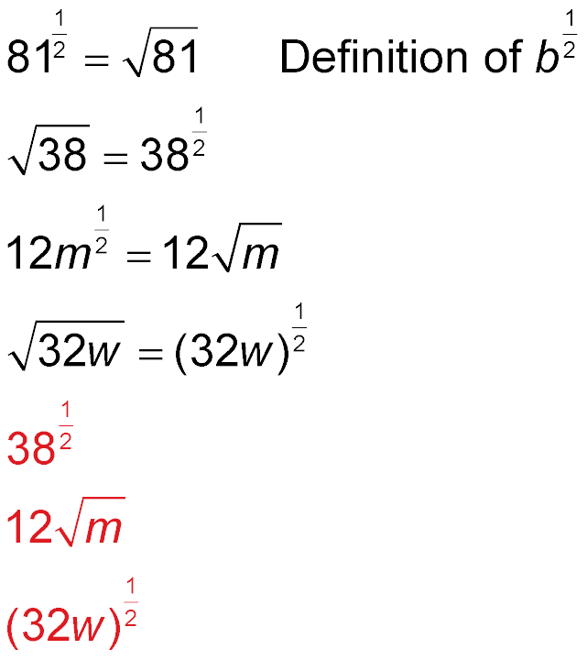
Example 1B
Radical and Exponential Forms
Write each expression in radical form, or write each radical in exponential form.
Answer:

Slide 15
Example 1C
Radical and Exponential Forms
Write each expression in radical form, or write each radical in exponential form.
Answer:

Slide 16
Example 1D
Radical and Exponential Forms
Write each expression in radical form, or write each radical in exponential form.
Answer: 9

Slide 17



Example 1CYP
A. 16
B. 8
C. 4
D. 2

Slide 18
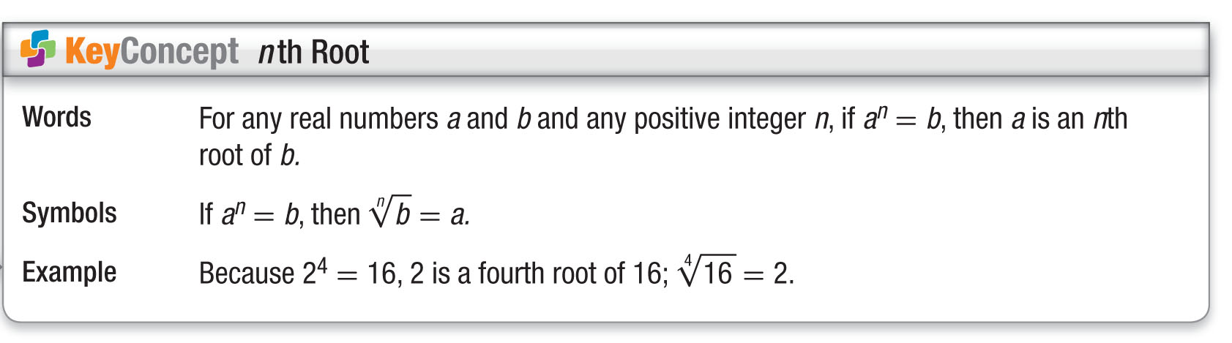
Concept

Slide 19
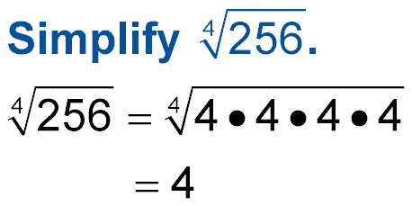
Example 2A
nth Roots
A.
Answer: 4

Slide 20
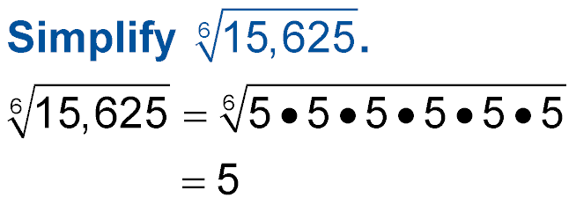
Example 2B
nth Roots
B.
Answer: 5

Slide 21
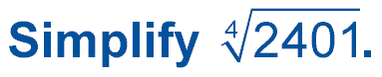
Example 2A
A. 343
B. 81
C. 49
D. 7

Slide 22
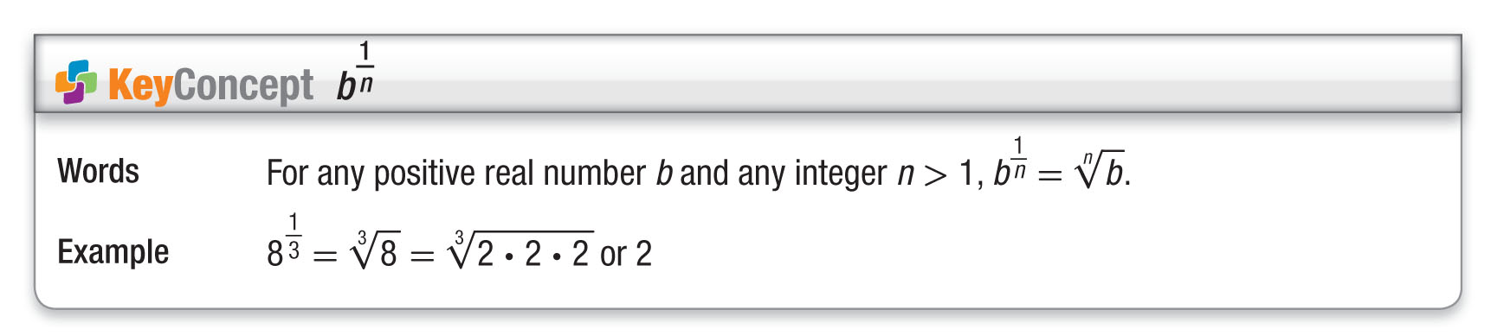
Concept

Slide 23
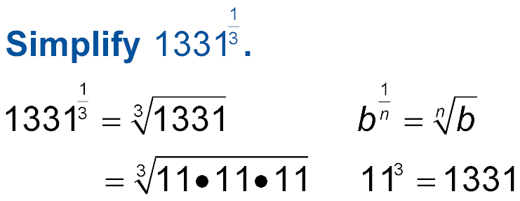
Example 3
Evaluate b Expressions
A.
= 11 Simplify.
Answer: 11

Slide 24
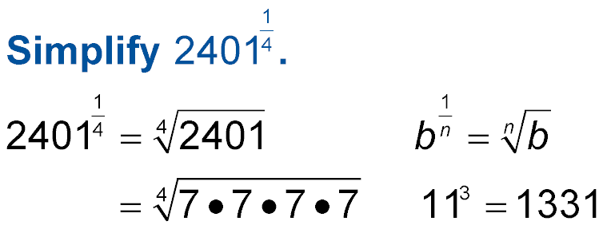
Example 3
Evaluate b Expressions
B.
= 7 Simplify.
Answer: 7

Slide 25

Example 3
A. 4
B. 8
C. 16
D. 32

Slide 26
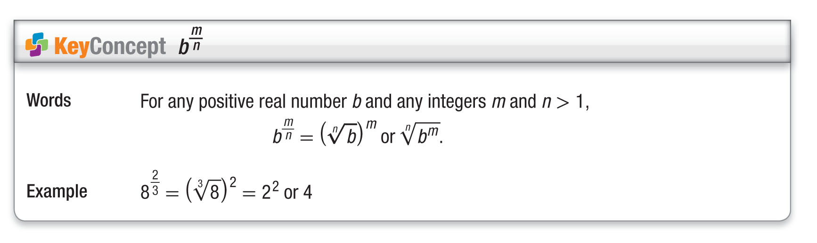
Concept

Slide 27
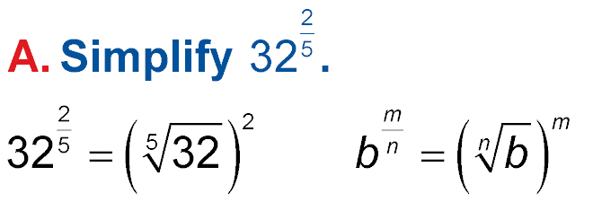
Example 4A
Evaluate b Expressions
= 2² 2⁵ = 32
= 4 Simplify.
Answer: 4

Slide 28
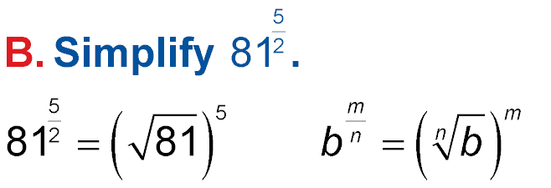
Example 4B
Evaluate b Expressions
= 9⁵ 9² = 81
= 59,049 Simplify.
Answer: 59,049

Slide 29
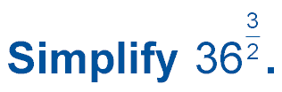
Example 4
A. 216
B. 36
C. 18
D. 6

Slide 30

Concept

Slide 31
Example 5A
Solve Exponential Equations
A. Solve 9^{x} = 729.
9^{x} = 729 Original equation
9^{x} = 9³ Rewrite 729 as 9³.
x = 3 Power Property of equality
Answer: 3

Slide 32
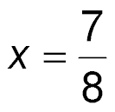

Example 5B
Solve Exponential Equations
B. Solve 16^{2x – 1} = 8.
16^{2x – 1} = 8 Original equation
(2⁴)^{2x – 1} = 2³ Rewrite 16 as 2⁴ and 8 as 2³.
2^{8x – 4} = 2³ Power of a Power, Distributive Property
8x – 4 = 3 Power Property of Equality
8x = 7 Add 4 to each side.
Divide each side by 8.
Answer:

Slide 33

Example 5A
Solve 93^{x + 1} = 27⁴.
A.
B.
C.
D. 2

Slide 34
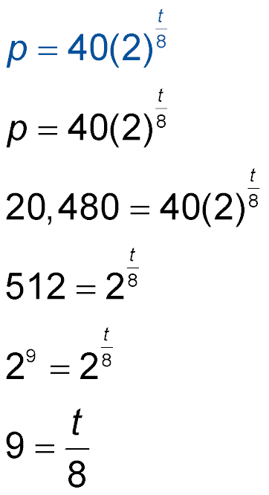
Example 6
Solve Exponential Equations
BIOLOGY The population p of a culture that begins with 40 bacteria and doubles every 8 hours can be
modeled by , where t is time in hours. Find
t if p = 20,480.
Original equation
p = 20,480
Divide each side by 40.

Slide 35
Example 6
Solve Exponential Equations
Rewrite 512 as 2⁹.
Power Property of Equality
72 = t Multiply each side by 8.
Answer: 72

Slide 36
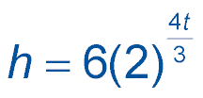
Example 6
NEWS The number of hits to a news story online can be modeled by , where t is time in hours. Find t if h = 24,576.
A. 6
B. 8
C. 9
D. 12

Slide 37
End of the Lesson

