Slide 1


Splash Screen

Slide 2
Lesson Menu
Five-Minute Check (over Lesson 7–3)
CCSS
Then/Now
New Vocabulary
Key Concept: Standard Form to Scientific Notation
Example 1: Standard Form to Scientific Notation
Key Concept: Scientific Notation to Standard Form
Example 2: Scientific Notation to Standard Form
Example 3: Multiply with Scientific Notation
Example 4: Divide with Scientific Notation
Example 5: Real-World Example: Use Scientific Notation

Slide 3


5-Minute Check 1
A. –2
B. 2
C. 4
D. 8

Slide 4
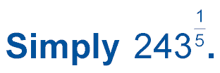

5-Minute Check 2
A. 3
B. 5
C. 7
D. 9

Slide 5
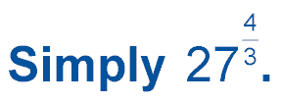

5-Minute Check 3
A. 3
B. 4
C. 12
D. 81

Slide 6
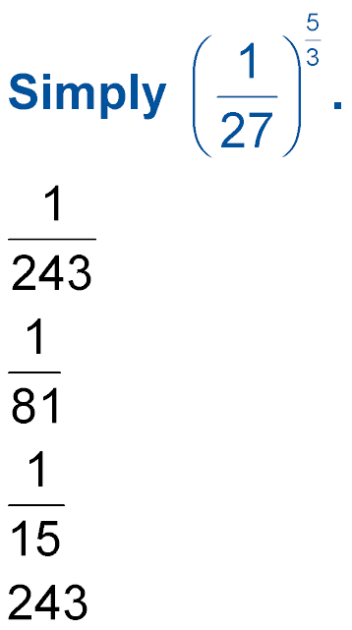

5-Minute Check 4
A.
B.
C.
D. 243

Slide 7

5-Minute Check 5
Solve 5^{2x – 5} = 125.
A. 3
B. 3.5
C. 4
D. 4.5

Slide 8

CCSS
Content Standards
A.SSE.2 Use the structure of an expression to identify ways to rewrite it.
Mathematical Practices
3 Construct viable arguments and critique the reasoning of others.
6 Attend to precision.
Common Core State Standards © Copyright 2010. National Governors Association Center for Best Practices and Council of Chief State School Officers. All rights reserved.

Slide 9


Then/Now
You found products and quotients of monomials.
Express numbers in scientific notation.
Find products and quotients of numbers expressed in scientific notation.

Slide 10

Vocabulary
scientific notation

Slide 11
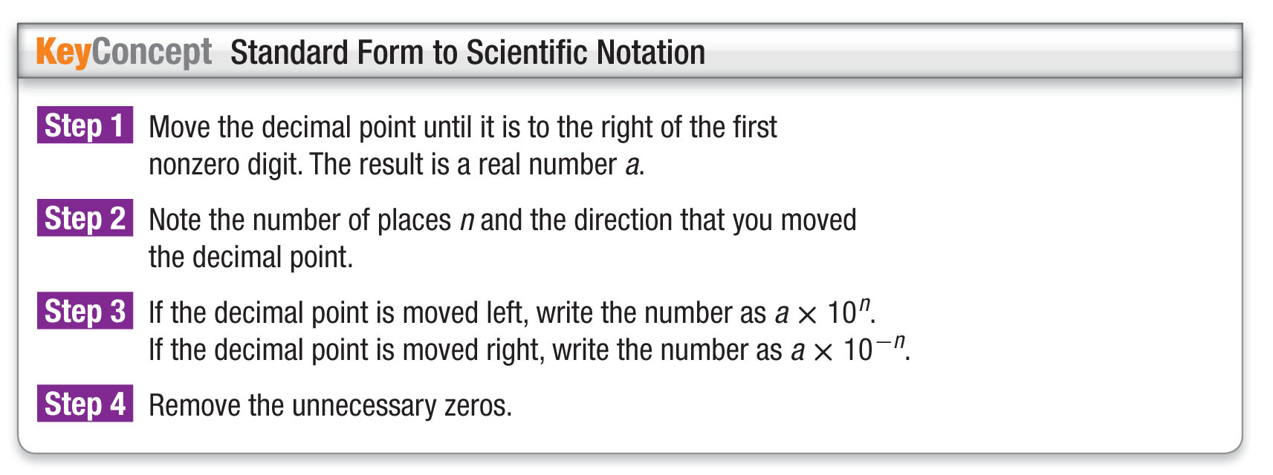
Concept

Slide 12
Example 1A
Standard Form to Scientific Notation
A. Express 4,062,000,000,000 in scientific notation.
Step 1 4,062,000,000,000 → 4,062,000,000,000
a = 4.062000000000
Step 2 The decimal point moved 12 places to the left, so n = 12.
Step 3 4,062,000,000,000 = 4.062000000000 × 10¹²
Step 4 4.062 × 10¹²
Answer: 4.062 × 10¹²

Slide 13
Example 1B
Standard Form to Scientific Notation
B. Express 0.000000823 in scientific notation.
Step 1 0.000000823 → 0.0000008223
a = 0000008.23
Step 2 The decimal point moved 7 places to the right, so n = 7.
Step 3 0.000000823 = 0000008.23 × 10^{–7}
Step 4 8.23 × 10^{–7}
Answer: 8.23 × 10^{–7}

Slide 14


Example 1A
A. Express 458,000,000 in scientific notation.
A. 4.58 × 10⁶
B. 4.58 × 10⁷
C. 4.58 × 10⁸
D. 4.58 × 10^{–8}

Slide 15
Example 1B
B. Express 0.0000452 in scientific notation.
A. 4.52 × 10⁴
B. 4.52 × 10^{–4}
C. 4.52 × 10⁵
D. 4.52 × 10^{–5}

Slide 16
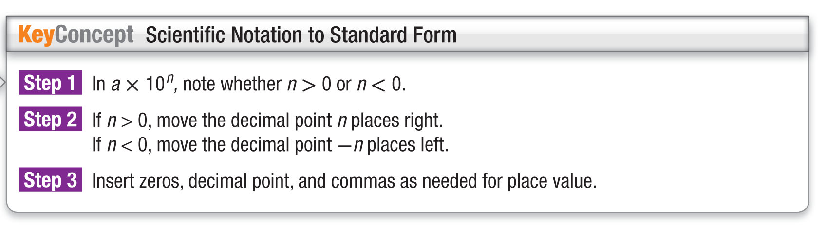
Concept

Slide 17
Example 2A
Scientific Notation to Standard Form
A. Express 6.49 × 10⁵ in standard form.
Step 1 The exponent is 5, so n = 5.
Step 2 Since n > 0, move the decimal point 5 places to the right.
6.49 × 10⁵ → 649000
Step 3 6.49 × 10⁵ = 649,000 Rewrite; insert commas.
Answer: 649,000

Slide 18
Example 2B
Scientific Notation to Standard Form
B. Express 1.8 × 10^{–3} in standard form.
Step 1 The exponent is –3, so n = –3.
Step 2 Since n < 0, move the decimal point 3 places to the left.
1.8 × 10^{–3} → 001.8
Step 3 1.8 × 10^{–3} = 0.0018 Rewrite; insert a 0 before the decimal point.
Answer: 0.0018

Slide 19
Example 2A
A. Express 3.16 × 10^{–2} in standard notation.
A. 0.0316
B. 0.00316
C. 3.1600
D. 316

Slide 20
Example 2B
B. Express 7.61 × 10³ in standard notation.
A. 0.00761
B. 0.000761
C. 761
D. 7610

Slide 21
Example 3
Multiply with Scientific Notation
Evaluate (5 × 10^{–6})(2.3 × 10¹²). Express the result in both scientific notation and standard form.
(5 × 10^{–6})(2.3 × 10¹²) Original expression
= (5 × 2.3)(10^{–6} × 10¹²) Commutative and Associative Properties
= 11.5 × 10⁶ Product of Powers
= (1.15 × 10¹) × 10⁶ 11.5 = 1.15 × 10
= 1.15 × 10⁷ Product of Powers
= 11,500,000 Standard form
Answer: 1.15 × 10⁷;11,500,000

Slide 22
Example 3
Evaluate (8 × 10⁵)(2.1 × 10^{–3}). Express the result in both scientific notation and standard form.
A. 16.8; 168
B. 1.68 × 10¹; 168
C. 1.68 × 10²; 1680
D. 1.68 × 10³; 1680

Slide 23
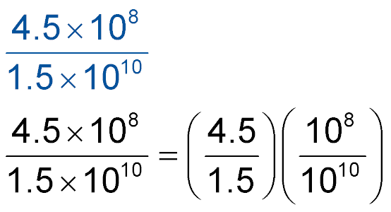
Example 4
Divide with Scientific Notation
Evaluate . Express the result in both
scientific notation and standard form.
Product rule for fractions
= 3 × 10^{–2} Quotient of Powers
= 0.03 Standard form
Answer: 3 × 10^{–2}; 0.03

Slide 24
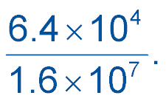
Example 4
Evaluate Express the result in both
scientific notation and standard form.
A. 4 × 10³; 4000
B. 4 × 10^{–3}; 0.004
C. 4 × 10^{–2}; 0.04
D. 4 × 10^{–1}; 0.4

Slide 25
Example 5A
Use Scientific Notation
A. Watercraft Last year Afyu’s state registered over 400 thousand watercraft. Boat sales in her state generated more than $15.4 million in state sales taxes that same year.
Express the number of watercraft registered and the state sales tax generated from boat sales last year in Afyu’s state in standard notation.
Answer: watercraft registered:
400 thousand = 400,000;
state sales tax generated:
$15.4 million = $15,400,000

Slide 26
Example 5B
Use Scientific Notation
B. Watercraft Last year Afyu’s state registered over 400 thousand watercraft. Boat sales in her state generated more than $15.4 million in state sales taxes that same year.
Write each number in scientific notation.
Answer: watercraft registered:
400,000 = 4 × 10⁵;
state sales tax generated:
$15,400,000 = 1.54 × 10⁷

Slide 27
Example 5C
Use Scientific Notation
C. Watercraft Last year Afyu’s state registered over 400 thousand watercraft. Boat sales in her state generated more than $15.4 million in state sales taxes that same year.
How many watercraft have been registered in Afyu’s state if 12 times the number registered last year have been registered in all? Write your answer in scientific notation and standard form.
Multiply the number of watercraft registered by 12.
(12)(4 × 10⁵) Original expression
= (12 × 4)(10⁵) Associative Property

Slide 28
Example 5C
Use Scientific Notation
= 48 × 10⁵ Multiply.
= (4.8 × 10¹) × 10⁵ 48 = 4.8 × 10¹
= 4.8 × 10⁶ Product of Powers
= 4,800,000 Standard form
Answer: 4.8 × 10⁶; 4,800,000

Slide 29
Example 5A
A. NEWSPAPERS A local newspaper has a circulation of 150 thousand daily newspapers and receives about $1.2 million in advertising revenue per year.
Express the newspaper circulation and the amount of advertising revenue in standard notation.
A. 1500; $120,000
B. 15,000; $120,000
C. 150,000; $1,002,000
D. 150,000; $1,200,000

Slide 30
Example 5B
B. NEWSPAPERS A local newspaper has a circulation of 150 thousand daily newspapers and receives about $1.2 million in advertising revenue per year.
Express the newspaper circulation and the amount of advertising revenue in scientific notation.
A. 1.5 × 10³; 1.2 × 10⁵
B. 1.5 × 10⁴; 1.2 × 10⁵
C. 1.5 × 10⁵; 1.2 × 10⁶
D. 1.5 × 10⁵; 1.2 × 10⁷

Slide 31
Example 5C
C. NEWSPAPERS A local newspaper has a circulation of 150 thousand daily newspapers and receives about
$1.2 million in advertising revenue per year.
The newspaper predicts its advertising revenue will decrease by next year as more people get their news from the Internet. What will the advertising revenue be after this decrease?
1
__
2
A. 6 × 10⁵
B. 6 × 10⁴
C. 6 × 10³
D. 6 × 10²

Slide 32
End of the Lesson

