Slide 1


Splash Screen

Slide 2
Lesson Menu
Five-Minute Check (over Lesson 7–4)
CCSS
Then/Now
New Vocabulary
Key Concept: Exponential Function
Example 1: Graph with a > 0 and b > 1
Example 2: Graph with a > 0 and 0 < b < 1
Key Concept: Graphs of Exponential Functions
Example 3: Real-World Example: Use Exponential Functions to Solve Problems
Example 4: Identify Exponential Behavior

Slide 3

5-Minute Check 1
What is 3,352,000 in scientific notation?
A. 3.3 × 10⁴
B. 33.52 × 10⁴
C. 3.352 × 10⁶
D. 0.3352 × 10⁷

Slide 4

5-Minute Check 2
What is 0.00000281 in scientific notation?
A. 2.81 × 10^{–6}
B. 2.81 × 10^{–7}
C. 0.281 × 10^{–7}
D. 28.1 × 10^{–5}

Slide 5

5-Minute Check 3
What is 3 × 10⁴ in standard form?
A. 3.0000
B. 300.00
C. 3000
D. 30,000

Slide 6

5-Minute Check 4
What is 6.12 × 10^{–5} in standard form?
A. 0.00000612
B. 0.0000612
C. 0.00612
D. 0.612

Slide 7


5-Minute Check 5
A. 3 × 10⁶
B. 3 × 10⁷
C. 3 × 10⁸
D. 30 × 10⁸

Slide 8

5-Minute Check 6
What value of m makes (5.3 × 10^{m})² = 2.809 × 10⁷ true?
A. 2
B. 3
C. 4
D. 5

Slide 9

CCSS
Content Standards
F.IF.7e Graph exponential and logarithmic functions, showing intercepts and end behavior, and trigonometric functions, showing period, midline, and amplitude.
F.LE.2 Construct linear and exponential functions, including arithmetic and geometric sequences, given a graph, a description of a relationship, or two input- output pairs (include reading these from a table).
Mathematical Practices
1 Make sense of problems and persevere in solving them.
Common Core State Standards © Copyright 2010. National Governors Association Center for Best Practices and Council of Chief State School Officers. All rights reserved.

Slide 10


Then/Now
You evaluated numerical expressions involving exponents.
Graph exponential functions.
Identify data that display exponential behavior.

Slide 11

Vocabulary
exponential function
exponential growth function
exponential decay function

Slide 12
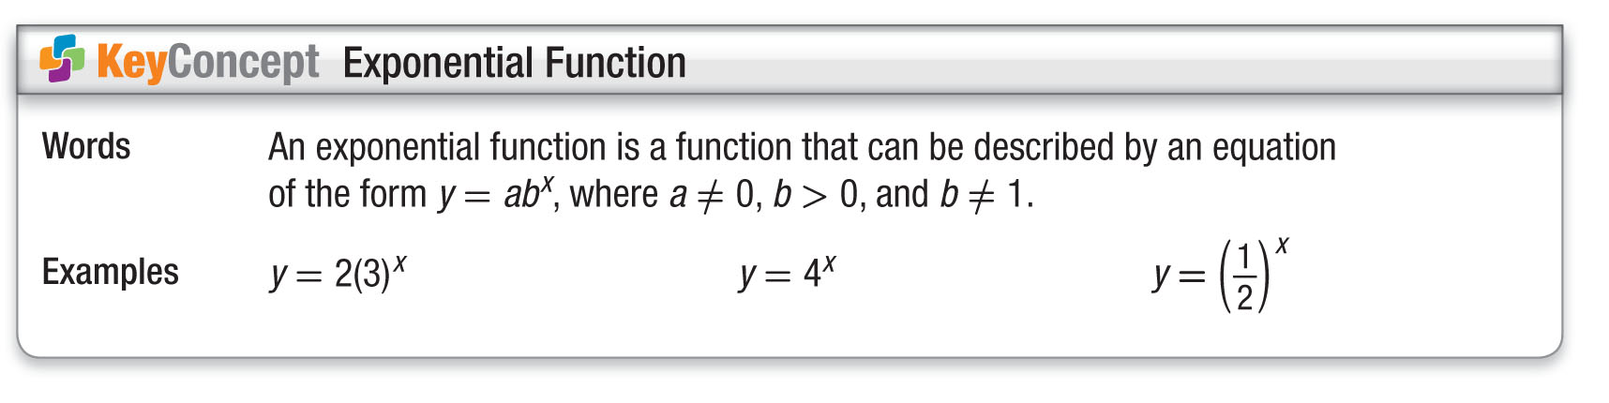
Concept

Slide 13
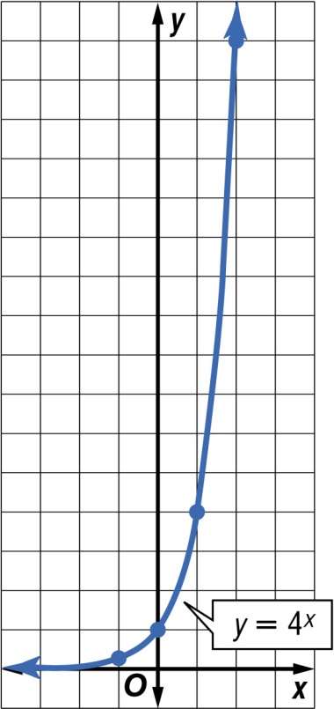
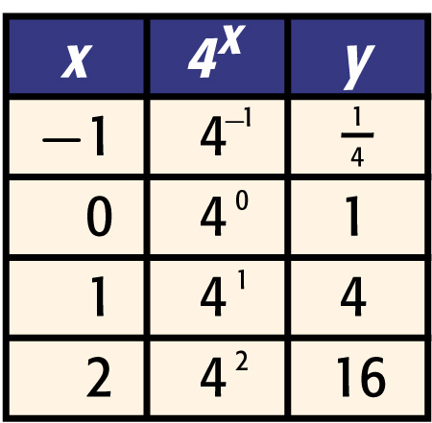
Example 1
Graph with a > 0 and b > 1
A. Graph y = 4^{x}. Find the y-intercept and state the domain and range.
Graph the ordered pairs and connect the points with a smooth curve.
Answer: The graph crosses the y-axis at 1, so the
y-intercept is 1. The domain is all real numbers and the range is all positive real numbers.

Slide 14
Example 1
Graph with a > 0 and b > 1
B. Use the graph of y = 4^{x} to determine
the approximate value of 4^{1.5}.
The graph represents all real values of
x and their corresponding values of y
for y = 4^{x}.
Answer: The value of y is 8 when
x = 1.5.
Use a calculator to confirm this value.
4^{1.5} = 8

Slide 15


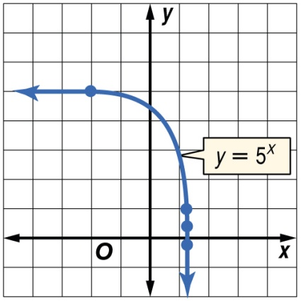
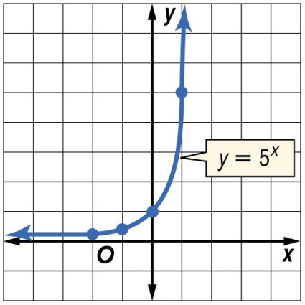
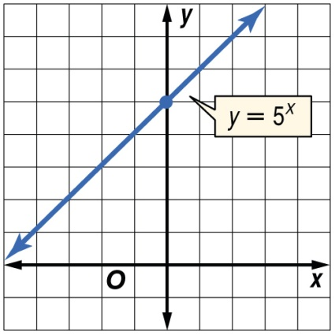
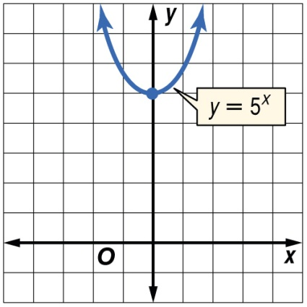
Example 1
A. Graph y = 5^{x}.
A. B.
C. D.

Slide 16

Example 1
B. Use the graph of y = 5^{x} to determine the approximate value of 5^{0.25}.
A. about 2.5
B. about 5
C. about 2
D. about 1.5

Slide 17
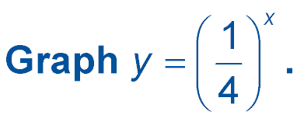
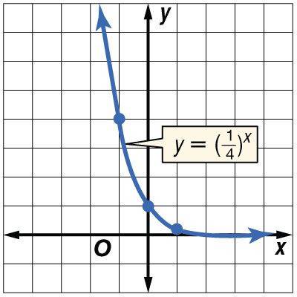
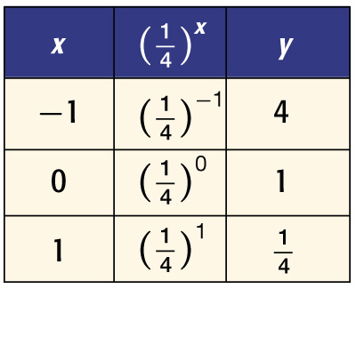
Example 2
Graph with a > 0 and 0 < b < 1
A. Find the y-intercept and state the domain and range.
Graph the ordered pairs and connect the points with a smooth curve.
Answer: The y-intercept is 1. The domain is all real numbers and the range is all positive real numbers.

Slide 18
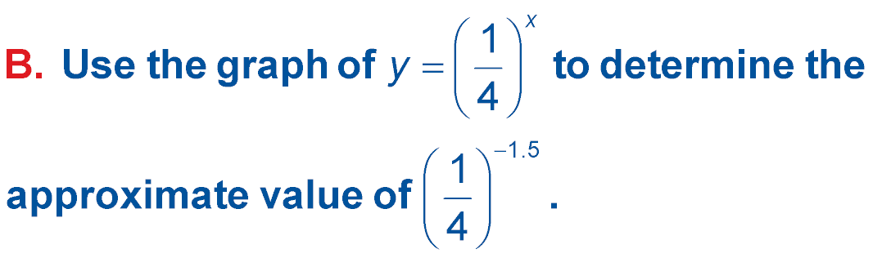
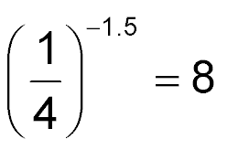
Example 2
Graph with a > 0 and 0 < b < 1
Answer: The value of y is about 8 when x = –1.5.
Use a calculator to confirm this value.

Slide 19
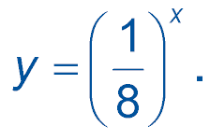
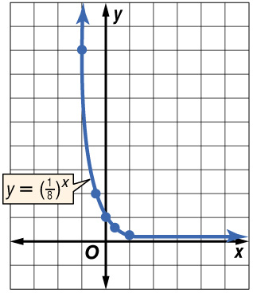
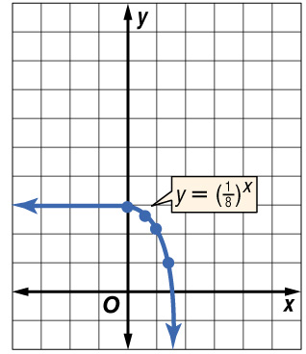
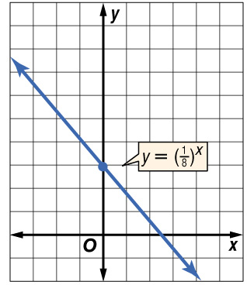
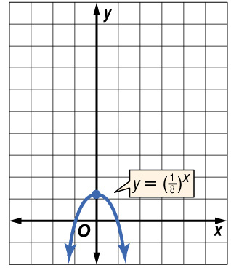
Example 2
A. Graph
A. B.
C. D.

Slide 20
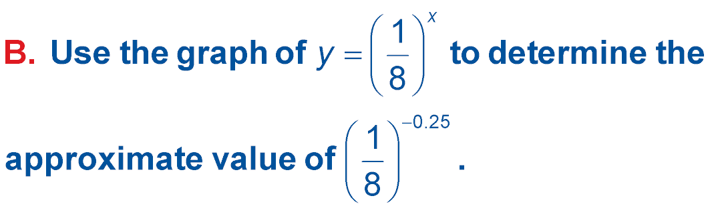
Example 2
A. about 1
B. about 3
C. about 2
D. about 0.1

Slide 21
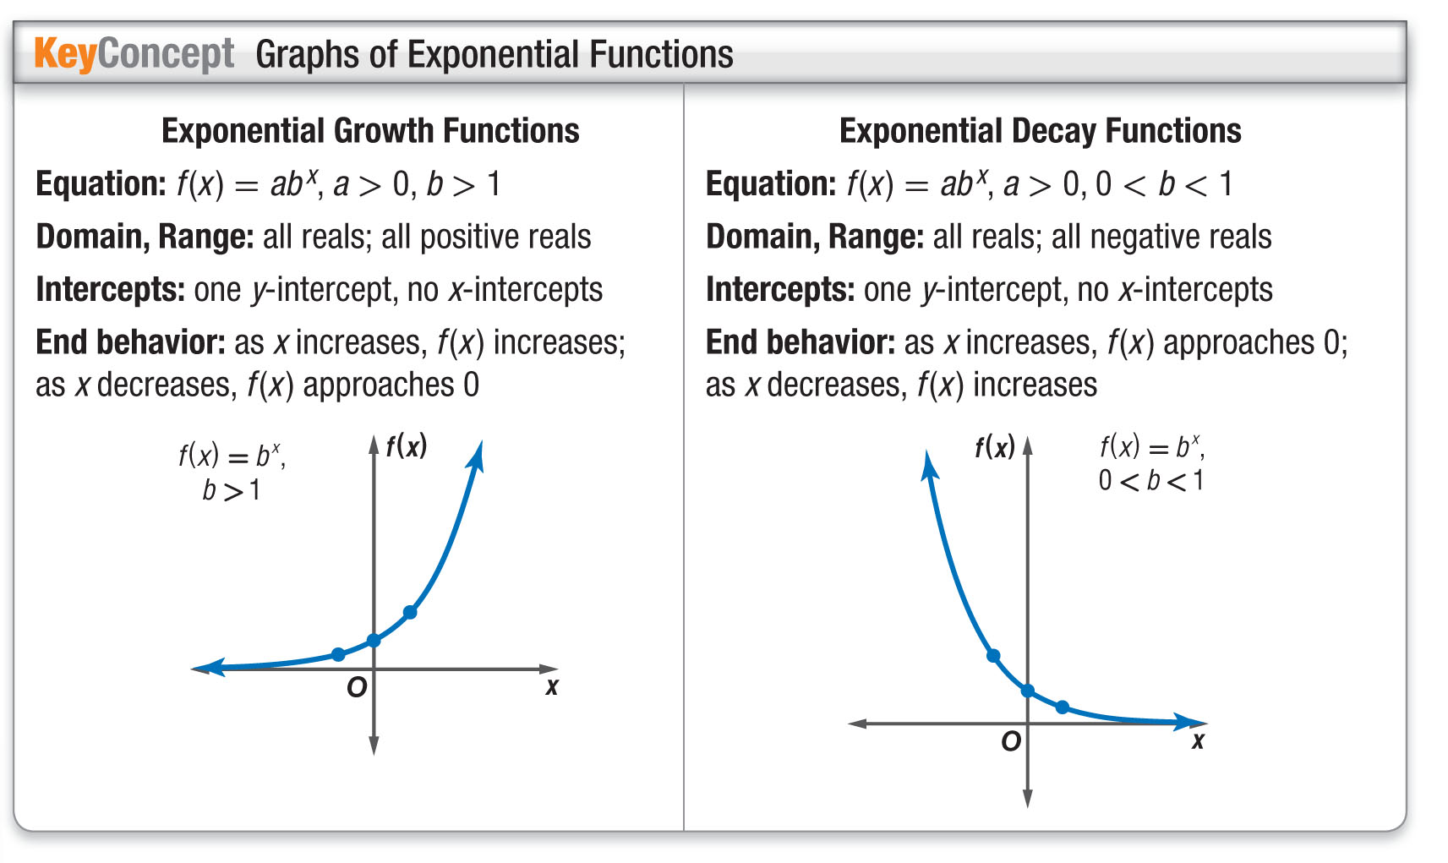
Concept

Slide 22
Example 3
Use Exponential Functions to Solve Problems
A. DEPRECIATION Some people say that the value of a new car decreases as soon as it is driven off the dealer’s lot. The function V = 25,000 ● 0.82^{t} models the depreciation of the value of a new car that originally cost $25,000. V represents the value of the car and t represents the time in years from the time the car was purchased. Graph the function. What values of V and t are meaningful in the function?
Use a graphing calculator to graph the function.

Slide 23
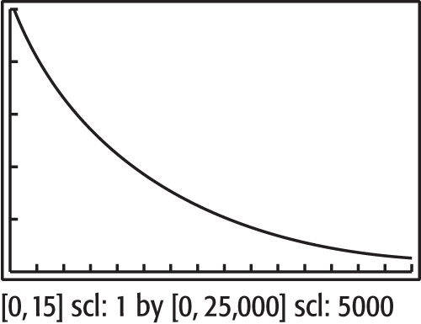
Example 3
Use Exponential Functions to Solve Problems
Since t represents time, t > 0. At t = 0, the value of the car is $25,000, so V ≤ 25,000.
Answer: Only the values of 0 ≤ V ≤ 25,000 and t ≥ 0 are meaningful in the context of the problem.

Slide 24
Example 3
Use Exponential Functions to Solve Problems
B. What is the value of the car after five years?
V = 25,000 ● 0.82^{t} Original equation
V = 25,000 ● 0.82⁵ t = 5
V ≈ 9268 Use a calculator.
Answer: After five years, the car's value is about $9268.

Slide 25
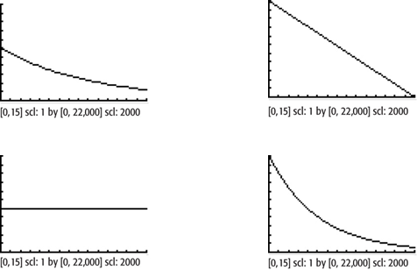
Example 3
A. DEPRECIATION The function V = 22,000 ● 0.82^{t} models the depreciation of the value of a new car that originally cost $22,000. V represents the value of the car and t represents the time in years from the time the car was purchased. Graph the function.
A. B.
C. D.

Slide 26
Example 3
B. DEPRECIATION The function V = 22,000 ● 0.82^{t} models the depreciation of the value of a new car that originally cost $22,000. V represents the value of the car and t represents the time in years from the time the car was purchased. What is the value of the car after one year?
A. $21,000
B. $23,600
C. $18,040
D. $20,000

Slide 27

Example 4
Identify Exponential Behavior
Determine whether the set of data displays exponential behavior. Explain why or why not.
Method 1 Look for a pattern.
The domain values are at regular intervals of 10.
Look for a common factor among the range values.
10 25 62.5 156.25
× 2.5
× 2.5
× 2.5

Slide 28
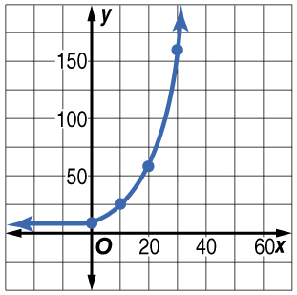
Example 4
Identify Exponential Behavior
Answer: Since the domain values are at regular intervals and the range values differ by a positive common factor, the data are probably exponential. The equation for the data may involve (2.5)^{x}.
Method 2 Graph the data.
Answer: The graph shows rapidly increasing values of y as x increases. This is
a characteristic of exponential behavior.

Slide 29

Example 4
Determine whether the set of data displays exponential behavior.
A. no
B. yes
C. cannot be determined

Slide 30
End of the Lesson

