Slide 1


Splash Screen

Slide 2
Lesson Menu
Five-Minute Check (over Lesson 7–5)
CCSS
Then/Now
New Vocabulary
Key Concept: Equation for Exponential Growth
Example 1: Real-World Example: Exponential Growth
Key Concept: Equation for Compound Interest
Example 2: Real-World Example: Compound Interest
Key Concept: Equation for Exponential Decay
Example 3: Real-World Example: Exponential Decay

Slide 3
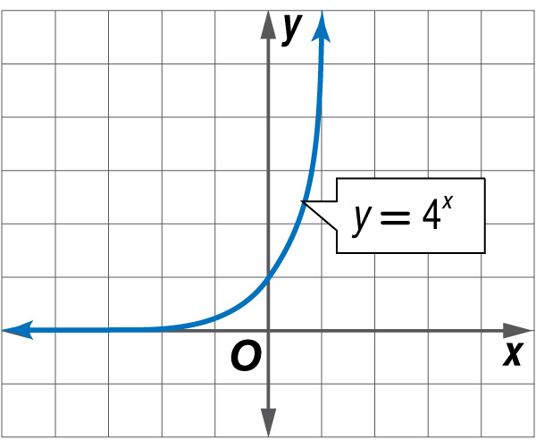

5-Minute Check 1
The graph of y = 4^{x} is shown. State the y-intercept. Then use the graph to approximate the value of 4^{0.6}.
A. 1; 1
B. 1; 2
C. 1; 4
D. 0; 6

Slide 4

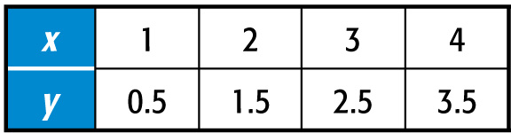
5-Minute Check 2
Determine whether the data in the table display exponential behavior.
A. Yes; the domain values are at regular intervals and the range values are increasing.
B. No; the domain values are at regular intervals and the range values have a common difference.

Slide 5

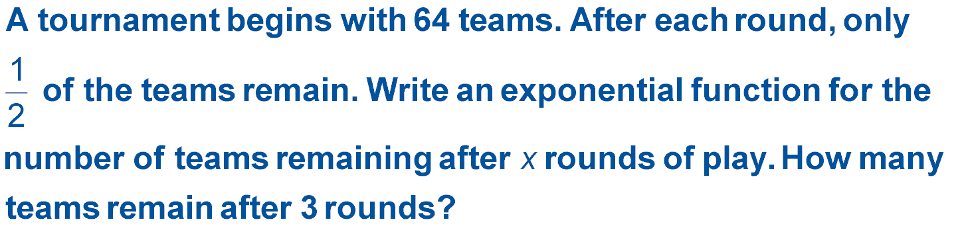
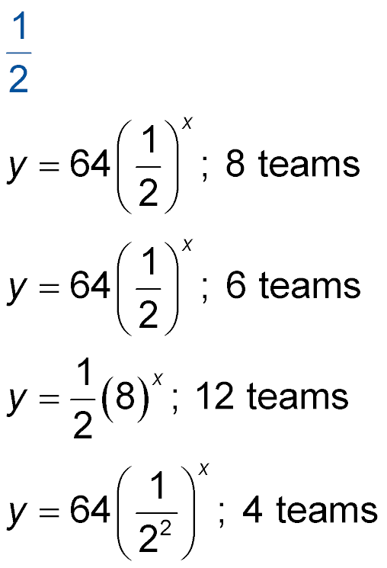
5-Minute Check 3
A.
B.
C.
D.

Slide 6

CCSS
Content Standards
F.IF.8b Use the properties of exponents to interpret expressions for exponential functions.
F.LE.2 Construct linear and exponential functions, including arithmetic and geometric sequences, given a graph, a description of a relationship, or two input-output pairs (include reading these from a table).
Mathematical Practices
4 Model with mathematics.
Common Core State Standards © Copyright 2010. National Governors Association Center for Best Practices and Council of Chief State School Officers. All rights reserved.

Slide 7


Then/Now
You analyzed exponential functions.
Solve problems involving exponential growth.
Solve problems involving exponential decay.

Slide 8

Vocabulary
compound interest

Slide 9
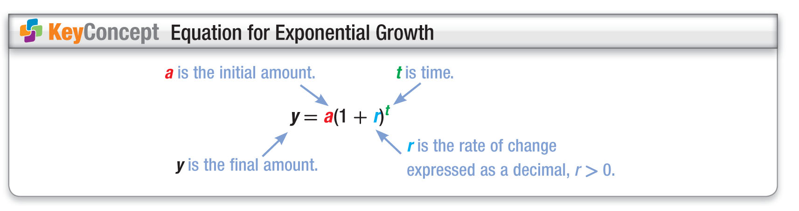
Concept

Slide 10
Example 1
Exponential Growth
A. POPULATION In 2008, the town of Flat Creek had a population of about 280,000 and a growth rate of 0.85% per year. Write an equation to represent the population of Flat Creek since 2008.
The rate 0.85% can be written has 0.0085.
y = a(1 + r)^{t} Equation for exponential growth
y = 280,000(1 + 0.0085)^{t} a = 280,000 and r = 0.0085
y = 280,000(1.0085)^{t} Simplify.
Answer: An equation to represent the population of Flat Creek is y = 280,000(1.0085)^{t}, where y is the population and t is the number of years since 2008.

Slide 11
Example 1
Exponential Growth
B. POPULATION In 2008, the town of Flat Creek had a population of about 280,000 and a growth rate of 0.85% per year. According to the equation, what will be the population of Flat Creek in the year 2018?
In 2018, t will equal 2018 – 2008 or 10.
y = 280,000(1.0085)^{t} Equation for population of Flat Creek
y = 280,000(1.0085)¹⁰ t = 10
y ≈ 304,731 Use a calculator.
Answer: In 2018, there will be about 304,731 people in Flat Creek.

Slide 12


Example 1
A. POPULATION In 2008, Scioto School District had a student population of about 4500 students, and a growth rate of about 0.15% per year. Write an equation to represent the student population of the Scioto School District since the year 2008.
A. y = 4500(1.0015)
B. y = 4500(1.0015)^{t}
C. y = 4500(0.0015)^{t}
D. y = (1.0015)^{t}

Slide 13
Example 1
B. POPULATION In 2008, Scioto School District had a student population of about 4500 students, and a growth rate of about 0.15% per year. According to the equation, what will be the student population of the Scioto School District in the year 2014?
A. about 9000 students
B. about 4600 students
C. about 4540 students
D. about 4700 students

Slide 14
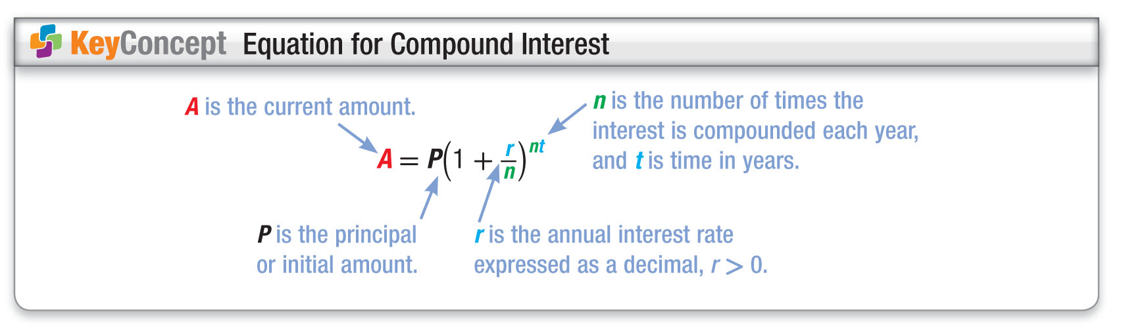
Concept

Slide 15
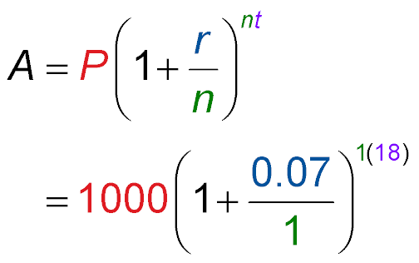
Example 2
Compound Interest
COLLEGE When Jing May was born, her grandparents invested $1000 in a fixed rate savings account at a rate of 7% compounded annually. The money will go to Jing May when she turns 18 to help with her college expenses. What amount of money will Jing May receive from the investment?
Compound interest equation
P = 1000, r = 7% or 0.07,
n = 1, and t = 18

Slide 16
Example 2
Compound Interest
= 1000(1.07)¹⁸ Simplify.
≈ 3379.93 Use a calculator.
Answer: She will receive about $3380.

Slide 17
Example 2
COMPOUND INTEREST When Lucy was 10 years old, her father invested $2500 in a fixed rate savings account at a rate of 8% compounded semiannually. When Lucy turns 18, the money will help to buy her
a car. What amount of money will Lucy receive from the investment?
A. about $4682
B. about $5000
C. about $4600
D. about $4500

Slide 18
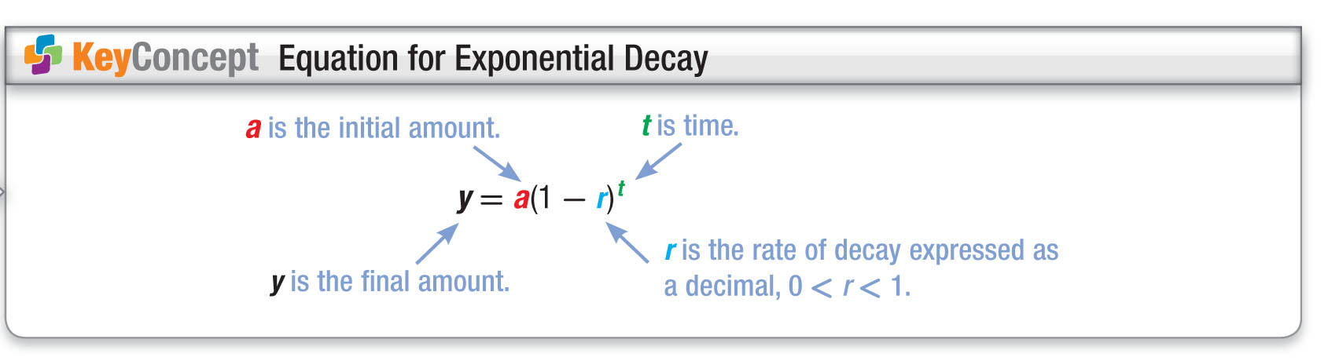
Concept

Slide 19
Example 3
Exponential Decay
A. CHARITY During an economic recession, a charitable organization found that its donations dropped by 1.1% per year. Before the recession, its donations were $390,000. Write an equation to represent the charity’s donations since the beginning of the recession.
y = a(1 – r)^{t} Equation for exponential decay
y = 390,000(1 – 0.011)^{t} a = 390,000 and r = 1.1% or 0.011
y = 390,000(0.989)^{t} Simplify.
Answer: y = 390,000(0.989)^{t}

Slide 20
Example 3
Exponential Decay
B. CHARITY During an economic recession, a charitable organization found that its donations dropped by 1.1% per year. Before the recession, its donations were $390,000. Estimate the amount of the donations 5 years after the start of the recession.
y = 390,000(0.989)^{t} Equation for amount of donations
y = 390,000(0.989)⁵ t = 5
y ≈ 369,016.74 Use a calculator.
Answer: The amount of donations should be about $369,017.

Slide 21
Example 3
A. CHARITY A charitable organization found that the value of its clothing donations dropped by 2.5% per year. Before this downturn in donations, the organization received clothing valued at $24,000. Write an equation to represent the value of the charity’s clothing donations since the beginning of the downturn.
A. y = (0.975)^{t}
B. y = 24,000(0.975)^{t}
C. y = 24,000(1.975)^{t}
D. y = 24,000(0.975)

Slide 22
Example 3
B. CHARITY A charitable organization found that the value of its clothing donations dropped by 2.5% per year. Before this downturn in donations, the organization received clothing valued at $24,000. Estimate the value of the clothing donations 3 years after the start of the downturn.
A. about $23,000
B. about $21,000
C. about $22,245
D. about $24,000

Slide 23
End of the Lesson

