Slide 1


Splash Screen

Slide 2
Lesson Menu
Five-Minute Check (over Lesson 7–6)
CCSS
Then/Now
New Vocabulary
Example 1: Identify Geometric Sequences
Example 2: Find Terms of Geometric Sequences
Key Concept: nth term of a Geometric Sequence
Example 3: Find the nth Term of a Geometric Sequence
Example 4: Real-World Example: Graph a Geometric Sequence

Slide 3

5-Minute Check 1
The number of people who carry cell phones increases by 29% each year. In 2002, there were 180 million cell phone users. Which equation models the number of people with cell phones y if it is t years after 2002?
A. y = 180(1 + 0.29)^{t}
B. y = 180(1 + 2.9)^{t}
C. y = 180(0.29)
D. y = 180(1 + 0.29)t

Slide 4

5-Minute Check 2
The number of people who carry cell phones increases by 29% each year. In 2002, there were 180 million cell phone users. What is the approximate number of cell phone users in 2010?
A. 865,300 users
B. 803,560,500 users
C. 1,380,350,000 users
D. 37,800,500,300 users

Slide 5

5-Minute Check 3
In 2004, there were 243 million vehicles in the U.S. This number is increasing by 1.6% each year. If
y represents cars and t represents the number of years after 2004, which equation models the number of cars in the U.S.?
A. y = 243(0.016)^{t}
B. y = 243(1 + 0.016)^{t}
C. y = 243(0.16)t
D. y = 243(1 + 0.016)t

Slide 6

5-Minute Check 4
How many cars will be in the U.S. in 2020?
A. about 320,000 cars
B. about 3,210,000 cars
C. about 32,130,000 cars
D. about 313,260,000 cars

Slide 7

5-Minute Check 5
Which function is an example of exponential decay?
A. y = 2^{x}
B. y = 2^{–x}
C. y = 2x
D. y = x²

Slide 8

CCSS
Content Standards
F.BF.2 Write arithmetic and geometric sequences both recursively and with an explicit formula, use them to model situations, and translate between the two forms.
F.LE.1 Distinguish between situations that can be modeled with linear functions and with exponential functions.
a. Prove that linear functions grow by equal differences over equal intervals, and that exponential functions grow by equal factors over equal intervals.
b. Recognize situations in which one quantity changes at a constant rate per unit interval relative to another.
c. Recognize situations in which a quantity grows or decays by a constant percent rate per unit interval relative to another.
Mathematical Practices
7 Look for and make use of structure.
Common Core State Standards © Copyright 2010. National Governors Association Center for Best Practices and Council of Chief State School Officers. All rights reserved.

Slide 9


Then/Now
You related arithmetic sequences to linear functions.
Identify and generate geometric sequences.
Relate geometric sequences to exponential functions.

Slide 10

Vocabulary
geometric sequence
common ratio

Slide 11
Example 1
Identify Geometric Sequences
A. Determine whether the sequence is arithmetic, geometric, or neither. Explain.
0, 8, 16, 24, 32, ...
0 8 16 24 32
8 – 0 = 8
16 – 8 = 8
24 – 16 = 8
32 – 24 = 8
Answer: The common difference is 8. So, the sequence is arithmetic.

Slide 12
Example 1
Identify Geometric Sequences
B. Determine whether the sequence is arithmetic, geometric, or neither. Explain.
64, 48, 36, 27, ...
64 48 36 27
48
3
36
3
27
3
___
__
___
__
___
__
=
=
=
64
4
48
4
36
4
3
__
Answer: The common ratio is , so the sequence is geometric.
4

Slide 13


Example 1
A. Determine whether the sequence is arithmetic, geometric, or neither.
1, 7, 49, 343, ...
A. arithmetic
B. geometric
C. neither

Slide 14
Example 1
B. Determine whether the sequence is arithmetic, geometric, or neither.
1, 2, 4, 14, 54, ...
A. arithmetic
B. geometric
C. neither

Slide 15
Example 2
Find Terms of Geometric Sequences
A. Find the next three terms in the geometric sequence.
1, –8, 64, –512, ...
Step 1 Find the common ratio.
1 –8 64 –512
–8
64
–512
__
= –8
___
= –8
______
= –8
1
–8
64
The common ratio is –8.

Slide 16
Example 2
Find Terms of Geometric Sequences
Step 2 Multiply each term by the common ratio to find the next three terms.
–512
4096
–32,768
262,144
× (–8)
× (–8)
× (–8)
Answer: The next 3 terms in the sequence are 4096;
–32,768; and 262,144.

Slide 17
Example 2
Find Terms of Geometric Sequences
B. Find the next three terms in the geometric sequence.
40, 20, 10, 5, ....
Step 1 Find the common ratio.
40 20 10 5
40
1
10
1
5
1
___
__
___
__
___
__
=
=
=
20
2
20
2
10
2
1
__
The common ratio is .
2

Slide 18
Example 2
Find Terms of Geometric Sequences
Step 2 Multiply each term by the common ratio to find the next three terms.
5
5
5
5
__
__
__
2
4
8
1
1
1
__
__
__
×
×
×
2
2
2
5
__
Answer: The next 3 terms in the sequence are ,
2
5
5
__
__
, and .
4
8

Slide 19
Example 2
A. Find the next three terms in the geometric sequence.
1, –5, 25, –125, ....
A. 250, –500, 1000
B. 150, –175, 200
C. –250, 500, –1000
D. 625, –3125, 15,625

Slide 20
Example 2
B. Find the next three terms in the geometric sequence.
800, 200, 50, , ....
25
__
2
A. 15, 10, 5
B. , ,
C. 12, 3,
D. 0, –25, –50
25
25
25
__
___
____
8
32
128
3
__
4

Slide 21
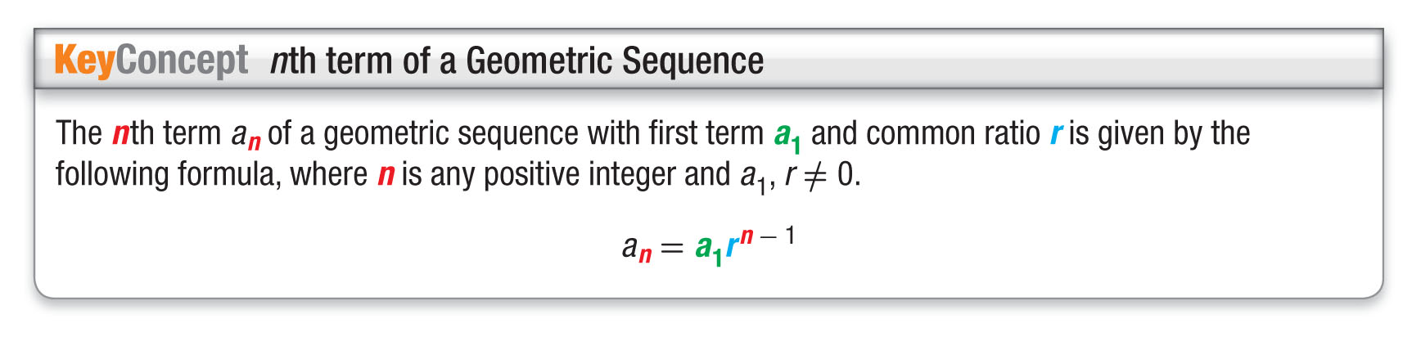
Concept

Slide 22
Example 3
Find the nth Term of a Geometric Sequence
A. Write an equation for the nth term of the geometric sequence 1, –2, 4, –8, ... .
The first term of the sequence is 1. So, a₁ = 1. Now find the common ratio.
1 –2 4 –8
The common ratio is –2.
–2
4
–8
___
= –2
___
= –2
___
= –2
1
–2
4
a_{n} = a₁r^{n – 1} Formula for the nth term
a_{n} = 1(–2)^{n – 1} a₁ = 1 and r = –2
Answer: a_{n} = 1(–2)^{n – 1}

Slide 23
Example 3
Find the nth Term of a Geometric Sequence
B. Find the 12th term of the sequence.
1, –2, 4, –8, ... .
a_{n} = a₁r^{n – 1} Formula for the nth term
a₁₂ = 1(–2)^{12 – 1} For the nth term, n = 12.
= 1(–2)¹¹ Simplify.
= 1(–2048) (–2)¹¹ = –2048
= –2048 Multiply.
Answer: The 12th term of the sequence is –2048.

Slide 24
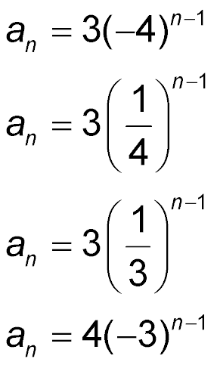
Example 3
A. Write an equation for the nth term of the geometric sequence 3, –12, 48, –192, ....
A.
B.
C.
D.

Slide 25
Example 3
B. Find the 7th term of this sequence using the equation a_{n} = 3(–4)^{n – 1}.
A. 768
B. –3072
C. 12,288
D. –49,152

Slide 26
Example 4
Graph a Geometric Sequence
ART A 50-pound ice sculpture is melting at a rate in which 80% of its weight remains each hour. Draw a graph to represent how many pounds of the sculpture is left at each hour.
Compared to each previous hour, 80% of the weight remains. So, r = 0.80. Therefore, the geometric sequence that models this situation is 50, 40, 32, 25.6, 20.48,….
So after 1 hour, the sculpture weighs 40 pounds,
32 pounds after 2 hours, 25.6 pounds after 3 hours, and so forth. Use this information to draw a graph.

Slide 27
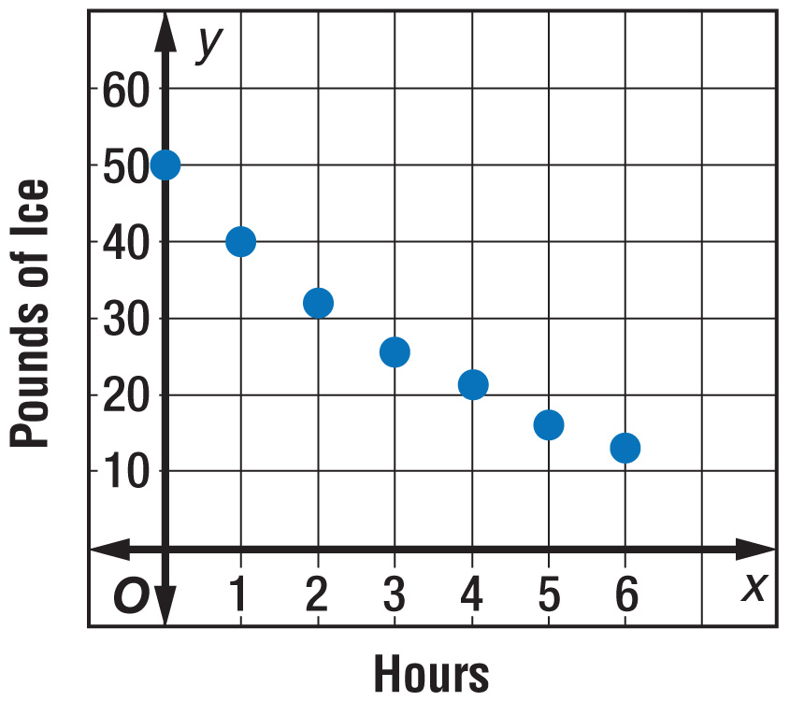
Example 4
Graph a Geometric Sequence
Answer:

Slide 28
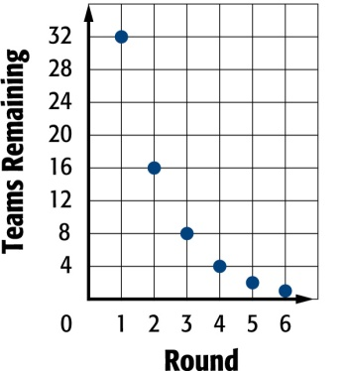
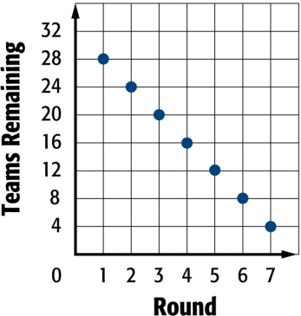
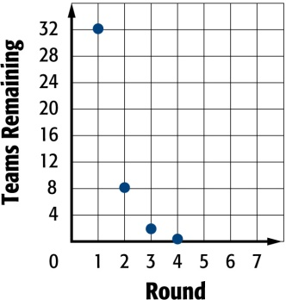
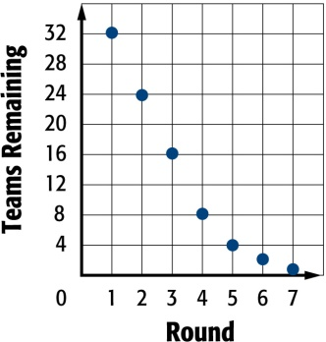
Example 4
SOCCER A soccer tournament begins with 32 teams in the first round. In each of the following rounds, one half of the teams are left to compete, until only one team remains. Draw a graph to represent how many teams are left to compete in each round.
A. B.
C. D.

Slide 29
End of the Lesson

