Slide 1


Splash Screen

Slide 2
Lesson Menu
Five-Minute Check (over Lesson 7–7)
CCSS
Then/Now
Example 1: Use a Recursive Formula
Key Concept: Writing Recursive Formulas
Example 2: Write Recursive Formulas
Example 3: Write Recursive and Explicit Formulas
Example 4: Translate between Recursive and
Explicit Formulas

Slide 3

5-Minute Check 1
Which best describes the sequence 1, 4, 9, 16, …?
A. arithmetic
B. geometric
C. neither

Slide 4

5-Minute Check 2
Which best describes the sequence 3, 7, 11, 15, …?
A. arithmetic
B. geometric
C. neither

Slide 5

5-Minute Check 3
Which best describes the sequence 1, –2, 4, –8, …?
A. arithmetic
B. geometric
C. neither

Slide 6

5-Minute Check 4
Find the next three terms in the geometric sequence 2, –10, 50, … .
A. –50, 250, –1250
B. –20, 100, –40
C. –250, 1250, –6250
D. –250, 500, –1000

Slide 7

5-Minute Check 5
What is the function rule for the sequence
12, –24, 48, –96, 192, …?
A. A(n) = 2^{–2n}
B. A(n) = 3 ● 2^{n – 1}
C. A(n) = 4 ● 3^{n – 1}
D. A(n) = 3 ● (–2)^{n + 1}

Slide 8

CCSS
Content Standards
F.IF.3 Recognize that sequences are functions, sometimes defined recursively, whose domain is a subset of the integers.
F.BF.2 Write arithmetic and geometric sequences both recursively and with an explicit formula, use them to model situations, and translate between the two forms.
Mathematical Practices
3 Construct viable arguments and critique the reasoning of others.
Common Core State Standards © Copyright 2010. National Governors Association Center for Best Practices and Council of Chief State School Officers. All rights reserved.

Slide 9


Then/Now
You wrote explicit formulas to represent arithmetic and geometric sequences.
Use a recursive formula to list terms in a sequence.
Write recursive formulas for arithmetic and geometric sequences.

Slide 10
Example 1
Use a Recursive Formula
Find the first five terms of the sequence in which
a₁ = –8 and a_{n} = –2a_{n – 1} + 5, if n ≥ 2.
The given first term is a₁ = –8. Use this term and the recursive formula to find the next four terms.
a₂ = –2a_{2 – 1} + 5 n = 2
= –2a₁ + 5 Simplify.
= –2(–8) + 5 or 21 a₁ = –8
a₃ = –2a_{3 – 1} + 5 n = 3
= –2a₂ + 5 Simplify.
= –2(21) + 5 or –37 a₂ = 21

Slide 11
Example 1
Use a Recursive Formula
a₄ = –2a_{4 – 1} + 5 n = 4
= –2a₃ + 5 Simplify.
= –2(–37) + 5 or 79 a₃ = –37
a₅ = –2a_{5 – 1} + 5 n = 5
= –2a₄ + 5 Simplify.
= –2(79) + 5 or –153 a₄ = 79
Answer: The first five terms are –8, 21, –37, 79,
and –153.

Slide 12


Example 1
Find the first five terms of the sequence in which
a₁ = –3 and a_{n} = 4a_{n – 1} – 9, if n ≥ 2.
A. –3, –12, –48, –192, –768
B. –3, –21, –93, –381, –1533
C. –12, –48, –192, –768, –3072
D. –21, –93, –381, –1533, –6141

Slide 13
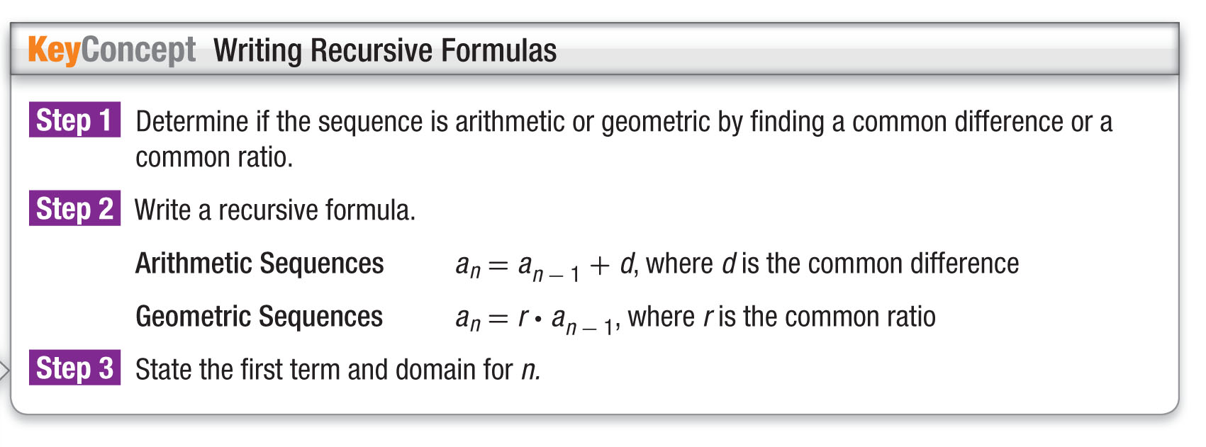
Concept

Slide 14
Example 2
Write Recursive Formulas
A. Write a recursive formula for the sequence
23, 29, 35, 41,…
Step 1
First subtract each term from the term that follows it.
29 – 23 = 6 35 – 29 = 6 41 – 35 = 6
There is a common difference of 6. The sequence is arithmetic.
Step 2
Use the formula for an arithmetic sequence.
a_{n} = a_{n –1} + d Recursive formula for arithmetic
sequence.
a_{n} = a_{n –1} + 6 d = 6

Slide 15
Example 2
Write Recursive Formulas
Step 3
The first term a₁ is 23, and n ≥ 2.
Answer: A recursive formula for the sequence is
a₁ = 23, a_{n} = a_{n – 1},+ 6, n ≥ 2.

Slide 16
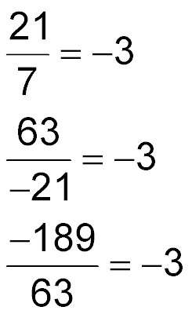
Example 2
Write Recursive Formulas
B. Write a recursive formula for the sequence
7, –21, 63, –189,…
Step 1
First subtract each term from the term that follows it.
–21 – 7 = –28 63 – (–21) = 84 –189 – 63 = –252
There is no common difference. Check for a common ratio by dividing each term by the term that precedes it.
There is a common ratio of –3. The sequence is geometric.

Slide 17
Example 2
Write Recursive Formulas
Step 2
Use the formula for a geometric sequence.
a_{n} = r ● a_{n –1} Recursive formula for geometric
sequence.
a_{n} = –3a_{n –1} r = –3
Step 3
The first term a₁ is 7, and n ≥ 2.
Answer: A recursive formula for the sequence is
a₁ = 7, a_{n} = –3a_{n – 1}, n ≥ 2.

Slide 18
Example 2
Write a recursive formula for –3, –12, –21, –30,…
A. a₁ = –3, a_{n} = –4a_{n – 1}, n ≥ 2
B. a₁ = –3, a_{n} = 4a_{n – 1}, n ≥ 2
C. a₁ = –3, a_{n} = a_{n – 1} – 9, n ≥ 2
D. a₁ = –3, a_{n} = a_{n – 1} + 9, n ≥ 2

Slide 19
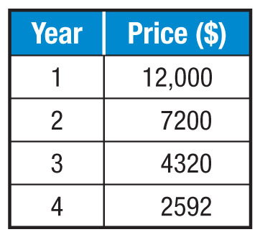
Example 3
Square of a Difference
A. CARS The price of a car depreciates at the end of each year. Write a recursive formula for the sequence.
Step 1
First subtract each term from the
term that follows it.
7200 – 12,000 = –4800
4320 – 7200 = –2880
2592 – 4320 = –1728
There is no common difference. Check for a common ratio by dividing each term by the term that precedes it.

Slide 20
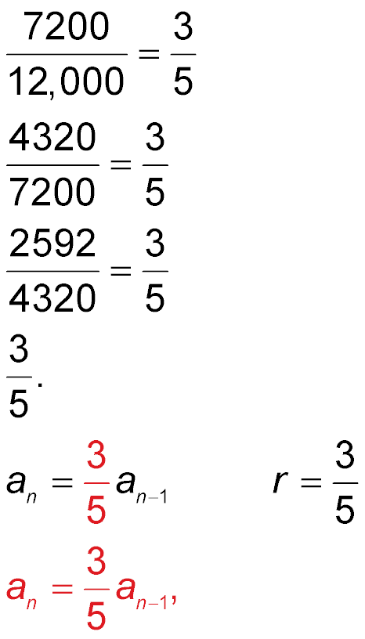
Example 3
Square of a Difference
There is a common ratio of The sequence is geometric.
Step 2
Use the formula for a geometric sequence.
a_{n} = r ● a_{n –1} Recursive formula for geometric
sequence.

Slide 21
Example 3
Square of a Difference
Step 3
The first term a₁ is 12,000, and n ≥ 2.
Answer: A recursive formula for the sequence is
a₁ = 12,000, n ≥ 2.

Slide 22
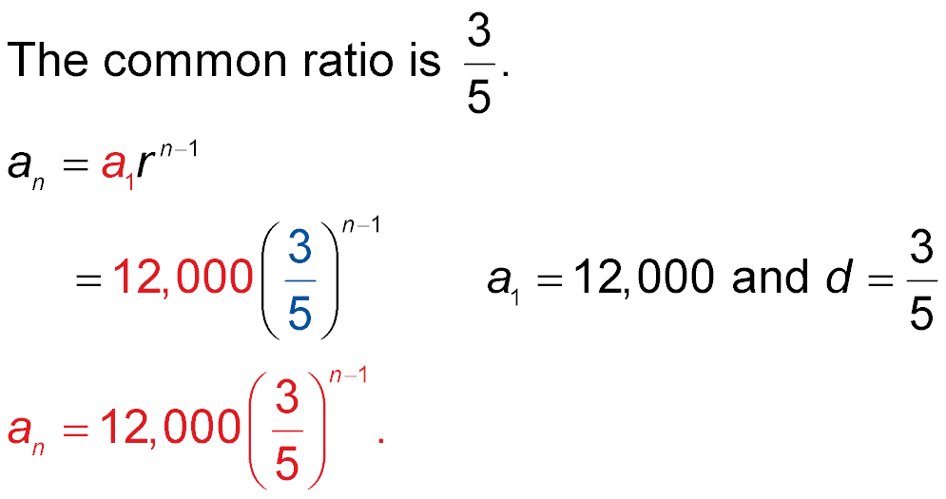
Example 3
Square of a Difference
A. CARS The price of a car depreciates at the end of each year. Write a explicit formula for the sequence.
Step 1
Step 2
Use the formula for the nth term of a geometric sequence.
a_{n} = a₁r^{n–1} Formula for nth term.

Slide 23
Example 3
Square of a Difference
Answer: An explicit formula for the sequence is

Slide 24
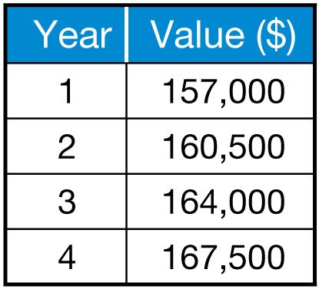
Example 3
HOMES The value of a home has increased each year. Write a recursive and explicit formula for the sequence.
A. a₁ = 157,000, a_{n} = a_{n – 1} + 3500,
n ≥ 2; a_{n} = 157,000 + 3500n
B. a₁ = 157,000, a_{n} = a_{n – 1} + 3500, n ≥ 2;
a_{n} = 153,500 + 3500n
C. a₁ = 153,500, a_{n} = a_{n – 1} + 3500, n ≥ 2;
a_{n} = 153,500 + 3500n
D. a₁ = 153,500, a_{n} = a_{n – 1} + 3500, n ≥ 2;
a_{n} = 157,000 + 3500n

Slide 25
Example 4
Translate between Recursive and
Explicit Formulas
A. Write a recursive formula for a_{n} = 2n – 4.
a_{n} = 2n – 4 is an explicit formula for an arithmetic sequence with d = 2 and a₁ = 2(1) – 4 or –2. Therefore,
a recursive formula for a_{n} is a₁ = –2, a_{n} = a_{n – 1} + 2,
n ≥ 2.
Answer: a₁ = –2, a_{n} = a_{n – 1} + 2, n ≥ 2

Slide 26
Example 4
Translate between Recursive and
Explicit Formulas
B. Write an explicit formula for a₁ = 84, a_{n} = 1.5a_{n – 1},
n ≥ 2.
a₁ = 84, a_{n} = 1.5a_{n – 1} is a recursive formula with a₁ = 84 and r = 1.5. Therefore, an explicit formula for a_{n} is
a_{n} = 84(1.5)^{n – 1}.
Answer: a_{n} = 84(1.5)^{n – 1}

Slide 27
Example 4
Write an explicit formula for a₁ = 9, a_{n} = 0.2a_{n – 1}, n ≥ 2.
A. a_{n} = 45(0.2)^{n – 1}
B. a_{n} = 9(0.2)^{n + 1}
C. a_{n} = 9(0.2)^{n}
D. a_{n} = 9(0.2)^{n – 1}

Slide 28
End of the Lesson

