Slide 1


Splash Screen

Slide 2
Lesson Menu
Five-Minute Check (over Chapter 7)
CCSS
Then/Now
New Vocabulary
Example 1: Identify Polynomials
Example 2: Standard Form of a Polynomial
Example 3: Add Polynomials
Example 4: Subtract Polynomials
Example 5: Real-World Example: Add and Subtract Polynomials

Slide 3

5-Minute Check 1
Determine whether –8 is a polynomial. If so, identify it as a monomial, binomial, or trinomial.
A. yes; monomial
B. yes; binomial
C. yes; trinomial
D. not a polynomial

Slide 4
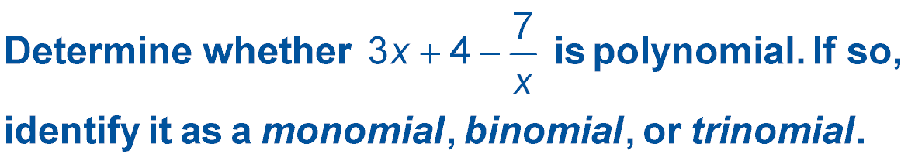

5-Minute Check 2
A. yes; monomial
B. yes; binomial
C. yes; trinomial
D. not a polynomial

Slide 5
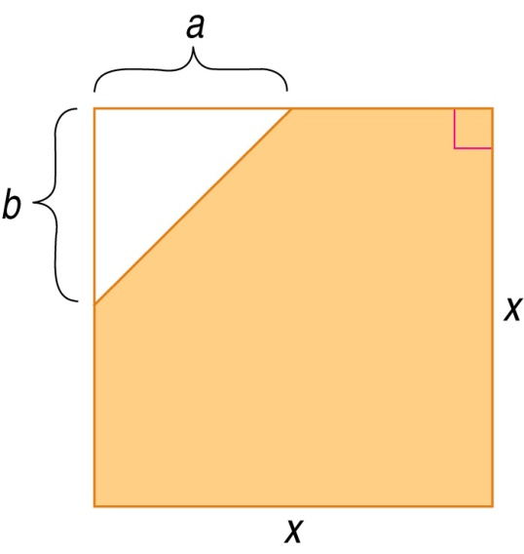

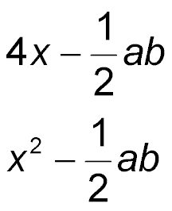
5-Minute Check 3
Which polynomial represents the area of the shaded region?
A.
B. 2x – ab
C.
D. x² – ab

Slide 6

5-Minute Check 4
What is the degree of the polynomial
5ab³ + 4a²b + 3b⁵ – 2?
A. 6
B. 5
C. 4
D. 3

Slide 7

5-Minute Check 5
Which of the following polynomials is a cubic trinomial?
A. –2x⁴ + 5x²
B. 4g³ – 8g² + 6
C. 7w² + 12 – 5w⁴
D. 16 – 3p + 9p²

Slide 8

CCSS
Content Standards
A.SSE.1a Interpret parts of an expression, such as terms, factors, and coefficients.
A.APR.1 Understand that polynomials form a system analogous to the integers, namely, they are closed under the operations of addition, subtraction, and multiplication; add, subtract, and multiply polynomials.
Mathematical Practices
3 Construct viable arguments and critique the reasoning of others.
Common Core State Standards © Copyright 2010. National Governors Association Center for Best Practices and Council of Chief State School Officers. All rights reserved.

Slide 9


Then/Now
You identified monomials and their characteristics.
Write polynomials in standard form.
Add and subtract polynomials.

Slide 10

Vocab
polynomial
binomial
trinomial
degree of a monomial
degree of a polynomial
standard form of a polynomial
leading coefficient

Slide 11
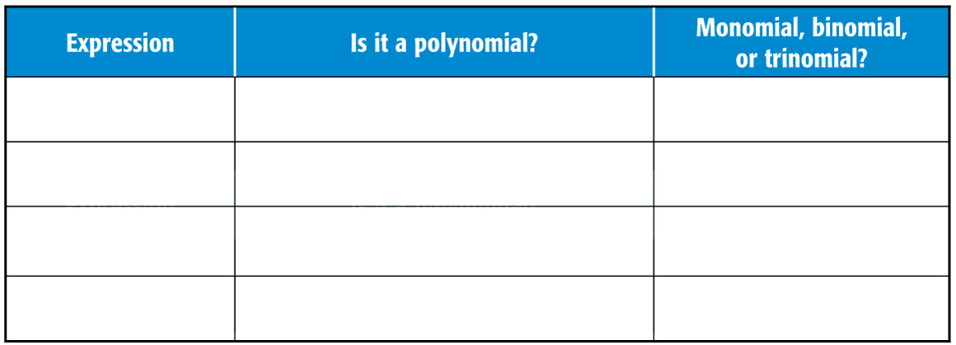
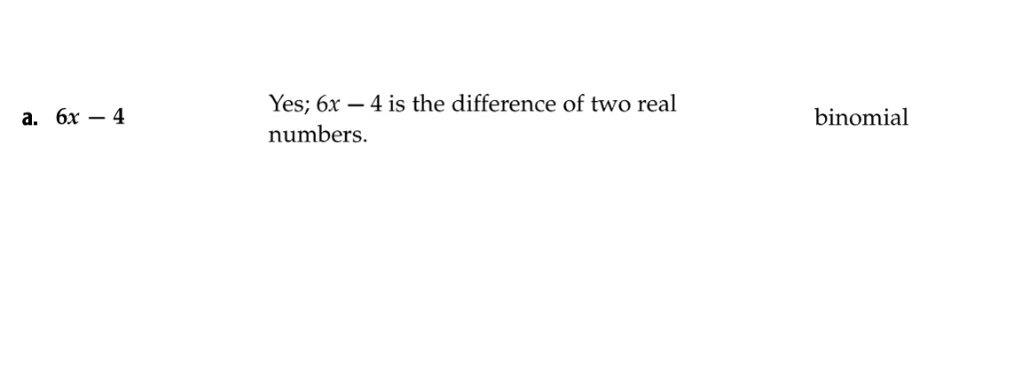
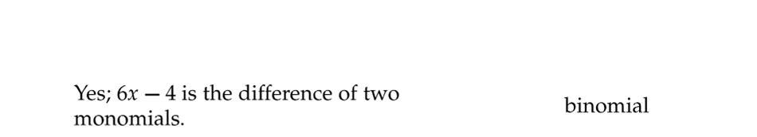
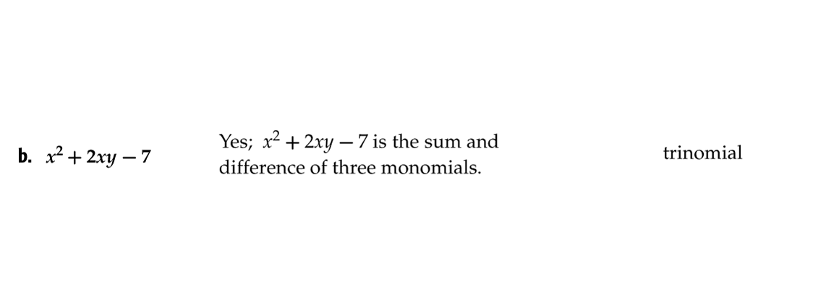
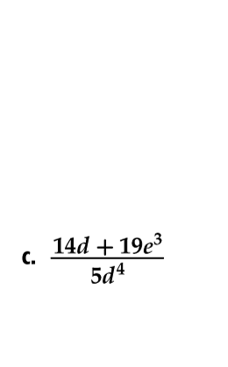
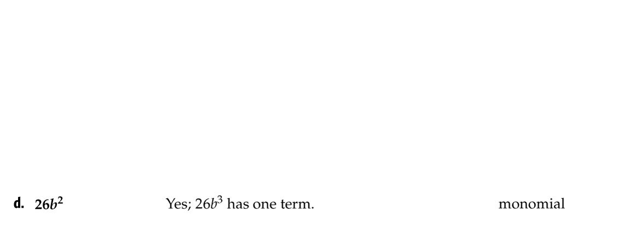
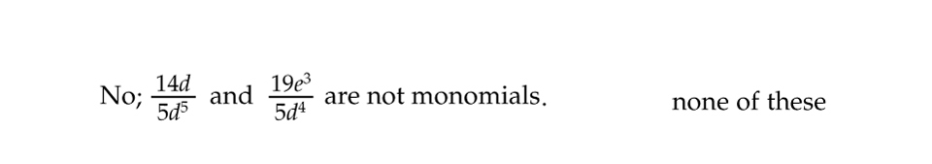
Example 1
Identify Polynomials
State whether each expression is a polynomial. If it is a polynomial, identify it as a monomial, binomial, or trinomial.

Slide 12


Example 1
A. State whether 3x² + 2y + z is a polynomial. If it is
a polynomial, identify it as a monomial, binomial, or trinomial.
A. yes, monomial
B. yes, binomial
C. yes, trinomial
D. not a polynomial

Slide 13
Example 1
B. State whether 4a² – b^{–2} is a polynomial. If it is a polynomial, identify it as a monomial, binomial, or trinomial.
A. yes, monomial
B. yes, binomial
C. yes, trinomial
D. not a polynomial

Slide 14
Example 1
C. State whether 8r – 5s is a polynomial. If it is a polynomial, identify it as a monomial, binomial, or trinomial.
A. yes, monomial
B. yes, binomial
C. yes, trinomial
D. not a polynomial

Slide 15
Example 1
D. State whether 3y⁵ is a polynomial. If it is a polynomial, identify it as a monomial, binomial, or trinomial.
A. yes, monomial
B. yes, binomial
C. yes, trinomial
D. not a polynomial

Slide 16
Example 2
Standard Form of a Polynomial
A. Write 9x² + 3x⁶ – 4x in standard form. Identify the leading coefficient.
Step 1 Find the degree of each term.
Degree: 2 6 1
Polynomial: 9x² + 3x⁶ – 4x
Step 2 Write the terms in descending order.
Answer: 3x⁶ + 9x² – 4x;
the leading coefficient is 3.

Slide 17
Example 2
Standard Form of a Polynomial
B. Write 12 + 5y + 6xy + 8xy² in standard form. Identify the leading coefficient.
Step 1 Find the degree of each term.
Degree: 0 1 2 3
Polynomial: 12 + 5y + 6xy + 8xy²
Step 2 Write the terms in descending order.
Answer: 8xy² + 6xy + 5y + 12;
the leading coefficient is 8.

Slide 18
Example 2
A. Write –34x + 9x⁴ + 3x⁷ – 4x² in standard form.
A. 3x⁷ + 9x⁴ – 4x² – 34x
B. 9x⁴ + 3x⁷ – 4x² – 34x
C. –4x² + 9x⁴ + 3x⁷ – 34x
D. 3x⁷ – 4x² + 9x⁴ – 34x

Slide 19
Example 2
B. Identify the leading coefficient of
5m + 21 –6mn + 8mn³ – 72n³ when it is written in standard form.
A. –72
B. 8
C. –6
D. 72

Slide 20
Example 3
Add Polynomials
A. Find (7y² + 2y – 3) + (2 – 4y + 5y²).
Horizontal Method
(7y² + 2y – 3) + (2 – 4y + 5y²)
= (7y² + 5y²) + [2y + (–4y) + [(–3) + 2] Group like terms.
= 12y² – 2y – 1 Combine like terms.

Slide 21
Example 3
Add Polynomials
Vertical Method
7y² + 2y – 3
(+) 5y² – 4y + 2
Notice that terms are in descending order with like terms aligned.
12y² – 2y – 1
Answer: 12y² – 2y – 1

Slide 22
Example 3
Add Polynomials
B. Find (4x² – 2x + 7) + (3x – 7x² – 9).
Horizontal Method
(4x² – 2x + 7) + (3x – 7x² – 9)
= [4x² + (–7x²)] + [(–2x) + 3x] + [7 + (–9)] Group like terms.
= –3x² + x – 2 Combine like terms.

Slide 23
Example 3
Add Polynomials
Vertical Method
4x² – 2x + 7
(+) –7x² + 3x – 9
Align and combine like terms.
–3x² + x – 2
Answer: –3x² + x – 2

Slide 24
Example 3
A. Find (3x² + 2x – 1) + (–5x² + 3x + 4).
A. –2x² + 5x + 3
B. 8x² + 6x – 4
C. 2x² + 5x + 4
D. –15x² + 6x – 4

Slide 25
Example 3
B. Find (4x³ + 2x² – x + 2) + (3x² + 4x – 8).
A. 5x² + 3x – 6
B. 4x³ + 5x² + 3x – 6
C. 7x³ + 5x² + 3x – 6
D. 7x³ + 6x² + 3x – 6

Slide 26
Example 4
Subtract Polynomials
A. Find (6y² + 8y⁴ – 5y) – (9y⁴ – 7y + 2y²).
Horizontal Method
Subtract 9y⁴ – 7y + 2y² by adding its additive inverse.
(6y² + 8y⁴ – 5y) – (9y⁴ – 7y + 2y²)
= (6y² + 8y⁴ – 5y) + (–9y⁴ + 7y – 2y²)
= [8y⁴ + (–9y⁴)] + [6y² + (–2y²)] + (–5y + 7y)
= –y⁴ + 4y² + 2y

Slide 27
Example 4
Subtract Polynomials
Vertical Method
Align like terms in columns and subtract by adding the additive inverse.
8y⁴ + 6y² – 5y
(–) 9y⁴ + 2y² – 7y
8y⁴ + 6y² – 5y
(+) –9y⁴ – 2y² + 7y
Add the opposite.
–y⁴ + 4y² + 2y
Answer: –y⁴ + 4y² + 2y

Slide 28
Example 4
Subtract Polynomials
Find (6n² + 11n³ + 2n) – (4n – 3 + 5n²).
Horizontal Method
Subtract 4n⁴ – 3 + 5n² by adding the additive inverse.
(6n² + 11n³ + 2n) – (4n – 3 + 5n²)
= (6n² + 11n³ + 2n) + (–4n + 3 – 5n² )
= 11n³ + [6n² + (–5n²)] + [2n + (–4n)] + 3
= 11n³ + n² – 2n + 3
Answer: 11n³ + n² – 2n + 3

Slide 29
Example 4
Subtract Polynomials
Vertical Method
Align like terms in columns and subtract by adding the additive inverse.
11n³ + 6n² + 2n + 0
(–) 0n³ + 5n² + 4n – 3
11n³ + 6n² + 2n + 0
(+) 0n³ – 5n² – 4n + 3
Add the opposite.
11n³ + n² – 2n + 3
Answer: 11n³ + n² – 2n + 3

Slide 30
Example 4
A. Find (3x³ + 2x² – x⁴) – (x² + 5x³ – 2x⁴).
A. 2x² + 7x³ – 3x⁴
B. x⁴ – 2x³ + x²
C. x² + 8x³ – 3x⁴
D. 3x⁴ + 2x³ + x²

Slide 31
Example 4
B. Find (8y⁴ + 3y² – 2) – (6y⁴ + 5y³ + 9).
A. 2y⁴ – 2y² – 11
B. 2y⁴ + 5y³ + 3y² – 11
C. 2y⁴ – 5y³ + 3y² – 11
D. 2y⁴ – 5y³ + 3y² + 7

Slide 32
Example 5
Add and Subtract Polynomials
A. VIDEO GAMES The total amount of toy sales T
(in billions of dollars) consists of two groups: sales of video games V and sales of traditional toys R. In recent years, the sales of traditional toys and total sales could be modeled by the following equations, where n is the number of years since 2000.
R = 0.46n³ – 1.9n² + 3n + 19
T = 0.45n³ – 1.85n² + 4.4n + 22.6
A. Write an equation that represents the sales of video games V.

Slide 33
Example 5
Add and Subtract Polynomials
Find an equation that models the sales of video games V.
video games + traditional toys = total toy sales
V + R = T
V = T – R
Subtract the polynomial for R from the polynomial for T.
0.45n³ – 1.85n² + 4.4n + 22.6
(–) 0.46n³ – 1.9n² + 3n + 19

Slide 34
Example 5
Add and Subtract Polynomials
0.45n³ – 1.85n² + 4.4n + 22.6
(+) –0.46n³ + 1.9n² – 3n – 19
–0.01n³ + 0.05n² + 1.4n + 3.6
Add the opposite.
Answer: V = –0.01n³ + 0.05n² + 1.4n + 3.6

Slide 35
Example 5
Add and Subtract Polynomials
B. Use the equation to predict the amount of video game sales in the year 2009.
The year 2009 is 2009 – 2000 or 9 years after the year 2000. Substitute 9 for n.
V = –0.01(9)³ + 0.05(9)² + 1.4(9) + 3.6
= –7.29 + 4.05 + 12.6 + 3.6
= 12.96
Answer: The amount of video game sales in 2009 will be 12.96 billion dollars.

Slide 36
Example 5
A. BUSINESS The profit a business makes is found by subtracting the cost to produce an item C from the amount earned in sales S. The cost to produce and the sales amount could be modeled by the following equations, where x is the number of items produced.
C = 100x² + 500x – 300
S = 150x² + 450x + 200
Find an equation that models the profit.
A. 50x² – 50x + 500
B. –50x² – 50x + 500
C. 250x² + 950x + 500
D. 50x² + 950x + 100

Slide 37
Example 5
B. Use the equation 50x² – 50x + 500 to predict the profit if 30 items are produced and sold.
A. $500
B. $30
C. $254,000
D. $44,000

Slide 38
End of the Lesson

