Slide 1


Splash Screen

Slide 2
Lesson Menu
Five-Minute Check (over Lesson 8–1)
CCSS
Then/Now
Example 1: Multiply a Polynomial by a Monomial
Example 2: Simplify Expressions
Example 3: Standardized Test Example
Example 4: Equations with Polynomials on Both Sides

Slide 3

5-Minute Check 1
Find (6a + 7b²) + (2a² – 3a + b²).
A. 2a² + 3a + 8b²
B. 2a² + 9a + 7b²
C. 8a² + 10a + b²
D. 8a² – 3a + 8b²

Slide 4

5-Minute Check 2
Find (5x² – 3) – (x² + 4x).
A. 6x² + 4x – 3
B. 6x² + x – 3
C. 4x² – 4x – 3
D. 4x² – x + 3

Slide 5

5-Minute Check 3
Find (6x² + 2x – 9) – (3x² – 8x + 2) + (x + 1).
A. 3x² + 6x – 7
B. 3x² + 11x – 10
C. 3x² – 10x – 6
D. 9x² + 11x – 10

Slide 6
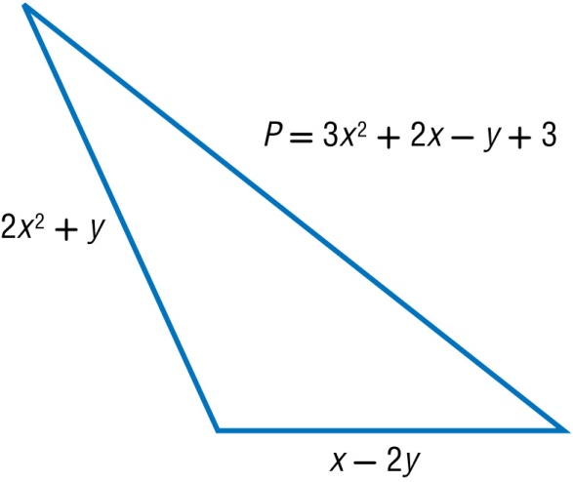

5-Minute Check 4
If P is the perimeter of the triangle and the measures of two sides are given, find the measure of the third side of the triangle.
A. x² + x + 3
B. x² + 2x – 3
C. 2x² + 2x + 3
D. 2x² + x – y

Slide 7

5-Minute Check 5
Simplify (8a⁴ – 3a² – 9) – (2a³ – 14 – 3a²).
A. 8a⁴ – 6a² – 2a³ – 23
B. 8a⁴ – 2a³ + 5
C. 8a⁴ – 2a³ – 6a² – 23
D. 8a⁴ + 5 – 2a³ – 6a²

Slide 8

CCSS
Content Standards
A.APR.1 Understand that polynomials form a system analogous to the integers, namely, they are closed under the operations of addition, subtraction, and multiplication; add, subtract, and multiply polynomials.
Mathematical Practices
5 Use appropriate tools strategically.
Common Core State Standards © Copyright 2010. National Governors Association Center for Best Practices and Council of Chief State School Officers. All rights reserved.

Slide 9


Then/Now
You multiplied monomials.
Multiply a polynomial by a monomial.
Solve equations involving the products of monomials and polynomials.

Slide 10
Example 1
Multiply a Polynomial by a Monomial
Find 6y(4y² – 9y – 7).
Horizontal Method
6y(4y² – 9y – 7) Original expression
= 6y(4y²) – 6y(9y) – 6y(7) Distributive Property
= 24y³ – 54y² – 42y Multiply.

Slide 11
Example 1
Multiply a Polynomial by a Monomial
Vertical Method
4y² – 9y – 7
(×) 6y Distributive Property
24y³ – 54y² – 42y Multiply.
Answer: 24y³ – 54y² – 42y

Slide 12


Example 1
Find 3x(2x² + 3x + 5).
A. 6x² + 9x + 15
B. 6x³ + 9x² + 15x
C. 5x³ + 6x² + 8x
D. 6x² + 3x + 5

Slide 13
Example 2
Simplify Expressions
Simplify 3(2t² – 4t – 15) + 6t(5t + 2).
3(2t² – 4t – 15) + 6t(5t + 2)
= 3(2t²) – 3(4t) – 3(15) + 6t(5t) + 6t(2) Distributive Property
= 6t² – 12t – 45 + 30t² + 12t Multiply.
= (6t² + 30t²) + [(–12t) + 12t] – 45 Commutative and Associative Properties
= 36t² – 45 Combine like terms.
Answer: 36t² – 45

Slide 14
Example 2
Simplify 5(4y² + 5y – 2) + 2y(4y + 3).
A. 4y² + 9y + 1
B. 8y² + 5y – 6
C. 20y² + 9y + 6
D. 28y² + 31y – 10

Slide 15
Example 3
GRIDDED RESPONSE Admission to the Super Fun Amusement Park is $10. Once in the park, super rides are an additional $3 each and regular rides are an additional $2. Wyome goes to the park and rides 15 rides, of which s of those 15 are super rides. Find the cost if Wyome rode 9 super rides.
Read the Test Item
The question is asking you to find the total cost if
Wyome rode 9 super rides, in addition to the regular rides, and park admission.

Slide 16
Example 3
Solve the Test Item
Write an equation to represent the total money Wyome spent.
Let C represent the total cost of the day.
C = 3s + 2(15 – s) + 10 total cost
= 3(9) + 2(15 – 9) + 10 Substitute 9 in for s.
= 3(9) + 2(6) + 10 Subtract 9 from 15.
= 27 + 12 + 10 Multiply.
= 49 Add.

Slide 17
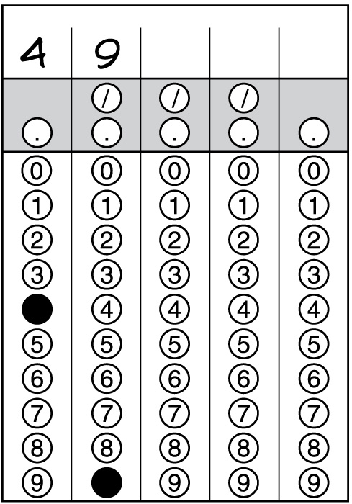
Example 3
Answer: It cost $49 to ride 9 super rides, 6 regular rides, and admission.

Slide 18
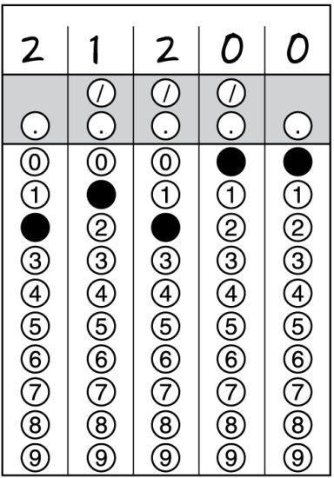
Example 3
The Fosters own a vacation home that they rent throughout the year. The rental rate during peak season is $120 per day and the rate during the off-peak season is $70 per day. Last year they rented the house 210 days, p of which were during peak season. Determine how much rent the Fosters received if p is equal to 130.
A. $120,000
B. $21,200
C. $70,000
D. $210,000

Slide 19
Example 4
Equations with Polynomials on Both Sides
Solve b(12 + b) – 7 = 2b + b(–4 + b).
b(12 + b) – 7 = 2b + b(–4 + b) Original equation
12b + b² – 7 = 2b – 4b + b² Distributive Property
12b + b² – 7 = –2b + b² Combine like terms.
12b – 7 = –2b Subtract b² from each side.

Slide 20
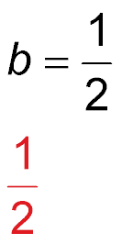
Example 4
Equations with Polynomials on Both Sides
12b = –2b + 7 Add 7 to each side.
14b = 7 Add 2b to each side.
Divide each side by 14.
Answer:

Slide 21
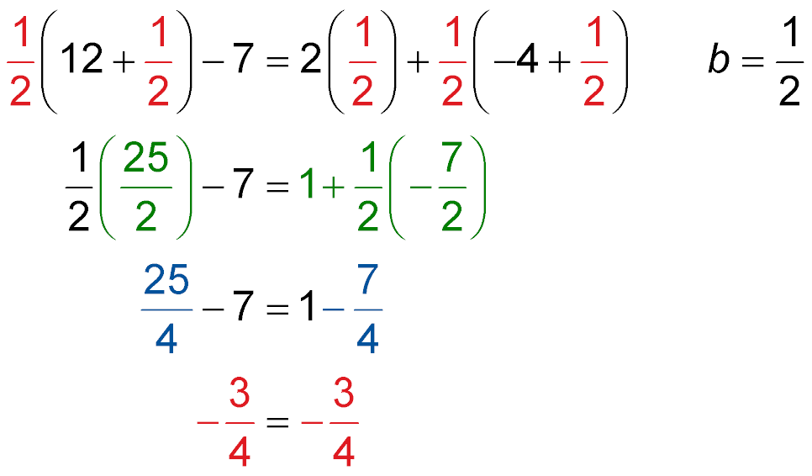
Example 4
Equations with Polynomials on Both Sides
Check b(12 + b) – 7 = 2b + b(–4 + b) Original equation
Simplify.
Multiply.
✓
Subtract.

Slide 22
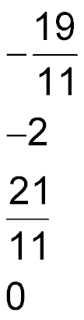
Example 4
Solve x(x + 2) + 2x(x – 3) + 7 = 3x(x – 5) – 12.
A.
B.
C.
D.

Slide 23
End of the Lesson

