Slide 1


Splash Screen

Slide 2
Lesson Menu
Five-Minute Check (over Lesson 8–2)
CCSS
Then/Now
New Vocabulary
Example 1: The Distributive Property
Key Concept: FOIL Method
Example 2: FOIL Method
Example 3: Real-World Example: FOIL Method
Example 4: The Distributive Property

Slide 3

5-Minute Check 1
Find –3w(w² + 7w – 9).
A. 3w – 9
B. –3w² + 4w – 12
C. –3w² + 21w + 27
D. –3w³ – 21w² + 27w

Slide 4
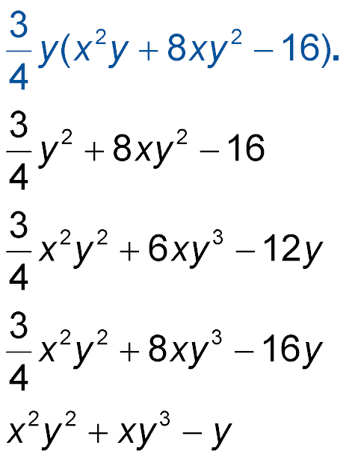

5-Minute Check 2
Find
A.
B.
C.
D.

Slide 5

5-Minute Check 3
Simplify 3ab(5a² – a – 2) + 2a(b + 1).
A. 15a³b – 3a²b – 4ab + 2a
B. 15ab – 3a² + 4ab²
C. 15a³ – a²b – 4ab
D. 8a³b – 3a²b – 2ab + a

Slide 6

5-Minute Check 4
Solve 3(2c – 3) – 1 = –4(2c + 1) + 8.
A. 3
B. 2
C. 1
D. 0

Slide 7



5-Minute Check 5
Solve 5(9w + 2) = 3(8w – 7) + 17.
A. 1
B. 0
C.
D.

Slide 8

5-Minute Check 6
Find the product of –7z and 4z – 3.
A. –28z² + 21
B. 28z² – 21z
C. 28z² – 21
D. –28z² + 21z

Slide 9

CCSS
Content Standards
A.APR.1 Understand that polynomials form a system analogous to the integers, namely, they are closed under the operations of addition, subtraction, and multiplication; add, subtract, and multiply polynomials.
Mathematical Practices
7 Look for and make use of structure.
Common Core State Standards © Copyright 2010. National Governors Association Center for Best Practices and Council of Chief State School Officers. All rights reserved.

Slide 10


Then/Now
You multiplied polynomials by monomials.
Multiply binomials by using the FOIL method.
Multiply polynomials by using the Distributive Property.

Slide 11

Vocabulary
FOIL method
quadratic expression

Slide 12
Example 1
The Distributive Property
A. Find (y + 8)(y – 4).
Vertical Method
Multiply by –4.
Multiply by y.
Combine like terms.
y + 8
(×) y – 4
y + 8
(×) y – 4
–4y – 32 –4(y + 8) = –4y – 32
y² + 8y y(y + 8) = y² + 8y
y² + 4y – 32

Slide 13
Example 1
The Distributive Property
Horizontal Method
(y + 8)(y – 4) = y(y – 4) + 8(y – 4) Rewrite as a sum of two products.
= y(y) – y(4) + 8(y) – 8(4) Distributive Property
= y² – 4y + 8y – 32 Multiply.
= y² + 4y – 32 Combine like terms.
Answer: y² + 4y – 32

Slide 14
Example 1
The Distributive Property
B. Find (2x + 1)(x + 6).
Vertical Method
Multiply by 6.
Multiply by x.
Combine like terms.
2x + 1
(×) x + 6
2x + 1
(×) x + 6
12x + 6 6(2x + 1) = 12x + 6
2x² + x x(2x + 1) = 2x² + x
2x² + 13x + 6

Slide 15
Example 1
The Distributive Property
Horizontal Method
(2x + 1)(x + 6) = 2x(x + 6) + 1(x + 6) Rewrite as a sum of two products.
= 2x(x) + 2x(6) + 1(x) + 1(6) Distributive Property
= 2x² + 12x + x + 6 Multiply.
= 2x² + 13x + 6 Combine like terms.
Answer: 2x² + 13x + 6

Slide 16


Example 1
A. Find (c + 2)(c – 4).
A. c² – 6c + 8
B. c² – 4c – 8
C. c² – 2c + 8
D. c² – 2c – 8

Slide 17
Example 1
B. Find (x + 3)(4x – 1).
A. 4x² – 11x – 3
B. 4x² + 11x – 3
C. 4x² + 13x – 3
D. 4x² + 12x – 3

Slide 18
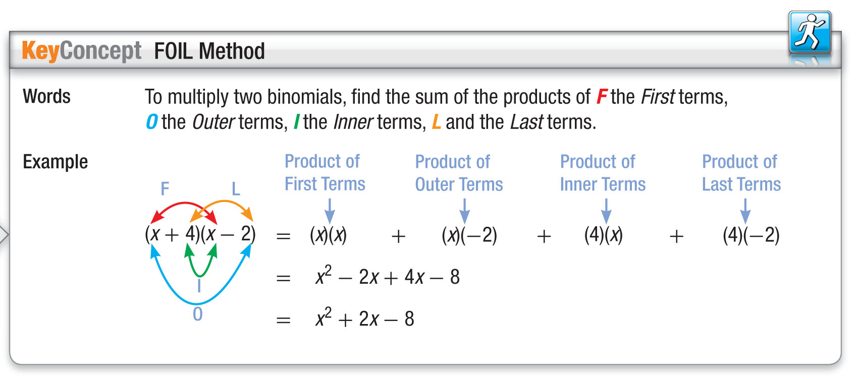
Concept

Slide 19
Example 2
FOIL Method
A. Find (z – 6)(z – 12).
F
L
F
O
I
L
(z – 6)(z – 12) = z(z)
(z – 6)(z – 12) = z(z) + z(–12)
(z – 6)(z – 12) = z(z) + z(–12) + (–6)z + (–6)(–12)
(z – 6)(z – 12) = z(z) + z(–12) + (–6)z
(z – 6)(z – 12)
I
= z² – 12z – 6z + 72 Multiply.
O
= z² – 18z + 72 Combine like terms.
Answer: z² – 18z + 72

Slide 20
Example 2
FOIL Method
B. Find (5x – 4)(2x + 8).
(5x – 4)(2x + 8)
F
O
I
L
= (5x)(2x) + (5x)(8) + (–4)(2x) + (–4)(8)
= 10x² + 40x – 8x – 32 Multiply.
= 10x² + 32x – 32 Combine like terms.
Answer: 10x² + 32x – 32

Slide 21
Example 2
A. Find (x + 2)(x – 3).
A. x² + x – 6
B. x² – x – 6
C. x² + x + 6
D. x² + x + 5

Slide 22
Example 2
B. Find (3x + 5)(2x – 6).
A. 5x² – 8x + 30
B. 6x² + 28x – 1
C. 6x² – 8x – 30
D. 6x – 30

Slide 23
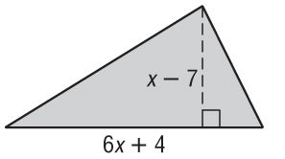
Example 3
FOIL Method
PATIO A patio in the shape of the
triangle shown is being built in
Lavali’s backyard. The dimensions
given are in feet. The area A of the
triangle is one half the height h times
the base b. Write an expression for the area of the patio.
Understand We need to find an expression for the area of the patio. We know the measurements of the height and base.
Plan Use the formula for the area of a triangle. Identify the height and base.
h = x – 7
b = 6x + 7

Slide 24
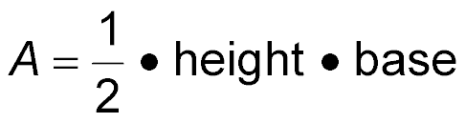
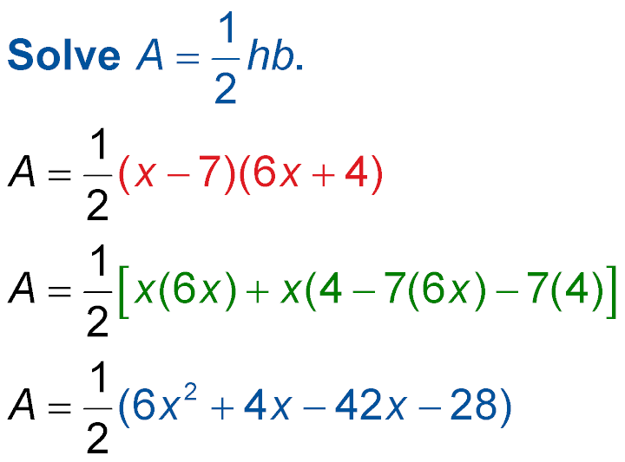
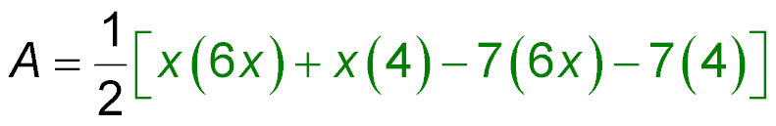
Example 3
FOIL Method
Solve
Original formula
Substitution
FOIL method
Multiply.

Slide 25
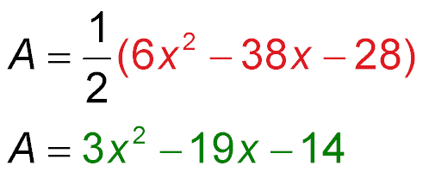
Example 3
FOIL Method
Combine like terms.
Distributive Property
Answer: The area of the triangle is 3x² – 19x – 14 square feet.
Check Choose a value for x. Substitute this value into
(x – 7)(6x + 4) and 3x² – 19x – 14. If the result is the same for both expressions, then they are equivalent.
1
__
2

Slide 26
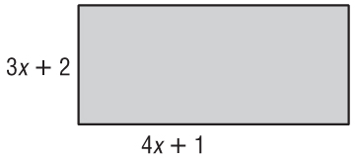
Example 3
GEOMETRY The area of a rectangle is the measure of the base times the height. Write an expression for the area of the rectangle.
A. 7x + 3 units²
B. 12x² + 11x + 2 units²
C. 12x² + 8x + 2 units²
D. 7x² + 11x + 3 units²

Slide 27
Example 4
The Distributive Property
A. Find (3a + 4)(a² – 12a + 1).
(3a + 4)(a² – 12a + 1)
= 3a(a² – 12a + 1) + 4(a² – 12a + 1) Distributive
Property
= 3a³ – 36a² + 3a + 4a² – 48a + 4 Distributive
Property
= 3a³ – 32a² – 45a + 4 Combine like terms.
Answer: 3a³ – 32a² – 45a + 4

Slide 28
Example 4
The Distributive Property
B. Find (2b² + 7b + 9)(b² + 3b – 1) .
(2b² + 7b + 9)(b² + 3b – 1)
= (2b²)(b² + 3b – 1) + 7b(b² + 3b – 1) + 9(b² + 3b – 1)
Distributive Property
= 2b⁴ + 6b³ – 2b² + 7b³ + 21b² – 7b + 9b² + 27b – 9
Distributive Property
= 2b⁴ + 13b³ + 28b² + 20b – 9 Combine like terms.
Answer: 2b⁴ + 13b³ + 28b² + 20b – 9

Slide 29
Example 4
A. Find (3z + 2)(4z² + 3z + 5).
A. 12z³ + 9z² + 15z
B. 8z² + 6z + 10
C. 12z³ + z² + 9z + 10
D. 12z³ + 17z² + 21z + 10

Slide 30
Example 4
B. Find (3x² + 2x + 1)(4x² – 3x – 2).
A. 12x⁴ – 9x³ – 6x²
B. 7x³ – x – 1
C. 12x⁴ – x³ – 8x² – 7x – 2
D. –x² + 5x + 3

Slide 31
End of the Lesson

