Slide 1


Splash Screen

Slide 2
Lesson Menu
Five-Minute Check (over Lesson 8–3)
CCSS
Then/Now
Key Concept: Square of a Sum
Example 1: Square of a Sum
Key Concept: Square of a Difference
Example 2: Square of a Difference
Example 3: Real-World Example: Square of a Difference
Key Concept: Product of a Sum and a Difference
Example 4: Product of a Sum and a Difference

Slide 3

5-Minute Check 1
Find the product of (a + 6)(a – 3).
A. a² + 3a + 3
B. a² + 3a – 18
C. 2a – 18
D. a² + 9a – 3

Slide 4

5-Minute Check 2
Find the product of (3w + 7)(2w + 5).
A. 6w² + 29w
B. 6w² + 29w + 35
C. 6w² + 14w + 35
D. 5w² + 14w + 35

Slide 5

5-Minute Check 3
Find the product of (5b – 3)(5b² + 3b – 2).
A. 5b² + 8b – 5
B. 25b² + 8b + 6
C. 25b³ – 9b + 6
D. 25b³ – 19b + 6

Slide 6
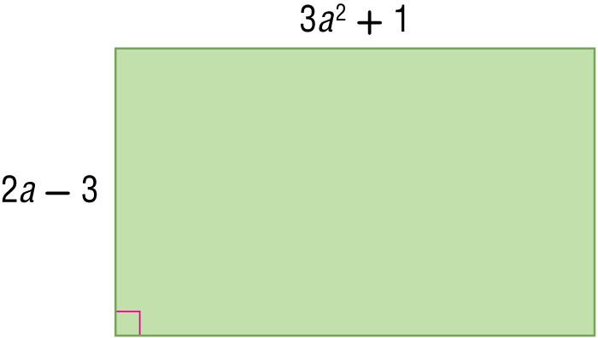

5-Minute Check 4
Which expression represents the area of the figure?
A. 6a³ – 9a² + 2a – 3 units²
B. 5a³ – 2a² + 2a – 2 units²
C. 4a³ – 2a² + a – 2 units²
D. 3a³ – a² + 3a + 3 units²

Slide 7

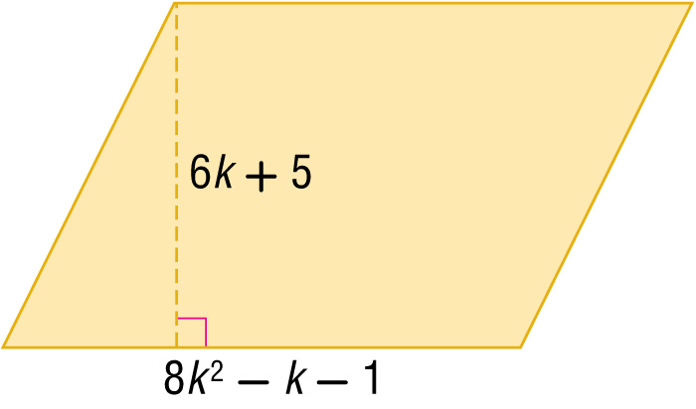
5-Minute Check 5
Which expression represents the area of the figure?
A. 14k² + 6k + 5 units²
B. 48k² + 34k + 5 units²
C. 48k³ + 34k² – 11k – 5 units²
D. 42k³ + 8k² + 6k – 4 units²

Slide 8

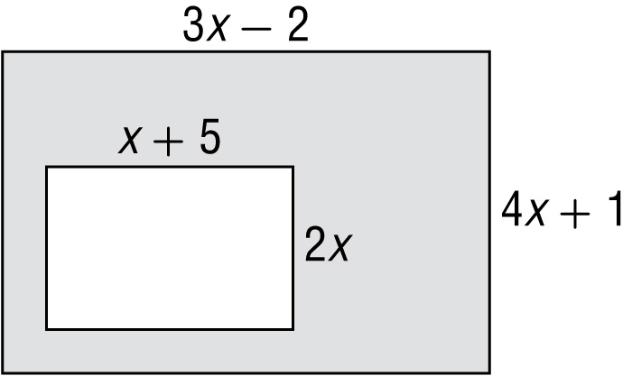
5-Minute Check 6
What expression describes the area of the shaded region in square units?
A. 6x² + 7x – 10
B. 10x² – 15x – 2
C. 12x² – 5x – 2
D. 2x² + 10x

Slide 9

CCSS
Content Standards
A.APR.1 Understand that polynomials form a system analogous to the integers, namely, they are closed under the operations of addition, subtraction, and multiplication; add, subtract, and multiply polynomials.
Mathematical Practices
8 Look for and express regularity in repeated reasoning.
Common Core State Standards © Copyright 2010. National Governors Association Center for Best Practices and Council of Chief State School Officers. All rights reserved.

Slide 10


Then/Now
You multiplied binomials by using the FOIL method.
Find squares of sums and differences.
Find the product of a sum and a difference.

Slide 11
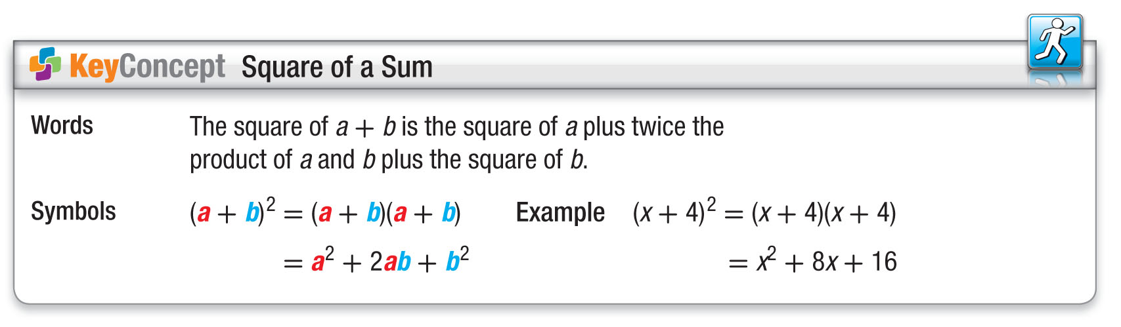
Concept

Slide 12
Example 1
Square of a Sum
Find (7z + 2)².
(a + b)² = a² + 2ab + b² Square of a sum
(7z + 2)² = (7z)² + 2(7z)(2) + (2)² a = 7z and b = 2
= 49z² + 28z + 4 Simplify.
Answer: 49z² + 28z + 4

Slide 13


Example 1
Find (3x + 2)².
A. 9x² + 4
B. 9x² + 6x + 4
C. 9x + 4
D. 9x² + 12x + 4

Slide 14
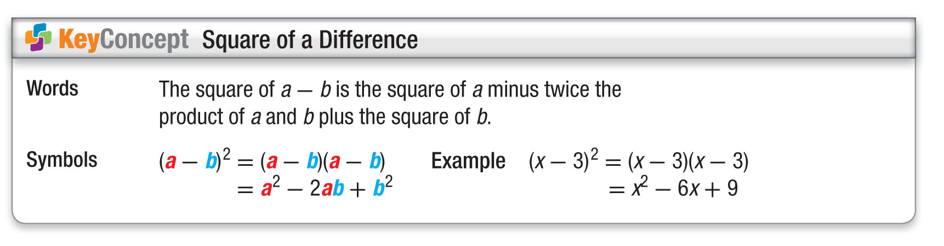
Concept

Slide 15
Example 2
Square of a Difference
Find (3c – 4)².
(a – b)² = a² – 2ab + b² Square of a difference
(3c – 4)² = (3c)² – 2(3c)(4) + (4)² a = 3c and b = 4
= 9c² – 24c + 16 Simplify.
Answer: 9c² – 24c + 16

Slide 16
Example 2
Find (2m – 3)².
A. 4m² + 9
B. 4m² – 9
C. 4m² – 6m + 9
D. 4m² – 12m + 9

Slide 17
Example 3
Square of a Difference
GEOMETRY Write an expression that represents
the area of a square that has a side length of
3x + 12 units.
The formula for the area of a square is A = s².
A = s² Area of a square
A = (3x + 12)² s = (3x + 12)
A = (3x)² + 2(3x)(12) + (12)² a = 3x and b = 12
A = 9x² + 72x + 144 Simplify.
Answer: The area of the square is
9x² + 72x + 144 square units.

Slide 18
Example 3
GEOMETRY Write an expression that represents the area of a square that has a side length of
(3x – 4) units.
A. 9x² – 24x + 16 units²
B. 9x² + 16 units²
C. 9x² – 16 units²
D. 9x² – 12x + 16 units²

Slide 19
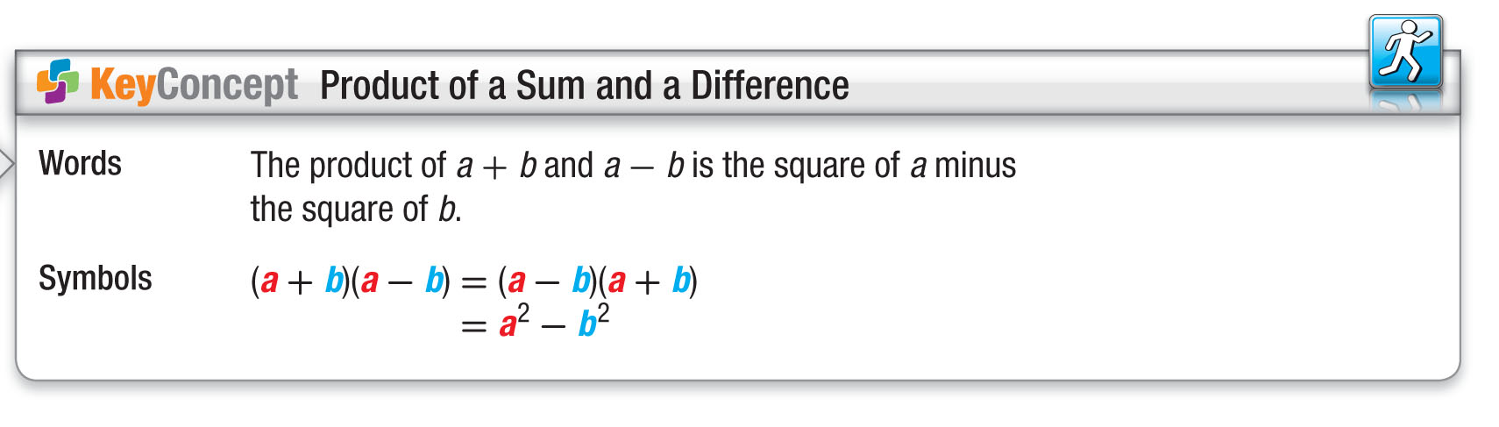
Concept

Slide 20
Example 4
Product of a Sum and a Difference
Find (9d + 4)(9d – 4).
(a + b)(a – b) = a² – b²
(9d + 4)(9d – 4) = (9d)² – (4)² a = 9d and b = 4
= 81d² – 16 Simplify.
Answer: 81d² – 16

Slide 21
Example 4
Find (3y + 2)(3y – 2).
A. 9y² + 4
B. 6y² – 4
C. 6y² + 4
D. 9y² – 4

Slide 22
End of the Lesson

