Slide 1


Splash Screen

Slide 2
Lesson Menu
Five-Minute Check (over Lesson 8–4)
CCSS
Then/Now
New Vocabulary
Example 1: Use the Distributive Property
Key Concept: Factoring by Grouping
Example 2: Factor by Grouping
Example 3: Factor by Grouping with Additive Inverses
Key Concept: Zero Product Property
Example 4: Solve Equations
Example 5: Real-World Example: Use Factoring

Slide 3

5-Minute Check 1
Find (4x + 5)².
A. 16x² + 25
B. 16x² + 20x + 25
C. 16x² + 40x + 25
D. 4x² + 20x + 5

Slide 4

5-Minute Check 2
Find (3a – 5b)².
A. 15a² – 30ab + 15b²
B. 9a² – 30ab + 25b²
C. 9a² – 15ab + 25b²
D. 3a² – 15ab + 5b²

Slide 5

5-Minute Check 3
Find (3x + 4)(3x – 4).
A. 9x² + 24x – 16
B. 9x² – 24x – 16
C. 9x² + 16
D. 9x² – 16

Slide 6

5-Minute Check 4
Find (2c² + 6d)(2c² – 6d).
A. 4c² – 36d²
B. 4c² + 36d²
C. 4c² + 24cd + 36d²
D. 4c² + 24cd – 36d²

Slide 7

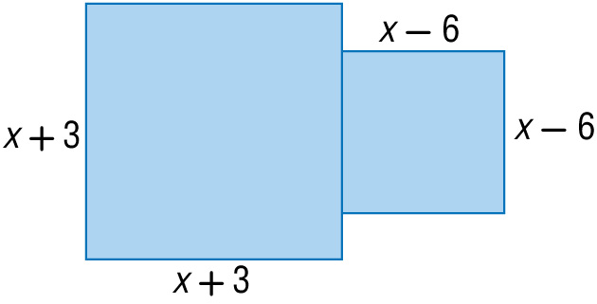
5-Minute Check 5
Write a polynomial that represents the area of the figure at the right.
A. (x + 3)²(x – 6)²
B. 2x² – 6x + 45
C. (x + 3)² + (x – 6)²
D. 2x² + 45

Slide 8

CCSS
Content Standards
A.SSE.2 Use the structure of an expression to identify ways to rewrite it.
A.SSE.3a Factor a quadratic expression to reveal the zeros of the function it defines.
Mathematical Practices
2 Reason abstractly and quantitatively.
Common Core State Standards © Copyright 2010. National Governors Association Center for Best Practices and Council of Chief State School Officers. All rights reserved.

Slide 9


Then/Now
Used the Distributive Property to evaluate expressions.
Use the Distributive Property to factor polynomials.
Solve quadratic equations of the form
ax² + bx = 0.

Slide 10

Vocabulary
factoring
factoring by grouping
Zero Product Property

Slide 11
Example 1
Use the Distributive Property
A. Use the Distributive Property to factor 15x + 25x².
First, find the GCF of 15x + 25x².
15x = 3 ● 5 ● x Factor each monomial.
Circle the common prime factors.
25x² = 5 ● 5 ● x ● x
GCF = 5 ● x or 5x
Write each term as the product of the GCF and its remaining factors. Then use the Distributive Property
to factor out the GCF.

Slide 12
Example 1
Use the Distributive Property
15x + 25x² = 5x(3) + 5x(5 ● x) Rewrite each term using the GCF.
= 5x(3 + 5x) Distributive Property
Answer: The completely factored form of 15x + 25x² is 5x(3 + 5x).

Slide 13
Example 1
Use the Distributive Property
B. Use the Distributive Property to factor
12xy + 24xy² – 30x²y⁴.
Factor each term.
12xy = 2 ● 2 ● 3 ● x ● y
24xy² = 2 ● 2 ● 2 ● 3 ● x ● y ● y
–30x²y⁴ = –1 ● 2 ● 3 ● 5 ● x ● x ● y ● y ● y ● y
Circle common factors.
GCF = 2 ● 3 ● x ● y or 6xy

Slide 14
Example 1
Use the Distributive Property
12xy + 24xy² – 30x²y⁴ = 6xy(2) + 6xy(4y) + 6xy(–5xy³) Rewrite each term using the GCF.
= 6xy(2 + 4y – 5xy³)
Distributive Property
Answer: The factored form of 12xy + 24xy² – 30x²y⁴ is 6xy(2 + 4y – 5xy³).

Slide 15


Example 1
A. Use the Distributive Property to factor the polynomial 3x²y + 12xy².
A. 3xy(x + 4y)
B. 3(x²y + 4xy²)
C. 3x(xy + 4y²)
D. xy(3x + 2y)

Slide 16
Example 1
B. Use the Distributive Property to factor the polynomial 3ab² + 15a²b² + 27ab³.
A. 3(ab² + 5a²b² + 9ab³)
B. 3ab(b + 5ab + 9b²)
C. ab(b + 5ab + 9b²)
D. 3ab²(1 + 5a + 9b)

Slide 17
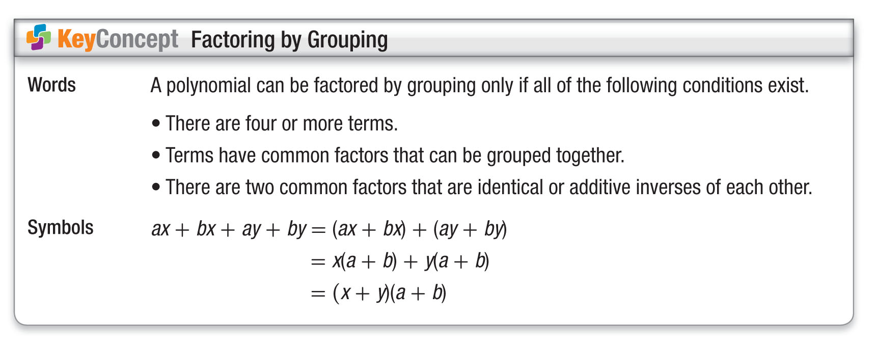
Concept

Slide 18
Example 2
Factor by Grouping
Factor 2xy + 7x – 2y – 7.
2xy + 7x – 2y – 7
= (2xy – 2y) + (7x – 7) Group terms with common factors.
= 2y(x – 1) + 7(x – 1) Factor the GCF from each group.
= (2y + 7)(x – 1) Distributive Property
Answer: (2y + 7)(x – 1) or (x – 1)(2y + 7)

Slide 19
Example 2
Factor 4xy + 3y – 20x – 15.
A. (4x – 5)(y + 3)
B. (7x + 5)(2y – 3)
C. (4x + 3)(y – 5)
D. (4x – 3)(y + 5)

Slide 20
Example 3
Factor by Grouping with Additive Inverses
Factor 15a – 3ab + 4b – 20.
15a – 3ab + 4b – 20
= (15a – 3ab) + (4b – 20) Group terms with common factors.
= 3a(5 – b) + 4(b – 5) Factor the GCF from each group.
= 3a(–1)(b – 5) + 4(b – 5) 5 – b = –1(b – 5)
= –3a(b – 5) + 4(b – 5) 3a(–1) = –3a
= (–3a + 4)(b – 5) Distributive Property
Answer: (–3a + 4)(b – 5) or (3a – 4)(5 – b)

Slide 21
Example 3
Factor –2xy – 10x + 3y + 15.
A. (2x – 3)(y – 5)
B. (–2x + 3)(y + 5)
C. (3 + 2x)(5 + y)
D. (–2x + 5)(y + 3)

Slide 22
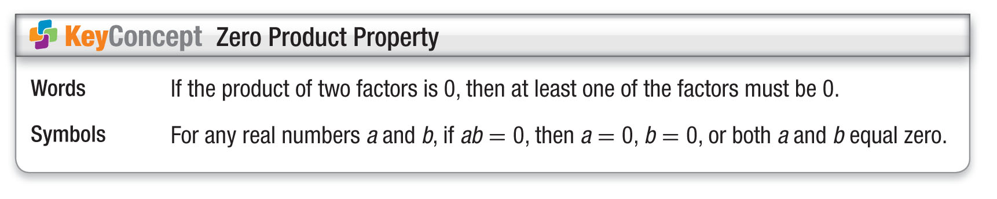
Concept

Slide 23
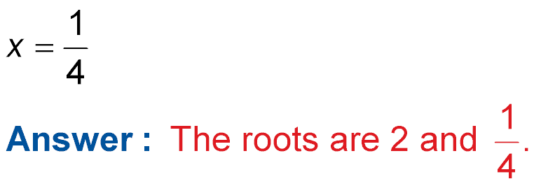
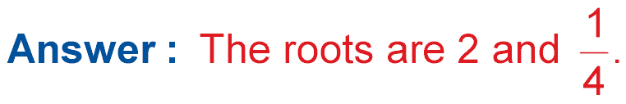
Example 4
Solve Equations
A. Solve (x – 2)(4x – 1) = 0. Check the solution.
If (x – 2)(4x – 1) = 0, then according to the Zero Product Property, either x – 2 = 0 or 4x – 1 = 0.
(x – 2)(4x – 1) = 0 Original equation
x – 2 = 0 or 4x – 1 = 0 Zero Product Property
x = 2 4x = 1 Solve each equation.
Divide.

Slide 24
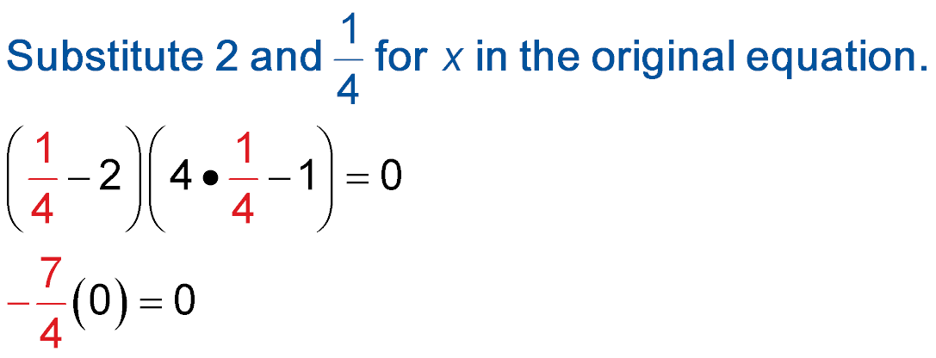
Example 4
Solve Equations
Check Substitute 2 and for x in the original equation.
(x – 2)(4x – 1) = 0 (x – 2)(4x – 1) = 0
?
?
(2 – 2)(4 ● 2 – 1) = 0
?
?
(0)(7) = 0
0 = 0 0 = 0
✓
✓

Slide 25
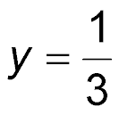
Example 4
Solve Equations
B. Solve 4y = 12y². Check the solution.
Write the equation so that it is of the form ab = 0.
4y = 12y² Original equation
4y – 12y² = 0 Subtract 12y² from each side.
4y(1 – 3y) = 0 Factor the GCF of 4y and 12y², which is 4y.
4y = 0 or 1 – 3y = 0 Zero Product Property
y = 0 –3y = –1 Solve each equation.
Divide.

Slide 26
Example 4
Solve Equations
1
__
Answer: The roots are 0 and . Check by substituting
0 and for y in the original equation.
3
1
__
3

Slide 27
Example 4
A. Solve (s – 3)(3s + 6) = 0. Then check the solution.
A. {3, –2}
B. {–3, 2}
C. {0, 2}
D. {3, 0}

Slide 28
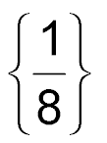
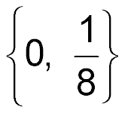
Example 4
B. Solve 5x – 40x² = 0. Then check the solution.
A. {0, 8}
B.
C. {0}
D.

Slide 29
Example 5
Use Factoring
FOOTBALL A football is kicked into the air. The height of the football can be modeled by the equation h = –16x² + 48x, where h is the height reached by the ball after x seconds. Find the values of x when h = 0.
h = –16x² + 48x Original equation
0 = –16x² + 48x h = 0
0 = 16x(–x + 3) Factor by using the GCF.
16x = 0 or –x + 3 = 0 Zero Product Property
x = 0 x = 3 Solve each equation.
Answer: 0 seconds, 3 seconds

Slide 30
Example 5
Juanita is jumping on a trampoline in her back yard. Juanita’s jump can be modeled by the equation h = –14t² + 21t, where h is the height of the jump in feet at t seconds. Find the values of t when h = 0.
A. 0 or 1.5 seconds
B. 0 or 7 seconds
C. 0 or 2.66 seconds
D. 0 or 1.25 seconds

Slide 31
End of the Lesson

