Slide 1


Splash Screen

Slide 2
Lesson Menu
Five-Minute Check (over Lesson 8–5)
CCSS
Then/Now
New Vocabulary
Key Concept: Factoring x² + bx + c
Example 1: b and c are Positive
Example 2: b is Negative and c is Positive
Example 3: c is Negative
Example 4: Solve an Equation by Factoring
Example 5: Real-World Example: Solve a Problem by Factoring

Slide 3

5-Minute Check 1
Use the Distributive Property to factor
20x²y + 15xy.
A. 15(xy)
B. 10x(xy)
C. 5xy(x)
D. 5xy(4x + 3)

Slide 4

5-Minute Check 2
Use the Distributive Property to factor
3r²t + 6rt – 7r – 14.
A. (3rt + 2)(r – 7)
B. (3rt – 7)(r + 2)
C. (3r + 7t)(r + 2)
D. (3r + 2t)(r – 7)

Slide 5

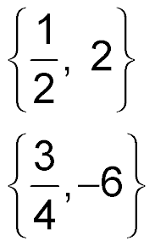
5-Minute Check 3
Solve (4d – 3)(d + 6) = 0.
A. {0, 3}
B.
C.
D. {1, 4}

Slide 6

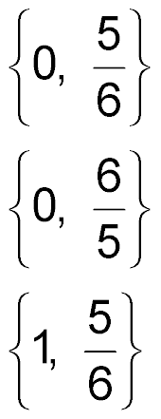
5-Minute Check 4
Solve 5y² = 6y.
A.
B.
C. {1, 1}
D.

Slide 7

5-Minute Check 5
The height h of a ball thrown upward at a speed of 24 feet per second can be modeled by
h = 24t – 16t², where t is time in seconds. How long will this ball remain in the air before bouncing?
A. 2 seconds
B. 1.75 seconds
C. 1.5 seconds
D. 1.0 second

Slide 8

5-Minute Check 6
Simplify (5y² – 3y)(4y² + 7y – 8) using the Distributive Property.
A. 20y⁴ + 23y³ – 61y² – 24y
B. 20y⁴ + 23y³ – 61y² + 24y
C. 20y⁴ + 12y³ – 21y² + 24y
D. 20y⁴ + 12y³ – 21y² – 24y

Slide 9

CCSS
Content Standards
A.SSE.3a Factor a quadratic expression to reveal the zeros of the function it defines.
A.REI.4b Solve quadratic equations by inspection (e.g., for
x² = 49), taking square roots, completing the square, the quadratic formula and factoring, as appropriate to the initial form of the equation. Recognize when the quadratic formula gives complex solutions and write them as a ± bi for real numbers a and b.
Mathematical Practices
7 Look for and make use of structure.
8 Look for and express regularity in repeated reasoning.
Common Core State Standards © Copyright 2010. National Governors Association Center for Best Practices and Council of Chief State School Officers. All rights reserved.

Slide 10


Then/Now
You multiplied binomials by using the FOIL method.
Factor trinomials of the form x² + bx + c.
Solve equations of the form x² + bx + c = 0.

Slide 11

Vocabulary
quadratic equation

Slide 12
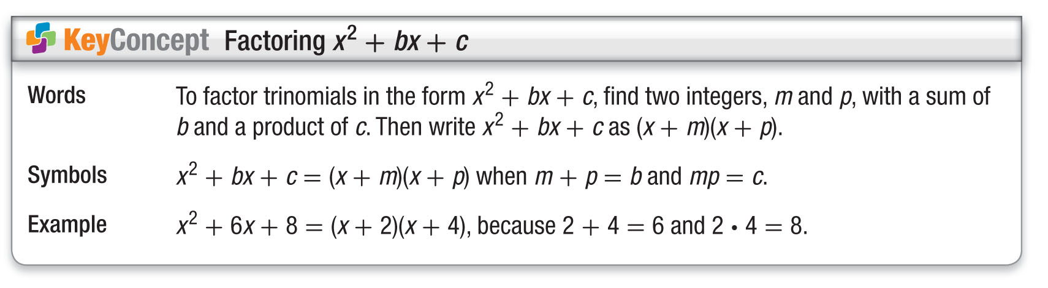
Concept

Slide 13
Example 1
b and c are Positive
Factor x² + 7x + 12.
In this trinomial, b = 7 and c = 12. You need to find two positive factors with a sum of 7 and a product of 12. Make an organized list of the factors of 12, and look for the pair of factors with a sum of 7.
Factors of 12 Sum of Factors
1, 12 13
2, 6 8
3, 4 7 The correct factors
are 3 and 4.

Slide 14
Example 1
b and c are Positive
x² + 7x + 12 = (x + m)(x + p) Write the pattern.
= (x + 3)(x + 4) m = 3 and p = 4
Answer: (x + 3)(x + 4)
Check You can check the result by multiplying the two factors.
F O I L
(x + 3)(x + 4) = x² + 4x + 3x + 12 FOIL method
= x² + 7x + 12 Simplify.
✓

Slide 15


Example 1
Factor x² + 3x + 2.
A. (x + 3)(x + 1)
B. (x + 2)(x + 1)
C. (x – 2)(x – 1)
D. (x + 1)(x + 1)

Slide 16
Example 2
b is Negative and c is Positive
Factor x² – 12x + 27.
In this trinomial, b = –12 and c = 27. This means m + p is negative and mp is positive. So, m and p must both be negative. Make a list of the negative factors of 27, and look for the pair with a sum of –12.
Factors of 27 Sum of Factors
–1, –27 –28
–3, –9 –12 The correct factors are
–3 and –9.

Slide 17
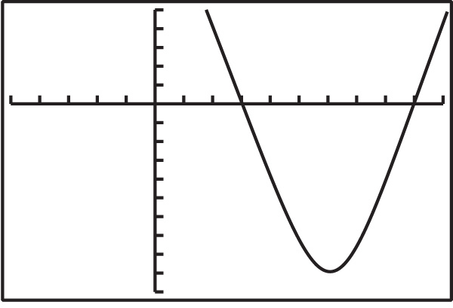
Example 2
b is Negative and c is Positive
x² – 12x + 27 = (x + m)(x + p) Write the pattern.
= (x – 3)(x – 9) m = –3 and p = –9
Answer: (x – 3)(x – 9)
Check You can check this result by using a graphing calculator. Graph y = x² – 12x + 27 and
y = (x – 3)(x – 9) on the same screen. Since only one graph appears,
the two graphs must
coincide. Therefore, the
trinomial has been
factored correctly.
✓

Slide 18
Example 2
Factor x² – 10x + 16.
A. (x + 4)(x + 4)
B. (x + 2)(x + 8)
C. (x – 2)(x – 8)
D. (x – 4)(x – 4)

Slide 19
Example 3
c is Negative
A. Factor x² + 3x – 18.
In this trinomial, b = 3 and c = –18. This means m + p is positive and mp is negative, so either m or p is negative, but not both. Therefore, make a list of the factors of –18 where one factor of each pair is negative. Look for the pair of factors with a sum of 3.

Slide 20
Example 3
c is Negative
Factors of –18 Sum of Factors
1, –18 –17
–1, 18 17
2, –9 –7
–2, 9 7
3, –6 –3
–3, 6 3 The correct factors are –3
and 6.

Slide 21
Example 3
c is Negative
x² + 3x – 18 = (x + m)(x + p) Write the pattern.
= (x – 3)(x + 6) m = –3 and p = 6
Answer: (x – 3)(x + 6)

Slide 22
Example 3
c is Negative
B. Factor x² – x – 20.
Since b = –1 and c = –20, m + p is negative and mp is negative. So either m or p is negative, but not both.
Factors of –20 Sum of Factors
1, –20 –19
–1, 20 19
2, –10 –8
–2, 10 8
4, –5 –1
–4, 5 1 The correct factors are
4 and –5.

Slide 23
Example 3
c is Negative
x² – x – 20 = (x + m)(x + p) Write the pattern.
= (x + 4)(x – 5) m = 4 and p = –5
Answer: (x + 4)(x – 5)

Slide 24
Example 3
A. Factor x² + 4x – 5.
A. (x + 5)(x – 1)
B. (x – 5)(x + 1)
C. (x – 5)(x – 1)
D. (x + 5)(x + 1)

Slide 25
Example 3
B. Factor x² – 5x – 24.
A. (x + 8)(x – 3)
B. (x – 8)(x – 3)
C. (x + 8)(x + 3)
D. (x – 8)(x + 3)

Slide 26
Example 4
Solve an Equation by Factoring
Solve x² + 2x = 15. Check your solution.
x² + 2x = 15 Original equation
x² + 2x – 15 = 0 Subtract 15 from each side.
(x + 5)(x – 3) = 0 Factor.
x + 5 = 0 or x – 3 = 0 Zero Product Property
x = –5 x = 3 Solve each equation.
Answer: The solution set is {–5, 3}.

Slide 27
Example 4
Solve an Equation by Factoring
Check Substitute –5 and 3 for x in the original equation.
x² + 2x – 15 = 0 x² + 2x – 15 = 0
?
?
(–5)² + 2(–5) – 15 = 0 3² + 2(3) – 15 = 0
?
?
25 + (–10) – 15 = 0 9 + 6 – 15 = 0
0 = 0 0 = 0
✓
✓

Slide 28
Example 4
Solve x² – 20 = x. Check your solution.
A. {–5, 4}
B. {5, 4}
C. {5, –4}
D. {–5, –4}

Slide 29
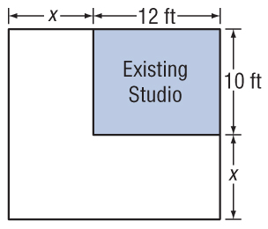
Example 5
Solve a Problem by Factoring
ARCHITECTURE Marion wants to build a new art studio that has three times the area of her old studio by increasing the length and width by the same amount. What should be the dimensions of the new studio?
Understand You want to find the length and width of the new studio.

Slide 30
Example 5
Solve a Problem by Factoring
Plan Let x = the amount added to each dimension of the studio.
The new length times the new width equals the new area.
x + 12 ● x + 10 = 3(12)(10)
old area
Solve (x + 12)(x + 10) = 3(12)(10) Write the equation.
x² + 22x + 120 = 360 Multiply.
x² + 22x – 240 = 0 Subtract 360 from each side.

Slide 31
Example 5
Solve a Problem by Factoring
(x + 30)(x – 8) = 0 Factor.
x + 30 = 0 or x – 8 = 0 Zero Product
Property
x = –30 x = 8 Solve each equation.
Since dimensions cannot be negative, the amount added to each dimension is 8 feet.
Answer: The length of the new studio should be 8 + 12 or 20 feet, and the new width should be 8 + 10 or 18 feet.

Slide 32
Example 5
Solve a Problem by Factoring
Check The area of the old studio was 12 ● 10 or
120 square feet. The area of the new studio is
18 ● 20 or 360 square feet, which is three times the area of the old studio.
✓

Slide 33
Example 5
PHOTOGRAPHY Adina has a 4 × 6 photograph. She wants to enlarge the photograph by increasing the length and width by the same amount. What dimensions of the enlarged photograph will produce an area twice the area of the original photograph?
A. 6 × –8
B. 6 × 8
C. 8 × 12
D. 12 × 18

Slide 34
End of the Lesson

