Slide 1


Splash Screen

Slide 2
Lesson Menu
Five-Minute Check (over Lesson 8–6)
CCSS
Then/Now
New Vocabulary
Key Concept: Factoring ax² + bx + c
Example 1: Factor ax² + bx + c
Example 2: Factor ax² – bx + c
Example 3: Determine Whether a Polynomial is Prime
Example 4: Real-World Example: Solve Equations by Factoring

Slide 3

5-Minute Check 1
Factor m² – 13m + 36.
A. (m – 4)(m – 9)
B. (m + 4)(m + 9)
C. (m + 6)(m – 6)
D. (m + 6)²

Slide 4

5-Minute Check 2
Factor –1 – 5x + 24x².
A. (2x – 1)(12x + 1)
B. (6x – 1)(4x + 1)
C. (6x + 3)(4x – 2)
D. (8x + 1)(3x – 1)

Slide 5

5-Minute Check 3
Solve y² – 8y – 20 = 0.
A. {–4, 3}
B. {3, 6}
C. {–2, 10}
D. {1, 8}

Slide 6

5-Minute Check 4
Solve x² + 8x = –12.
A. {–8, –4}
B. {–6, –2}
C. {–4, 4}
D. {2, 3}

Slide 7

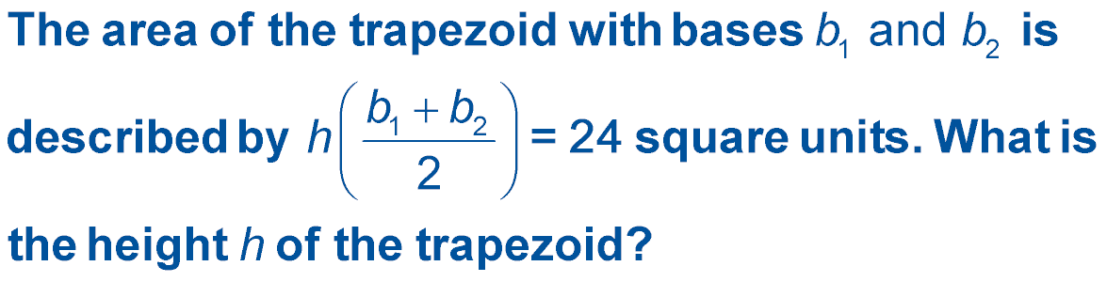
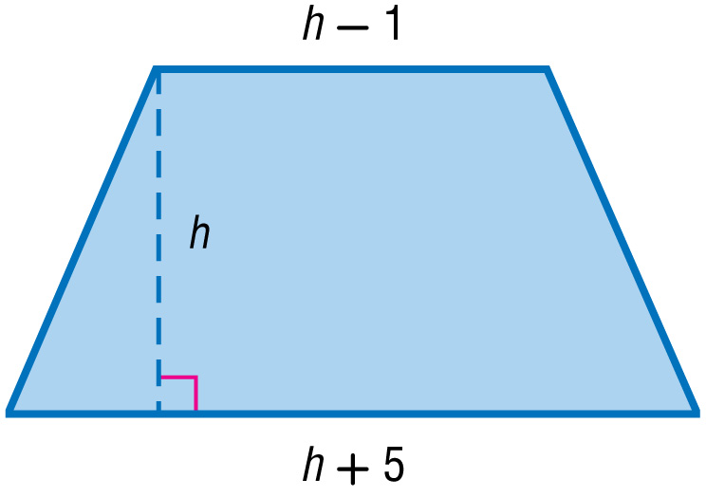
5-Minute Check 5
A. 3.5 units
B. 4 units
C. 5 units
D. 5.5 units

Slide 8

5-Minute Check 6
Which shows the factors of p⁸ – 8p⁴ – 84?
A. (p⁴ – 14)(p⁴ + 6)
B. (p⁴ + 7)(p² – 12)
C. (p⁴ – 21)(p⁴ – 4)
D. (p⁴ – 2)(p² + 24)

Slide 9

CCSS
Content Standards
A.SSE.3a Factor a quadratic expression to reveal the zeros of the function it defines.
A.REI.4b Solve quadratic equations by inspection (e.g., for x² = 49), taking square roots, completing the square, the quadratic formula and factoring, as appropriate to the initial form of the equation. Recognize when the quadratic formula gives complex solutions and write them as a ± bi for real numbers a and b.
Mathematical Practices
4 Model with mathematics.
Common Core State Standards © Copyright 2010. National Governors Association Center for Best Practices and Council of Chief State School Officers. All rights reserved.

Slide 10


Then/Now
You factored trinomials of the form x² + bx + c.
Factor trinomials of the form ax² + bx + c.
Solve equations of the form ax² + bx + c = 0.

Slide 11

Vocabulary
prime polynomial

Slide 12
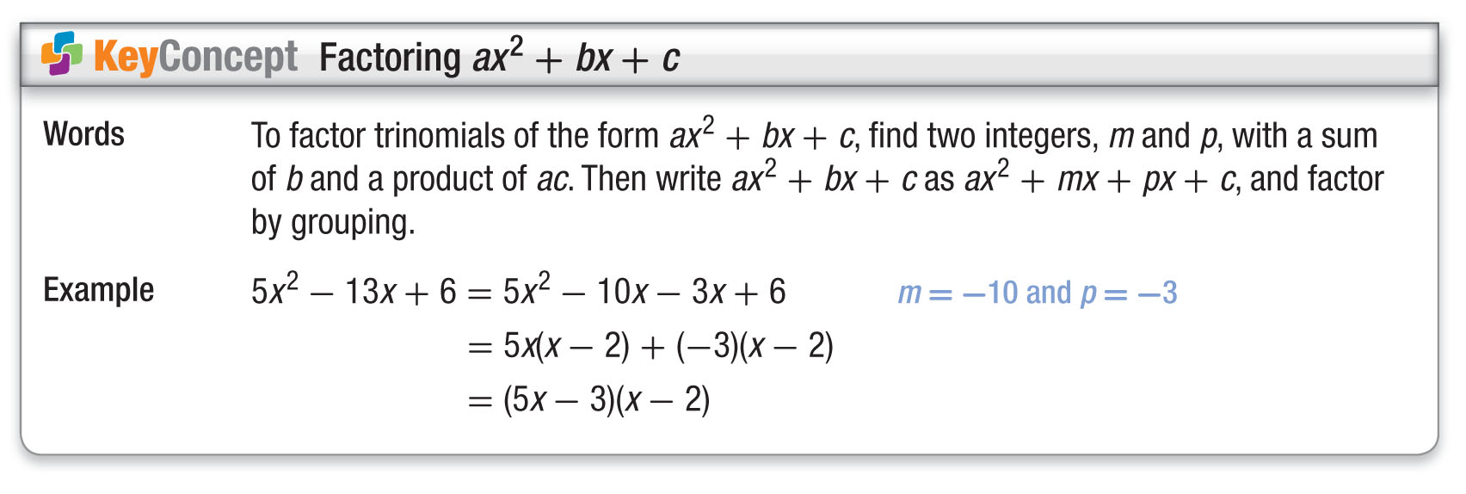
Concept

Slide 13
Example 1
Factor ax² + bx + c
A. Factor 5x² + 27x + 10.
In this trinomial, a = 5, b = 27, and c = 10. You need to find two numbers with a sum of 27 and with a product of 5 ● 10 or 50. Make an organized list of the factors of 50 and look for the pair of factors with the sum of 27.
Factors of 50 Sum of Factors
1, 50 51
2, 25 27 The correct factors
are 2 and 25.
5x² + 27x + 10 = 5x² + mx + px + 10 Write the pattern.
= 5x² + 2x + 25x + 10 m = 2 and p = 25

Slide 14
Example 1
Factor ax² + bx + c
= (5x² + 2x) + (25x + 10) Group terms with common factors.
= x(5x + 2) + 5(5x + 2) Factor the GCF.
= (x + 5)(5x + 2) Distributive
Property
Answer: (x + 5)(5x + 2) or (5x + 2)(x + 5)

Slide 15
Example 1
Factor ax² + bx + c
B. Factor 4x² + 24x + 32.
The GCF of the terms 4x², 24x, and 32 is 4. Factor this term first.
4x² + 24x + 32 = 4(x² + 6x + 8) Distributive
Property
Now factor x² + 6x + 8. Since the lead coefficient is 1, find the two factors of 8 whose sum is 6.
Factors of 8 Sum of Factors
1, 8 9
2, 4 6 The correct factors
are 2 and 4.

Slide 16
Example 1
Factor ax² + bx + c
Answer: So, x² + 6x + 4 = (x + 2)(x + 4). Thus, the complete factorization of 4x² + 24x + 32 is
4(x + 2)(x + 4).

Slide 17


Example 1
A. Factor 3x² + 26x + 35.
A. (3x + 7)(x + 5)
B. (3x + 1)(x + 35)
C. (3x + 5)(x + 7)
D. (x + 1)(3x + 7)

Slide 18
Example 1
B. Factor 2x² + 14x + 20.
A. (2x + 4)(x + 5)
B. (x + 2)(2x + 10)
C. 2(x² + 7x + 10)
D. 2(x + 2)(x + 5)

Slide 19
Example 2
Factor ax² – bx + c
Factor 24x² – 22x + 3.
In this trinomial, a = 24, b = –22, and c = 3. Since b is negative, m + p is negative. Since c is positive, mp is positive. So m and p must both be negative. Therefore, make a list of the negative factors of 24 ● 3 or 72, and look for the pair of factors with the sum of –22.
Factors of 72 Sum of Factors
–1, –72 –73
–2, –36 –38
–3, –24 –27
–4, –18 –22 The correct factors
are –4 and –18.

Slide 20
Example 2
Factor ax² – bx + c
24x² – 22x + 3 = 24x² + mx + px + 3 Write the pattern.
= 24x² – 4x – 18x + 3 m = –4 and p = –18
= (24x² – 4x) + (–18x + 3) Group terms with common factors.
= 4x(6x – 1) + (–3)(6x – 1) Factor the GCF.
= (4x – 3)(6x – 1) Distributive
Property
Answer: (4x – 3)(6x – 1)

Slide 21
Example 2
Factor 10x² – 23x + 12.
A. (2x + 3)(5x + 4)
B. (2x – 3)(5x – 4)
C. (2x + 6)(5x – 2)
D. (2x – 6)(5x – 2)

Slide 22
Example 3
Determine Whether a Polynomial is Prime
Factor 3x² + 7x – 5, if possible.
In this trinomial, a = 3, b = 7, and c = –5. Since b is positive, m + p is positive. Since c is negative, mp is negative, so either m or p is negative, but not both. Therefore, make a list of all the factors of 3(–5) or –15, where one factor in each pair is negative. Look for the pair of factors with a sum of 7.
Factors of –15 Sum of Factors
–1, 15 14
1, –15 –14
–3, 5 2
3, –5 –2

Slide 23
Example 3
Determine Whether a Polynomial is Prime
There are no factors whose sum is 7. Therefore,
3x² + 7x – 5 cannot be factored using integers.
Answer: 3x² + 7x – 5 is a prime polynomial.

Slide 24
Example 3
Factor 3x² – 5x + 3, if possible.
A. (3x + 1)(x – 3)
B. (3x – 3)(x – 1)
C. (3x – 1)(x – 3)
D. prime

Slide 25
Example 4
Solve Equations by Factoring
ROCKETS Mr. Nguyen’s science class built a model rocket for a competition. When they launched their rocket outside the classroom, the rocket cleared the top of a 60-foot high pole and then landed in a nearby tree. If the launch pad was 2 feet above the ground, the initial velocity of the rocket was 64 feet per second, and the rocket landed 30 feet above the ground, how long was the rocket in flight? Use the equation h = –16t² + vt + h₀.
h = –16t² + vt + h₀ Equation for height
30 = –16t² + 64t + 2 h = 30, v = 64, h₀ = 2
0 = –16t² + 64t – 28 Subtract 30 from each side.

Slide 26
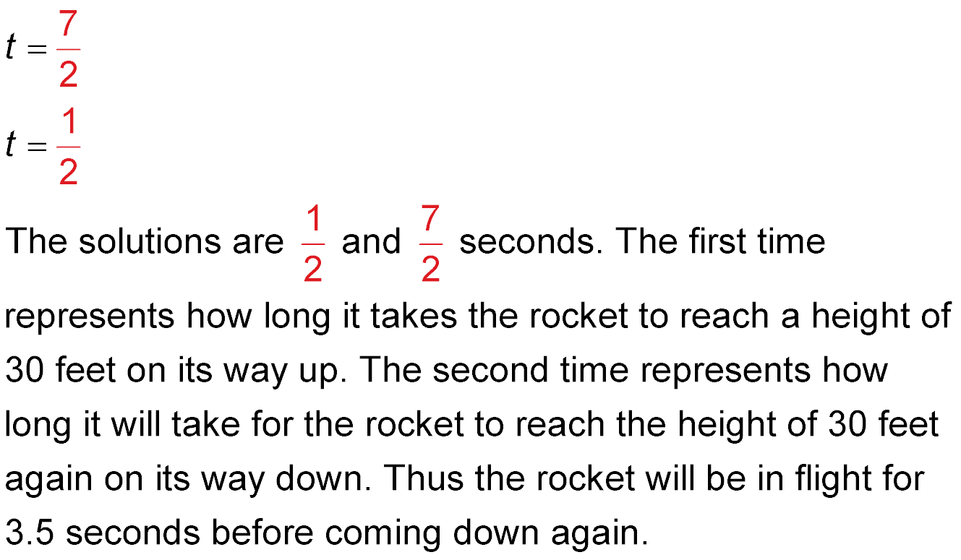
Example 4
Solve Equations by Factoring
0 = –4(4t² – 16t + 7) Factor out –4.
0 = 4t² – 16t + 7 Divide each side by –4.
0 = (2t – 7)(2t – 1) Factor 4t² – 16t + 7.
2t – 7 = 0 or 2t – 1 = 0 Zero Product Property
2t = 7 2t = 1 Solve each equation.
Divide.

Slide 27
Example 4
Solve Equations by Factoring
again on its way down. Thus, the rocket was in flight for about 3.5 seconds before landing.
Answer: about 3.5 seconds

Slide 28
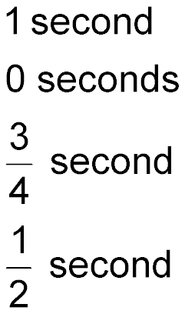
Example 4
When Mario jumps over a hurdle, his feet leave the ground traveling at an initial upward velocity of
12 feet per second. Find the time t in seconds it takes for Mario’s feet to reach the ground again. Use the equation h = –16t² + vt + h₀.
A. 1 second
B. 0 seconds
C.
D.

Slide 29
End of the Lesson

