Slide 1


Splash Screen

Slide 2
Lesson Menu
Five-Minute Check (over Lesson 8–7)
CCSS
Then/Now
New Vocabulary
Key Concept: Difference of Squares
Example 1: Factor Differences of Squares
Example 2: Apply a Technique More than Once
Example 3: Apply Different Techniques
Example 4: Standardized Test Example

Slide 3

5-Minute Check 1
Factor 2c² – 17c + 36, if possible.
A. (2c + 6)(2c – 6)
B. (2c + 6)(c – 6)
C. (2c – 9)(c – 4)
D. prime

Slide 4

5-Minute Check 2
Factor 5g² + 14g – 10, if possible.
A. (5g + 2)(g – 5)
B. (5g – 2)(g + 5)
C. (5g + 2)(g – 7)
D. prime

Slide 5

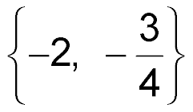
5-Minute Check 3
Solve 4n² + 11n = –6.
A. {–4, 2}
B.
C. {1, 2}
D. {0, 4}

Slide 6

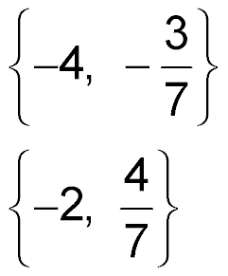
5-Minute Check 4
Solve 7x² + 25x – 12 = 0.
A.
B.
C. {3, 7}
D. {5, 4}

Slide 7

5-Minute Check 5
The sum of the squares of two consecutive positive integers is 61. What are the two integers?
A. 3, 4
B. 5, 6
C. 7, 8
D. 8, 9

Slide 8

5-Minute Check 6
Which of the following does not have a product of 18b² – 3b – 105?
A. (2b – 5)(9b + 21)
B. 3(2b – 5)(3b + 7)
C. (2b – 5)(3b + 7)
D. (6b – 15)(3b + 7)

Slide 9

CCSS
Content Standards
A.SSE.3a Factor a quadratic expression to reveal the zeros of the function it defines.
A.REI.4b Solve quadratic equations by inspection (e.g., for x² = 49), taking square roots, completing the square, the quadratic formula and factoring, as appropriate to the initial form of the equation. Recognize when the quadratic formula gives complex solutions and write them as a ± bi for real numbers a and b.
Mathematical Practices
1 Make sense of problems and persevere in solving them.
Common Core State Standards © Copyright 2010. National Governors Association Center for Best Practices and Council of Chief State School Officers. All rights reserved.

Slide 10


Then/Now
You factored trinomials into two binomials.
Factor binomials that are the difference of squares.
Use the difference of squares to solve equations.

Slide 11

Vocabulary
difference of two squares

Slide 12
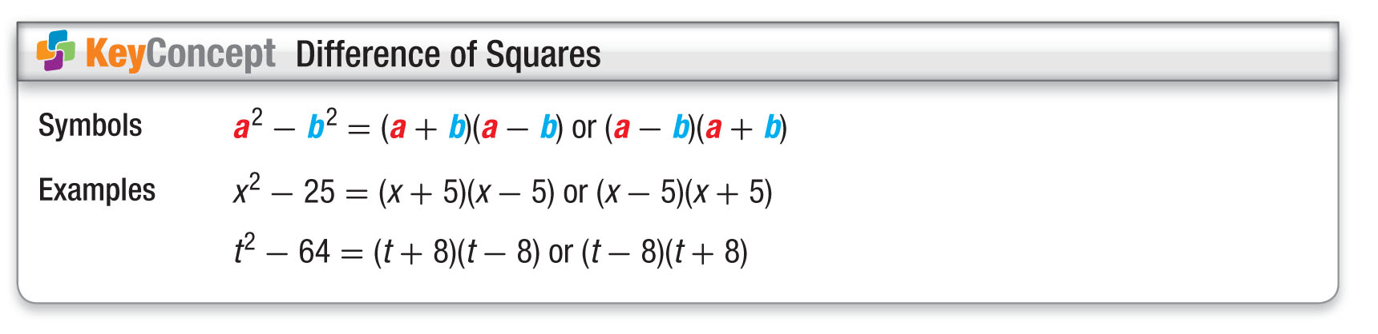
Concept

Slide 13
Example 1
Factor Differences of Squares
A. Factor m² – 64.
m² – 64 = m² – 8² Write in the form a² – b².
= (m + 8)(m – 8) Factor the difference of squares.
Answer: (m + 8)(m – 8)

Slide 14
Example 1
Factor Differences of Squares
B. Factor 16y² – 81z².
16y² – 81z² = (4y)² – (9z)² Write in the form
a² – b².
= (4y + 9z)(4y – 9z) Factor the difference of squares.
Answer: (4y + 9z)(4y – 9z)

Slide 15
Example 1
Factor Differences of Squares
C. Factor 3b³ – 27b.
If the terms of a binomial have a common factor, the GCF should be factored out first before trying to apply any other factoring technique.
3b³ – 27b = 3b(b² – 9) The GCF of 3b² and 27b is 3b.
= 3b[(b)² – (3)²] Write in the form a² – b².
= 3b(b + 3)(b – 3) Factor the difference of squares.
Answer: 3b(b + 3)(b – 3)

Slide 16


Example 1
A. Factor the binomial b² – 9.
A. (b + 3)(b + 3)
B. (b – 3)(b + 1)
C. (b + 3)(b – 3)
D. (b – 3)(b – 3)

Slide 17
Example 1
B. Factor the binomial 25a² – 36b².
A. (5a + 6b)(5a – 6b)
B. (5a + 6b)²
C. (5a – 6b)²
D. 25(a² – 36b²)

Slide 18
Example 1
C. Factor 5x³ – 20x.
A. 5x(x² – 4)
B. (5x² + 10x)(x – 2)
C. (x + 2)(5x² – 10x)
D. 5x(x + 2)(x – 2)

Slide 19
Example 2
Apply a Technique More than Once
A. Factor y⁴ – 625.
y⁴ – 625 = [(y²)² – 25²] Write y⁴ – 625 in a² – b² form.
= (y² + 25)(y² – 25) Factor the difference of squares.
= (y² + 25)(y² – 5²) Write y² – 25 in a² – b² form.
= (y² + 25)(y + 5)(y – 5) Factor the difference of squares.
Answer: (y² + 25)(y + 5)(y – 5)

Slide 20
Example 2
Apply a Technique More than Once
B. Factor 256 – n⁴.
256 – n⁴ = 16² – (n²)² Write 256 – n⁴ in
a² – b² form.
= (16 + n²)(16 – n²) Factor the difference of squares.
= (16 + n²)(4² – n²) Write 16 – n² in
a² – b² form.
= (16 + n²)(4 – n)(4 + n) Factor the difference of squares.
Answer: (16 + n²)(4 – n)(4 + n)

Slide 21
Example 2
A. Factor y⁴ – 16.
A. (y² + 4)(y² – 4)
B. (y + 2)(y + 2)(y + 2)(y – 2)
C. (y + 2)(y + 2)(y + 2)(y + 2)
D. (y² + 4)(y + 2)(y – 2)

Slide 22
Example 2
B. Factor 81 – d⁴.
A. (9 + d)(9 – d)
B. (3 + d)(3 – d)(3 + d)(3 – d)
C. (9 + d²)(9 – d²)
D. (9 + d²)(3 + d)(3 – d)

Slide 23
Example 3
Apply Different Techniques
A. Factor 9x⁵ – 36x.
9x⁵ – 36x = 9x(x⁴ – 4) Factor out the GCF.
= 9x[(x²)² – 2²] Write x² – 4 in a² – b² form.
= 9x(x² – 2)(x² + 2) Factor the difference of squares.
Answer: 9x(x² – 2)(x² + 2)

Slide 24
Example 3
Apply Different Techniques
B. Factor 6x³ + 30x² – 24x – 120.
6x³ + 30x² – 24x – 120 Original polynomial
= 6(x³ + 5x² – 4x – 20) Factor out the GCF.
= 6[(x³ – 4x) + (5x² – 20)] Group terms with common factors.
= 6[x(x² – 4) + 5(x² – 4)] Factor each grouping.
= 6(x² – 4)(x + 5) x² – 4 is the common factor.
= 6(x + 2)(x – 2)(x + 5) Factor the difference of squares.
Answer: 6(x + 2)(x – 2)(x + 5)

Slide 25
Example 3
A. Factor 3x⁵ – 12x.
A. 3x(x² + 3)(x² – 4)
B. 3x(x² + 2)(x² – 2)
C. 3x(x² + 2)(x + 2)(x – 2)
D. 3x(x⁴ – 4x)

Slide 26
Example 3
B. Factor 5x³ + 25x² – 45x – 225.
A. 5(x² – 9)(x + 5)
B. (5x + 15)(x – 3)(x + 5)
C. 5(x + 3)(x – 3)(x + 5)
D. (5x + 25)(x + 3)(x – 3)

Slide 27
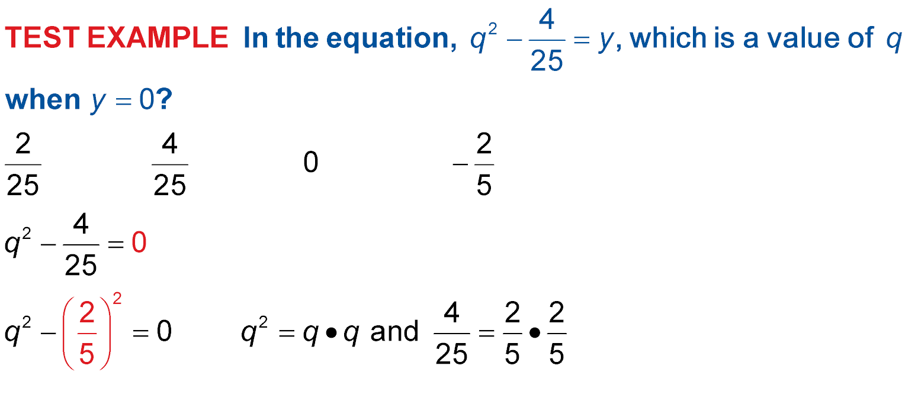
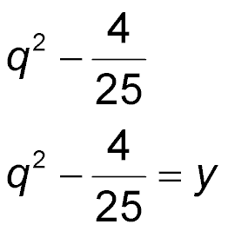
Example 4
In the equation which is a value of
q when y = 0?
A B C 0 D
Read the Test Item
Factor as the difference of squares.
Solve the Test Item
Original equation
Replace y with 0.

Slide 28
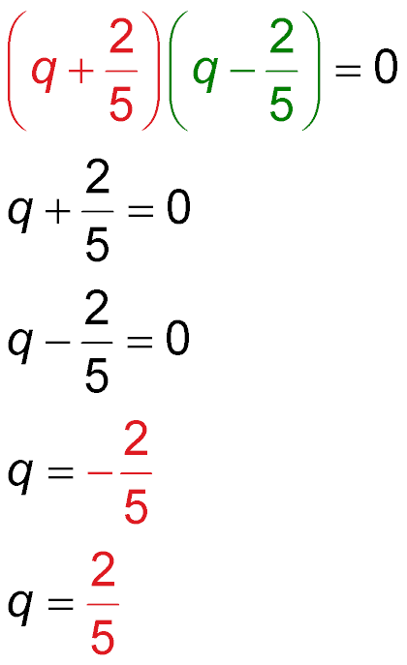

Example 4
Write in the form a² – b².
Factor the difference of squares.
or
Zero Product Property
Solve each equation.
Answer: The correct
answer is D.

Slide 29

Example 4
In the equation m² – 81 = y, which is a value of m when y = 0?
A. 0
B.
C. –9
D. 81

Slide 30
End of the Lesson

