Slide 1


Splash Screen

Slide 2
Lesson Menu
Five-Minute Check (over Lesson 8–8)
CCSS
Then/Now
New Vocabulary
Key Concept: Factoring Perfect Square Trinomials
Example 1: Recognize and Factor Perfect Square Trinomials
Concept Summary: Factoring Methods
Example 2: Factor Completely
Example 3: Solve Equations with Repeated Factors
Key Concept: Square Root Property
Example 4: Use the Square Root Property
Example 5: Real-World Example: Solve an Equation

Slide 3

5-Minute Check 1
Factor x² – 121.
A. (x + 11)(x – 11)
B. (x + 11)²
C. (x + 10)(x – 11)
D. (x – 11)²

Slide 4

5-Minute Check 2
Factor –36x² + 1.
A. (6x – 1)²
B. (4x + 1)(9x – 1)
C. (1 + 6x)(1 – 6x)
D. (4x)(9x + 1)

Slide 5

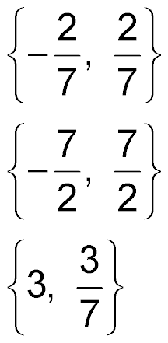
5-Minute Check 3
Solve 4c² = 49 by factoring.
A.
B.
C. {2, 7}
D.

Slide 6

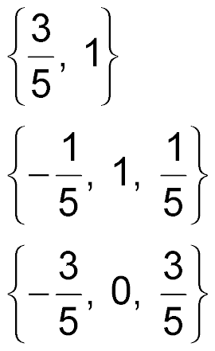
5-Minute Check 4
Solve 25x³ – 9x = 0 by factoring.
A.
B. {3, 5}
C.
D.

Slide 7

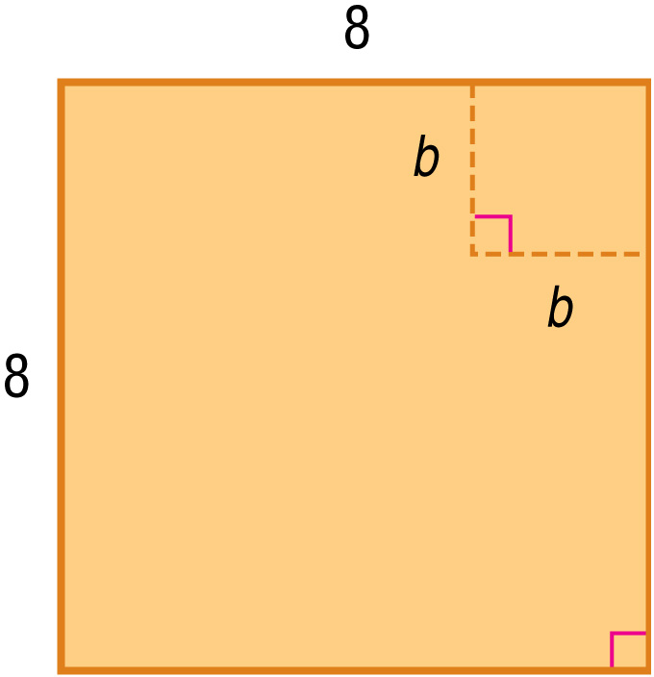
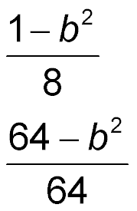
5-Minute Check 5
A square with sides of length b is removed from a square with sides of length 8. Write an expression to compare the area of the remaining figure to the area of the original square.
A. (8 – b)²
B.
C. 64 – b²
D.

Slide 8

5-Minute Check 6
Which shows the factors of 8m³ – 288m?
A. (m – 16)(m + 16)
B. 8m(m – 6)(m + 6)
C. (m + 6)(m – 6)
D. 8m(m – 6)(m – 6)

Slide 9

CCSS
Content Standards
A.SSE.3a Factor a quadratic expression to reveal the zeros of the function it defines.
A.REI.1 Explain each step in solving a simple equation as following from the equality of numbers asserted at the previous step, starting from the assumption that the original equation has a solution. Construct a viable argument to justify a solution method.
Mathematical Practices
6 Attend to precision.
Common Core State Standards © Copyright 2010. National Governors Association Center for Best Practices and Council of Chief State School Officers. All rights reserved.

Slide 10


Then/Now
You found the product of a sum and difference.
Factor perfect square trinomials.
Solve equations involving perfect squares.

Slide 11

Vocabulary
perfect square trinomial

Slide 12
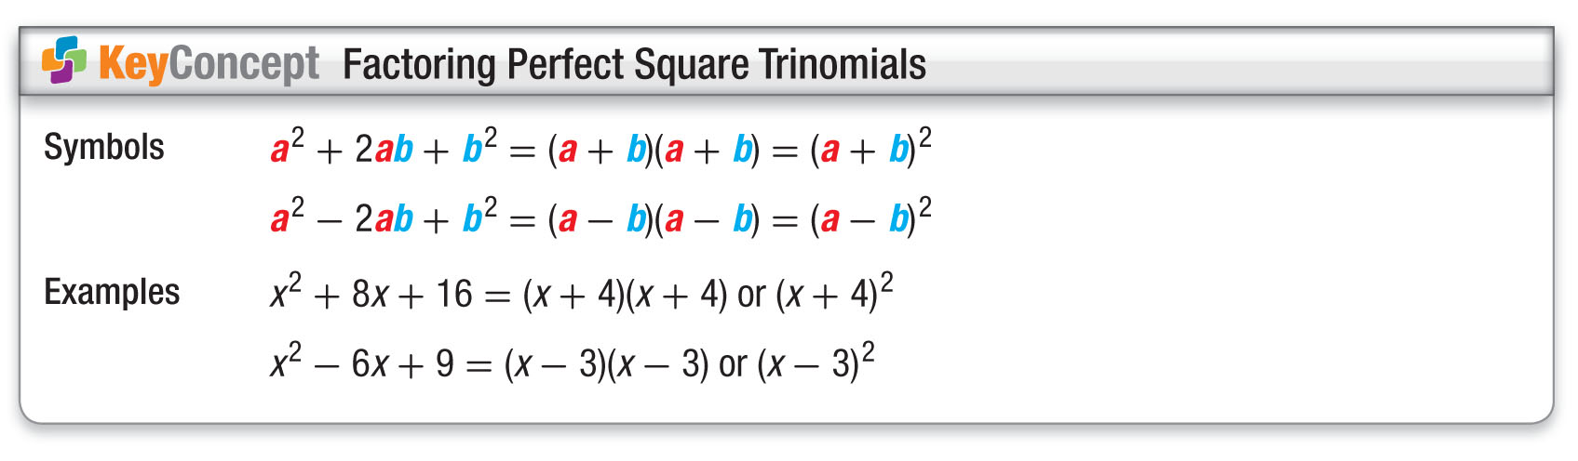
Concept

Slide 13
Example 1
Recognize and Factor Perfect Square Trinomials
A. Determine whether 25x² – 30x + 9 is a perfect square trinomial. If so, factor it.
1. Is the first term a perfect square? Yes, 25x² = (5x)².
2. Is the last term a perfect square? Yes, 9 = 3².
3. Is the middle term equal to 2(5x)(3)?
Yes, 30x = 2(5x)(3).
Answer: 25x² – 30x + 9 is a perfect square trinomial.
25x² – 30x + 9 = (5x)² – 2(5x)(3) + 3² Write as
a² – 2ab + b².
= (5x – 3)² Factor using the pattern.

Slide 14
Example 1
Recognize and Factor Perfect Square Trinomials
B. Determine whether 49y² + 42y + 36 is a perfect square trinomial. If so, factor it.
1. Is the first term a perfect square? Yes, 49y² = (7y)².
2. Is the last term a perfect square? Yes, 36 = 6².
3. Is the middle term equal to 2(7y)(6)?
No, 42y ≠ 2(7y)(6).
Answer: 49y² + 42y + 36 is not a perfect square trinomial.

Slide 15


Example 1
A. Determine whether 9x² – 12x + 16 is a perfect square trinomial. If so, factor it.
A. yes; (3x – 4)²
B. yes; (3x + 4)²
C. yes; (3x + 4)(3x – 4)
D. not a perfect square trinomial

Slide 16
Example 1
B. Determine whether 49x² + 28x + 4 is a perfect square trinomial. If so, factor it.
A. yes; (4x – 2)²
B. yes; (7x + 2)²
C. yes; (4x + 2)(4x – 4)
D. not a perfect square trinomial

Slide 17
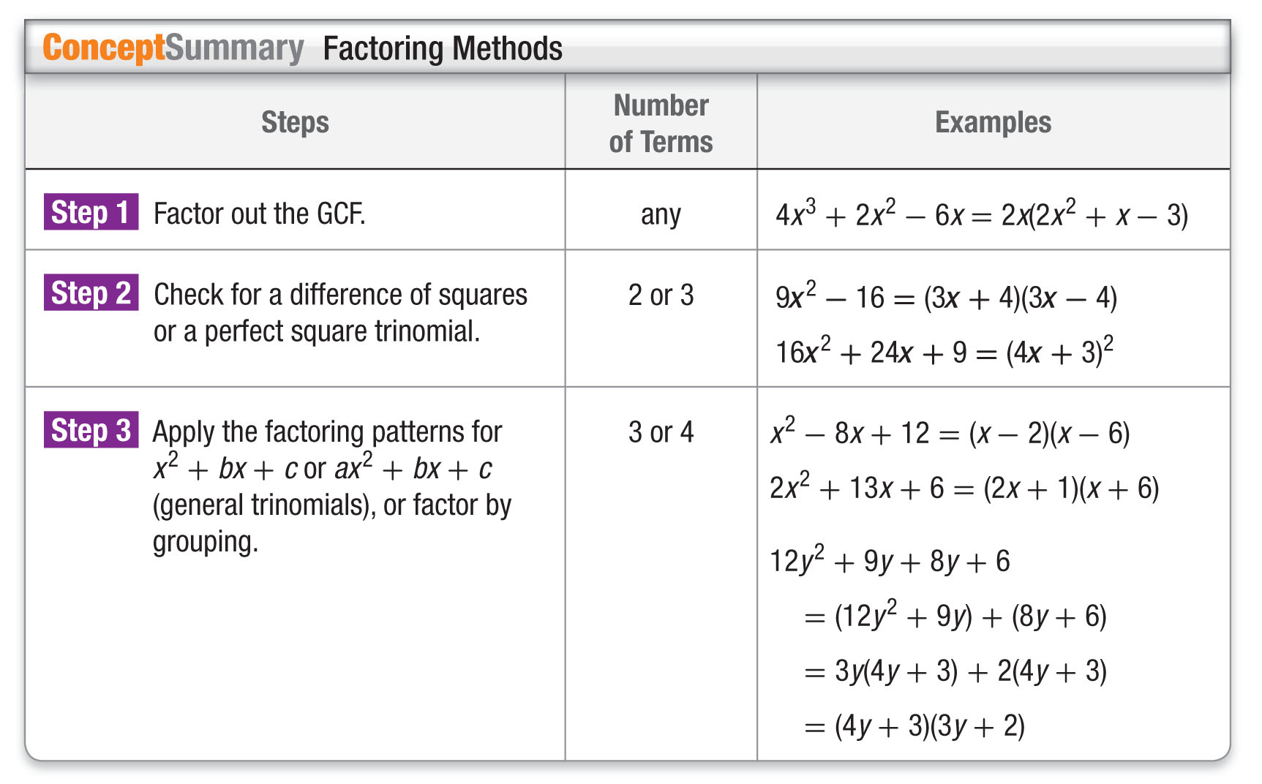
Concept

Slide 18
Example 2
Factor Completely
A. Factor 6x² – 96.
First, check for a GCF. Then, since the polynomial has two terms, check for the difference of squares.
6x² – 96 = 6(x² – 16) 6 is the GCF.
= 6(x² – 4²) x² = x ● x and 16 = 4 ● 4
= 6(x + 4)(x – 4) Factor the difference of
squares.
Answer: 6(x + 4)(x – 4)

Slide 19
Example 2
Factor Completely
B. Factor 16y² + 8y – 15.
This polynomial has three terms that have a GCF of 1. While the first term is a perfect square, 16y² = (4y)², the last term is not. Therefore, this is not a perfect square trinomial.
This trinomial is in the form ax² + bx + c. Are there two numbers m and p whose product is 16 ● (–15) or –240 and whose sum is 8? Yes, the product of 20 and –12 is
–240, and the sum is 8.

Slide 20
Example 2
Factor Completely
16y² + 8y – 15
= 16y² + mx + px – 15 Write the pattern.
= 16y² + 20y – 12y – 15 m = 20 and p = –12
= (16y² + 20y) + (–12y – 15) Group terms with common factors.
= 4y(4y + 5) – 3(4y + 5) Factor out the GCF from each grouping.

Slide 21
Example 2
Factor Completely
= (4y + 5)(4y – 3) 4y + 5 is the
common
factor.
Answer: (4y + 5)(4y – 3)

Slide 22
Example 2
A. Factor the polynomial 3x² – 3.
A. 3(x + 1)(x – 1)
B. (3x + 3)(x – 1)
C. 3(x² – 1)
D. (x + 1)(3x – 3)

Slide 23
Example 2
B. Factor the polynomial 4x² + 10x + 6.
A. (3x + 2)(4x + 6)
B. (2x + 2)(2x + 3)
C. 2(x + 1)(2x + 3)
D. 2(2x² + 5x + 6)

Slide 24
Example 3
Solve Equations with Repeated Factors
Solve 4x² + 36x = –81.
4x² + 36x = –81 Original equation
4x² + 36x + 81 = 0 Add 81 to each side.
(2x)² + 2(2x)(9) + 9² = 0 Recognize 4x² + 36x + 81 as a perfect square trinomial.
(2x + 9)² = 0 Factor the perfect square trinomial.
(2x + 9)(2x + 9) = 0 Write (2x + 9)² as two factors.

Slide 25
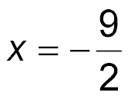
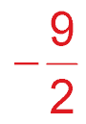
Example 3
Solve Equations with Repeated Factors
2x + 9 = 0 Set the repeated factor equal to zero.
2x = –9 Subtract 9 from each side.
Divide each side by 2.
Answer:

Slide 26
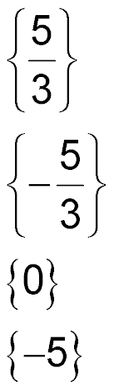
Example 3
Solve 9x² – 30x + 25 = 0.
A.
B.
C. {0}
D. {–5}

Slide 27
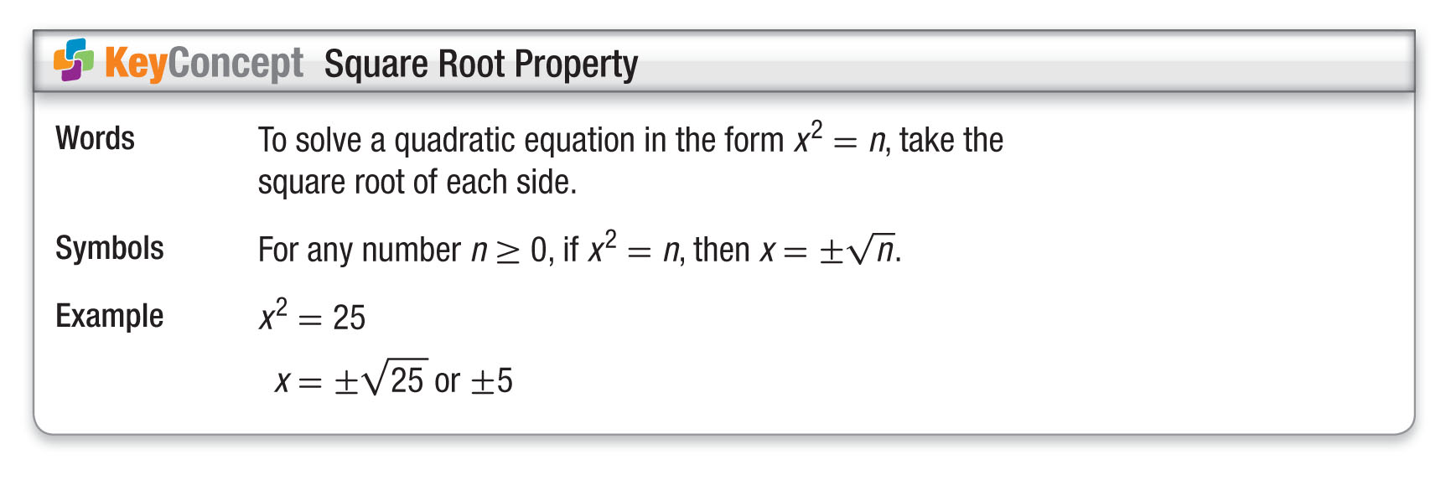
Concept

Slide 28

Example 4
Use the Square Root Property
A. Solve (b – 7)² = 36.
(b – 7)² = 36 Original equation
Square Root Property
b – 7 = 6 36 = 6 ● 6
b = 7 6 Add 7 to each side.
b = 7 + 6 or b = 7 – 6 Separate into two equations.
= 13 = 1 Simplify.
Answer: The roots are 1 and 13. Check each solution
in the original equation.

Slide 29
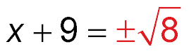
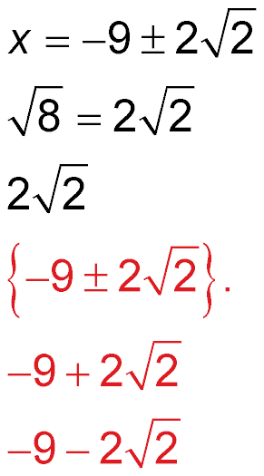
Example 4
Use the Square Root Property
B. Solve (x + 9)² = 8.
(x + 9)² = 8 Original equation
Square Root Property
Subtract 9 from each side.
Answer: The solution set is Using a calculator, the approximate solutions are
or about –6.17 and
or about –11.83.

Slide 30
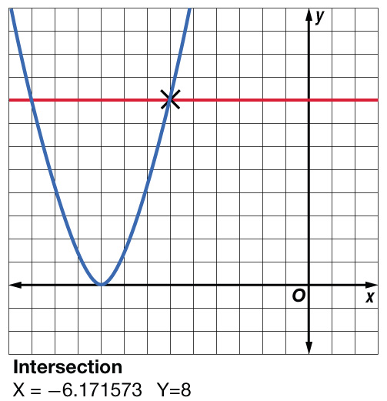
Example 4
Use the Square Root Property
Check You can check your answer using a graphing calculator. Graph y = (x + 9)² and y = 8. Using the INTERSECT feature of your graphing calculator, find where (x + 9)² = 8. The check of –6.17 as
one of the approximate
solutions is shown.
✓

Slide 31
Example 4
A. Solve the equation (x – 4)² = 25. Check your solution.
A. {–1, 9}
B. {–1}
C. {9}
D. {0, 9}

Slide 32
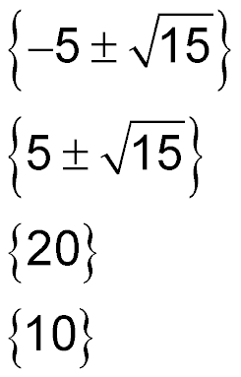
Example 4
B. Solve the equation (x – 5)² = 15. Check your solution.
A.
B.
C. {20}
D. {10}

Slide 33
Example 5
Solve an Equation
PHYSICAL SCIENCE A book falls from a shelf that is 5 feet above the floor. A model for the height h in feet of an object dropped from an initial height of h₀ feet is h = –16t² + h₀ , where t is the time in seconds after the object is dropped. Use this model to determine approximately how long it took for the book to reach the ground.
h = –16t² + h₀ Original equation
0 = –16t² + 5 Replace h with 0 and h₀ with 5.
–5 = –16t² Subtract 5 from each side.
0.3125 = t² Divide each side by –16.

Slide 34
Example 5
Solve an Equation
±0.56 ≈ t Take the square root of each side.
Answer: Since a negative number does not make sense in this situation, the solution is 0.56. This means that it takes about 0.56 second for the book to reach the ground.

Slide 35
Example 5
PHYSICAL SCIENCE An egg falls from a window that is 10 feet above the ground. A model for the height h in feet of an object dropped from an initial height of h₀ feet is h = –16t² + h₀, where t is the time in seconds after the object is dropped. Use this model to determine approximately how long it took for the egg to reach the ground.
A. 0.625 second
B. 10 seconds
C. 0.79 second
D. 16 seconds

Slide 36
End of the Lesson

