Slide 1


Splash Screen

Slide 2
Lesson Menu
Five-Minute Check (over Chapter 8 )
CCSS
Then/Now
New Vocabulary
Key Concept: Quadratic Functions
Example 1: Graph a Parabola
Example 2: Identify Characteristics from Graphs
Example 3: Identify Characteristics from Functions
Key Concept: Maximum and Minimum Values
Example 4: Maximum and Minimum Values
Key Concept: Graph Quadratic Functions
Example 5: Graph Quadratic Functions
Example 6: Real-World Example: Use a Graph of a Quadratic Function

Slide 3

5-Minute Check 1
Factor a² – 5a + 9, if possible.
A. (a + 3)(a – 3)
B. (a + 5)(a – 5)
C. (a + 4)(a – 5)
D. prime

Slide 4

5-Minute Check 2
Factor 6z² – z – 1, if possible.
A. (2z – 1)(3z + 1)
B. (2z + 1)(3z – 1)
C. (2z – 2)(3z + 1)
D. prime

Slide 5

5-Minute Check 3
Solve 5x² = 125.
A. {–15, 5}
B. {–5, 5}
C. {25, –5}
D. {25, 5}

Slide 6

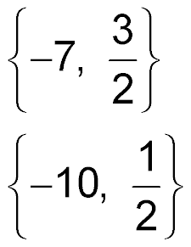
5-Minute Check 4
Solve 2x² + 11x – 21 = 0.
A. {7, 2}
B. {4, 3}
C.
D.

Slide 7

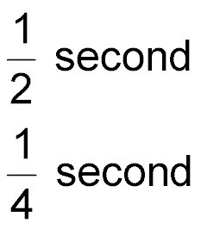
5-Minute Check 5
A certain basketball player’s hang time can be described by 4t² = 1, where t is time in seconds. How long is the player’s hang time?
A. 2 seconds
B. 1 second
C.
D.

Slide 8

5-Minute Check 6
One side length of a square is ax + b. The area of this square is 9x² + 12x + 4. What is the sum of
a and b?
A. 10
B. 9
C. 5
D. 4

Slide 9

CCSS
Content Standards
F.IF.4 For a function that models a relationship between two quantities, interpret key features of graphs and tables in terms of the quantities, and sketch graphs showing key features given a verbal description of the relationship.
F.IF.7a Graph linear and quadratic functions and show intercepts, maxima, and minima.
Mathematical Practices
2 Reason abstractly and quantitatively.
Common Core State Standards © Copyright 2010. National Governors Association Center for Best Practices and Council of Chief State School Officers. All rights reserved.

Slide 10


Then/Now
You graphed linear and exponential functions.
Analyze the characteristics of graphs of quadratic functions.
Graph quadratic functions.

Slide 11

Vocabulary
quadratic function
standard form
parabola
axis of symmetry
vertex
minimum
maximum

Slide 12
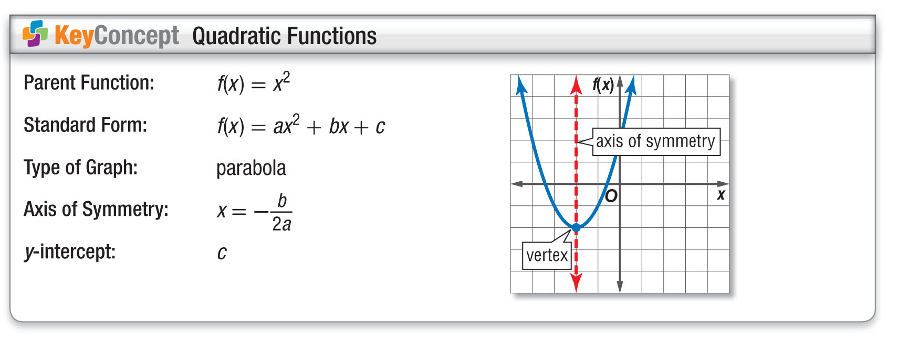
Concept

Slide 13
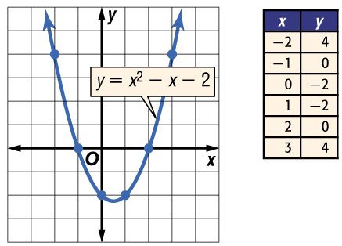
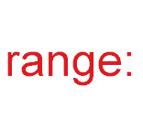

Example 1
Graph a Parabola
Use a table of values to graph
y = x² – x – 2. State the domain and range.
Graph these ordered pairs and connect them with a smooth curve.
Answer: domain: all real numbers;

Slide 14


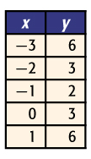
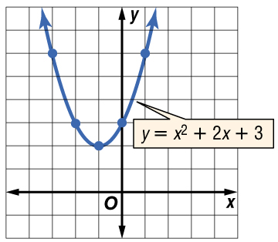
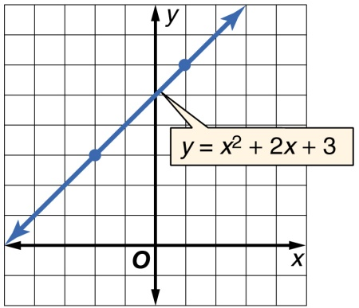
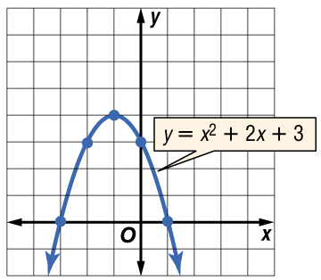
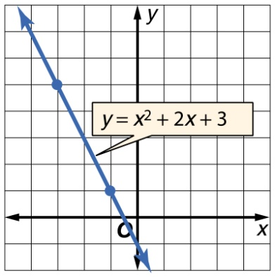
Example 1
Use a table of values to graph
y = x² + 2x + 3.
A. B.
C. D.

Slide 15
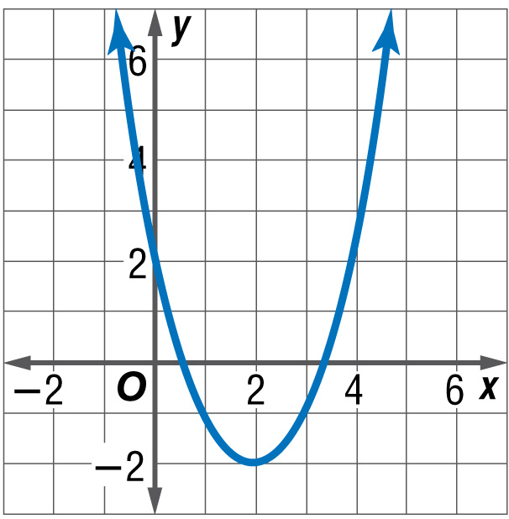
Example 2
Identify Characteristics from Graphs
A. Find the vertex, the equation of the axis of symmetry, and y-intercept of the graph.
Step 1 Find the vertex.
Because the parabola opens up, the vertex is located at the minimum point of the parabola. It is located at (2, –2).

Slide 16
Example 2
Identify Characteristics from Graphs
A. Find the vertex, the equation of the axis of symmetry, and y-intercept of the graph.
Step 2 Find the axis of symmetry.
The axis of symmetry is the line that goes through the vertex and divides the parabola into congruent halves. It is located at x = 2.

Slide 17
Example 2
Identify Characteristics from Graphs
A. Find the vertex, the equation of the axis of symmetry, and y-intercept of the graph.
Step 3 Find the y-intercept.
The y-intercept is the point where the graph intersects the y-axis. It is located at (0, 2), so the y-intercept is 2.

Slide 18
Example 2
Identify Characteristics from Graphs
A. Find the vertex, the equation of the axis of symmetry, and y-intercept of the graph.
Answer: vertex: (2, –2); axis of symmetry: x = 2;
y-intercept: 2

Slide 19
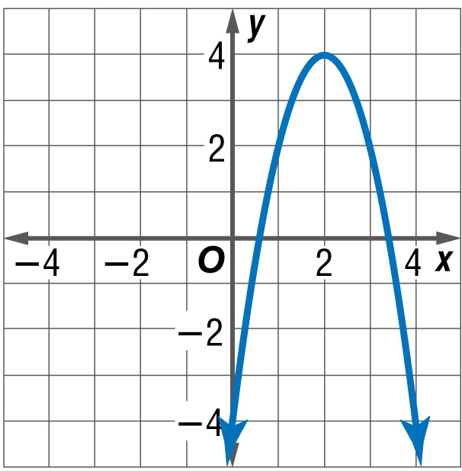
Example 2
Identify Characteristics from Graphs
B. Find the vertex, the equation of the axis of symmetry, and
y-intercept of the graph.
Step 1 Find the vertex.
The parabola opens down, so the vertex is located at the maximum point (2, 4).

Slide 20
Example 2
Identify Characteristics from Graphs
Step 2 Find the axis of symmetry.
The axis of symmetry is located at x = 2.
Step 3 Find the y-intercept.
The y-intercept is where the parabola intersects the y-axis. it is located at (0, –4), so the y-intercept is –4.
Answer: vertex: (2, 4); axis of symmetry: x = 2;
y-intercept: –4

Slide 21
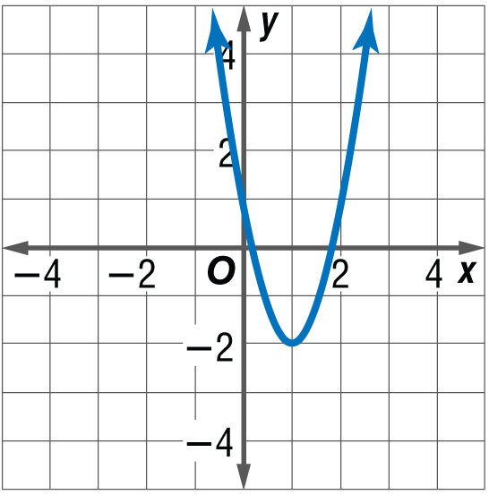
Example 2
A. Consider the graph of y = 3x² – 6x + 1. Write the equation of the axis of symmetry.
A. x = –6
B. x = 6
C. x = –1
D. x = 1

Slide 22
Example 2
B. Consider the graph of y = 3x² – 6x + 1. Find the coordinates of the vertex.
A. (–1, 10)
B. (1, –2)
C. (0, 1)
D. (–1, –8)

Slide 23
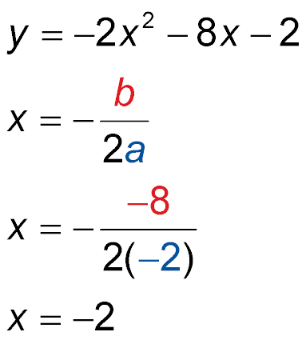
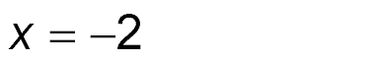
Example 3
Identify Characteristics from Functions
A. Find the vertex, the equation of the axis of symmetry, and y-intercept of y = –2x² – 8x – 2.
Formula for the equation of the axis of symmetry
a = –2, b = –8
Simplify.

Slide 24
Example 3
Identify Characteristics from Functions
The equation for the axis of symmetry is x = –2.
To find the vertex, use the value you found for the axis of symmetry as the x-coordinate of the vertex. To find the y-coordinate, substitute that value for x in the original equation
y = –2x² – 8x – 2 Original equation
= –2(–2)² – 8(–2) – 2 x = –2
= 6 Simplify.
The vertex is at (–2, 6).
The y-intercept occurs at (0, c). So, the
y-intercept is –2.

Slide 25
Example 3
Identify Characteristics from Functions
Answer: vertex: (–2, 6); axis of symmetry: x = –2;
y-intercept: –2

Slide 26
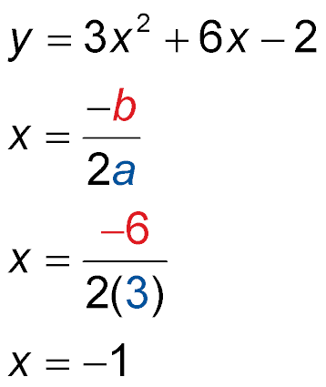
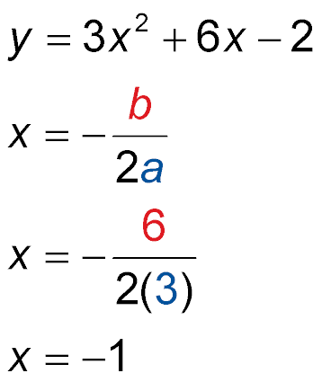
Example 3
Identify Characteristics from Functions
B. Find the vertex, the equation of the axis of symmetry, and y-intercept of y = 3x² + 6x – 2.
Formula for the equation of the axis of symmetry
a = 3, b = 6
Simplify.

Slide 27
Example 3
Identify Characteristics from Functions
The equation for the axis of symmetry is x = –1.
To find the vertex, use the value you found for the axis of symmetry as the x-coordinate of the vertex. To find the y-coordinate, substitute that value for x in the original equation.
y = 3x² + 6x – 2 Original equation
= 3(–1)² + 6(–1) – 2 x = –1
= –5 Simplify.
The vertex is at (–1, –5).
The y-intercept occurs at (0, c). So, the
y-intercept is –2.

Slide 28
Example 3
Identify Characteristics from Functions
Answer: vertex: (–1, –5); axis of symmetry: x = –1;
y-intercept: –2

Slide 29
Example 3
A. Find the vertex for y = x² + 2x – 3.
A. (0, –4)
B. (1, –2)
C. (–1, –4)
D. (–2, –3)

Slide 30
Example 3
B. Find the equation of the axis of symmetry for
y = 7x² – 7x – 5.
A. x = 0.5
B. x = 1.5
C. x = 1
D. x = –7

Slide 31
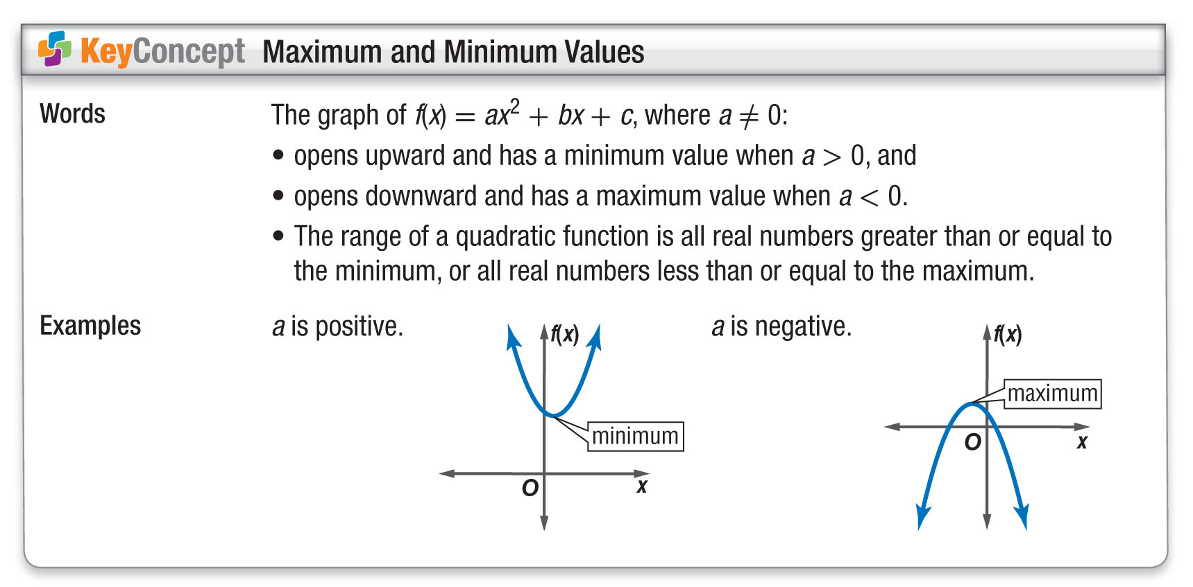
Concept

Slide 32
Example 4
Maximum and Minimum Values
A. Consider f(x) = –x² – 2x – 2. Determine whether the function has a maximum or a minimum value.
For f(x) = –x² – 2x – 2, a = –1, b = –2, and c = –2.
Answer: Because a is negative the graph opens down, so the function has a maximum value.

Slide 33
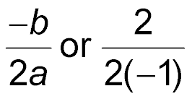
Example 4
Maximum and Minimum Values
B. Consider f(x) = –x² – 2x – 2. State the maximum or minimum value of the function.
The maximum value is the y-coordinate of the vertex.
The x-coordinate of the vertex is or –1.
f(x) = –x² – 2x – 2 Original function
f(–1) = –(–1)² – 2(–1) – 2 x = –1
f(–1) = –1 Simplify.
Answer: The maximum value is –1.

Slide 34
Example 4
Maximum and Minimum Values
C. Consider f(x) = –x² – 2x – 2. State the domain and range of the function.
Answer: The domain is all real numbers. The range is all real numbers less than or equal to the maximum value, or {y | y ≤ –1}.

Slide 35
Example 4
A. Consider f(x) = 2x² – 4x + 8. Determine whether the function has a maximum or a minimum value.
A. maximum
B. minimum
C. neither

Slide 36
Example 4
B. Consider f(x) = 2x² – 4x + 8. State the maximum or minimum value of the function.
A. –1
B. 1
C. 6
D. 8

Slide 37
Example 4
C. Consider f(x) = 2x² – 4x + 8. State the domain and range of the function.
A. Domain: all real numbers; Range: {y | y ≥ 6}
B. Domain: all positive numbers; Range: {y | y ≤ 6}
C. Domain: all positive numbers; Range: {y | y ≥ 8}
D. Domain: all real numbers; Range: {y | y ≤ 8}

Slide 38
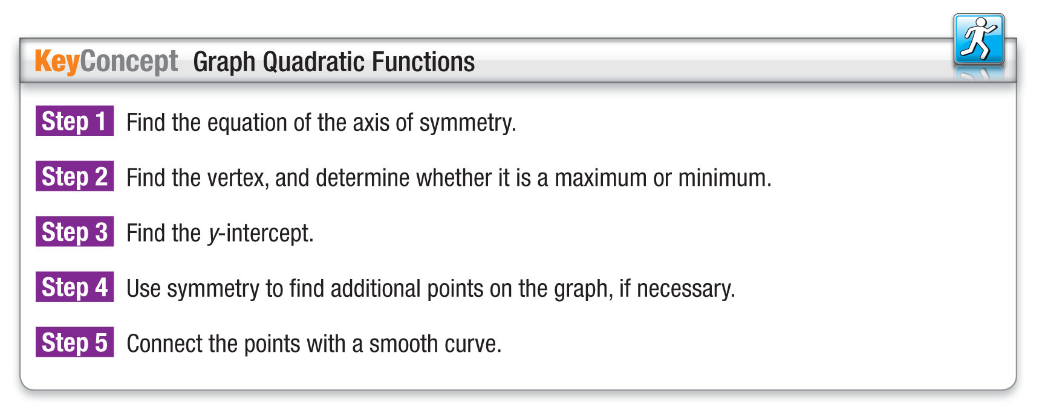
Concept

Slide 39
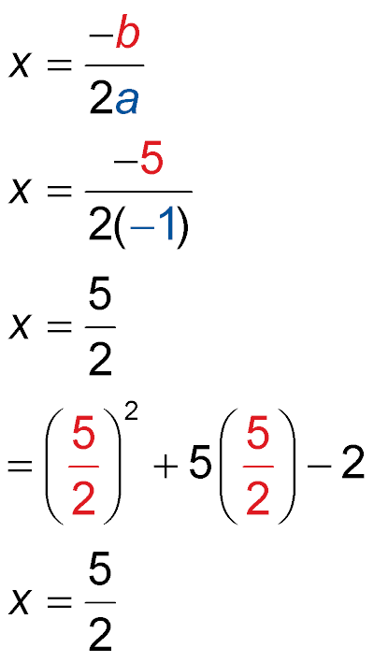
Example 5
Graph Quadratic Functions
Graph the function f(x) = –x² + 5x – 2.
Step 1 Find the equation of the axis of symmetry.
Formula for the equation of the axis of symmetry
a = –1 and b = 5
or 2.5
Simplify.

Slide 40
Example 5
Graph Quadratic Functions
Step 2 Find the vertex, and determine whether it is a maximum or minimum.
f(x) = –x² + 5x – 2 Original equation
= –(2.5)² + 5(2.5) – 2 x = 2.5
= 4.25 Simplify.
The vertex lies at (2.5, 4.25). Because a is negative the graph opens down, and the vertex is a maximum.

Slide 41
Example 5
Graph Quadratic Functions
Step 3 Find the y-intercept.
f(x) = –x² + 5x – 2 Original equation
= –(0)² + 5(0) – 2 x = 0
= –2 Simplify.
The y-intercept is –2.

Slide 42
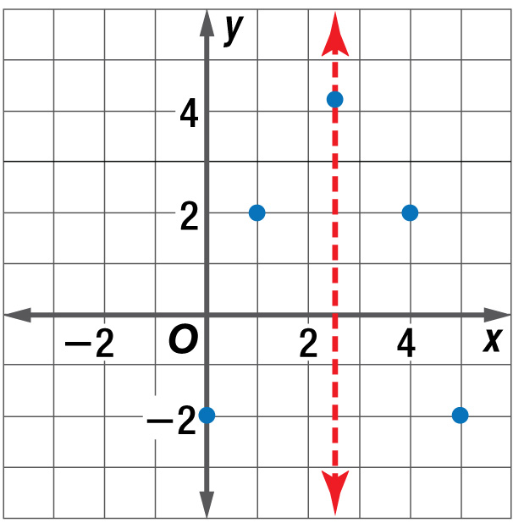
Example 5
Graph Quadratic Functions
Step 4 The axis of symmetry divides the parabola into two equal parts. So if there is a point on one side, there is a corresponding point on the other side that is the same distance from the axis of symmetry and has the same
y-value.

Slide 43
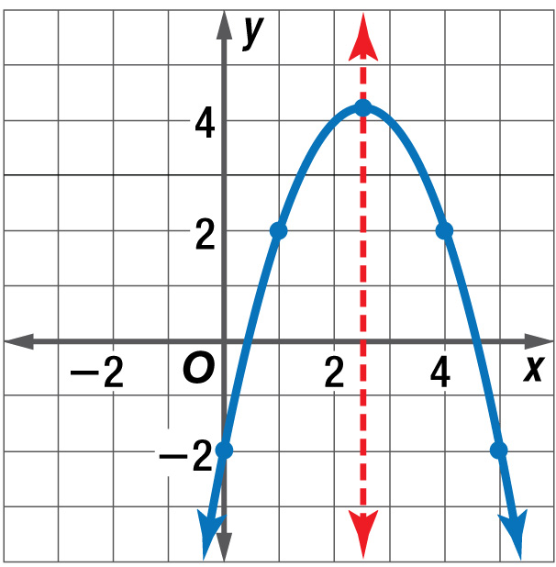
Example 5
Graph Quadratic Functions
Step 5 Connect the points with a smooth curve.
Answer:

Slide 44
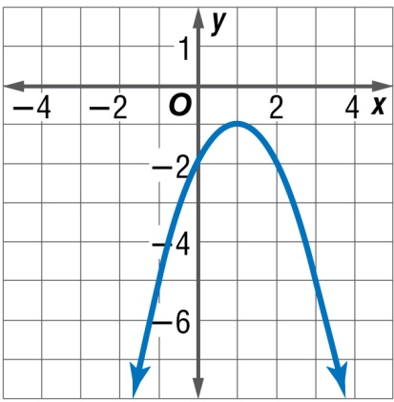
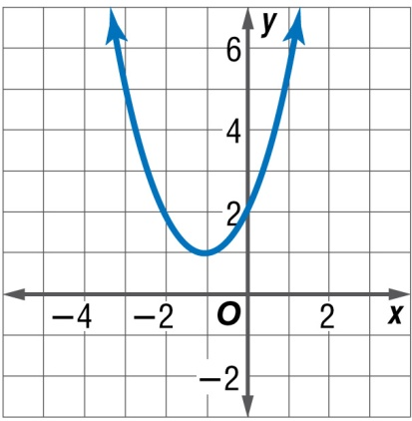
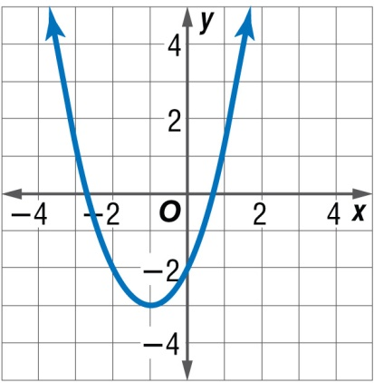
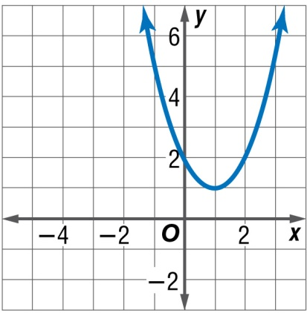
Example 5
Graph the function f(x) = x² + 2x – 2.
A. B.
C. D.

Slide 45
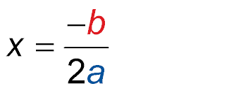
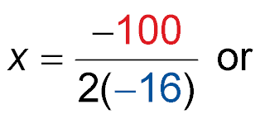
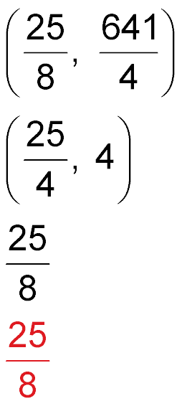
Example 6
Use a Graph of a Quadratic Function
A. ARCHERY Ben shoots an arrow. The path of the arrow can be modeled by y = –16x² + 100x + 4, where y represents the height in feet of the arrow
x seconds after it is shot into the air.
Graph the height of the arrow.
Equation of the axis of symmetry
a = –16 and b = 100

Slide 46
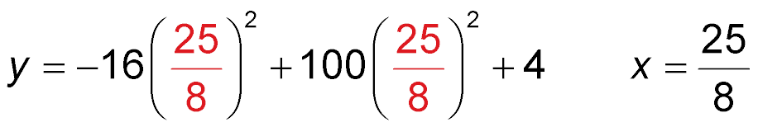
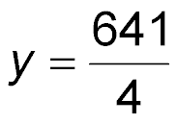
Example 6
Use a Graph of a Quadratic Function
The equation of the axis of symmetry is x = . Thus, the x-coordinate for the vertex is .
y = –16x² + 100x + 4 Original equation
Simplify.
The vertex is at .

Slide 47
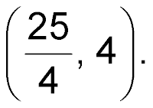
Example 6
Use a Graph of a Quadratic Function
Let’s find another point. Choose an x-value of 0 and substitute. Our new point is (0, 4). The point paired with it on the other side of the axis of symmetry is

Slide 48
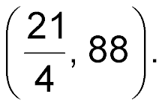
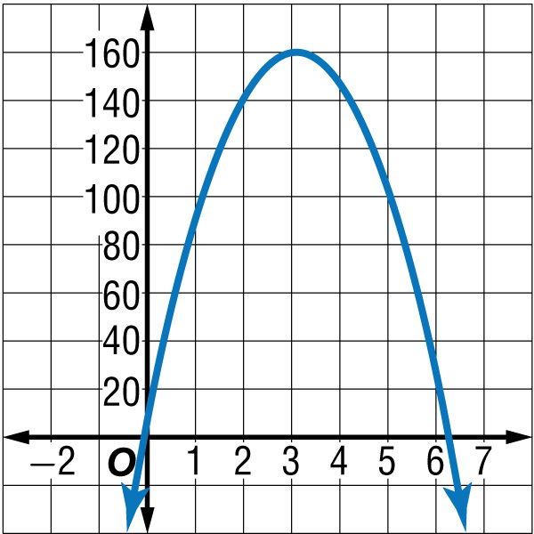
Example 6
Use a Graph of a Quadratic Function
Repeat this and choose an x-value to get (1, 88) and its
corresponding point Connect these with points and create a smooth curve.
Answer:

Slide 49
Example 6
Use a Graph of a Quadratic Function
B. ARCHERY Ben shoots an arrow. The path of the arrow can be modeled by y = –16x² + 100x + 4, where y represents the height in feet of the arrow
x seconds after it is shot in the air.
At what height was the arrow shot?
The arrow is shot when the time equals 0, or at the
y-intercept.
Answer: The arrow is shot when the time equal 0, or at the y-intercept. So, the arrow was 4 feet from the ground when it was shot.

Slide 50
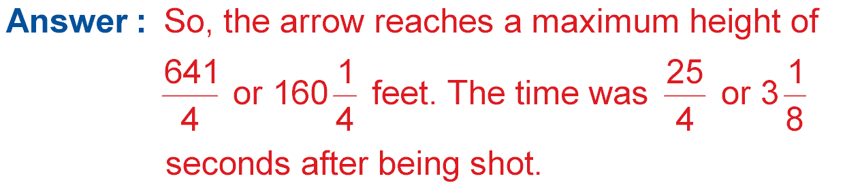
Example 6
Use a Graph of a Quadratic Function
C. ARCHERY Ben shoots an arrow. The path of the arrow can be modeled by y = –16x² + 100x + 4, where y represents the height in feet of the arrow
x seconds after it is shot in the air.
What is the maximum height of the arrow?
The maximum height of the arrow occurs at the vertex.

Slide 51
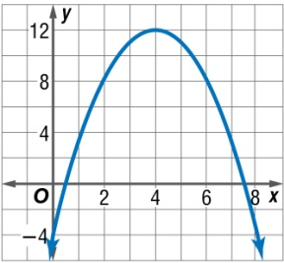
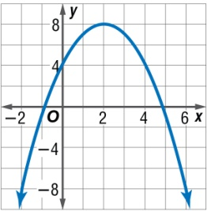
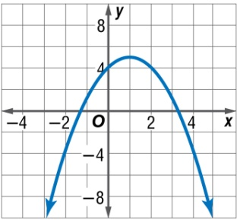
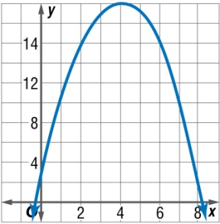
Example 6
A. TENNIS Ellie hit a tennis ball into the air. The path of the ball can be modeled by y = –x² + 8x + 2, where y represents the height in feet of the ball x seconds after it is hit into the air. Graph the path of the ball.
A. B.
C. D.

Slide 52
Example 6
B. TENNIS Ellie hit a tennis ball into the air. The path of the ball can be modeled by y = –x² + 8x + 2, where y represents the height in feet of the ball
x seconds after it is hit into the air. At what height was the ball hit?
A. 2 feet
B. 3 feet
C. 4 feet
D. 5 feet

Slide 53
Example 6
C. TENNIS Ellie hit a tennis ball into the air. The path of the ball can be modeled by y = –x² + 8x + 2, where y represents the height in feet of the ball
x seconds after it is hit into the air. What is the maximum height of the ball?
A. 5 feet
B. 8 feet
C. 18 feet
D. 22 feet

Slide 54
End of the Lesson

