Slide 1


Splash Screen

Slide 2
Lesson Menu
Five-Minute Check (over Lesson 9–1)
CCSS
Then/Now
New Vocabulary
Key Concept: Solutions of Quadratic Equations
Example 1: Two Roots
Example 2: Double Root
Example 3: No Real Roots
Example 4: Approximate Roots with a Table
Example 5: Real-World Example: Approximate Roots with a Calculator

Slide 3

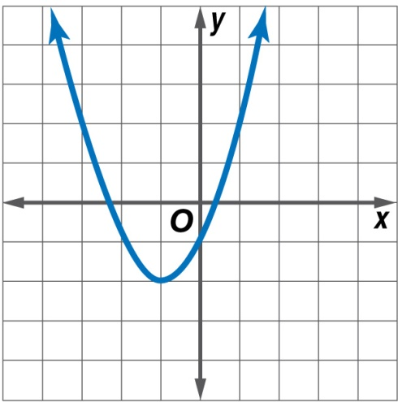
5-Minute Check 1
Use a table of values to graph y = x² + 2x – 1. State the domain and range.
D = {all real numbers},
R = {y | y ≤ –2}
B. D = {all real numbers},
R = {y | y ≥ –2}
C. D = {all real numbers},
R = {y | y ≥ –1}
D. D = {x | x > 1},
R = {y | y > 1}

Slide 4

5-Minute Check 2
What is the equation of the axis of symmetry for
y = –x² + 2?
A. x = 2
B. x = 0
C. x = –2
D. y = 2

Slide 5

5-Minute Check 3
What are the coordinates of the vertex of the graph of y = x² – 5x? Is the vertex a maximum or minimum?
A. (–1.5, 6); maximum
B. (2, –4); minimum
C. (2, 4); maximum
D. (2.5, –6.25); minimum

Slide 6

5-Minute Check 4
What is the maximum height of a rocket fired straight up if the height in feet is described by
h = –16t² + 64t + 1, where t is time in seconds?
A. 65 ft
B. 61 ft
C. 54 ft
D. 43 ft

Slide 7

CCSS
Content Standards
A.REI.4b Solve quadratic equations by inspection (e.g., for x² = 49), taking square roots, completing the square, the quadratic formula and factoring, as appropriate to the initial form of the equation. Recognize when the quadratic formula gives complex solutions and write them as a ± bi for real numbers a and b.
F.IF.7a Graph linear and quadratic functions and show intercepts, maxima, and minima.
Mathematical Practices
3 Construct viable arguments and critique the reasoning of others.
6 Attend to precision.
Common Core State Standards © Copyright 2010. National Governors Association Center for Best Practices and Council of Chief State School Officers. All rights reserved.

Slide 8


Then/Now
You solved quadratic equations by factoring.
Solve quadratic equations by graphing.
Estimate solutions of quadratic equations by graphing.

Slide 9

Vocabulary
double root

Slide 10
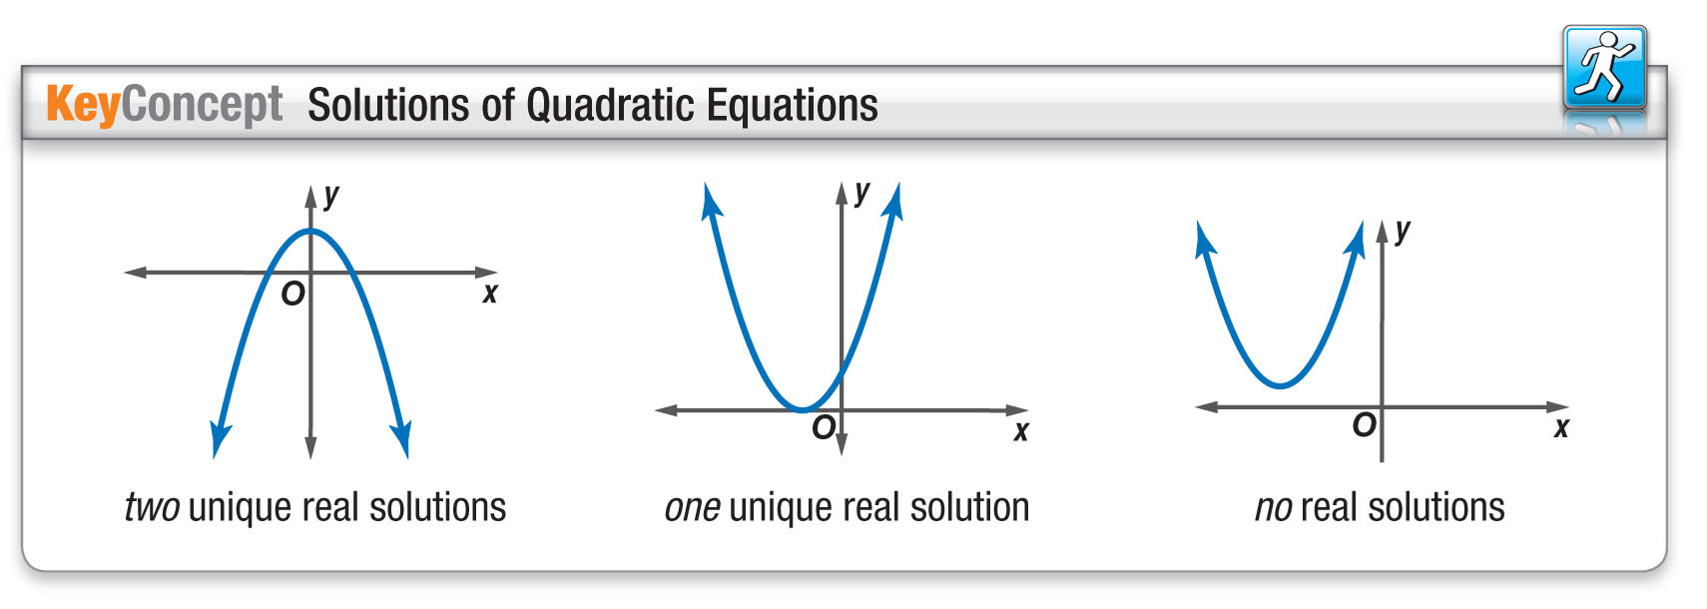
Concept

Slide 11
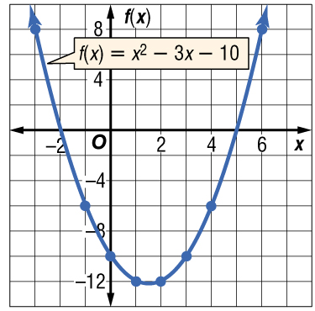
Example 1
Two Roots
Solve x² – 3x – 10 = 0 by graphing.
Graph the related function
f(x) = x² – 3x – 10.
The x-intercepts of the parabola appear to be at
–2 and 5. So the solutions are –2 and 5.

Slide 12
Example 1
Two Roots
Check Check each solution in the original equation.
x² – 3x – 10 = 0 Original equation x² – 3x – 10 = 0
?
?
(–2)² – 3(–2) – 10 = 0 x = –2 or x = 5 (5)² – 3(5) – 10 = 0
0 = 0 Simplify. 0 = 0
Answer: The solutions of the equation are –2 and 5.

Slide 13


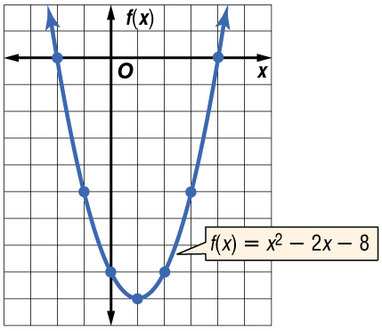
Example 1
Solve x² – 2x – 8 = 0 by graphing.
A. {–2, 4}
B. {2, –4}
C. {2, 4}
D. {–2, –4}

Slide 14
Example 2
Double Root
Solve x² + 8x = –16 by graphing.
Step 1 First, rewrite the equation so one side is equal to zero.
x² + 8x = –16 Original equation
x² + 8x + 16 = –16 + 16 Add 16 to each side.
x² + 8x + 16 = 0 Simplify.

Slide 15
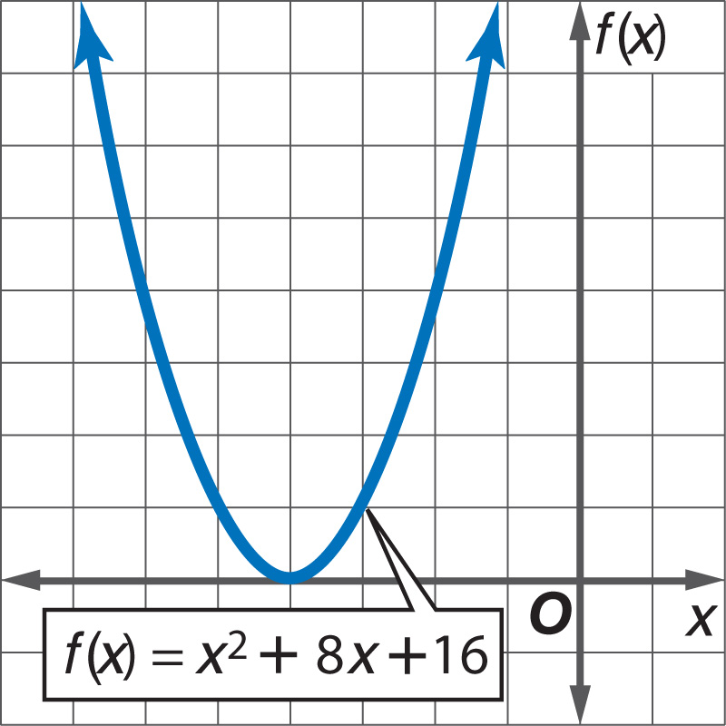
Example 2
Double Root
Step 2 Graph the related function
f(x) = x² + 8x + 16.

Slide 16
Example 2
Double Root
Step 3 Locate the x-intercepts of the graph. Notice that the vertex of the parabola is the only
x-intercept. Therefore, there is only one solution, –4.
Answer: The solution is –4.
Check Solve by factoring.
x² + 8x + 16 = 0 Original equation
(x + 4)(x + 4) = 0 Factor.
x + 4 = 0 or x + 4 = 0 Zero Product Property
x = –4 x = –4 Subtract 4 from each side.

Slide 17
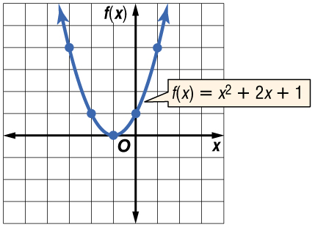
Example 2
Solve x² + 2x = –1 by graphing.
A. {1}
B. {–1}
C. {–1, 1}
D. Ø

Slide 18
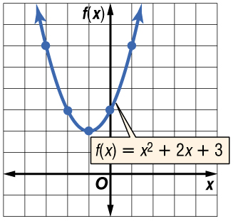
Example 3
No Real Roots
Solve x² + 2x + 3 = 0 by graphing.
Graph the related function
f(x) = x² + 2x + 3.
The graph has no x-intercept. Thus, there are no real number solutions for the equation.
Answer: The solution set is {Ø}.

Slide 19
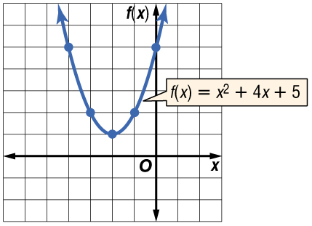
Example 3
Solve x² + 4x + 5 = 0 by graphing.
A. {1, 5}
B. {–1, 5}
C. {5}
D. Ø

Slide 20
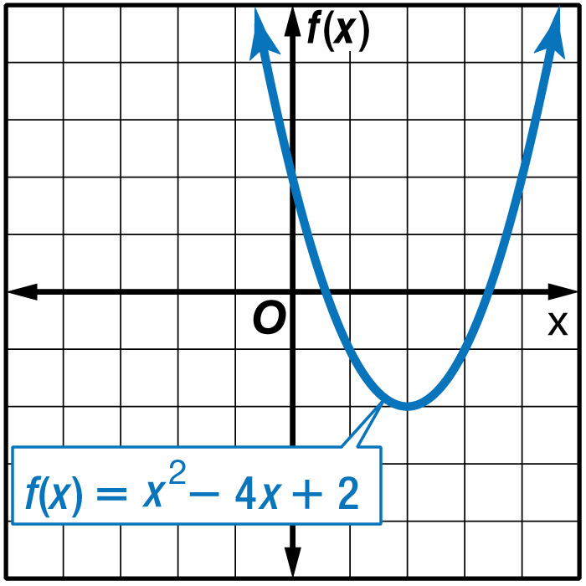
Example 4
Approximate Roots with a Table
Solve x² – 4x + 2 = 0 by graphing. If integral roots cannot be found, estimate the roots to the nearest tenth.
Graph the related function f(x) = x² – 4x + 2.

Slide 21
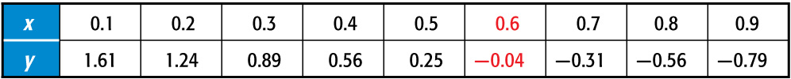
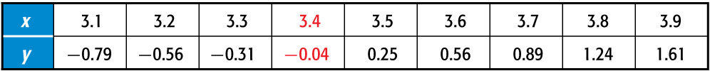
Example 4
Approximate Roots with a Table
The x-intercepts are located between 0 and 1 and between 3 and 4.
Make a table using an increment of 0.1 for the x-values located between 0 and 1 and between 3 and 4.
Look for a change in the signs of the function values. The function value that is closest to zero is the best approximation for a zero of the function.

Slide 22
Example 4
Approximate Roots with a Table
For each table, the function value that is closest to zero when the sign changes is –0.04. Thus, the roots are approximately 0.6 and 3.4.
Answer: 0.6, 3.4

Slide 23
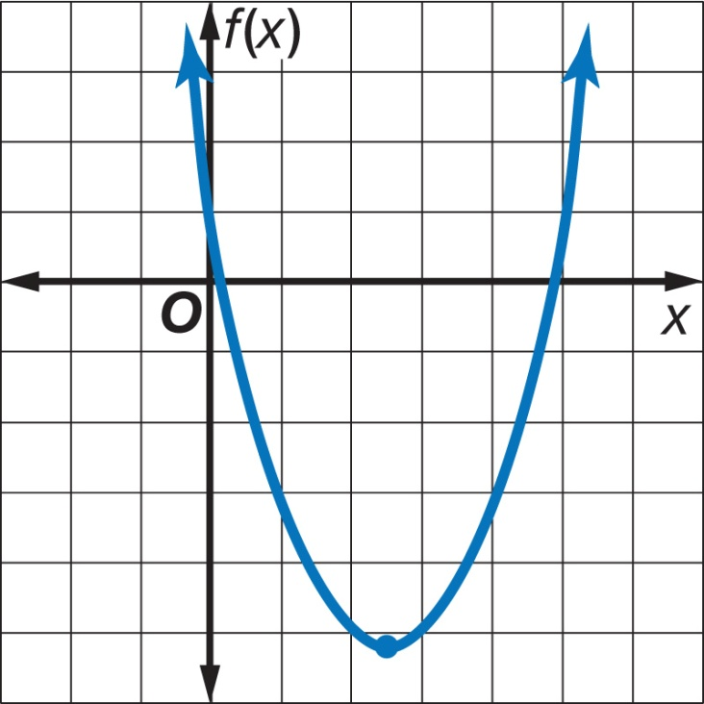
Example 4
Solve x² – 5x + 1 = 0 by graphing. If integral roots cannot be found, estimate the roots to the nearest tenth.
A. 0.4, 5.6
B. 0.1, 4.9
C. 0.2, 4.8
D. 0.3, 4.7

Slide 24
Example 5
Approximate Roots with a Calculator
MODEL ROCKETS Consuela built a model rocket for her science project. The equation
h = –16t² + 250t models the flight of the rocket, launched from ground level at a velocity of 250 feet per second, where h is the height of the rocket in feet after t seconds. Approximately how long was Consuela’s rocket in the air?
You need to find the roots of the equation
–16t² + 250t = 0. Use a graphing calculator to
graph the related function h = –16t² + 250t.

Slide 25
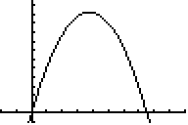
Example 5
Approximate Roots with a Calculator
The x-intercepts of the graph are approximately 0 and 15.6 seconds.
Answer: The rocket is in the air approximately
15.6 seconds.

Slide 26
Example 5
GOLF Martin hits a golf ball with an upward velocity of 120 feet per second. The function
h = –16t² + 120t models the flight of the golf ball hit at ground level, where h is the height of the ball in feet after t seconds. How long was the golf ball in the air?
A. approximately 3.5 seconds
B. approximately 7.5 seconds
C. approximately 4.0 seconds
D. approximately 6.7 seconds

Slide 27
End of the Lesson

