Slide 1


Splash Screen

Slide 2
Lesson Menu
Five-Minute Check (over Lesson 9–2)
CCSS
Then/Now
New Vocabulary
Key Concept: Vertical Translations
Example 1: Describe and Graph Translations
Key Concept: Horizontal Translation
Example 2: Horizontal Translations
Example 3: Horizontal and Vertical Translations
Key Concept: Dilations
Example 4: Describe and Graph Dilations
Key Concept: Reflections
Example 5: Describe and Graph Reflections
Example 6: Standardized Test Example

Slide 3

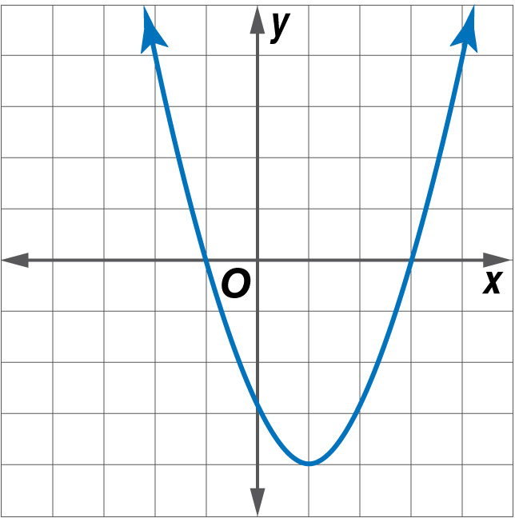
5-Minute Check 1
Solve m² – 2m – 3 = 0 by graphing.
A. 1, 3
B. –1, 3
C. 9, 3
D. –9, 3

Slide 4

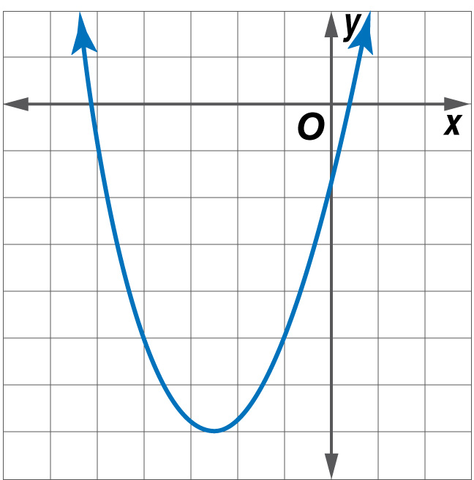
5-Minute Check 2
Solve w² + 5w – 1 = 0 by graphing. If integral roots cannot be found, estimate the roots by stating the consecutive integers between which the roots lie.
A. 6 < w < 5
B. 6 > w > 1
C. –6 < w < –5,
0 < w < 1
D. –5 < w < 1

Slide 5

5-Minute Check 3
Use a quadratic function to find two numbers that have a difference of 3 and a product of 10.
A. –5, 2
B. 1, 10
C. 5, –2
D. 5, 2

Slide 6

5-Minute Check 4
Solve 21 = x² + 2x – 14 by graphing.
A. –7, 5
B. 4, 10
C. –5, 7
D. –8, 4

Slide 7

CCSS
Content Standards
A.SSE.3b Complete the square in a quadratic expression to reveal the maximum or minimum value of the function it defines.
F.IF.7a Graph linear and quadratic functions and show intercepts, maxima, and minima.
Mathematical Practices
1 Make sense of problems and persevere in solving them.
8 Look for and express regularity in repeated reasoning.
Common Core State Standards © Copyright 2010. National Governors Association Center for Best Practices and Council of Chief State School Officers. All rights reserved.

Slide 8


Then/Now
You graphed quadratic functions by using the vertex and axis of symmetry.
Apply translations of quadratic functions.
Apply dilations and reflections to quadratic functions.

Slide 9

Vocabulary
transformation
translation
dilation
reflection
vertex form

Slide 10
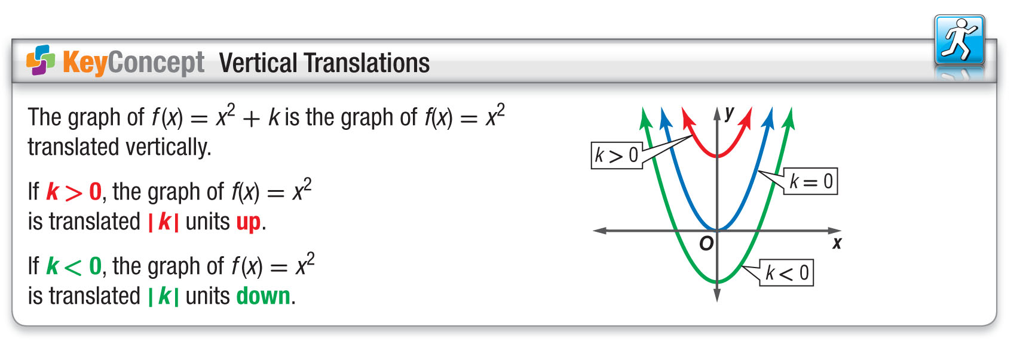
Concept

Slide 11
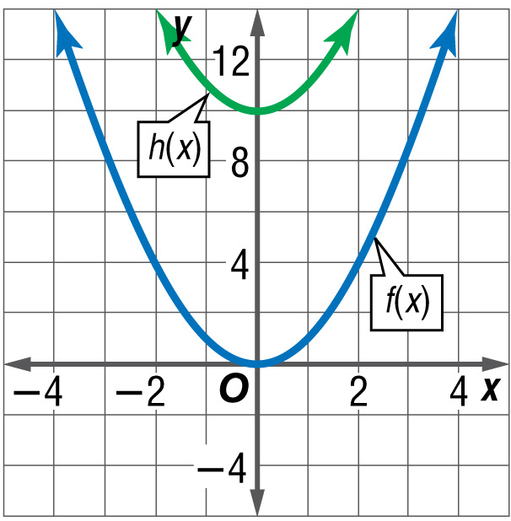
Example 1
Describe and Graph Translations
A. Describe how the graph of h(x) = 10 + x² is related to the graph f(x) = x².
Answer: The value of c is 10, and 10 > 0. Therefore, the graph of y = 10 + x² is a translation of the graph y = x² up 10 units.

Slide 12
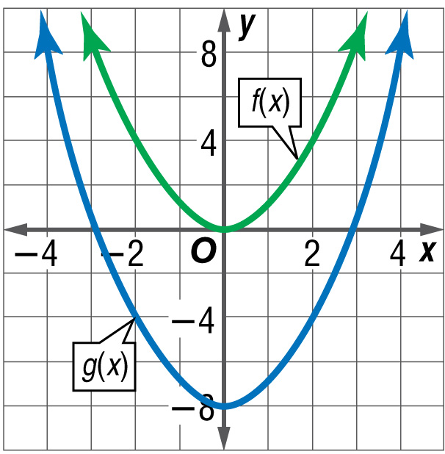
Example 1
Describe and Graph Translations
B. Describe how the graph of g(x) = x² – 8 is related to the graph f(x) = x².
Answer: The value of c is –8, and –8 < 0. Therefore, the graph of y = x² – 8 is a translation of the graph y = x² down 8 units.

Slide 13


Example 1
A. Describe how the graph of h(x) = x² + 7 is related to the graph of f(x) = x².
A. h(x) is translated 7 units up
from f(x).
B. h(x) is translated 7 units down
from f(x).
C. h(x) is translated 7 units left
from f(x).
D. h(x) is translated 7 units right
from f(x).

Slide 14
Example 1
B. Describe how the graph of g(x) = x² – 3 is related to the graph of f(x) = x².
A. g(x) is translated 3 units up
from f(x).
B. g(x) is translated 3 units down
from f(x).
C. g(x) is translated 3 units left
from f(x).
D. g(x) is translated 3 units right
from f(x).

Slide 15
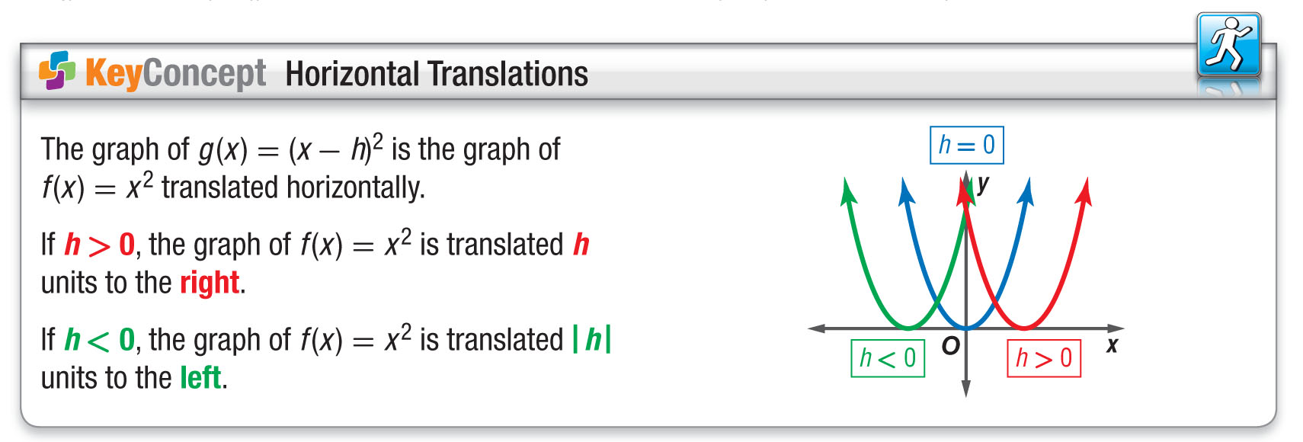
Concept

Slide 16
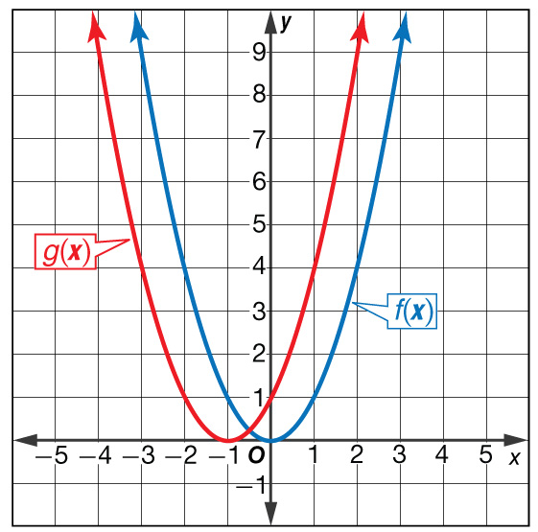
Example 2
Horizontal Translations
A. Describe how the graph of g(x) = (x + 1)² is related to the graph f(x) = x².
Answer: The graph of g(x) = (x – h)² is the graph of
f(x) = x² translated horizontally.
k = 0, h = –1, and –1 < 0
g(x) is a translation of the graph of f(x) = x² to
the left one unit.

Slide 17
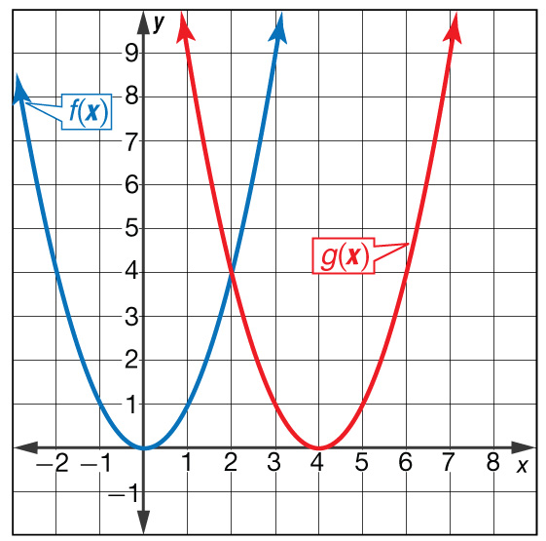
Example 2
Describe and Graph Dilations
B. Describe how the graph of g(x) = (x – 4)² is related to the graph f(x) = x².
Answer: The graph of g(x) = (x – h)² is the graph of
f(x) = x² translated horizontally.
k = 0, h = 4, and h > 0
g(x) is a translation of the graph of f(x) = x² to the right 4 units.

Slide 18
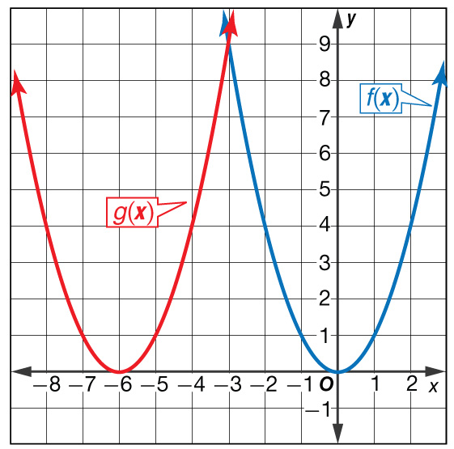
Example 2
Describe how the graph of g(x) = (x + 6)² is related to the graph of f(x) = x².
A. translated left 6 units
B. translated up 6 units
C. translated down 6 units
D. translated right 6 units

Slide 19
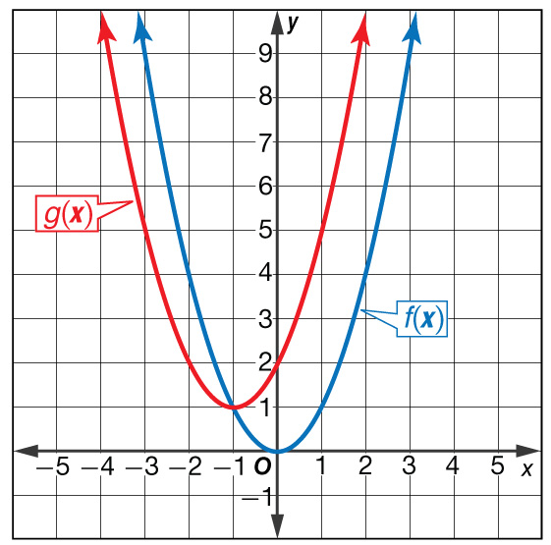
Example 3
Horizontal and Vertical Translations
A. Describe how the graph of g(x) = (x + 1)² + 1 is related to the graph f(x) = x².
Answer: The graph of g(x) = (x – h)² + k is the graph of f(x) = x² translated horizontally by a value of h and vertically by a value of k.
k = 1, h = –1, and –1 < 0
g(x) is a translation of the graph of f(x) = x² to the left 1 unit and up 1 unit.

Slide 20
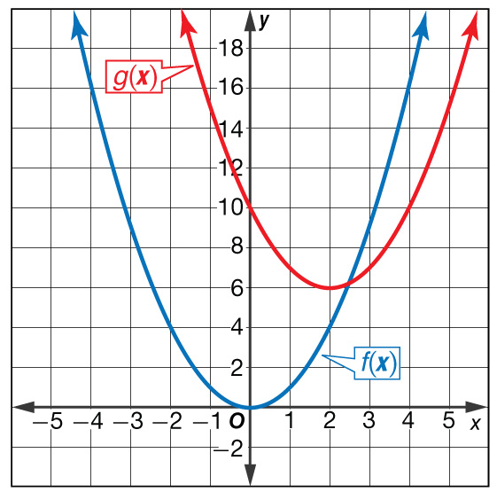
Example 3
Horizontal and Vertical Translations
B. Describe how the graph of g(x) = (x² – 2)² + 6 is related to the graph f(x) = x².
Answer: The graph of g(x) = (x – h)² + k is the graph of f(x) = x² translated horizontally by a value of h and vertically by a value of k.
k = 6, h = 2, and 2 > 0
g(x) is a translation of the graph of f(x) = x² to the right 2 units and up 6 units.

Slide 21
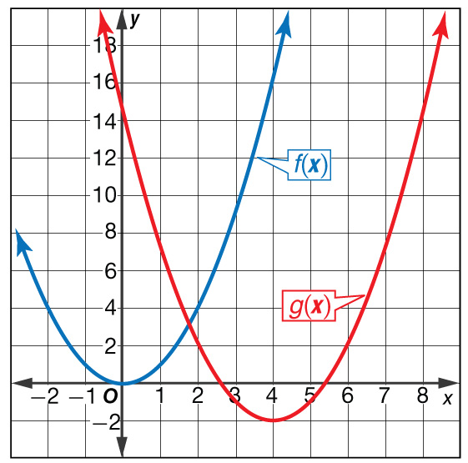
Example 3
Describe how the graph of
g(x) = (x – 4)² – 2 is related to the graph of f(x) = x².
A. translated right 4 units
and up 2 units
B. translated left 4 units and up 2 units
C. translated right 4 units and down 2 units
D. translated left 4 units and down 2 units

Slide 22
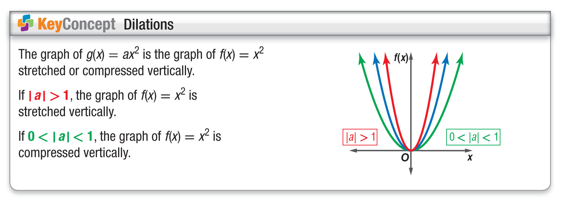
Concept

Slide 23
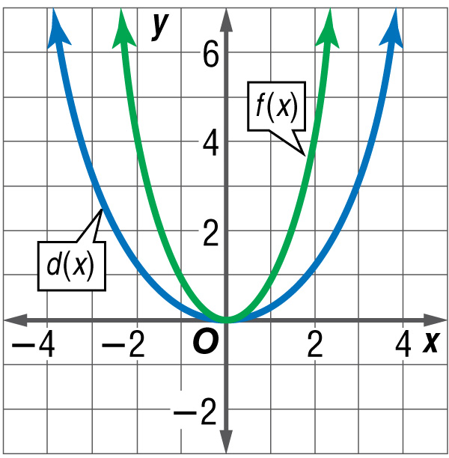
Example 4
Describe and Graph Dilations
A. Describe how the graph of d(x) = x² is related to the graph f(x) = x².
1
__
3
1
__
The function can be written d(x) = ax², where a = .
3

Slide 24
Example 4
Describe and Graph Dilations
Answer: Since 0 < < 1, the graph of y = x² is a vertical compression of the graph y = x².
1
1
__
__
3
3

Slide 25
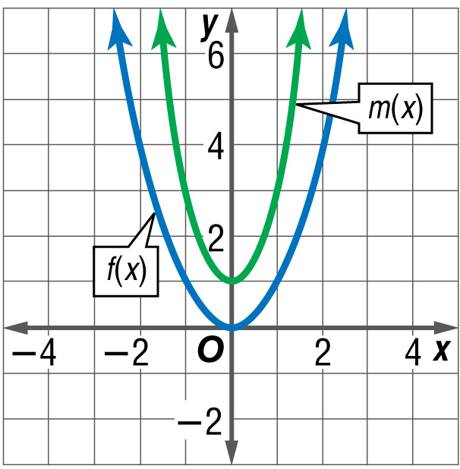
Example 4
Describe and Graph Dilations
B. Describe how the graph of m(x) = 2x² + 1 is related to the graph f(x) = x².
The function can be written m(x) = ax² + c, where a = 2 and c = 1.

Slide 26
Example 4
Describe and Graph Dilations
Answer: Since 1 > 0 and 3 > 1, the graph of y = 2x² + 1 is stretched vertically and then translated up
1 unit.

Slide 27
Example 4
A. Describe how the graph of n(x) = 2x² is related to the graph of f(x) = x².
A. n(x) is compressed vertically from f(x).
B. n(x) is translated 2 units
up from f(x).
C. n(x) is stretched vertically from f(x).
D. n(x) is stretched horizontally from f(x).

Slide 28
Example 4
B. Describe how the graph of b(x) = x² – 4 is related to the graph of f(x) = x².
1
__
2
A. b(x) is stretched vertically and translated 4 units down from f(x).
B. b(x) is compressed vertically and translated 4 units down from f(x).
C. b(x) is stretched horizontally and translated 4 units up from f(x).
D. b(x) is stretched horizontally and translated 4 units down from f(x).

Slide 29
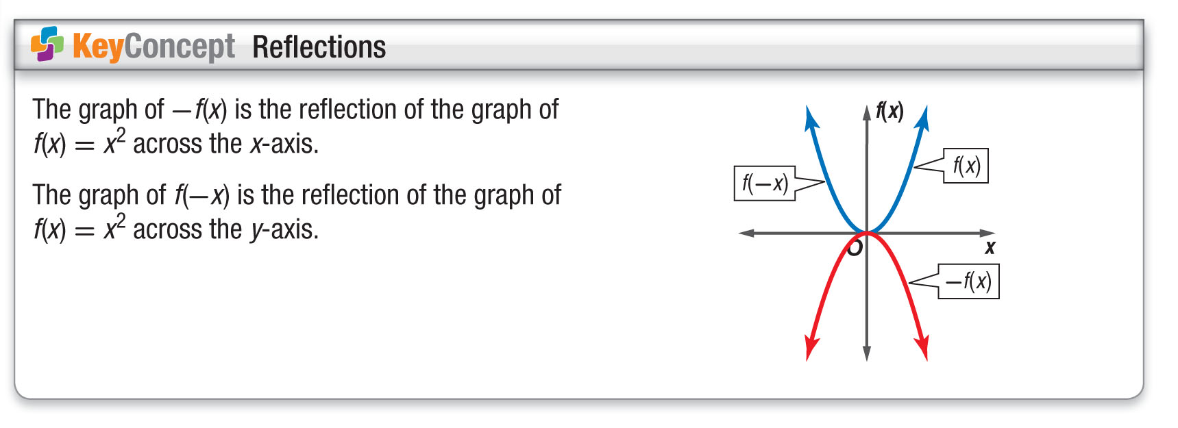
Concept

Slide 30
Example 5
Describe and Graph Reflections
A. Describe how the graph of g(x) = –3x² + 1 is related to the graph of f(x) = x².
You might be inclined to say that a = 3, but actually three separate transformations are occurring. The negative sign causes a reflection across the x-axis. Then a dilation occurs in which a = 3 and a translation occurs in which
c = 1.

Slide 31
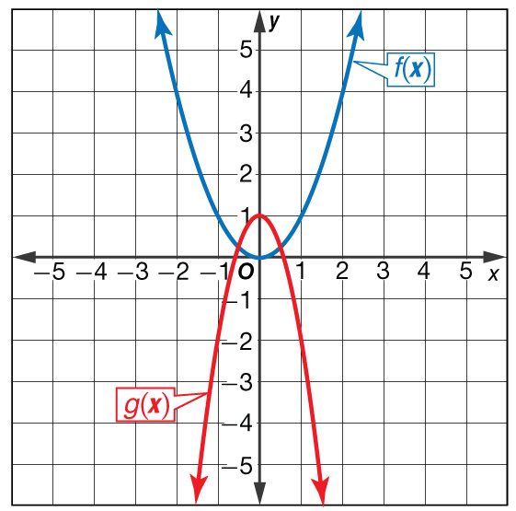
Example 5
Describe and Graph Reflections
Answer: The graph of g(x) = –3x² + 1 is reflected across the x-axis, stretched by a factor of 3,
and translated up 1 unit.

Slide 32
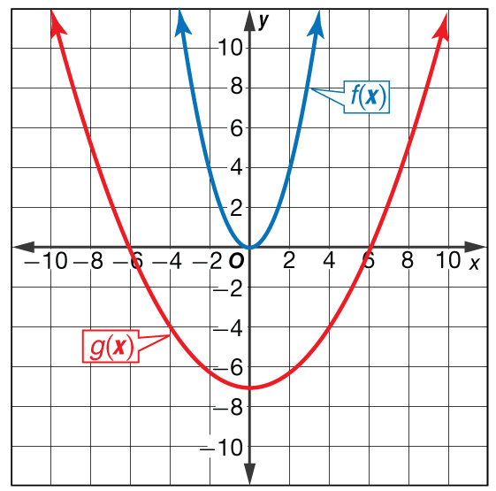
Example 5
Describe and Graph Reflections
B. Describe how the graph of g(x) = x² – 7 is related to the graph of f(x) = x².
1
__
5

Slide 33
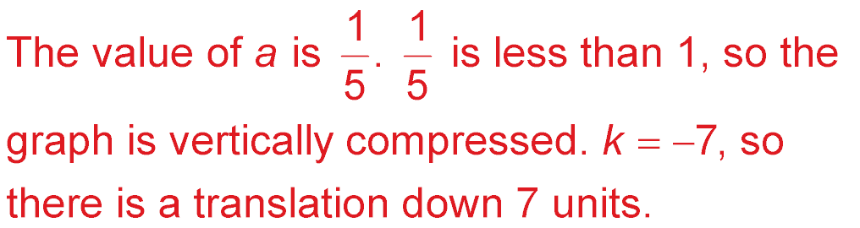
Example 5
Describe and Graph Reflections
Answer:

Slide 34
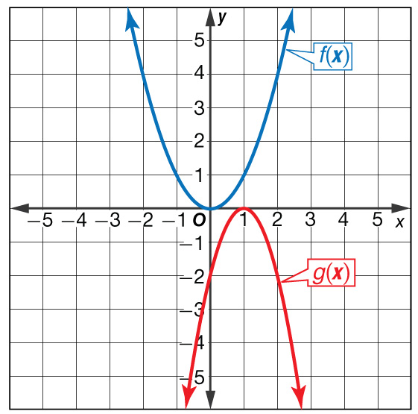
Example 5
Describe how the graph of
g(x) = –2(x + 1)² – 4 is related to the graph of f(x) = x².
A. reflected across the x-axis,
translated 1 unit left, and
vertically stretched
B. reflected across the x-axis, translated 1 unit left, and vertically compressed
C. reflected across the x-axis, translated 1 unit right, and vertically stretched
D. reflected across the x-axis, translated 1 unit right, and vertically compressed

Slide 35
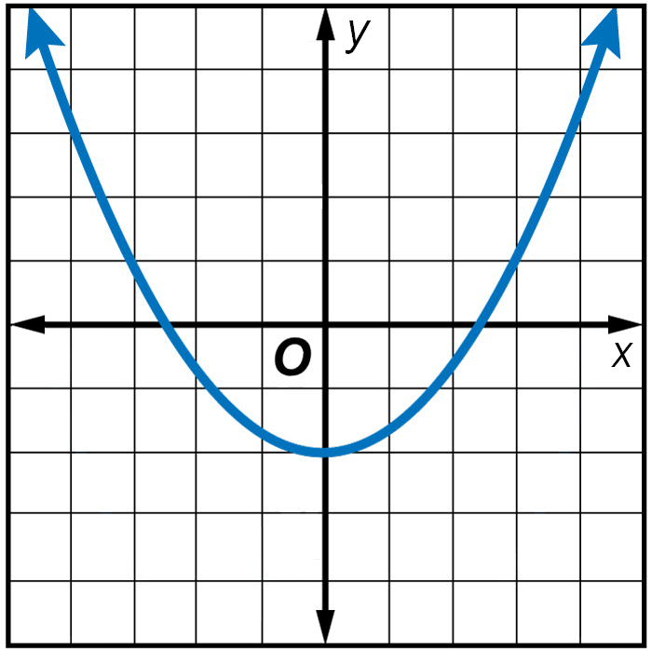
Example 6
Which is an equation for the function shown in the graph?
A y = x² – 2
B y = 3x² + 2
C y = – x² + 2
D y = –3x² – 2
1
__
3
1
__
3

Slide 36
Example 6
Read the Test Item
You are given the graph of a parabola. You need to find an equation of the graph.
Solve the Test Item
Notice that the graph opens upward. Therefore, equations C and D are eliminated because the leading coefficient should be positive. The parabola is translated down 2 units, so c = –2, which is shown in equation A.
Answer: The answer is A.

Slide 37
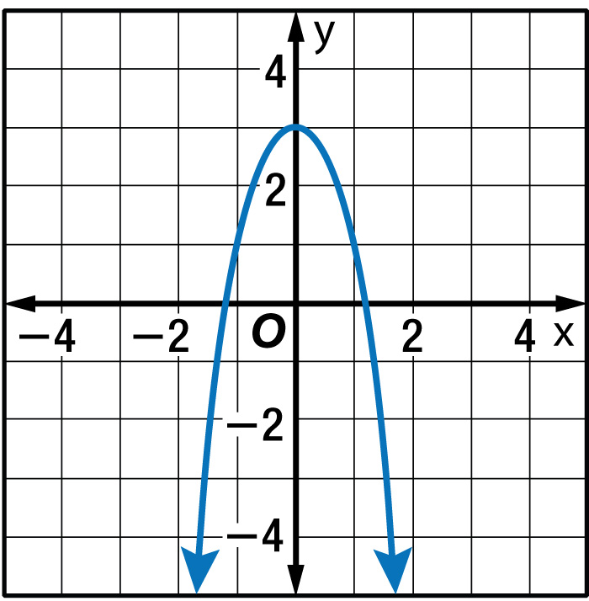
Example 6
Which is an equation for the function shown in the graph?
A. y = –2x² – 3
B. y = 2x² + 3
C. y = –2x² + 3
D. y = 2x² – 3

Slide 38
End of the Lesson

