Slide 1


Splash Screen

Slide 2
Lesson Menu
Five-Minute Check (over Lesson 9–3)
CCSS
Then/Now
New Vocabulary
Key Concept: Completing the Square
Example 1: Complete the Square
Example 2: Solve an Equation by Completing the Square
Example 3: Equation with a ≠ 1
Example 4: Real-World Example: Solve a Problem by Completing the Square

Slide 3

5-Minute Check 1
Describe how the graph of the function g(x) = x² – 4 is related to the graph of f(x) = x².
A. translated up
B. translated down
C. compressed vertically
D. stretched vertically

Slide 4

5-Minute Check 2
Describe how the graph of the function h(x) = 3x² is related to the graph of f(x) = x².
A. translated up
B. translated down
C. compressed vertically
D. stretched vertically

Slide 5
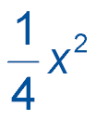

5-Minute Check 3
Describe how the graph of the function g(x) =
is related to the graph of f(x) = x².
A. translated up
B. translated down
C. compressed vertically
D. stretched vertically

Slide 6

5-Minute Check 4
What transformation is needed to obtain the graph of g(x) = x² + 4 from the graph of f(x) = x² – 1?
A. translated up
B. translated down
C. compressed vertically
D. stretched vertically

Slide 7

5-Minute Check 5
What transformation is needed to obtain the graph of g(x) = 2x² from the graph of f(x) = 3x²?
A. translated up
B. translated down
C. compressed vertically
D. stretched vertically

Slide 8

5-Minute Check 6
Which function has a graph that is the same as the graph of f(x) = 3x² – 2 shifted 5 units up?
A. f(x) = 3x² – 7
B. f(x) = 3(x – 5)² – 2
C. f(x) = 3(x + 5)² – 2
D. f(x) = 3x² + 3

Slide 9

CCSS
Content Standards
A.REI.4 Solve quadratic equations in one variable.
a. Use the method of completing the square to transform any quadratic equation in x into an equation of the form (x – p)² = q that has the same solutions. Derive the quadratic formula from this form.
b. Solve quadratic equations by inspection (e.g., for x² = 49), taking square roots, completing the square, the quadratic formula and factoring, as appropriate to the initial form of the equation. Recognize when the quadratic formula gives complex solutions and write them as
a ± bi for real numbers a and b.
F.IF.8a Use the process of factoring and completing the square in a quadratic function to show zeros, extreme values, and symmetry of the graph, and interpret these in terms of a context.
Mathematical Practices
4 Model with mathematics.
Common Core State Standards © Copyright 2010. National Governors Association Center for Best Practices and Council of Chief State School Officers. All rights reserved.

Slide 10


Then/Now
You solved quadratic equations by using the square root property.
Complete the square to write perfect square trinomials.
Solve quadratic equations by completing the square.

Slide 11

Vocabulary
completing the square

Slide 12
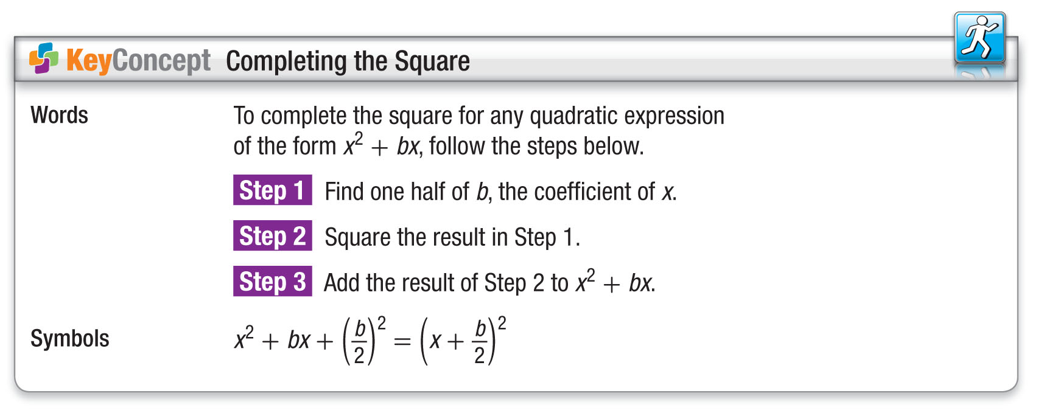
Concept

Slide 13
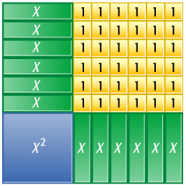
Example 1
Complete the Square
Find the value of c that makes x² – 12x + c a perfect square trinomial.
Method 1 Use algebra tiles.
Arrange the tiles for x² – 12x + c so that the two sides of the figure are congruent.
To make the figure a square, add 36 positive 1-tiles.
x² – 12x + 36 is a perfect square.

Slide 14
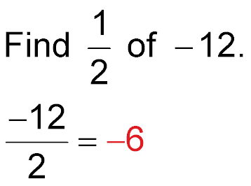
Example 1
Complete the Square
Method 2 Complete the square.
Step 1
Step 2 Square the result (–6)² = 36
of Step 1.
Step 3 Add the result of x² –12x + 36
Step 2 to x² – 12x.
Answer: Thus, c = 36. Notice that
x² – 12x + 36 = (x – 6)².

Slide 15


Example 1
Find the value of c that makes x² + 14x + c a perfect square.
A. 7
B. 14
C. 156
D. 49

Slide 16
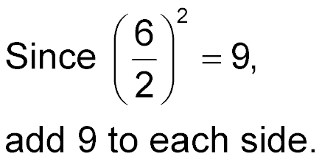
Example 2
Solve an Equation by Completing the Square
Solve x² + 6x + 5 = 12 by completing the square.
Isolate the x²- and x-terms. Then complete the square and solve.
x² + 6x + 5 = 12 Original equation
x² + 6x – 5 – 5 = 12 – 5 Subtract 5 from each side.
x² + 6x = 7 Simplify.
x² + 6x + 9 = 7 + 9

Slide 17
Example 2
Solve an Equation by Completing the Square
(x + 3)² = 16 Factor x² + 6x + 9.
x + 3 = ±4 Take the square root of each side.
x + 3 – 3 = ±4 – 3 Subtract 3 from each side.
x = ±4 – 3 Simplify.
x = –4 – 3 or x = 4 – 3 Separate the solutions.
= –7 = 1 Simplify.
Answer: The solutions are –7 and 1.

Slide 18
Example 2
Solve x² – 8x + 10 = 30.
A. {–2, 10}
B. {2, –10}
C. {2, 10}
D. Ø

Slide 19
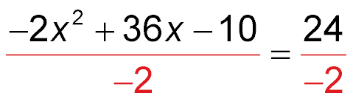
Example 3
Equation with a ≠ 1
Solve –2x² + 36x – 10 = 24 by completing the square.
Isolate the x²- and x-terms. Then complete the square and solve.
–2x² + 36x – 10 = 24 Original equation
Divide each side by –2.
x² – 18x + 5 = –12 Simplify.
x² – 18x + 5 – 5 = –12 – 5 Subtract 5 from each side.
x² – 18x = –17 Simplify.

Slide 20
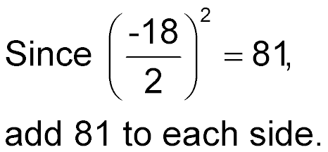
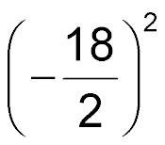
Example 3
Equation with a ≠ 1
x² – 18x + 81 = –17 + 81
(x – 9)² = 64 Factor x² – 18x + 81.
x – 9 = ±8 Take the square root of each side.
x – 9 + 9 = ±8 + 9 Add 9 to each side.
x = 9 ± 8 Simplify.
x = 9 + 8 or x = 9 – 8 Separate the solutions.
= 17 = 1 Simplify.

Slide 21
Example 3
Equation with a ≠ 1
Answer: The solutions are 1 and 17.

Slide 22
Example 3
Solve x² + 8x + 10 = 3 by completing the square.
A. {–1}
B. {–1, –7}
C. {–1, 7}
D. Ø

Slide 23

Example 4
Solve a Problem by Completing the Square
CANOEING Suppose the rate
of flow of an 80-foot-wide
river is given by the equation
r = –0.01x² + 0.8x, where r is the rate in miles per hour and x is the distance from the shore in feet. Joacquim does not want to paddle his canoe against a current that is faster than 5 miles per hour. At what distance from the river bank must he paddle in order to avoid a current of 5 miles per hour?
You know the function that relates distance from shore to the rate of the river current. You want to know how far away from the river bank he must paddle to avoid the current.

Slide 24
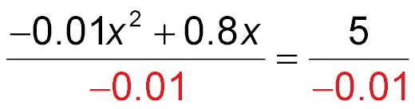
Example 4
Solve a Problem by Completing the Square
Find the distance when r = 5. Complete the square to solve –0.01x² + 0.8x = 5.
–0.01x² + 0.8x = 5 Equation for the current
Divide each side by –0.01.
x² – 80x = –500 Simplify.

Slide 25
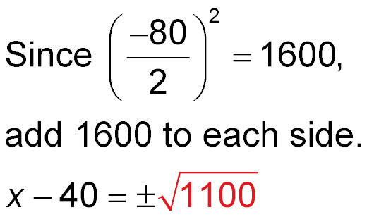
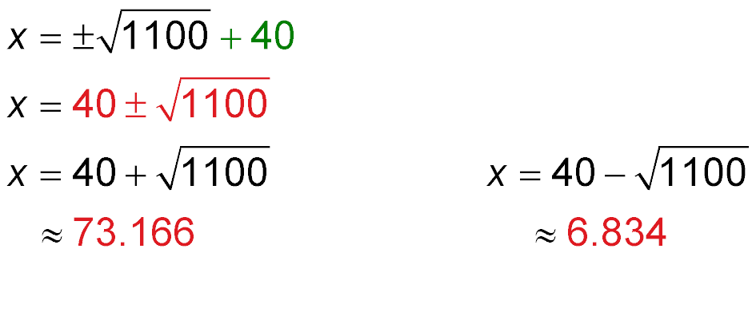
Example 4
Solve a Problem by Completing the Square
x² – 80x + 1600 = –500 + 1600
(x – 40)² = 1100 Factor x² – 80x + 1600.
Take the square root of each side.
Add 40 to each side.
Simplify.

Slide 26
Example 4
Solve a Problem by Completing the Square
Use a calculator to approximate each value of x.
The solutions of the equation are about 7 feet and about
73 feet. The solutions are distances from one shore. Since the river is 80 feet wide, 80 – 73 = 7.
Answer: He must stay within 7 feet of either bank.

Slide 27
Example 4
CANOEING Suppose the rate of flow of a 60-foot-wide river is given by the equation r = –0.01x² + 0.6x, where r is the rate in miles per hour and x is the distance from the shore in feet. Joacquim does not want to paddle his canoe against a current that is faster than 5 miles per hour. At what distance from the river bank must he paddle in order to avoid a current of 5 miles per hour?
A. 6 feet
B. 5 feet
C. 1 foot
D. 10 feet

Slide 28
End of the Lesson

