Slide 1


Splash Screen

Slide 2
Lesson Menu
Five-Minute Check (over Lesson 9–4)
CCSS
Then/Now
New Vocabulary
Key Concept: The Quadratic Formula
Example 1: Use the Quadratic Formula
Example 2: Use the Quadratic Formula
Example 3: Solve Quadratic Equations Using Different Methods
Concept Summary: Solving Quadratic Equations
Key Concept: Using the Discriminant
Example 4: Use the Discriminant

Slide 3

5-Minute Check 1
Solve x² + 8x + 16 = 16 by completing the square.
A. 8, 0
B. 4, 1
C. –4, 1
D. –8, 0

Slide 4

5-Minute Check 2
Solve x² – 6x – 2 = 5 by completing the square.
A. 1, 7
B. –1, 7
C. –7, 0
D. –7, 1

Slide 5

5-Minute Check 3
What is the value of c that makes z² – z + c
a perfect square trinomial?
A. 4
B. 1
C.
D. 0
3
__
9
1
__
4

Slide 6

5-Minute Check 4
The area of a square can be tripled by increasing the length and width by 10 inches. What is the original length of the square?
A. 30.4 in.
B. 23.6 in.
C. 13.7 in.
D. 9.1 in.

Slide 7

5-Minute Check 5
Which quadratic equation does not have the solutions –2, 4?
A. x² – 2x = 8
B. 4x² – 8x = 20
C. 2x² – 4x = 16
D. 3x² – 6x = 24

Slide 8

CCSS
Content Standards
A.REI.4 Solve quadratic equations in one variable.
a. Use the method of completing the square to transform any quadratic equation in x into an equation of the form (x - p)² = q that has the same solutions. Derive the quadratic formula from this form.
b. Solve quadratic equations by inspection (e.g., for x² = 49), taking square roots, completing the square, the quadratic formula and factoring, as appropriate to the initial form of the equation. Recognize when the quadratic formula gives complex solutions and write them as a ± bi for real numbers a and b.
Mathematical Practices
6 Attend to precision.
Common Core State Standards © Copyright 2010. National Governors Association Center for Best Practices and Council of Chief State School Officers. All rights reserved.

Slide 9


Then/Now
You solved quadratic equations by completing the square.
Solve quadratic equations by using the Quadratic Formula.
Use the discriminant to determine the number of solutions of a quadratic equation.

Slide 10

Vocabulary
Quadratic Formula
discriminant

Slide 11
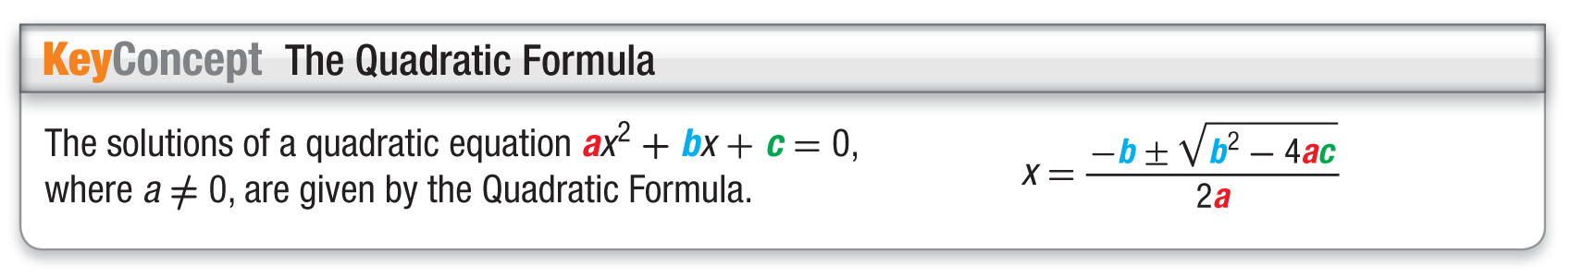
Concept

Slide 12
Example 1
Use the Quadratic Formula
Solve x² – 2x = 35 by using the Quadratic Formula.
Step 1 Rewrite the equation in standard form.
x² – 2x = 35 Original equation
x² – 2x – 35 = 0 Subtract 35 from each side.

Slide 13
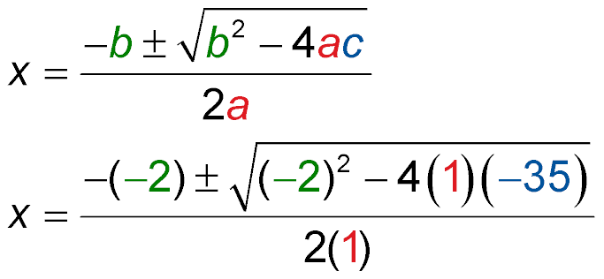
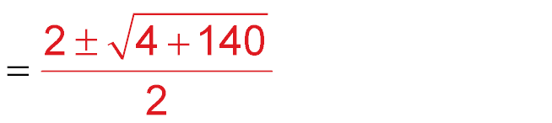
Example 1
Use the Quadratic Formula
Step 2 Apply the Quadratic Formula to find the solutions.
Quadratic Formula
a = 1, b = –2, and c = –35
Multiply.

Slide 14
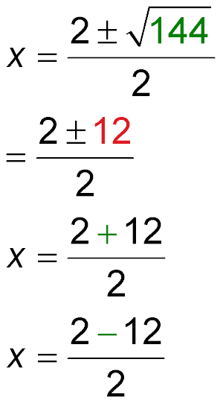
Example 1
Use the Quadratic Formula
Add.
Simplify.
or
Separate the solutions.
= 7 = –5
Answer: The solutions are –5 and 7.

Slide 15


Example 1
Solve x² + x – 30 = 0. Round to the nearest tenth if necessary.
A. {6, –5}
B. {–6, 5}
C. {6, 5}
D. Ø

Slide 16
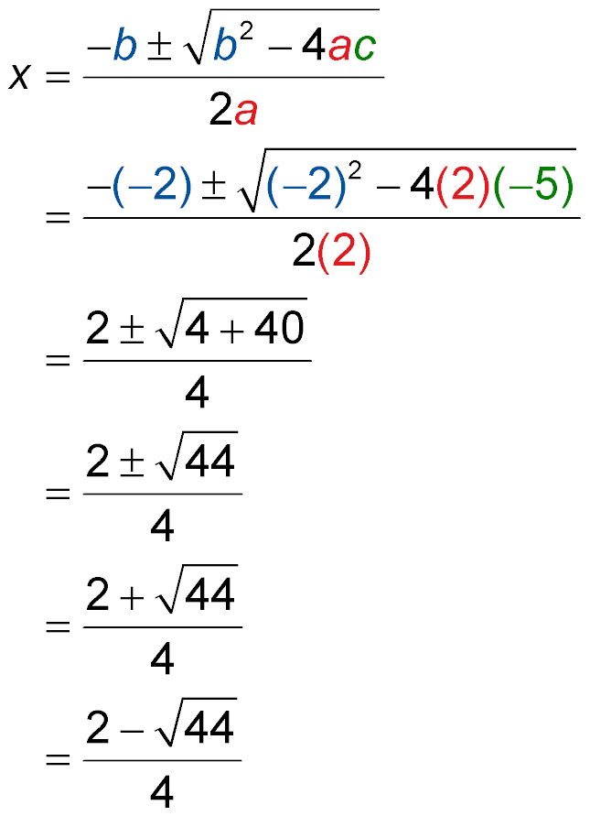
Example 2
Use the Quadratic Formula
A. Solve 2x² – 2x – 5 = 0 by using the Quadratic Formula. Round to the nearest tenth if necessary.
For the equation, a = 2, b = –2, and c = –5.
Quadratic Formula
a = 2, b = –2, c = –5
Multiply.

Slide 17
Example 2
Use the Quadratic Formula
Add and simplify.
x
or
x
Separate the solutions.
≈ 2.2
≈ –1.2
Simplify.
Answer: The solutions are about 2.2 and –1.2

Slide 18
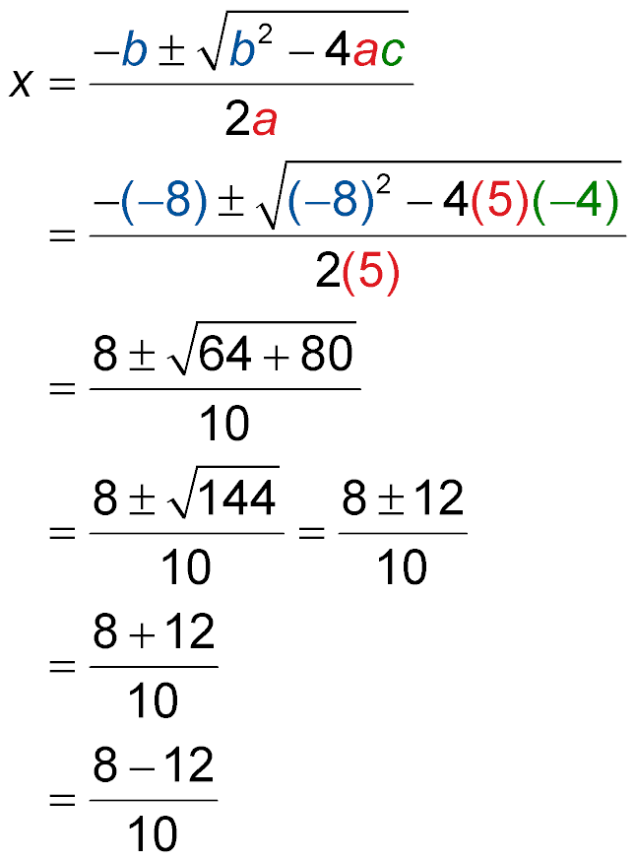
Example 2
Use the Quadratic Formula
B. Solve 5x² – 8x = 4 by using the Quadratic Formula. Round to the nearest tenth if necessary.
Step 1 Rewrite equation in standard form.
5x² – 8x = 4 Original equation
5x² – 8x – 4 = 0 Subtract 4 from each side.
Step 2 Apply the Quadratic Formula to find the solutions.
Quadratic Formula

Slide 19
Example 2
Use the Quadratic Formula
a = 5, b = –8, c = –4
Multiply.
or
Add and simplify.
x
or
x
Separate the solutions.
= 2
= –0.4
Simplify.
Answer: The solutions are 2 and –0.4.

Slide 20
Example 2
A. Solve 5x² + 3x – 8. Round to the nearest tenth if necessary.
A. 1, –1.6
B. –0.5, 1.2
C. 0.6, 1.8
D. –1, 1.4

Slide 21
Example 2
B. Solve 3x² – 6x + 2. Round to the nearest tenth if necessary.
A. –0.1, 0.9
B. –0.5, 1.2
C. 0.6, 1.8
D. 0.4, 1.6

Slide 22
Example 3
Solve Quadratic Equations Using Different Methods
Solve 3x² – 5x = 12.
Method 1 Graphing
Rewrite the equation in standard form.
3x² – 5x = 12 Original equation
3x² – 5x – 12 = 0 Subtract 12 from each side.

Slide 23
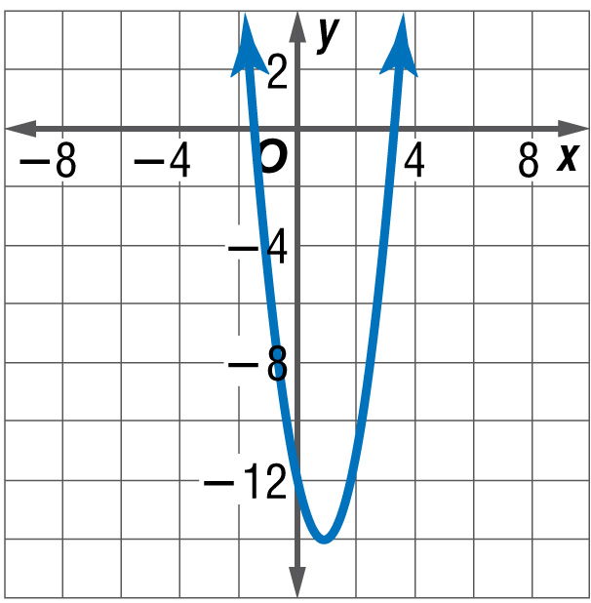
Example 3
Solve Quadratic Equations Using Different Methods
Graph the related function.
f(x) = 3x² – 5x – 12
Locate the x-intercepts of the graph.
4
__
The solutions are 3 and – .
3

Slide 24
Example 3
Solve Quadratic Equations Using Different Methods
Method 2 Factoring
3x² – 5x = 12 Original equation
3x² – 5x – 12 = 0 Subtract 12 from each side.
(x – 3)(3x + 4) = 0 Factor.
x – 3 = 0 or 3x + 4 = 0 Zero Product Property
4
__
x = 3 x = – Solve for x.
3

Slide 25
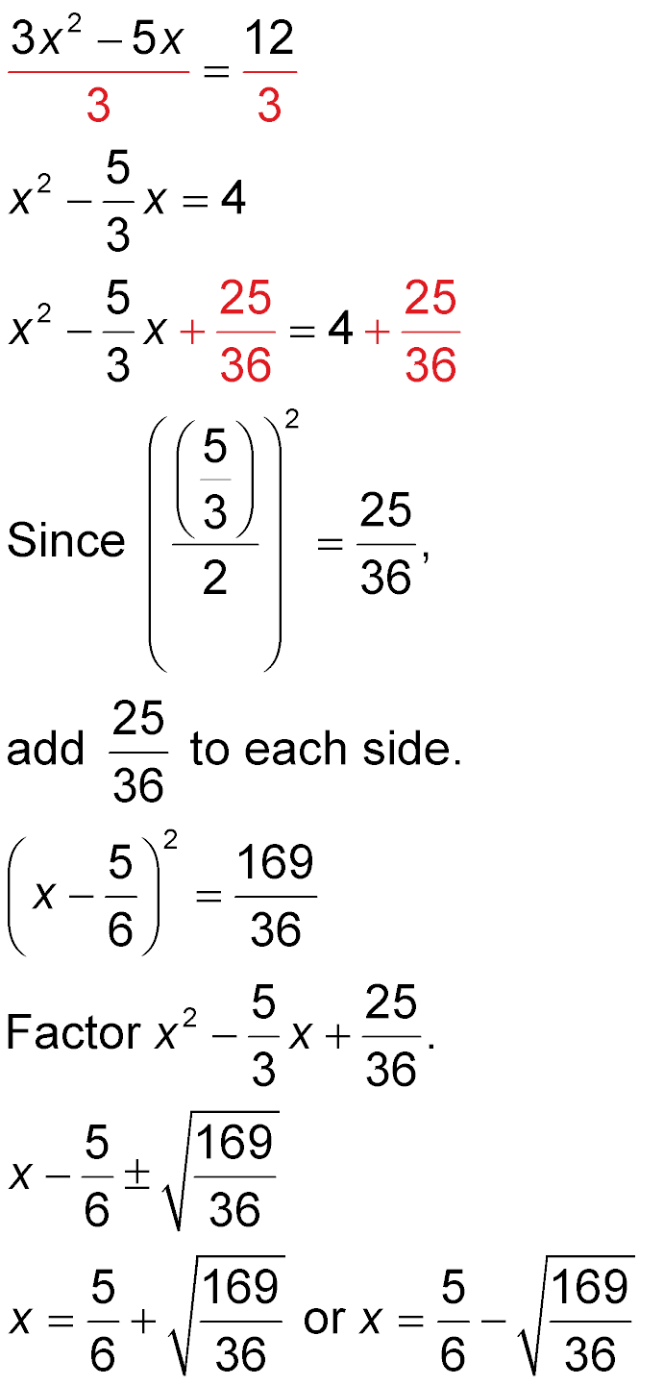
Example 3
Solve Quadratic Equations Using Different Methods
Method 3 Completing the Square
3x² – 5x = 12 Original equation
Divide each side
by 3.
Simplify.

Slide 26
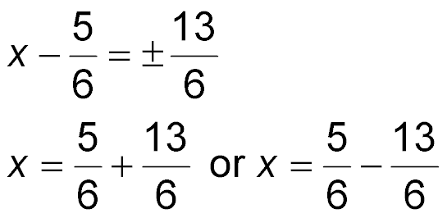
Example 3
Solve Quadratic Equations Using Different Methods
Take the square root of each side.
Separate the solutions.
4
__
= 3 = – Simplify.
3

Slide 27
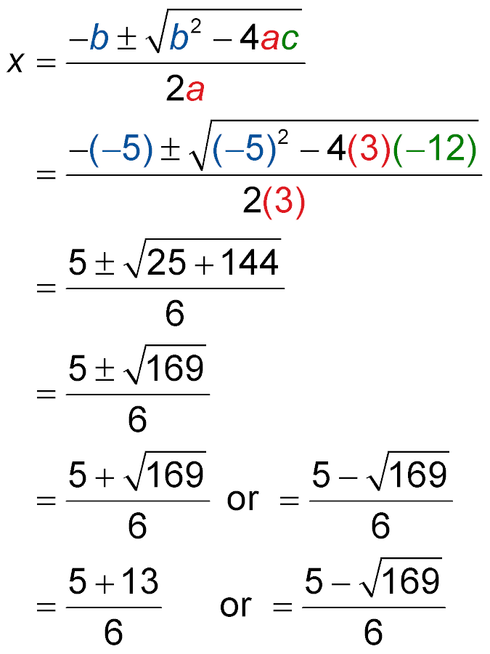
Example 3
Solve Quadratic Equations Using Different Methods
Method 4 Quadratic Formula
From Method 1, the standard form of the equation is
3x² – 5x – 12 = 0.
Quadratic Formula
a = 3, b = –5,
c = –12
Multiply.

Slide 28
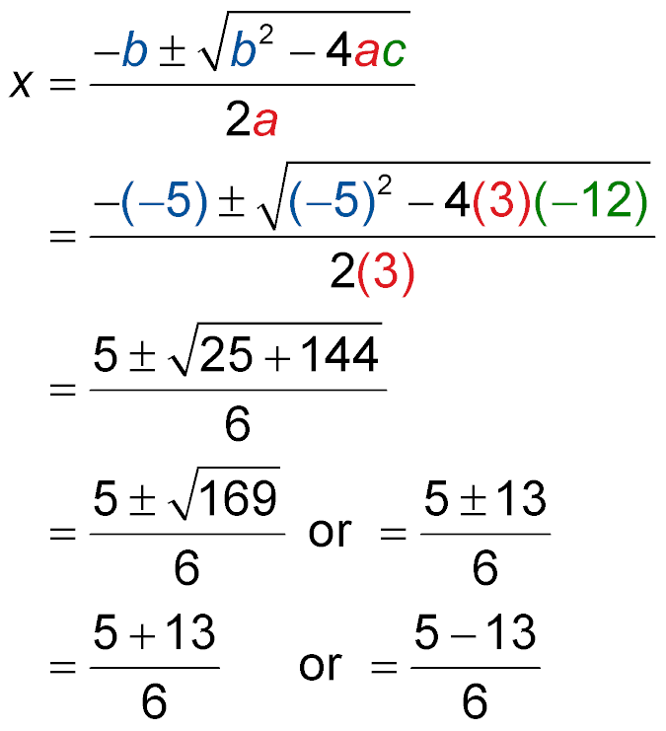
Example 3
Solve Quadratic Equations Using Different Methods
Add and simplify.
Separate the solutions.
x x
4
__
= 3 = – Simplify.
3
4
__
Answer: The solutions are 3 and – .
3

Slide 29
Example 3
Solve 6x² + x = 2 by any method.
A. –0.8, 1.4
B. – ,
C. – , 1
D. 0.6, 2.2
2
1
__
__
3
2
4
__
3

Slide 30
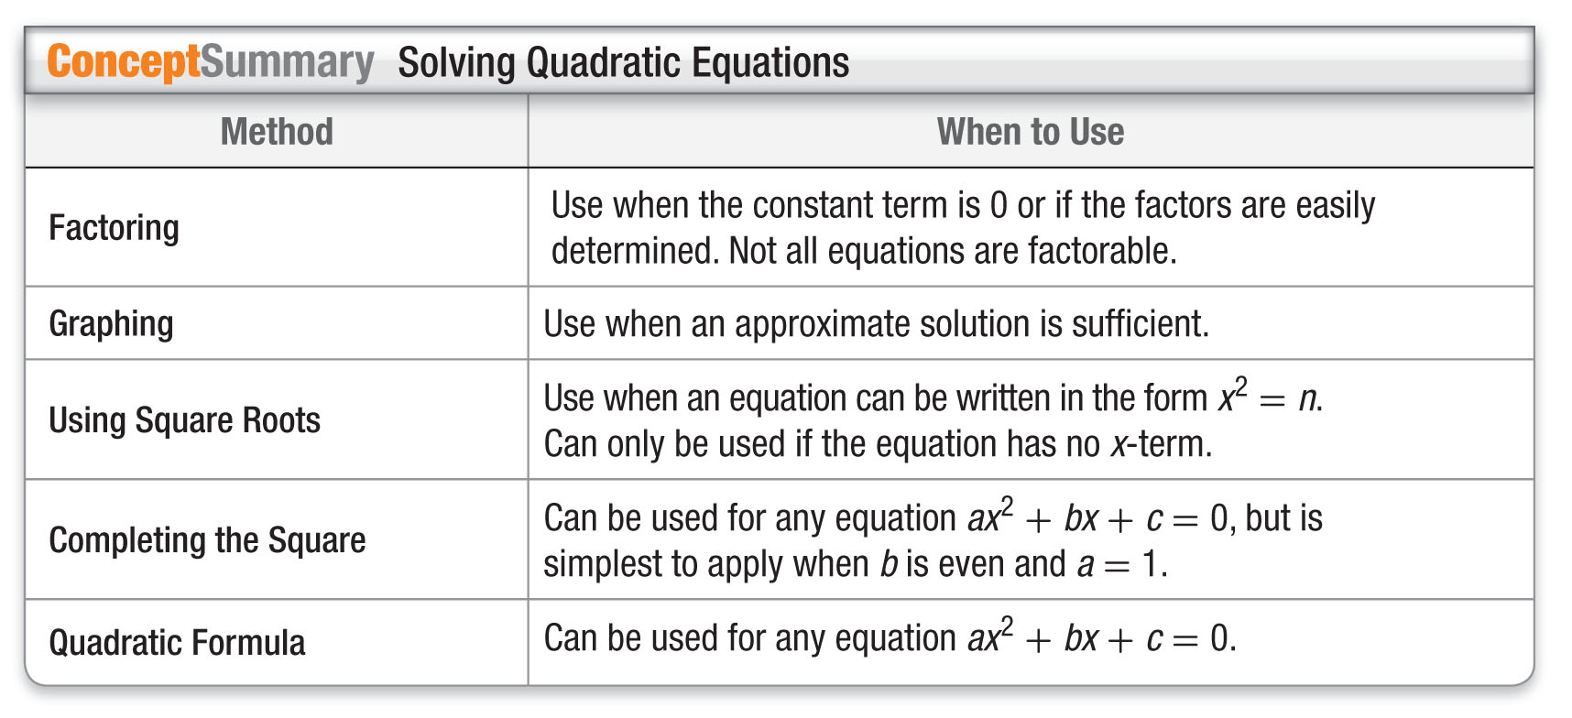
Concept

Slide 31
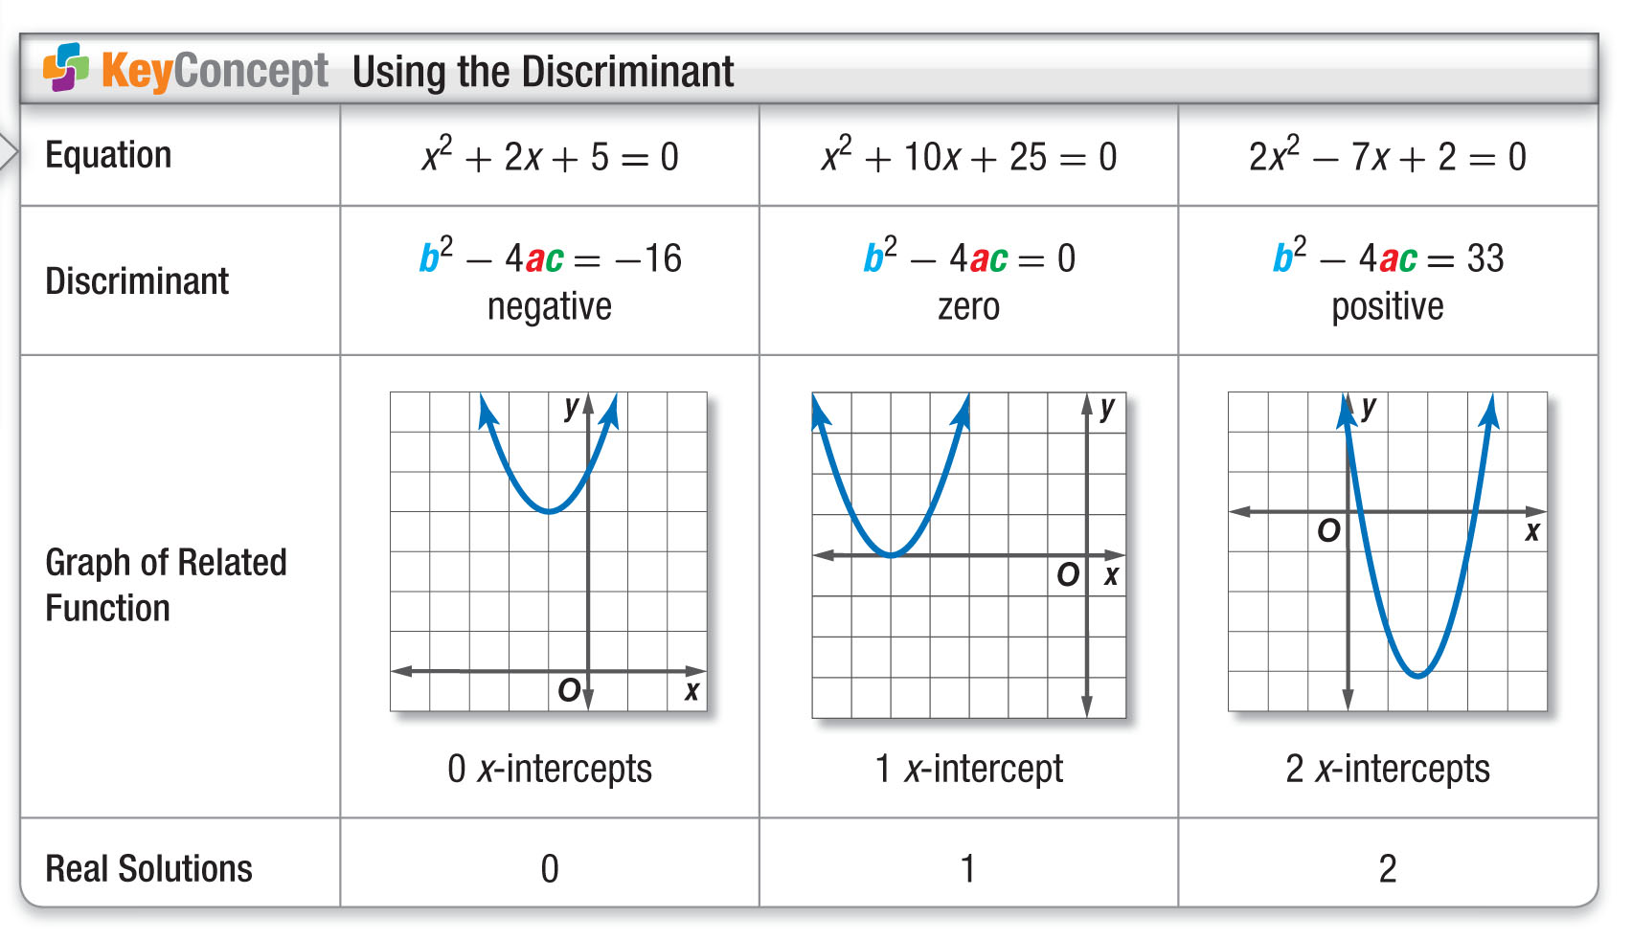
Concept

Slide 32
Example 4
Use the Discriminant
State the value of the discriminant for
3x² + 10x = 12. Then determine the number of real solutions of the equation.
Step 1 Rewrite the equation in standard form.
3x² + 10x = 12 Original equation
3x² + 10x – 12 = 12 – 12 Subtract 12 from each side.
3x² + 10x – 12 = 0 Simplify.

Slide 33
Example 4
Use the Discriminant
Step 2 Find the discriminant.
b² – 4ac = (10)² – 4(3)(–12) a = 3, b = 10, and
c = –12
= 244 Simplify.
Answer: The discriminant is 244. Since the discriminant is positive, the equation has two real solutions.

Slide 34
Example 4
State the value of the discriminant for the equation
x² + 2x + 2 = 0. Then determine the number of real solutions of the equation.
A. –4; no real solutions
B. 4; 2 real solutions
C. 0; 1 real solutions
D. cannot be determined

Slide 35
End of the Lesson

