Slide 1


Splash Screen

Slide 2
Lesson Menu
Five-Minute Check (over Lesson 9–5)
CCSS
Then/Now
Concept Summary: Linear and Nonlinear Functions
Example 1: Choose a Model Using Graphs
Example 2: Choose a Model Using Differences or Ratios
Example 3: Write an Equation
Example 4: Real-World Example: Write an Equation for a Real-World Situation

Slide 3

5-Minute Check 1
Solve x² – 6x – 7 = 0 using the Quadratic Formula.
A. 7, –1
B. 2, 5
C. –1, 7
D. no solution

Slide 4

5-Minute Check 2
Solve y² – 11y = –30 using the Quadratic Formula.
A. 7, 4
B. 5, 6
C. 3, 5
D. no solution

Slide 5

5-Minute Check 3
Solve 5z² + 16z + 3 = 0 using the Quadratic Formula.
1
__
A. –3, –
B. –1,
C. 2, 3
D. no solution
5
2
__
5
44
___
44

Slide 6

5-Minute Check 4
Solve 4n² = –19n – 25 using the Quadratic Formula.
A. 4, 3
B. –1
C. –2, 4
D. no solution

Slide 7

5-Minute Check 5
Without graphing, determine the number of
x-intercepts of the graph of f(x) = 3x² + x + 7.
A. 3
B. 2
C. 1
D. none

Slide 8

5-Minute Check 6
Which are the solutions for 2x² + 26x = –72?
A. –9, –4
B. 4, 9
C. –2, 15
D. –15, 2

Slide 9

CCSS
Content Standards
F.IF.6 Calculate and interpret the average rate of change of a function (presented symbolically or as a table) over a specified interval. Estimate the rate of change from a graph.
F.LE.1 Distinguish between situations that can be modeled with linear functions and with exponential functions.
a. Prove that linear functions grow by equal differences over equal intervals, and that exponential functions grow by equal factors over equal intervals.
b. Recognize situations in which one quantity changes at a constant rate per unit interval relative to another.
c. Recognize situations in which a quantity grows or decays by a constant percent rate per unit interval relative to another.
Mathematical Practices
7 Look for and make use of structure.
Common Core State Standards © Copyright 2010. National Governors Association Center for Best Practices and Council of Chief State School Officers. All rights reserved.

Slide 10


Then/Now
You graphed linear, quadratic, and exponential functions.
Identify linear, quadratic, and exponential functions from given data.
Write equations that model data.

Slide 11
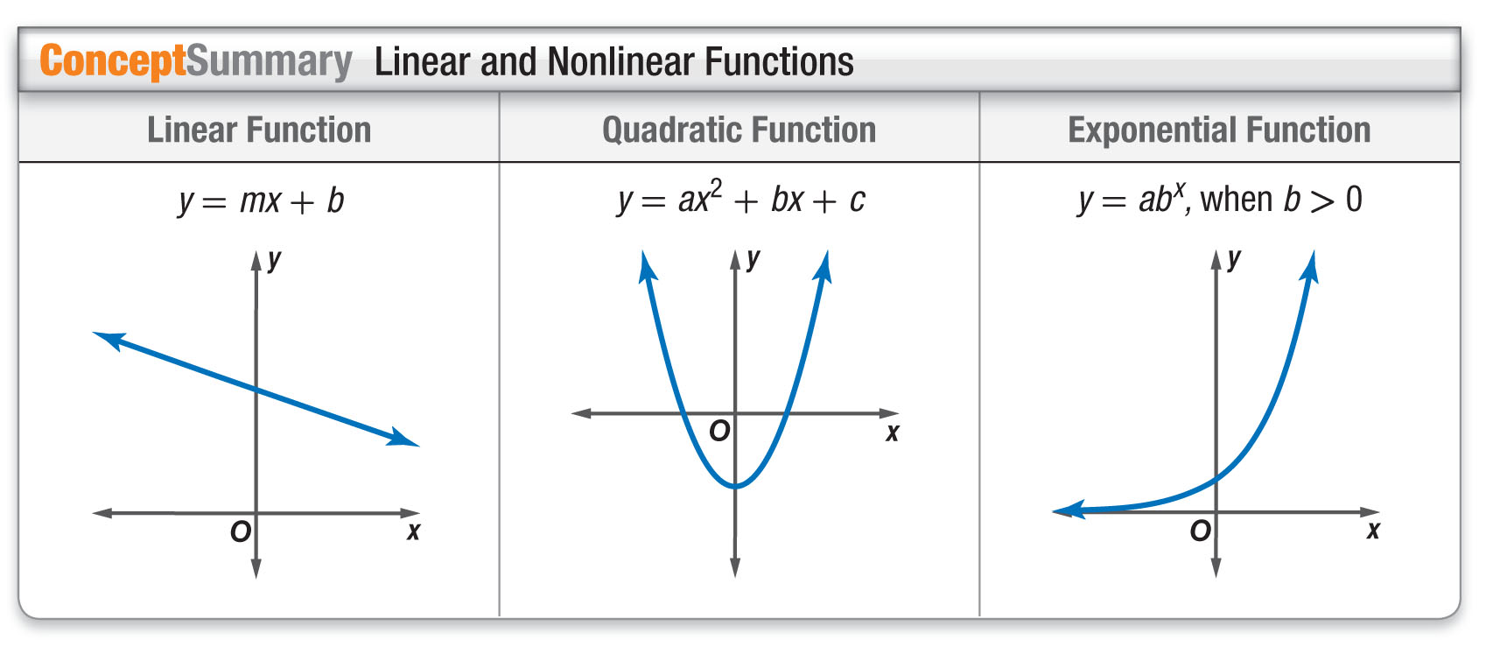
Concept

Slide 12
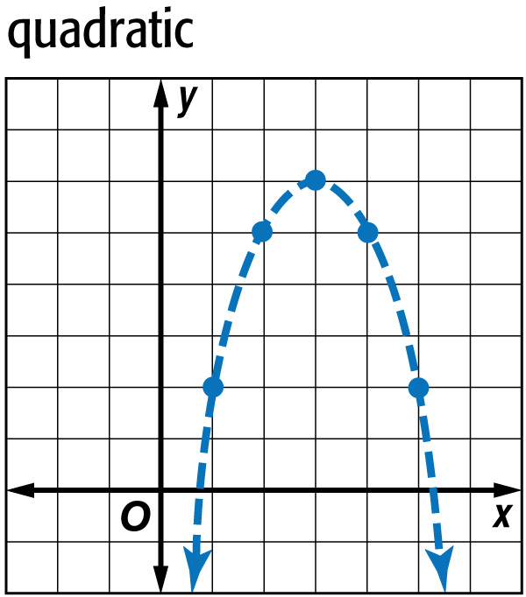
Example 1
Choose a Model Using Graphs
A. Graph the ordered pairs. Determine whether the ordered pairs represent a linear, quadratic, or exponential function.
(1, 2), (2, 5), (3, 6), (4, 5), (5, 2)
Answer: The ordered pairs appear to represent a quadratic equation.

Slide 13
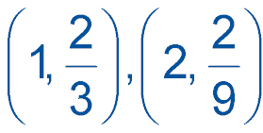
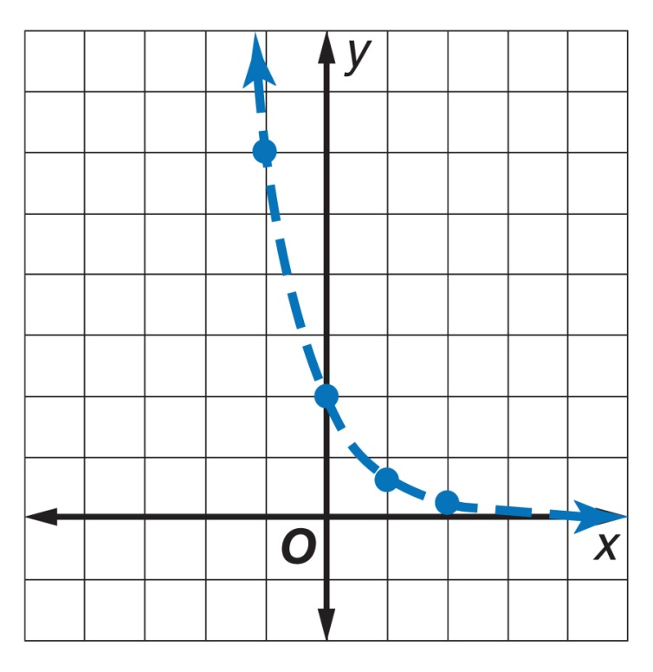
Example 1
Choose a Model Using Graphs
B. Graph the ordered pairs. Determine whether the ordered pairs represent a linear, quadratic, or exponential function.
(–1, 6), (0, 2),
Answer: The ordered pairs appear to represent an exponential function.

Slide 14


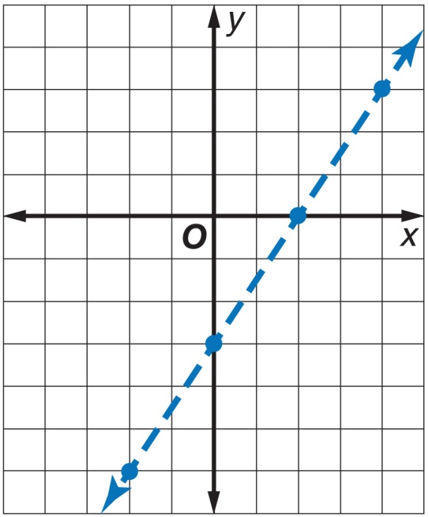
Example 1
A. Graph the set of ordered pairs. Determine whether the ordered pairs represent a linear, quadratic, or exponential function.
(–2, –6), (0, –3), (2, 0), (4, 3)
A. linear
B. quadratic
C. exponential

Slide 15
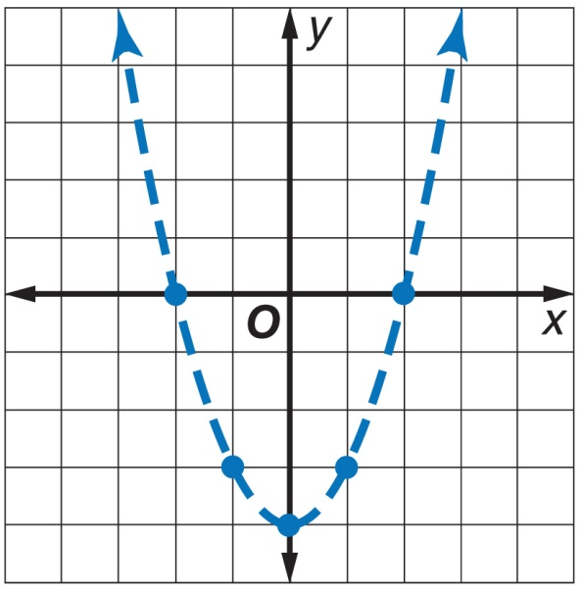
Example 1
B. Graph the set of ordered pairs. Determine whether the ordered pairs represent a linear, quadratic, or exponential function.
(–2, 0), (–1, –3), (0, –4), (1, –3), (2, 0)
A. linear
B. quadratic
C. exponential

Slide 16
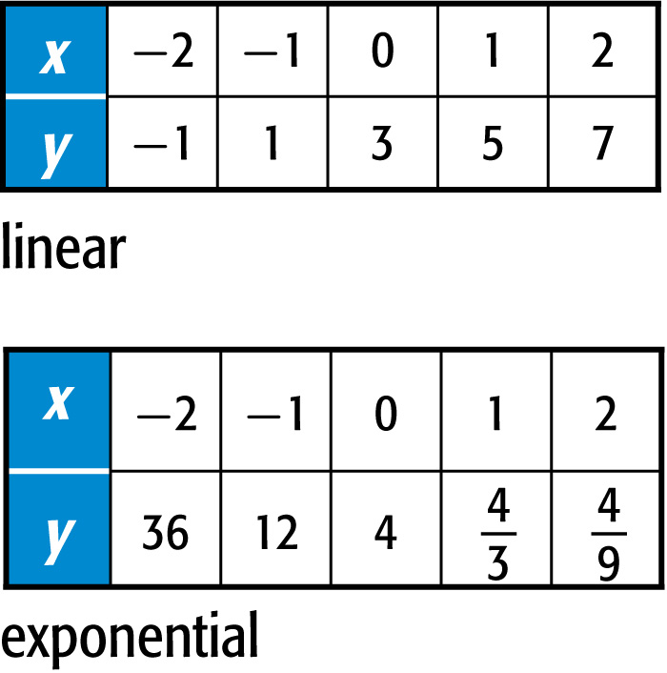
Example 2
Choose a Model Using Differences or Ratios
A. Look for a pattern in the table of values to determine which kind of model best describes the data.
–1 1 3 5 7
2
2
2
2
First differences:
Answer: Since the first differences are all equal, the table of values represents a linear function.

Slide 17
Example 2
Choose a Model Using Differences or Ratios
B. Look for a pattern in the table of values to determine which kind of model best describes the data.
4
4
__
__
36 12 4
3
9
2
8
–24
–8
__
–
__
First differences:
–2
3
9
The first differences are not all equal. So, the table of values does not represent a linear function. Find the second differences and compare.

Slide 18
Example 2
Choose a Model Using Differences or Ratios
2
8
–24
–8
__
–
__
First differences:
–2
3
9
1
7
__
__
Second differences:
16
5
1
3
9
The second differences are not all equal. So, the table of values does not represent a quadratic function. Find the ratios of the y-values and compare.
4
4
36
12
4
__
__
3
9
1
1
1
1
__
__
__
__
Ratios:
3
3
3
3

Slide 19
Example 2
Choose a Model Using Differences or Ratios
The ratios of successive y-values are equal.
Answer: The table of values can be modeled by an exponential function.

Slide 20
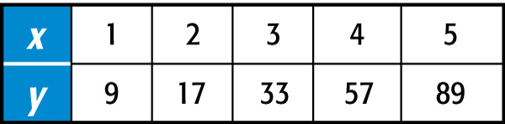
Example 2
A. Look for a pattern in the table of values to determine which kind of model best describes the data.
A. linear
B. quadratic
C. exponential
D. none of the above

Slide 21
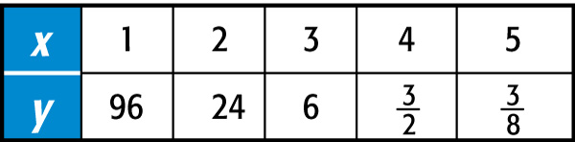
Example 2
B. Look for a pattern in the table of values to determine which kind of model best describes the data.
A. linear
B. quadratic
C. exponential
D. none of the above

Slide 22
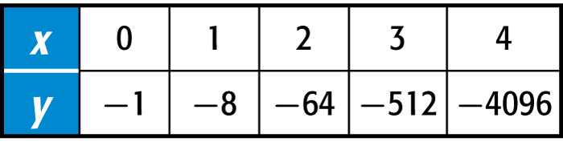
Example 3
Write an Equation
Determine which kind of model best describes the data. Then write an equation for the function that models the data.
Step 1 Determine which model fits the data.
–1 –8 –64 –512 –4096
First differences:
–7
–56
–448
–3584

Slide 23
Example 3
Write an Equation
First differences:
–7
–56
–448
–3584
Second differences:
–49
–392
–3136
Ratios:
–1
–8
–64
–512
–4096
× 8
× 8
× 8
× 8
The table of values can be modeled by an exponential function.

Slide 24
Example 3
Write an Equation
Step 2 Write an equation for the function that models the data.
The equation has the form y = ab^{x}. Find the value of a by choosing one of the ordered pairs from the table of values. Let’s use (1, –8).
y = ab^{x} Equation for exponential function
–8 = a(8)¹ x = 1, y = –8, b = 8
–8 = a(8) Simplify.
–1 = a An equation that models the data is y = –(8)^{x}.
Answer: y = –(8)^{x}

Slide 25
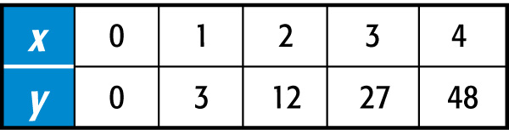
Example 3
Determine which model best describes the data. Then write an equation for the function that models the data.
A. quadratic; y = 3x²
B. linear; y = 6x
C. exponential; y = 3^{x}
D. linear; y = 3x

Slide 26
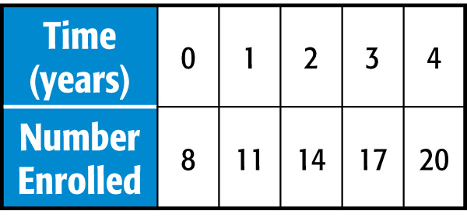
Example 4
Write an Equation for a Real-World
Situation
KARATE The table shows the number of children enrolled in a beginner’s karate class for four consecutive years. Determine which model best represents the data. Then write a function that models that data.

Slide 27
Example 4
Write an Equation for a Real-World Situation
Understand We need to find a model for the data, and then write a function.
Plan Find a pattern using successive differences or ratios. Then use the general form of the equation to write a function.
Solve The first differences are all 3. A linear function of the form y = mx + b models the data.

Slide 28
Example 4
Write an Equation for a Real-World Situation
y = mx + b Equation for linear function
8 = 3(0) + b x = 0, y = 8, and m = 3
b = 8 Simplify.
Answer: The equation that models the data is
y = 3x + 8.
Check You used (0, 8) to write the function. Verify that every other ordered pair satisfies the function.

Slide 29
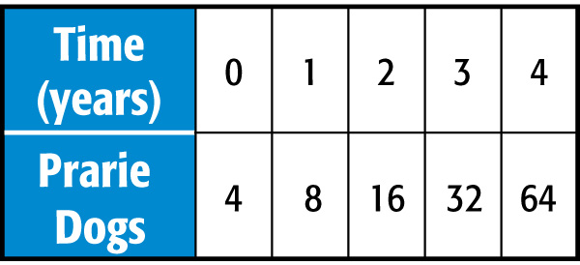
Example 4
WILDLIFE The table shows the growth of prairie dogs in a colony over the years. Determine which model best represents the data. Then write a function that models the data.
A. linear; y = 4x + 4
B. quadratic; y = 8x²
C. exponential; y = 2 ● 4^{x}
D. exponential; y = 4 ● 2^{x}

Slide 30
End of the Lesson

