Slide 1


Splash Screen

Slide 2
Lesson Menu
Five-Minute Check (over Lesson 9–6)
CCSS
Then/Now
New Vocabulary
Key Concept: Greatest Integer Function
Example 1: Greatest Integer Function
Example 2: Real-World Example: Step Function
Key Concept: Absolute Value Function
Example 3: Absolute Value Function
Example 4: Piecewise-Defined Function
Concept Summary: Special Functions

Slide 3

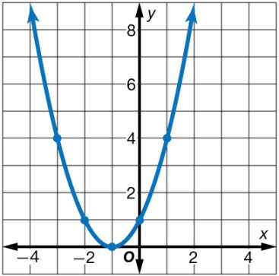
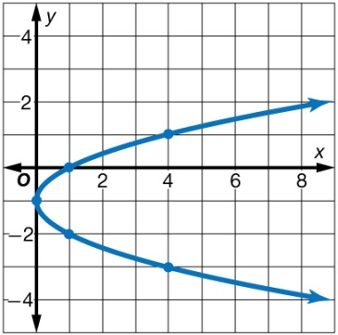
5-Minute Check 1
Graph each set of ordered pairs. Determine whether the ordered pairs represent a linear function, a quadratic function, or an exponential function.
{(–3, 4), (–2, 1), (–1, 0), (0, 1), (1, 4)}
A. quadratic;
B. exponential;
C. quadratic;
D. exponential;

Slide 4

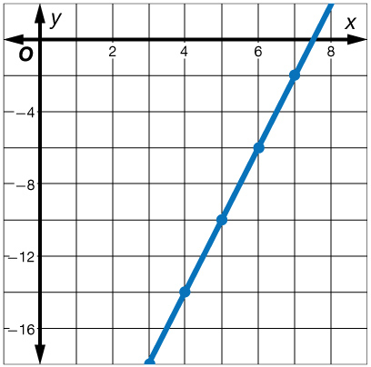
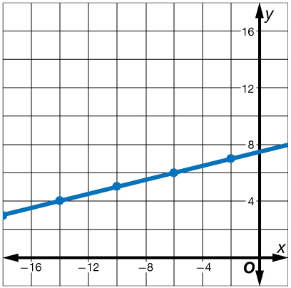
5-Minute Check 2
Graph each set of ordered pairs. Determine whether the ordered pairs represent a linear function, a quadratic function, or an exponential function.
{(3, –18), (4, –14), (5, –10), (6, –6), (7, –2)}
A. linear;
B. exponential;
C. linear;
D. exponential;

Slide 5

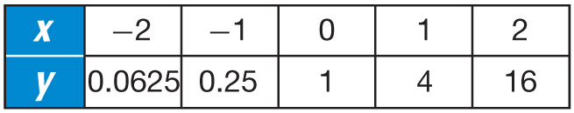
5-Minute Check 3
Look for a pattern in each table of values to determine which kind of model best describes the data.
A. exponential
B. quadratic
C. linear
D. none

Slide 6

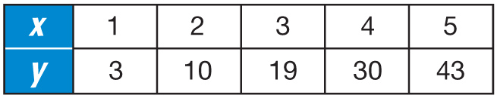
5-Minute Check 4
Look for a pattern in each table of values to determine which kind of model best describes the data.
A. exponential
B. quadratic
C. linear
D. none

Slide 7

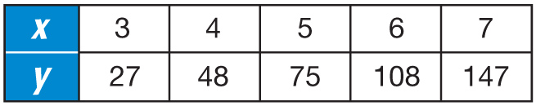
5-Minute Check 5
Determine which kind of model best describes the data. Then write an equation for the function that models the data.
A. exponential; y = 9 ● 3x
B. exponential; y = 3x
C. quadratic; y = 9x²
D. quadratic; y = 3x²

Slide 8

CCSS
Content Standards
F.IF.4 For a function that models a relationship between two quantities, interpret key features of graphs and tables in terms of the quantities, and sketch graphs showing key features given a verbal description of the relationship.
F.IF.7b Graph square root, cube root, and piecewise-defined functions, including step functions and absolute value functions.
Mathematical Practices
4 Model with mathematics.
Common Core State Standards © Copyright 2010. National Governors Association Center for Best Practices and Council of Chief State School Officers. All rights reserved.

Slide 9


Then/Now
You identified and graphed linear, exponential, and quadratic functions.
Identify and graph step functions.
Identify and graph absolute value and piecewise-defined functions.

Slide 10

Vocabulary
step function
piecewise-linear function
greatest integer function
absolute value function
piecewise-defined function

Slide 11
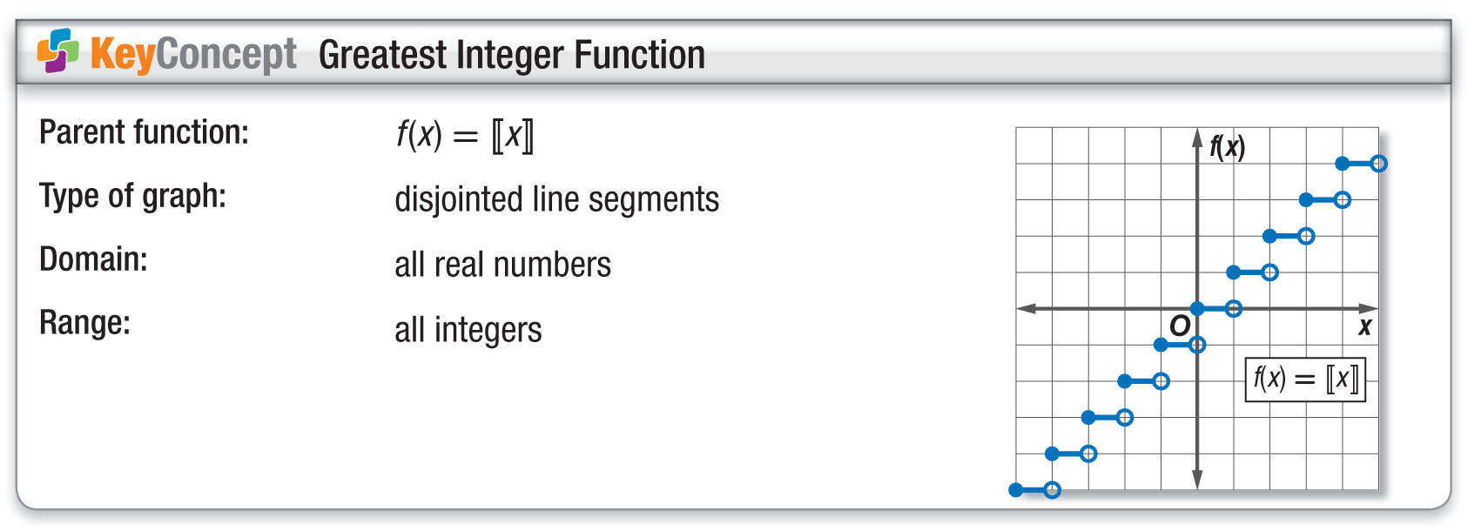
Concept

Slide 12
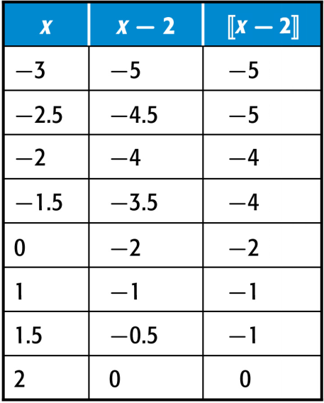
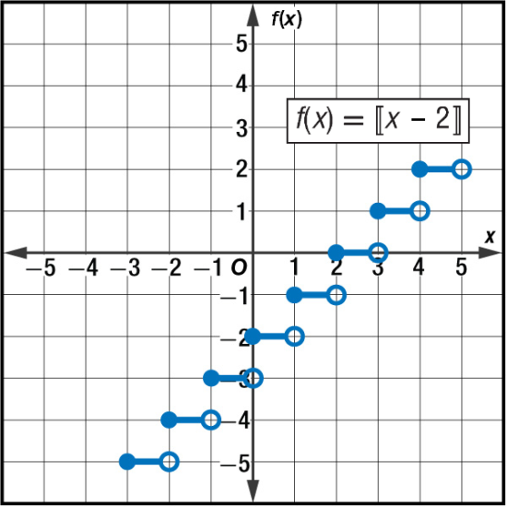
Example 1
Greatest Integer Function
First, make a table of values. Select a few values between integers. On the graph, dots represent points that are included. Circles represent points that are not included.
Answer: Because the dots and circles overlap, the domain is all real numbers. The range is all integers.

Slide 13



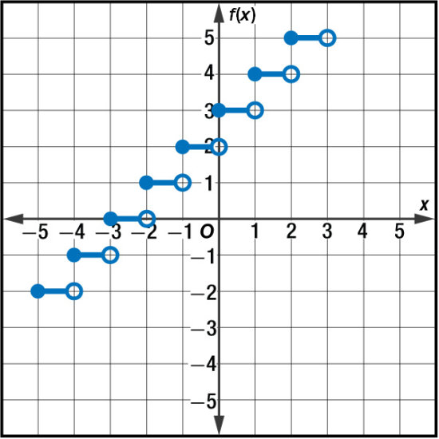
Example 1
A. D = all real numbers,
R = all real numbers
B. D = all integers,
R = all integers
C. D = all real numbers,
R = all integers
D. D = all integers,
R = all real numbers

Slide 14
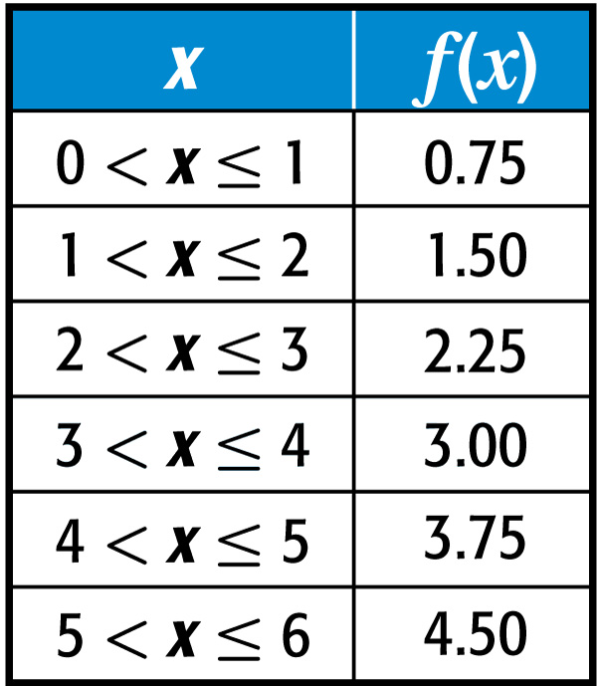
Example 2
Step Function
TAXI A taxi company charges a fee for waiting at a rate of $0.75 per minute or any fraction thereof. Draw a graph that represents this situation.
The total cost for the fee will be a multiple of $0.75, and the graph will be a step function. If the time is greater than 0 but less than or equal to 1 minute, the fee will be $0.75. If the time is greater than 2 minutes but less than or equal to 3 minutes, you will be charged for 3 minutes, or $2.25.

Slide 15
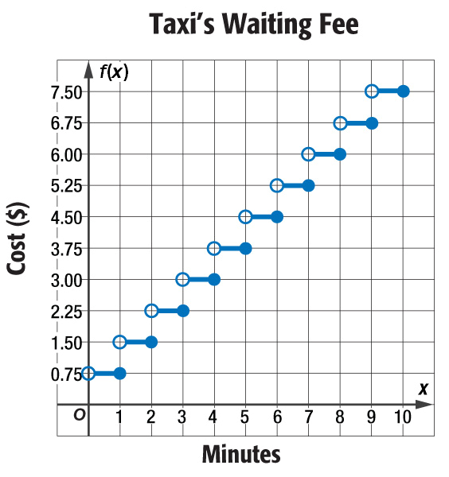
Example 2
Step Function
Answer:

Slide 16
Example 2
SHOPPING An on-line catalog company charges for shipping based upon the weight of the item being shipped. The company charges $4.75 for each pound or any fraction thereof. Draw a graph of this situation.

Slide 17
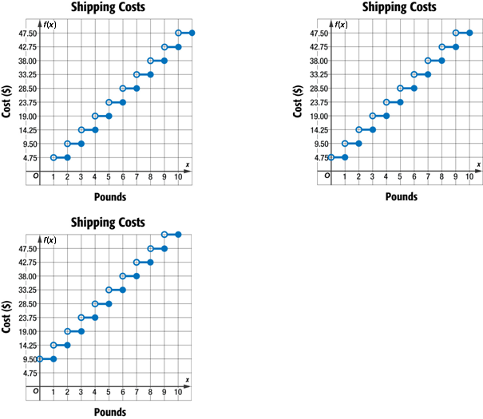
Example 2
A. B.
C.

Slide 18
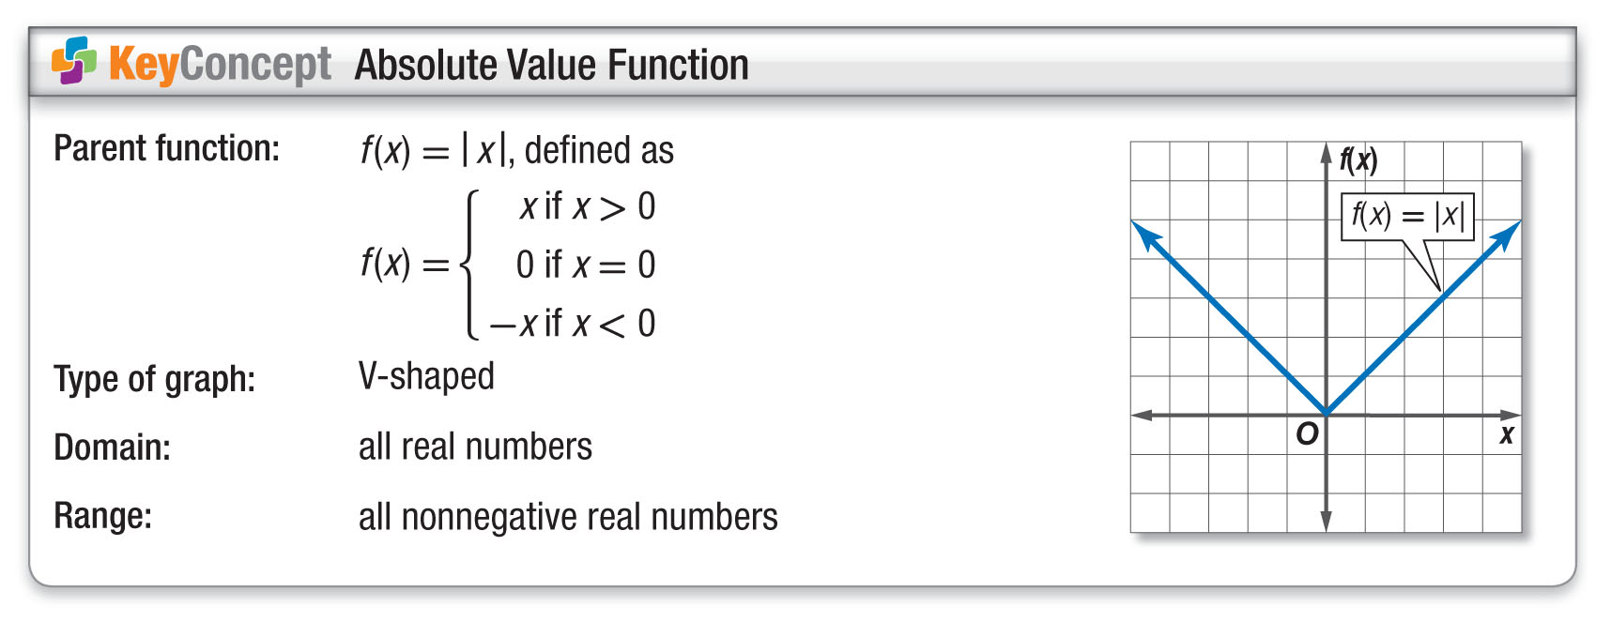
Concept

Slide 19
Example 3
Absolute Value Function
Graph f(x) = │2x + 2│. State the domain and range.
Since f(x) cannot be negative, the minimum point of the graph is where f(x) = 0.
f(x) = │2x + 2│ Original function
0 = 2x + 2 Replace f(x) with 0.
–2 = 2x Subtract 2 from each side.
–1 = x Divide each side by 2.

Slide 20
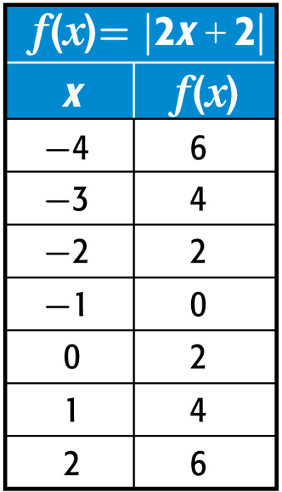
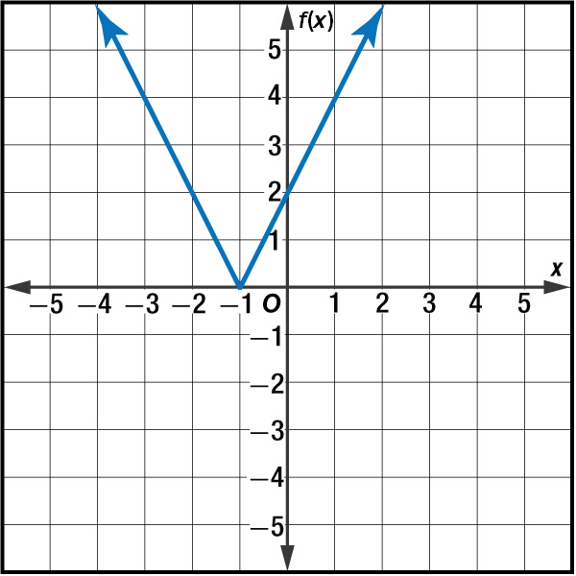
Example 3
Absolute Value Function
Next, make a table of values. Include values for
x > –5 and x < 3.
Answer: The domain is all real numbers. The range is all nonnegative numbers.

Slide 21
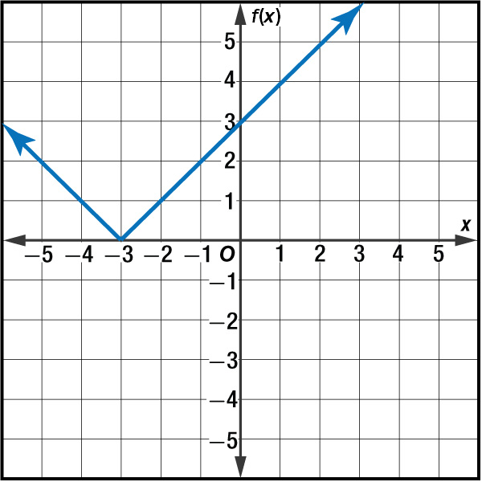
Example 3
Graph f(x) = │x + 3│. State the domain and range.
A. D = all real numbers,
R = all numbers ≥ 0
B. D = all numbers ≥ 0
R = all real numbers,
D = all numbers ≥ 0,
R = all numbers ≥ 0
D = all real numbers,
R = all real numbers

Slide 22
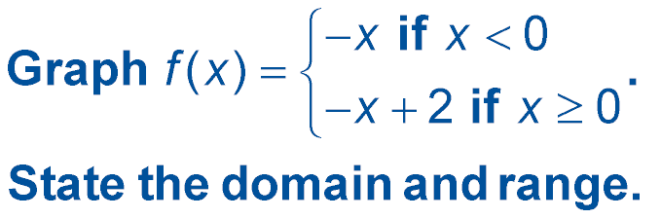
Example 4
Piecewise-Defined Function
Graph the first expression. Create a table of values for when x < 0, f(x) = –x, and draw the graph. Since x is not equal to 0, place a circle at (0, 0).
Next, graph the second expression. Create a table of values for when x ≥ 0, f(x) = –x + 2, and draw the graph. Since x is equal to 0, place a dot at (0, 2).

Slide 23
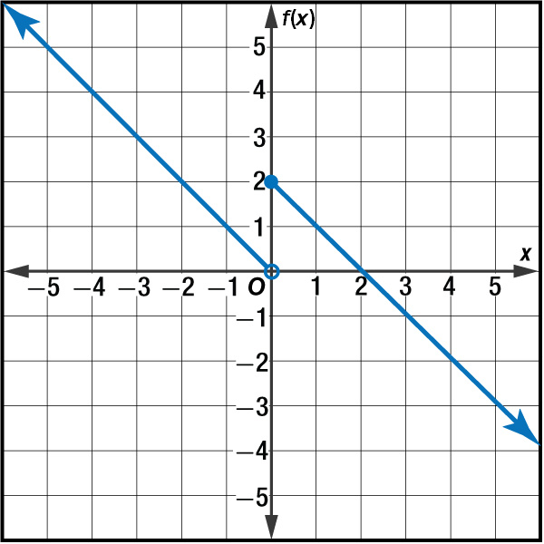
Example 4
Piecewise-Defined Function
Answer:
D = all real numbers, R = all real numbers

Slide 24
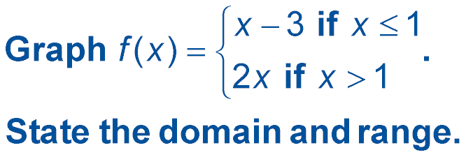
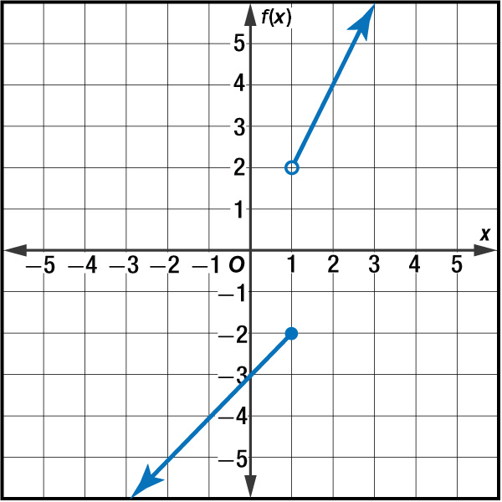
Example 4
D = y│y ≤ –2, y > 2,
R = all real numbers
D = all real numbers,
R = y│y ≤ –2, y > 2
D = all real numbers,
R = y│y < –2, y ≥ 2
D. D = all real numbers,
R = y│y ≤ 2, y > –2

Slide 25
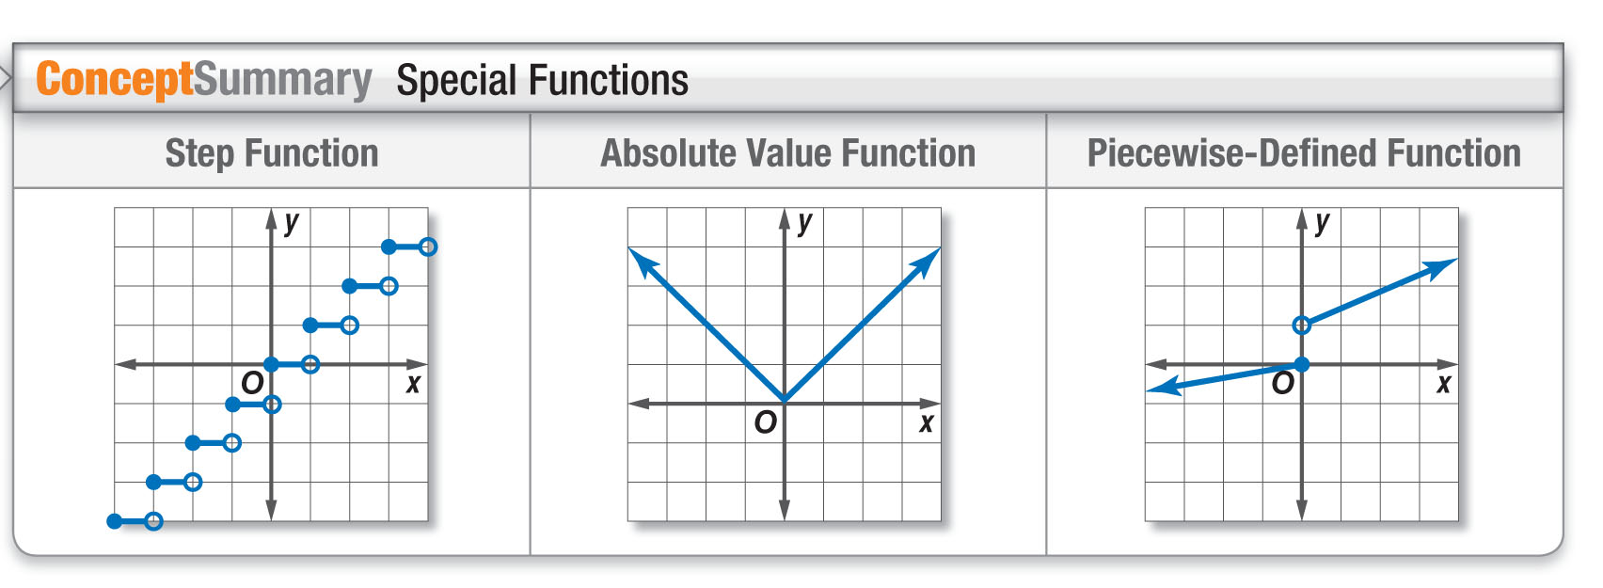
Concept

Slide 26
End of the Lesson

